Slide 1
Overview of AI/ML in Education and ISEA Logistics ISEA Session 1
Dr. Min Sun & Dr. Shawon Sarkar
University of Washington
01.24.2025

Slide 2
Learning Objectives/Agenda
Introduce the instructors and the students to each other
Introduce foundational concepts: data science, AI, ML and human-centered, domain specific data science, data science in education
Introduce the human-centered data science cycle and emphasize the role of governance and responsible AI/ML
Provide an overview of the ISEA schedule and resources
Get organized: logistics, data collection efforts

Slide 3
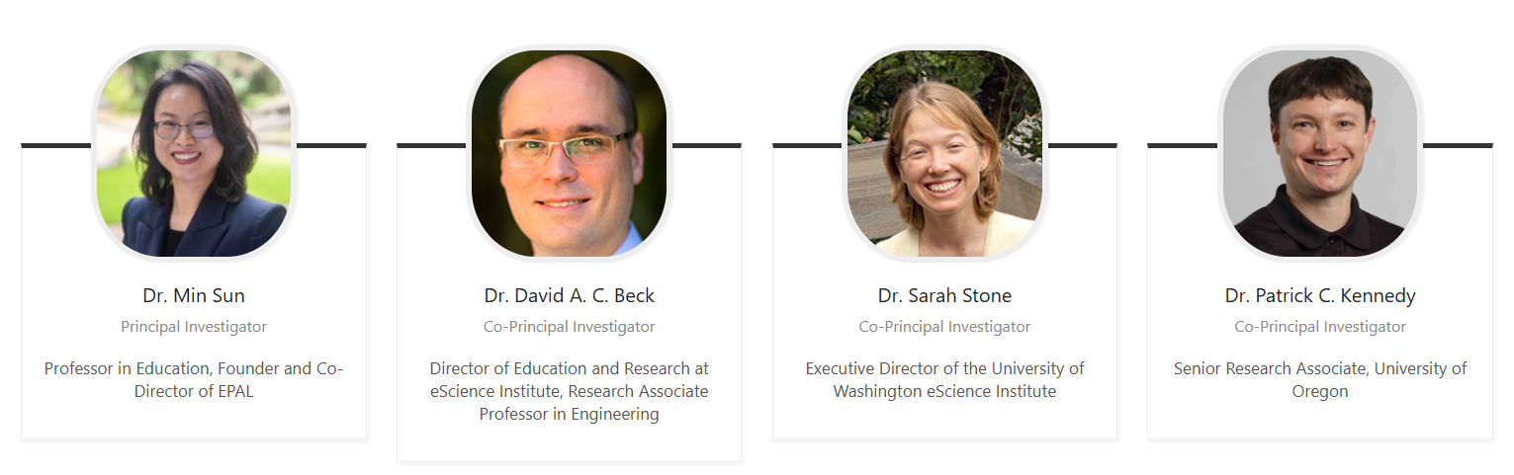
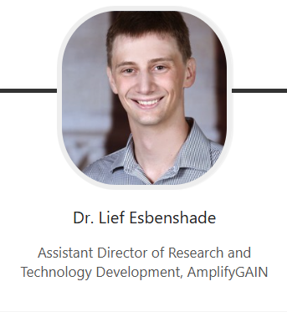
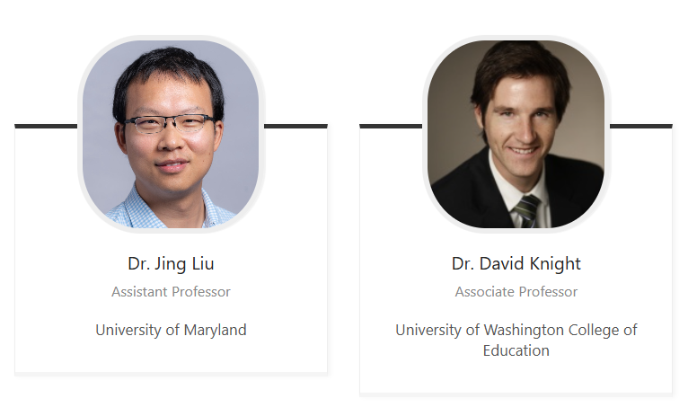
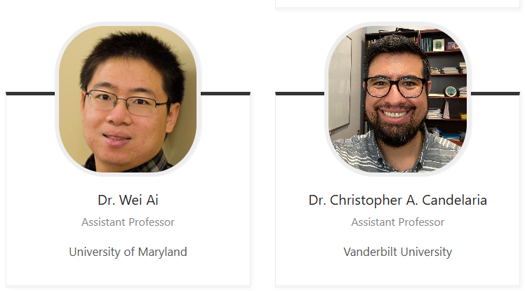
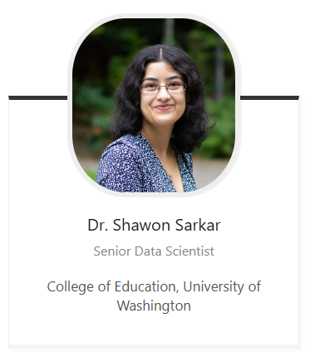
Instructors

Slide 4
What is ISEA?
A multidisciplinary, multisector intersection focus in AI/ML in educational science and product development
Education and Learning Sciences
Artificial Intelligence (AI)
Data Science
Software Engineering
Machine Learning (ML)
Notes:
Min will fix this diagram

Slide 5
My Feeling About This Field:
This field is moving so RAPIDLY!
The lines of different disciplines will blur even more.
A new generation of scholars and edtech workforce emerges.

Slide 6
What is AI?
Understanding AI Simply
Artificial Intelligence (AI) is technology that helps computers think and learn in ways similar to humans.
At its core, AI uses math and computer code to:
Find patterns in large amounts of information
Learn from new information
Make decision, predictions or suggestions.

Slide 7
AI and ML-Powered Data Science Methods Can Influence Many Aspects of Classroom Instruction
Comprehensive solutions: Colleague AI, MagicSchool, SchoolAI, Operation systems: Microsoft, Google
Teacher
- AI coaching and feedback (e.g., TeachFX and Edthena)
- Teachers’ engagement with the materials, adoption, and feedback/Iteration
- Communication with parents
- Feedback to students
Content
- Curriculum and instructional material analysis and generation (Canva, Pearson etc)
Student
- Personalized and adaptive learning
(e.g., Dreambox)
- Multi-tiered supporting mechanisms (Panorama etc)
- Formative assessment,
- Auto-grading,
- Tutoring and feedback (e.g., Khanmigo)
Notes:
(1) Instructional core: teacher, content, student; their interactions among them. AI has transformed all of them.
(2) You cannot change one thing without changing others. For example, if we encourage adopting AI to personalized and adaptive learning and multi-tiered peer assistance without building educator and administrators’ capacity to appropriately and effectively use AI

Slide 8
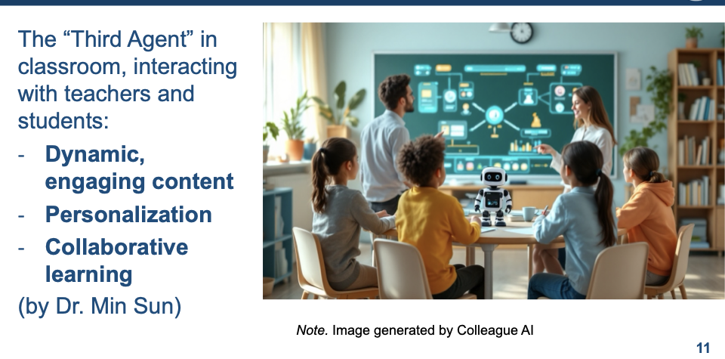
Dr. Sun’s Concept of AI As The Third Agent In Classroom Instruction: How AI will Transform Teaching and Learning?
See Dr. Sun’s Blog on Colleague AI’s Platform

Slide 9
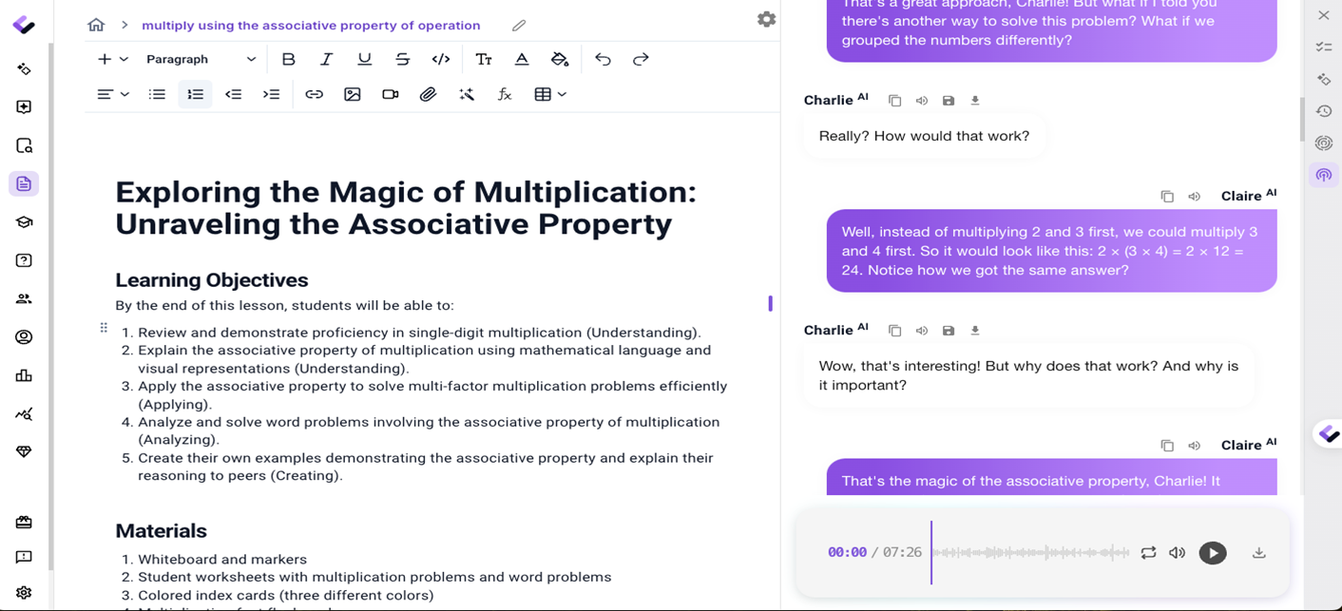

Example 1: Dynamic Generation of Content
Notes:
With just one click, a math lesson can be transformed into an engaging podcast, lecture, or summary through Colleague AI. In the near future, this content could be developed into interactive games or videos for students, on demand and in the moment. Let's listen the first few seconds of this audio.

Slide 10
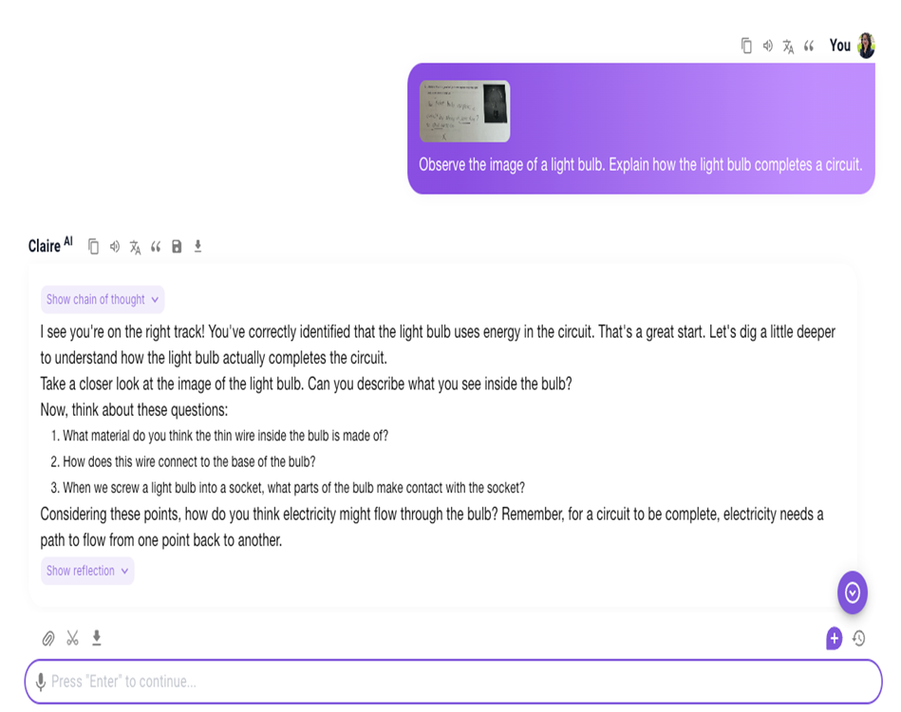
Example 2: Personalized Learning
A parent (Dr. Sun here) works with AI to explain to her 3rd grader about how a light bulb completes a circuit.
"This was the most helpful AI ever it helped me understand the entire algorithm and helped me finish 2x faster!
Thank you!"
— unsolicited feedback from a 7th grader
Notes:
Colleague AI scaffolds a parent (Dr. Min Sun here) to explain to her 3rd grader about how the light bulb completes a circuit. She snaps a picture of the homework. Ask the prompt: observe the image of the light bulb. Explain how the light bulb completes a circuit. Then, she and her son can have a guide conversation about science.

Slide 11
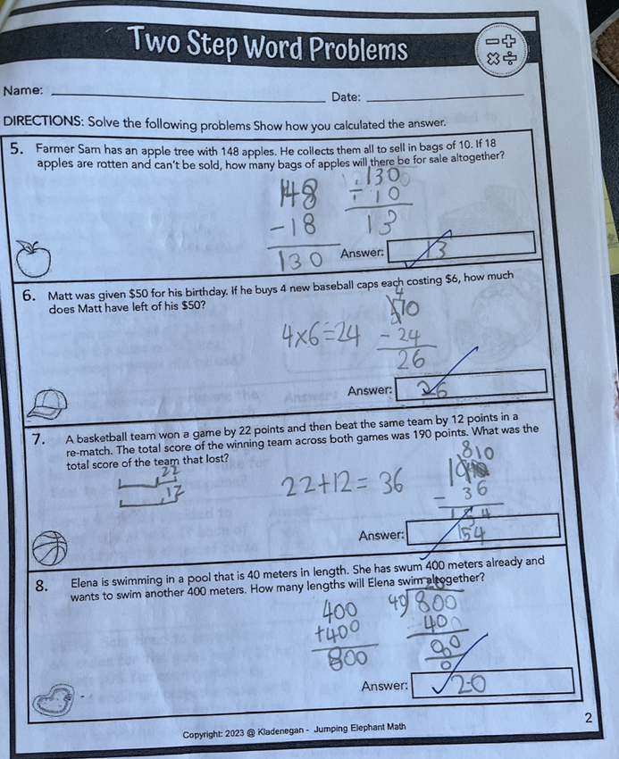
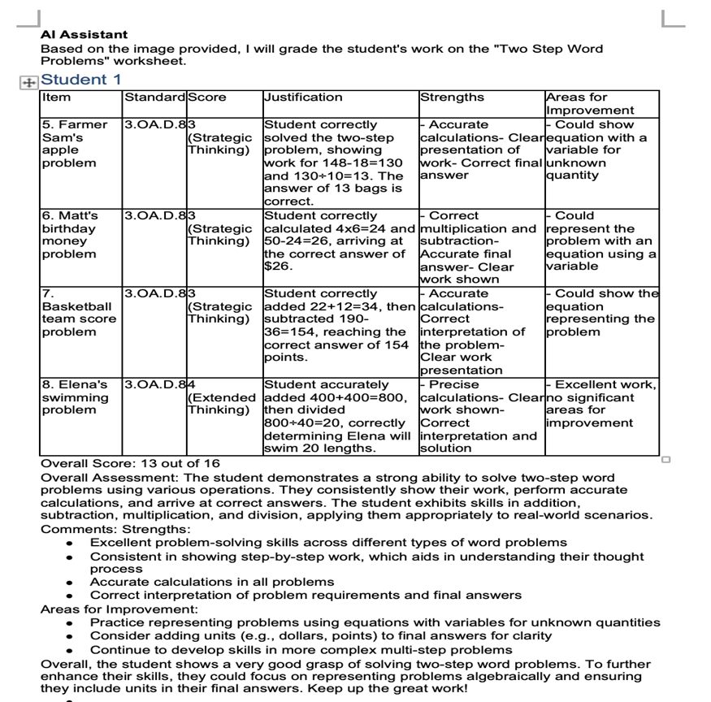
Example 3: Detailed, Individualized Feedback
“Super exciting data point! Halfway through the year, we take the iReady diagnostic. The goal is for students to be at 50% growth towards their yearly growth goal. Last year, my students made an average of 72% growth in January. This year, students have made an average of 108% growth in January. I attribute a lot of this towards Colleague AI, both teacher and student facing.
My student who uses the student-facing version the most has made 315% growth as of halfway through the school year, growing from 4th grade to 6th grade. For the last 2 years, he made 0% growth. ”
— unsolicited feedback from a 7th grade teacher
Notes:
By taking a picture of student's hand written work, AI assistant can generate a detailed report to students. Now teachers and parents can use the valuable time, instead of spending on grading, but focusing on having meaningful 1:1 conversations about their work, where they got it, and where they did not get and how to further improve.
This is a comment from a 7th grader whose written English is tested at 1st grade level (because she can use voice to communicate), shared this unsolicited feedback to their teacher who is piloting our classroom tool these days. We aim to meet where the students are and elevate their learning from there.

Slide 12
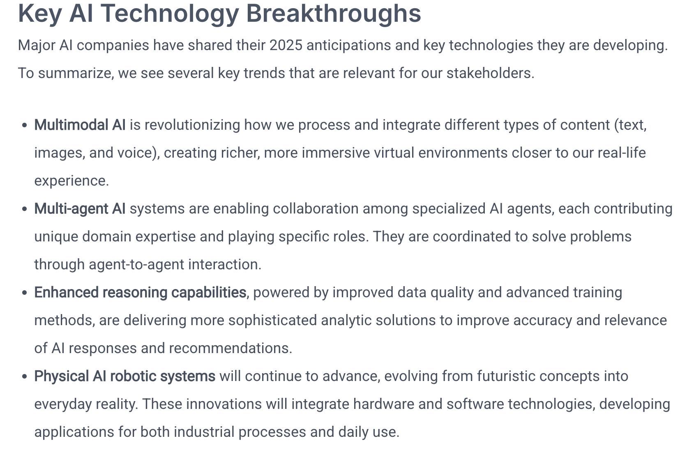
New Vision of AI In Education
See Dr. Sun’s Blog on Colleague AI’s Platform

Slide 13
Balanced Understanding about AI
We need to move beyond hype and fear.
AI is a powerful tool, but not magic, and certainly cannot replace human intelligence.
AI use should focus on augmenting human capabilities.
AI has been rapidly penetrating our lives, which highlights the importance for us to prepare our students to develop a balanced understanding about AI.

Slide 14
AI in Education Policy and Guidelines
Department of Education AI Guidance
Artificial Intelligence and the Future of Teaching and Learning: Insights and Recommendations
Designing for Education with Artificial Intelligence: An Essential Guide for Developers
OSPI’s AI Guideline
Council of the Great City Schools
UNESCO’s AI Guideline
Notes:
Min can update this later

Slide 15
Goals Of ISEA Web Sessions
Stimulate your interests in the intersection of AI/ML, data science, software engineering, and education.
Introduce use cases and develop fellows’ ability to apply technical skills to solve educational problems.
Develop fellows’ critical thinking and creativity.
Co-construct knowledge and learning among ISEA fellows and instructors.

Slide 16

A Human-Centered Partnership Model of Education Data Science
The human-centered partnership model: people, computer, and domain knowledge interact at every stage of data pipeline to enhance learning opportunity, human decision-making efficiency, and organization performance, and system-level equity.

Slide 17
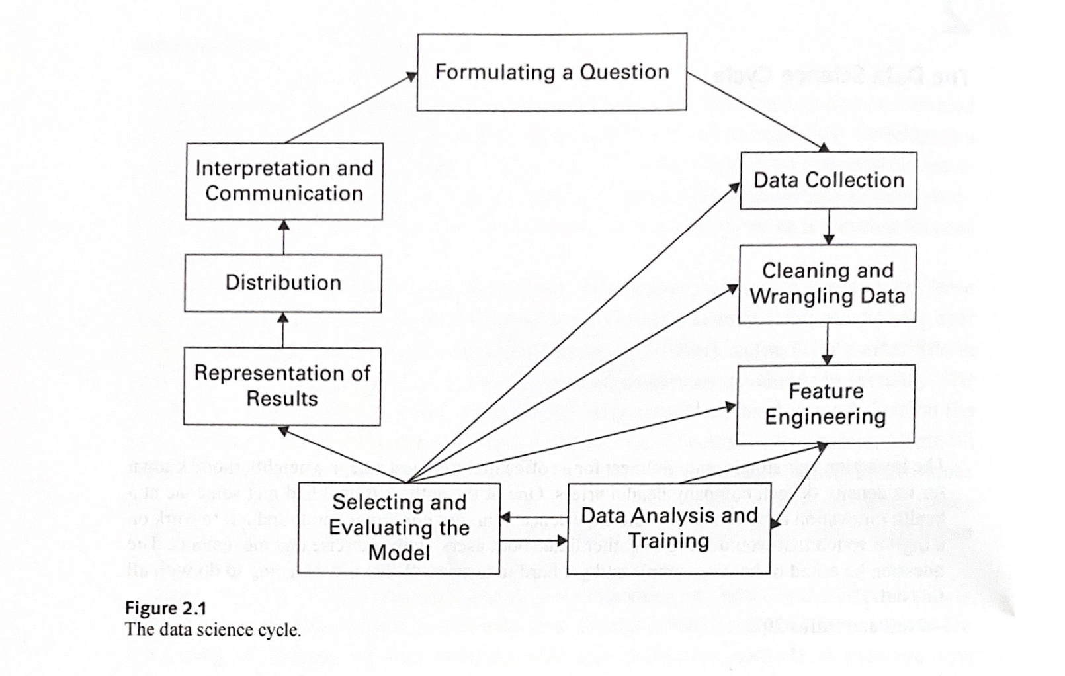
Human-Centered Data Science Cycle
Aragon, C., Guha, S., Kogan, M., Muller, M., & Neff, G. (2022). Human-centered data science: an introduction. MIT Press. p.14

Slide 18
Session Overview
Week | Session Date | Topic
1 | 1/24/25 | Overview of AI/ML in Education
2 | 1/31/25 | Software for Educational Data Mining I
3 | 2/7/25 | Software for Educational Data Mining II
4 | 2/14/25 | Design from a Learning Science Perspective
5 | 2/21/25 | Machine Learning I - fundamentals
6 | 2/28/25 | Machine Learning II - applications
7 | 3/7/25 | Text Analysis I - topic modeling and sentiment analysis
8 | 3/14/25 | Multimodal Data Analysis
9 | 3/21/25 | Causal Inference I - A/B testing and RCTs
- | 3/28/25 | BREAK
10 | 4/4/25 | Text Analysis II - measuring instructional practices
11 | 4/11/25 | Text Analysis III - teacher learning and RCTs
12 | 4/18/25 | Text Analysis IV - modeling and classification
13 | 4/25/25 | Causal Inference II - quasi-experimental frameworks
14 | 5/2/25 | Economic Evaluation
15 | 5/9/25 | Data ethics and professionalism
Notes:
Will walk through overall schedule of the program and topics

Slide 19
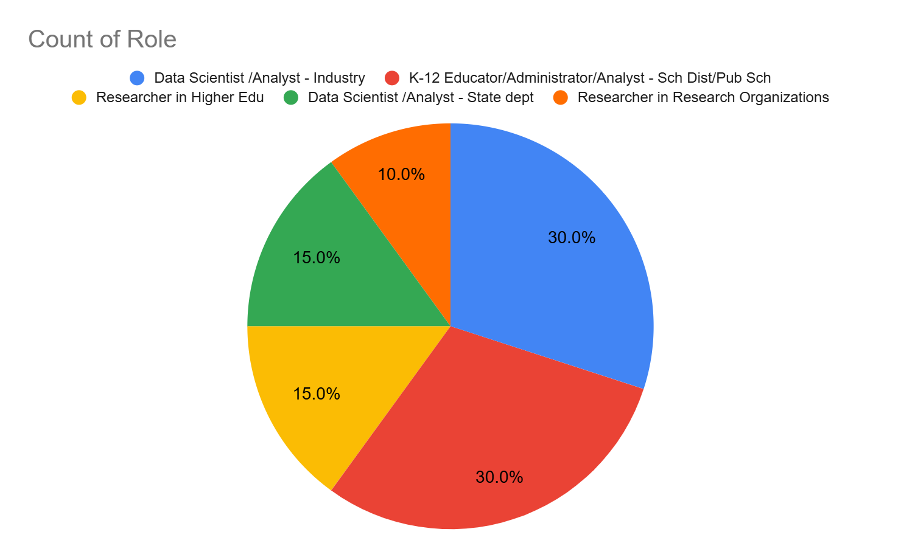
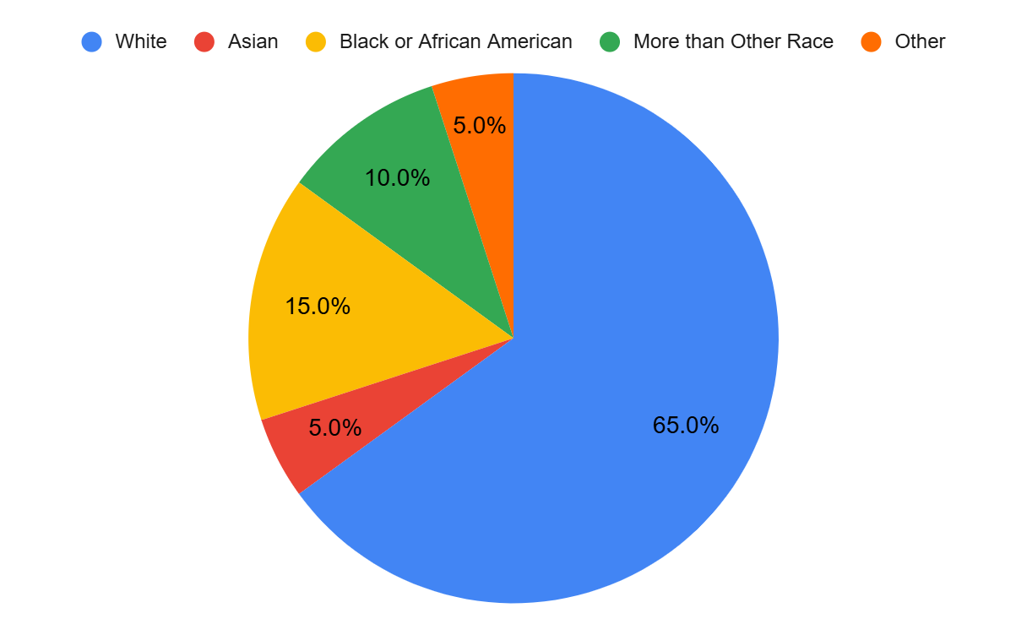
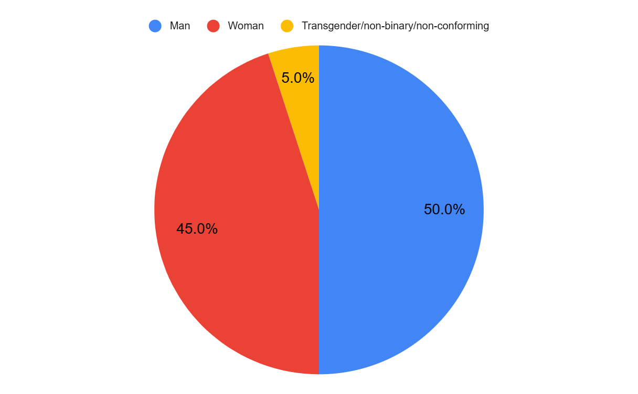
Educational Data Science and AI Training
For the second cohort, ISEA attracted 180 well-qualified applicants across four sectors: Higher education, non-profit think tanks and research institutions, K-12 district and state agencies, and EdTech industries.
Notes:
Do we give each of the fellows a bit of time to introduce themselves?

Slide 20
Fellow Introduction and Break
If you haven’t done so already, please share your name, organization, role, and your learning interests in data science in education in the Slack space
A small group activity (5 mins)
Introduce yourself
What drove you to ISEA?
How do you think about the human-centered data science cycle, and how might you use some of the concepts to inform your work?
Notes:
Do we give each of the fellows a bit of time to introduce themselves?

Slide 21
Individual Think and Share
Use this Link:
Which are the three topics you are most excited about?
Which are the three topics that are most relevant to your work?
Any other topics of interests you wish to discuss?
Any recommendations /expectations on teaching styles and methods?

Slide 22

Hackweek
Week of June 23-27 on the University of Washington campus in Seattle
We will share additional details as they’re finalized

Slide 23
Resources
Slack: Your primary means of communication with those in the program. Feel free to send Lavi a direct message about any program-related issue or question. Feel free to also reach out to your tutors using Slack
Canvas: Your primary means of managing all the content from the program. Slides and videos will be shared here. Schedules will be updated here (if/when needed)
Github: This GitHub repository serves as a location for the program-related codes: https://github.com/ISEA-Repositories/Cohort-2025

Slide 24
Program Data Collection
Data Collection for IES Reporting

Slide 25
Homework
Preview next week’s materials (will be posted soon)
Learning about the basics of python programming and Colab environments:
https://pandas.pydata.org/Pandas_Cheat_Sheet.pdf
https://jakevdp.github.io/PythonDataScienceHandbook/
https://colab.research.google.com/
https://www.statlearning.com/
Complete the surveys
Survey about your interests (Link in slide #21)
ISEA Pre-Test survey
Pre-test of data science knowledge and skills

