Slide 1
Text Analysis IV: Teacher Learning and RCTs ISEA Session 11 Jing Liu University of Maryland April 11, 2026

Slide 2
Opening Questions
What are the unique challenges and opportunities we face for evaluating AI tools/applications in education?
What can be some solutions to these challenges you identify?

Slide 3
Using NLP to Measure and Improve Teaching: A Framework
Measurement
Field Experiments
Speech Technology

Slide 4
Using NLP to Measure and Improve Teaching: A Framework
Measurement
Field Experiments
Speech Technology

Slide 5
Using NLP to Measure and Improve Teaching: A Framework
Measurement
Field Experiments
Speech Technology

Slide 6
The Importance of Formative Feedback
Providing teachers with formative feedback can improve both their instruction and their students’ outcomes (Taylor & Tyler, 2012; Steinberg & Sartain, 2015; Kraft et al., 2018 ).
Formative feedback is nonevaluative, supportive, timely, and specific, with the intention to modify teachers’ thinking or behavior to improve their teaching (Shute, 2008).
Few educators experience such feedback on a regular basis.
An average public school teacher only receives formative feedback once or twice per year (Kraft & Gilmour, 2016)
Teachers report the feedback they get as low utility (Hellrung & Hartig, 2013)
Only 40% of schools provide teachers access to a math or reading coach AND limited coach time on instruction (Taie & Goldring, 2017, Bean et al., 2010; Gibbons & Cobb, 2016; Scott et al., 2012)

Slide 7



Providing Instructors with Automated Feedback: Three RCTs
Online Computer Science Courses
Online Tutoring
Brick-and-Mortar Classrooms

Slide 8
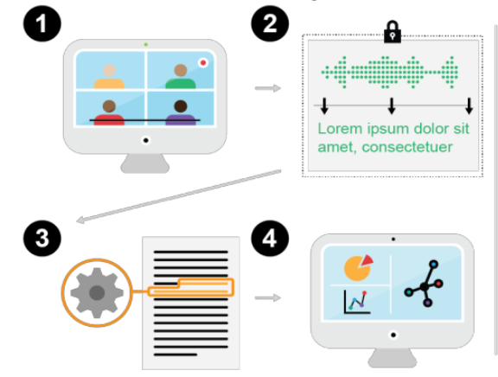
Pipeline of Giving Feedback
Recording
Transcription & Anonymization
Transcript Analysis
Feedback

Slide 9
Pipeline of Giving Feedback
Recording
Transcription & Anonymization
Transcript Analysis
Feedback

Slide 10
Pipeline of Giving Feedback
Recording
Transcription & Anonymization
Transcript Analysis
Feedback

Slide 11
Pipeline of Giving Feedback
Recording
Transcription & Anonymization
Transcript Analysis
Feedback

Slide 12
Design principles for reflective feedback
Non-judgmental & private
Concise, specific & actionable
Timely & regular

Slide 13
RCT with Code in Place
Code in Place is a five-week free online computer science course organized by Stanford University.
12k students + 1.2k section leaders
Provide automated feedback to instructors on a key teaching practice—uptake of student contributions, and evaluate how such feedback affects instruction and student outcomes
Among the first to evaluate the impact of automated feedback on teacher instruction through a large-scale RCT.

Slide 14
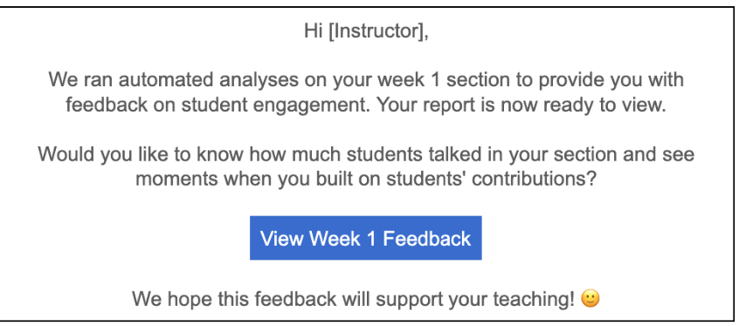
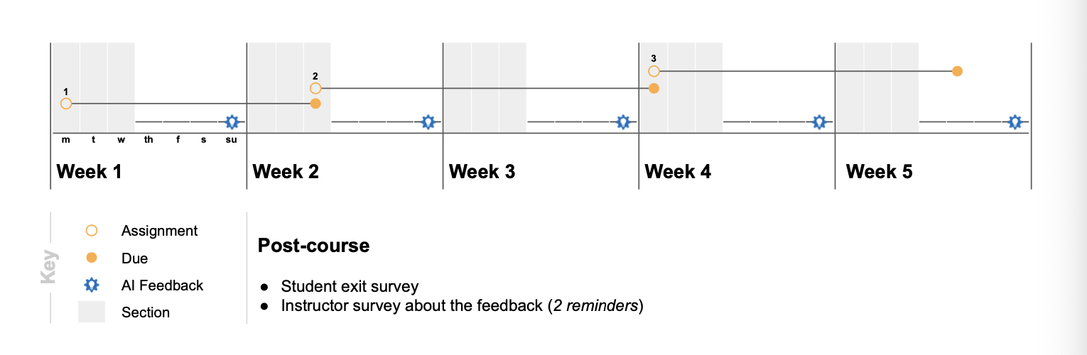
RCT with Code in Place
RCT Design
Randomized encouragement study
all instructors have access to feedback
A random 50% of instructors receive email reminders
Feedback after each section (5x total)

Slide 15
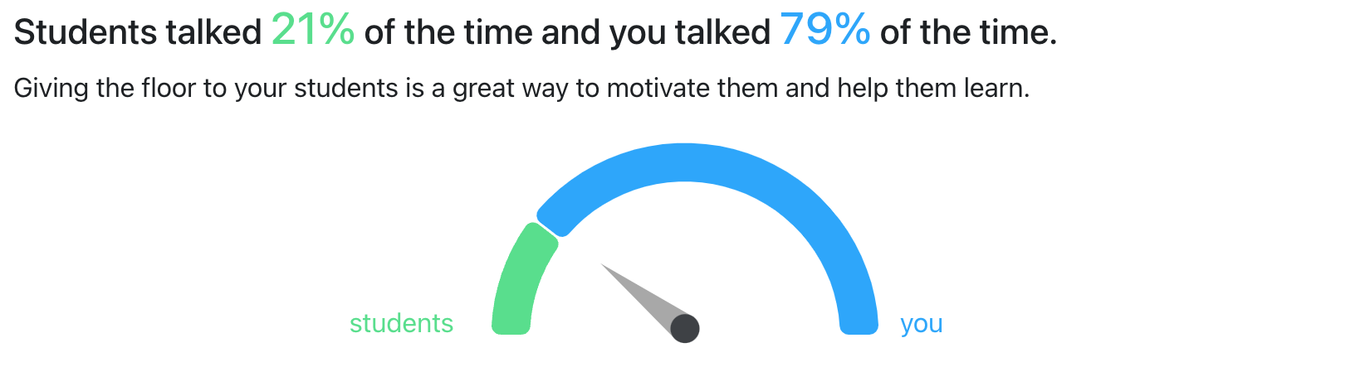
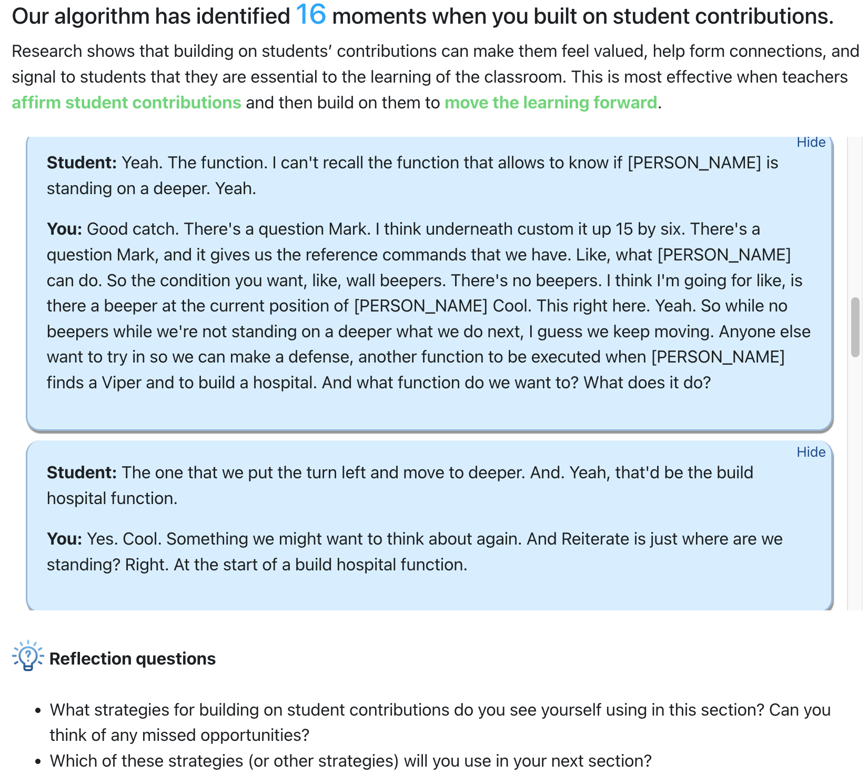

AI Powered Feedback on Your Teaching

Slide 16
Research questions
1. Does the feedback improve instructors’ practice?
Uptake, questions, repetition, and instructors’ talk time
2. Does the feedback impact student engagement and satisfaction?
Assignment completion
Class attendance
End-line survey about their perceptions
Notes:
We ask the following research questions.

Slide 17
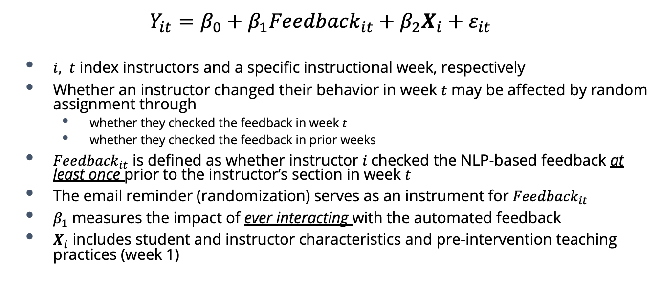
Identification Strategy: 2SLS Estimator
$$Y_{it}=β_{0}+β_{1}{Feedback}_{it}+β_{2}X_{i}+ε_{it}$$
$i, t$ index instructors and a specific instructional week, respectively
Whether an instructor changed their behavior in week $t$ may be affected by random assignment through
whether they checked the feedback in week $t$
whether they checked the feedback in prior weeks
${Feedback}_{it}$ is defined as whether instructor $i$checked the NLP-based feedback at least once prior to the instructor’s section in week $t$
The email reminder (randomization) serves as an instrument for ${Feedback}_{it}$
$β_{1}$ measures the impact of ever interacting with the automated feedback
$X_{i}$ includes student and instructor characteristics and pre-intervention teaching practices (week 1)

Slide 18
First Stages: By Week Outcome: Whether an instructor ever checked the feedback
Across all instruction weeks, the email reminder increases treated instructors’ likelihood of checking the feedback at least once to 71.2%, four times the rate in the control group (17.6%).
The take-up appears to be the strongest in week 2, which is after the first email reminder.
First-stage F statistics = 34.151

Slide 19
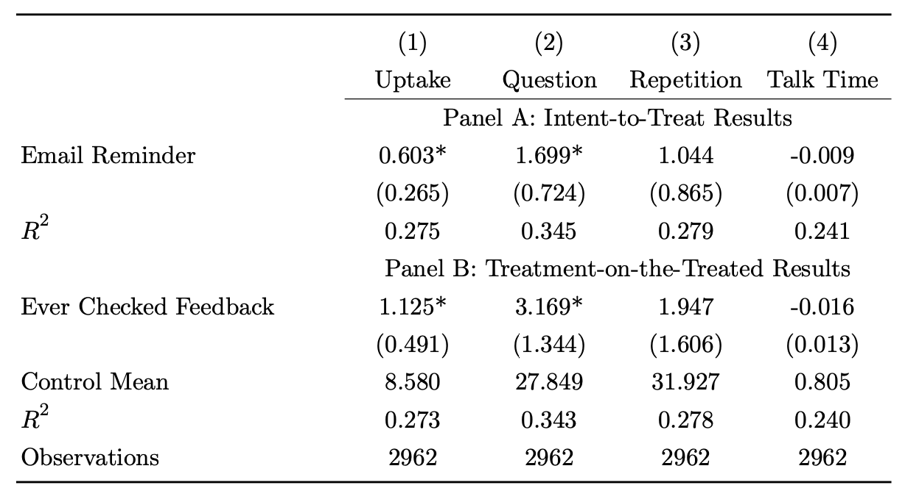
Effects of Automated Feedback on Teaching Practices
Instructors’ interaction with the feedback induced by the randomized email reminder improved their use of uptake by 1.13 times per hour (13.2%)
The improvement in uptake is driven primarily by more sophisticated strategies such as increased questioning rather than repetition or talk time.

Slide 20
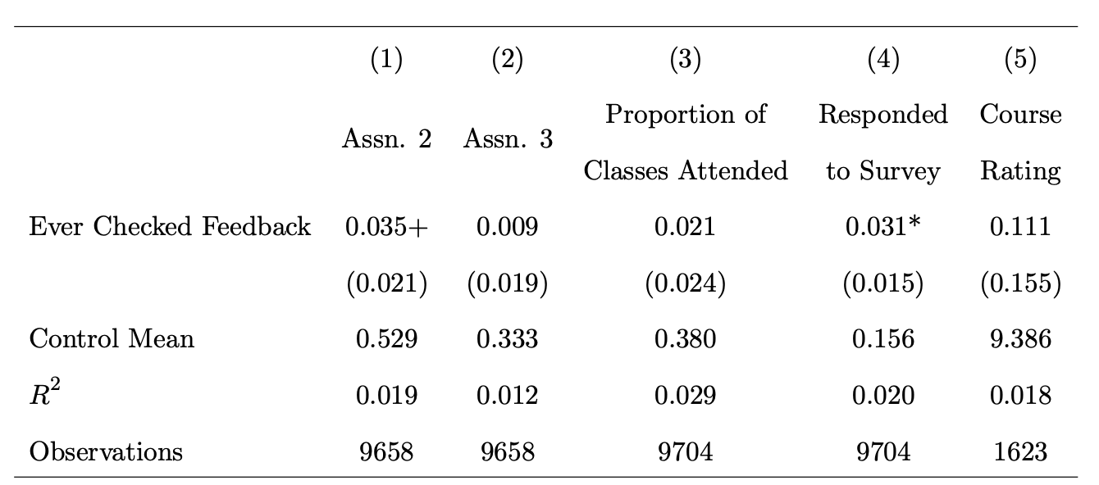
TOT Effects on Student Outcomes

Slide 21
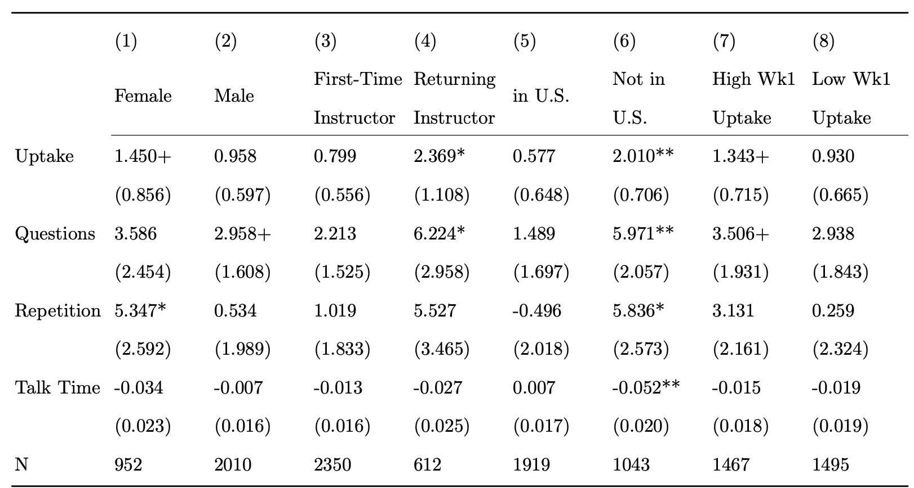
Heterogeneity

Slide 22

RCT with Polygence
Tutoring is a quickly expanding form of instruction, especially by serving as a learning recovery tool post-pandemic
Polygence: A research mentorship platform for high schoolers
1:1 online tutoring mainly offered by Ph.D. students
N=414 mentors
Randomly assigned half to receive automated feedback on uptake; the other half has no access to such feedback

Slide 23
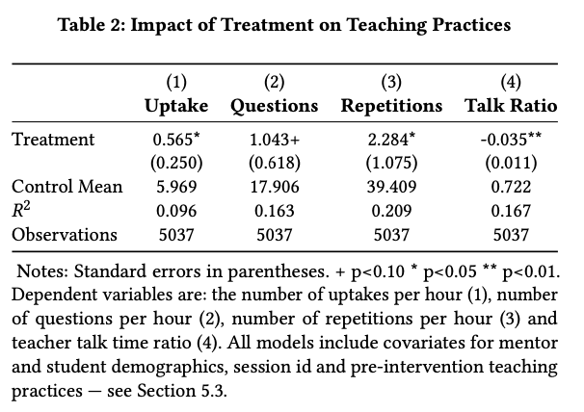
Results
Treated tutors improved their use of uptake by 0.57 times/hour.
The improvement in uptake is driven by both increased questioning and repetitions.
We also observe a reduced teacher-student talk ratio.
Results are broadly aligned with the Code in Place study.

Slide 24
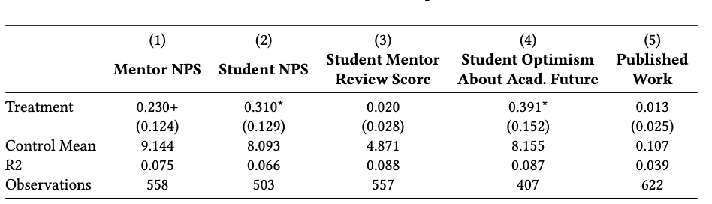
ITT on Project Outcomes
Note: NPS=Net promoter score (On a scale from 0 to 10, how likely are you to recommend this product/company to a friend or colleague?)
Notes:
NPS= net promoter score

Slide 25
RCT with TeachFX in Utah
First large-scale RCT that tests the efficacy of automated feedback in in-person, K-12 classrooms.
In partnership with TeachFX, a company that delivers automated feedback to teachers based on classroom recordings via a phone application.
N=523 math or science teachers teaching in Utah public schools.
All teachers have access to TeachFX’s feedback, but half of them are randomly assigned to additional weekly feedback on focusing questions through email.
Collected both quantitative data and rich interview data to understand teachers’ perceptions of the tool.
Notes:
Focusing is often contrasted to the less effective yet more common question pattern of funneling, where teachers pose “a set of questions to lead students to a desired procedure or conclusion, while giving limited attention to student responses that veer from the desired path”

Slide 26
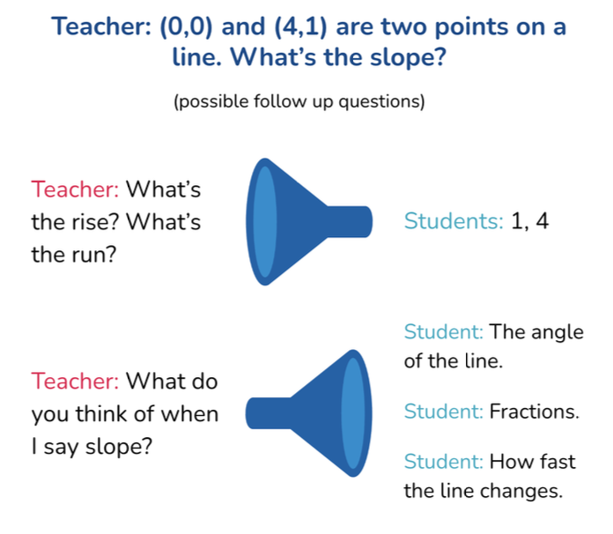
Identifying Focusing Questions
Binary classification machine learning model
Fine-tuning Bert based on labeled data from the NCTE dataset, augmented by 694 annotated examples from TeachFX
84% accuracy on a held-out set from TeachFX (Alic et al., 2022)

Slide 27
Treatment
Teachers enrolled in the study on a rolling basis and then got randomized assigned to the treatment or control group
An email early every Tuesday morning which contained both the number of focusing questions they asked in all class recordings in the previous week as well as a display of, at most, the top 3 chosen focusing questions
Top questions are identified by two math instructional coaches
The email also contains a link to the focusing question insights on the TeachFX app
Terminated treatment after 5 weeks of recordings for a given teacher

Slide 28
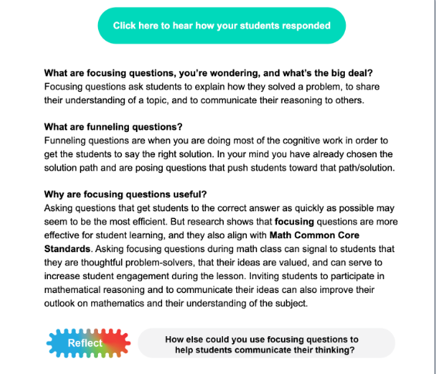
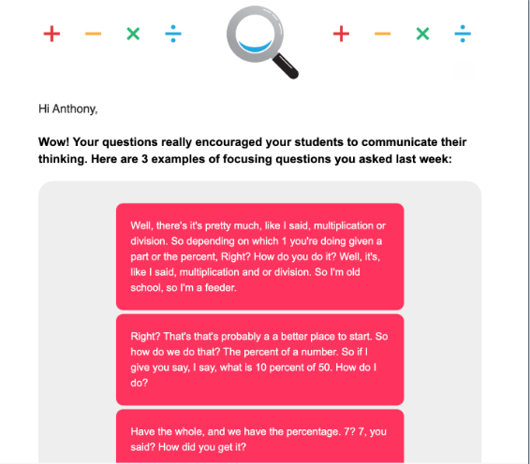

Slide 29
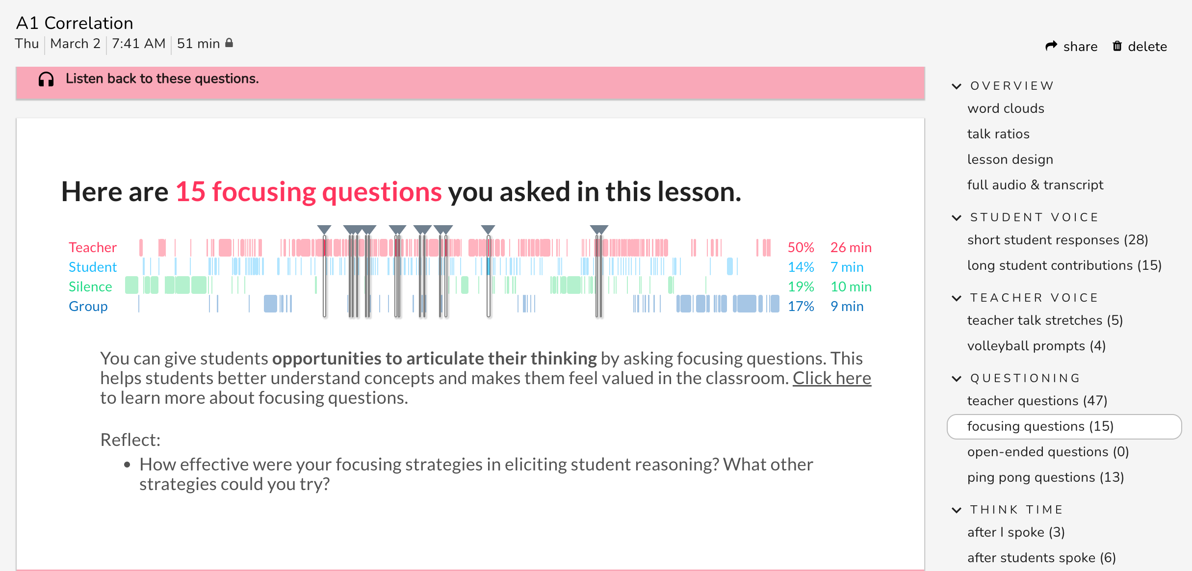

Slide 30
Research Questions
To what extent do K-12 teachers engage with the automated feedback on focusing questions?
Does the automated feedback on focusing questions impact instruction, including teachers’ use of focusing questions, student talk time, and student reasoning?
How do teachers perceive the automated feedback on both focusing questions and other teaching practices? What are the barriers for them to engage with the feedback?

Slide 31
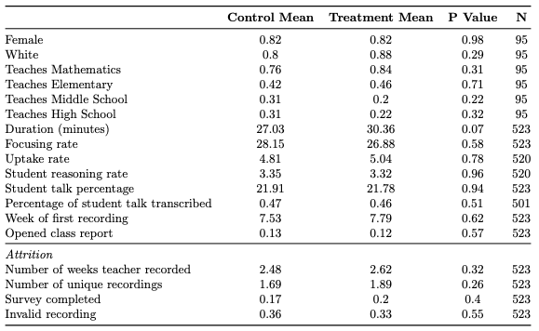
Descriptive Statistics

Slide 32
RQ1. Engagement with the feedback email and the TeachFX platform is limited
We tracked email opens and views of the focusing question insight on the TeachFX platform
Treated teachers opened the email Between 55-61% of teachers opened their emails across weeks, but only 17-22% of them viewed the focusing insight page.
On average, teachers opened 1.8 emails (SD=1.9) out of 5 throughout the RCT.
The intervention increases views of the TeachFX platform for the treated (21% of the time) vs. control teachers (15% of the time) (p<0.05)

Slide 33
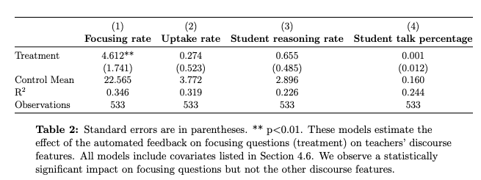
RQ2. The treatment improved teachers’ use of focusing questions, but not other related teaching practices or student engagement.

Slide 34
RQ3. Many barriers prevent teachers from fully engaging with the feedback
1. Low recording and transcription quality
“It has some really obvious flaws in the recording. And so a lot of us are like, ‘Oh, I did not say that.’ . . . I know that that’s a hang-up for a lot of teachers.”
2. Time constraint
“I think for me the hard [thing] is like didn’t have time to sit and read it when it would come in, and then I would forget about it.”
3. Concerns about data privacy issues involved in automated feedback
“Nobody likes listening to themselves and being observed and things like that, so like finding ways to be able to share things that we’re happy about without feeling like... I don’t know, like you’re going to be criticized.”

Slide 35
Conclusions
Automated feedback to teachers using NLP-based measures shows promising effects in improving a key teaching practice in in-person teaching contexts， but failed to generate tangible effects on related teaching practices
Many barriers prevent teachers from fully engaging with the feedback
Data availability and logistics constraints prevent us from conducting more in-depth analysis on how the intervention works for different groups of teachers and in what contexts
We are integrating coaching routines with automated feedback to enhance the take-up and effectiveness of our approach
New RCTs are in the pipeline

Slide 36
Discussion
What might be some other applications of AI-based instructional measurement you can think of other than giving teachers feedback?
How do you plan to evaluate whether such application works or not?

Slide 37
Assignment
Based on what we introduced today, make a plan for a data science-powered RCT you would like to run in education. You need to think through and describe the following elements in 1-2 page memo:
The underlying theory of change
Target population and sample
Intervention design
Outcomes you would like to measure
Implementation
Analytic approach

