Slide 1
National Language Process: Thematic and Sentiment Analysis
ISEA Session 7
Min Sun and Alex Liu
University of Washington
3.7.2025

Slide 2
Warm Up
What is one learning or news you came across this week about AI/ML, or data analysis, that excite/concern you the most?

Slide 3
Today’s Agenda
Natural Language Processing (NLP)
Thematic topics identification, text summarization
  LLM Prompting Engineering
  Traditional NLP—Topic Modeling /Classification
Sentiment Analysis
  Traditional and LLM methods
Application in one paper: analyzing interview data
  The benefits of human and computer interactive learning in the AI era
Code and programming

Slide 4
Natural Language Processing (NLP)
“Natural language processing (NLP) combines computational linguistics, machine learning, and deep learning models to process human language.”
  Amazon Web Services (AWS)

Slide 5
Natural Language Processing (NLP)
Computational linguistics: the science of understanding and constructing human language models with computers and software tools. Tools like: Language translators, Text-to-speech synthesizers; Speech recognition software are based on computational linguistics.
Machine Learning: A technology trains a computer with sample data to improve its efficiency. Machine learning (ML) methods teach NLP applications to recognize and accurately understand human language.
Deep Learning: A subset of machine learning that teaches computers to learn, think, act like humans. It involves neural network models to enable computers to recognize, classify, and co-relate complex patterns in language data.

Slide 6
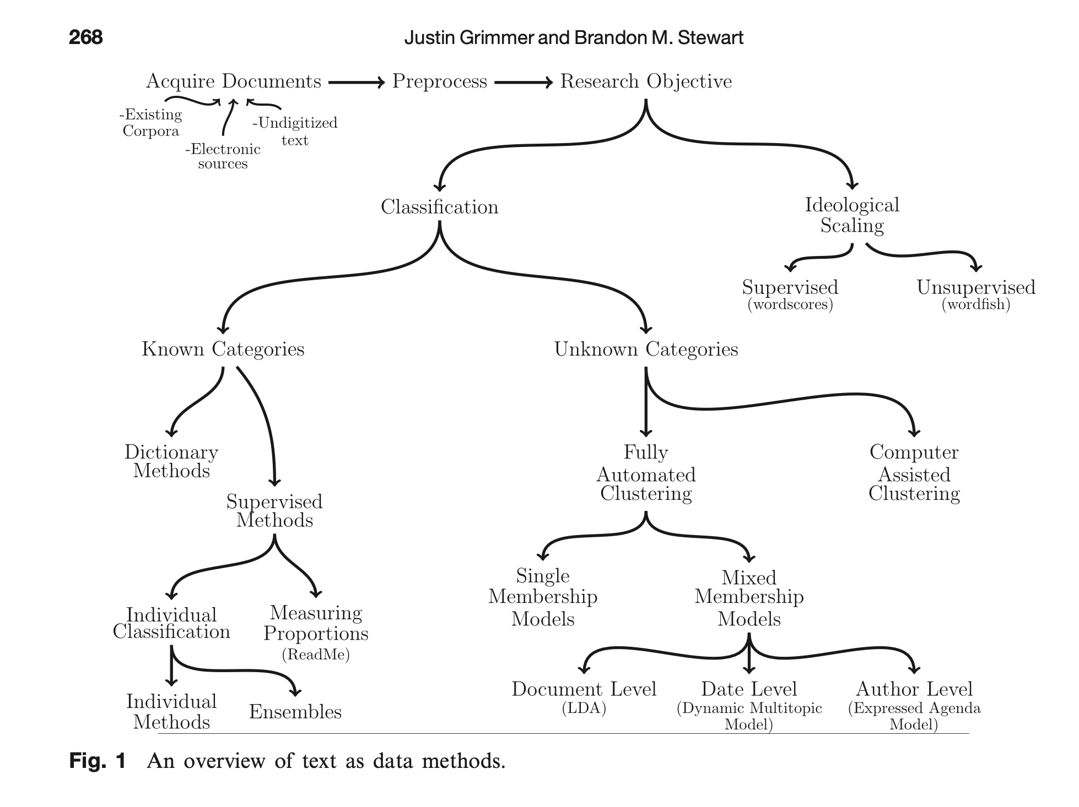
Traditional Text as Data Methods
Grimmer, J., & Stewart, B. M. (2013). Text as data: The promise and pitfalls of automatic content analysis methods for political texts. Political analysis, 21(3), 267-297.

Slide 7
Topic Modeling: latent Dirichlet allocation (LDA, see Blei, 2012; Blei, Ng, & Jordan, 2003)
LDA is a generative statistical model that identifies the latent topics and corresponding proportions that compose a document.
  LDA assumes that each document is a mixture of topics. For each document, π_{ik}, represents the proportion of task i dedicated to topic k. Each task collects the proportions across topics, as π_{i}= (π_{i1,} π_{i2, …,} π_{ik}). LDA represents a given task as a set of topic weights, rather than assigning it to one of those topics.
  (see an example next slide)
Notes:
In contrast to other clustering methods that assign documents to one topic only, LDA analysis aims to discover the latent topics across all documents, and
Simultaneously derive the composition of topics for each text entry (each task).
It is a generalization of older approach of probabilistic latent semantic analysis.

Slide 8



Text Analysis: latent Dirichlet allocation (LDA, see Blei, 2012; Blei, Ng, & Jordan, 2003)
Topic 1: Leadership | Topic 2: Teacher Capacity Building | Topic 3: Engaging Parents
0.6 | 0.1 | 0.3
0.4 | 0.5 | 0.1
0.1 | 0.1 | 0.8

Slide 9
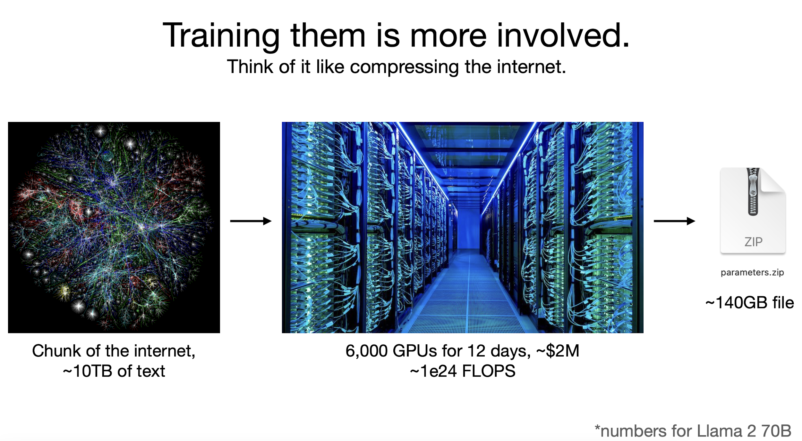
Large Language Models (LLM)
Andrej Karpathy (2023): Intro to LLM for busy people. https://www.youtube.com/watch?v=zjkBMFhNj_g&ab_channel=AndrejKarpathy

Slide 10
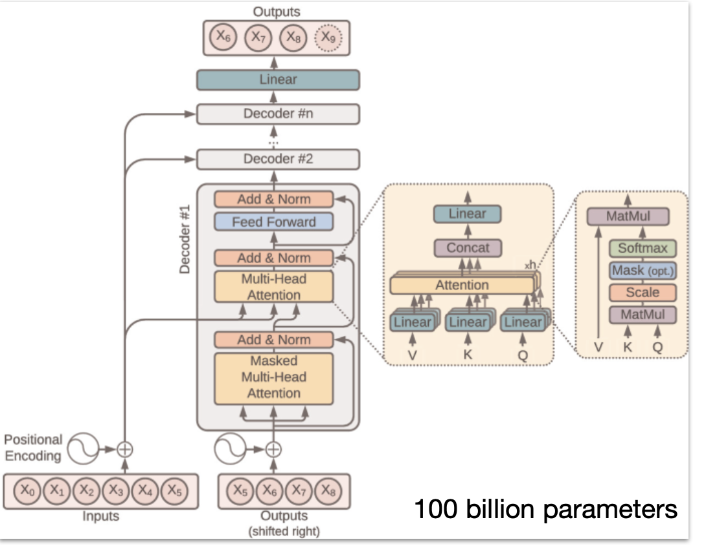
LLM: How does it work?
“Little is known in full detail...
Billions of parameters are dispersed through the network.
We know how to iteratively adjust them to make it better at prediction. We can measure that this works, but we don’t really know how the billions of parameters collaborate to do it.
They build and maintain some kind of knowledge database, but it is a bit strange and imperfect.”
Vaswani, A., Shazeer, N., Parmar, N., Uszkoreit, J., Jones, L., Gomez, A. N., ... & Polosukhin, I. (2017). Attention is all you need. Advances in neural information processing systems, 30. https://arxiv.org/pdf/1706.03762.pdf

Slide 11
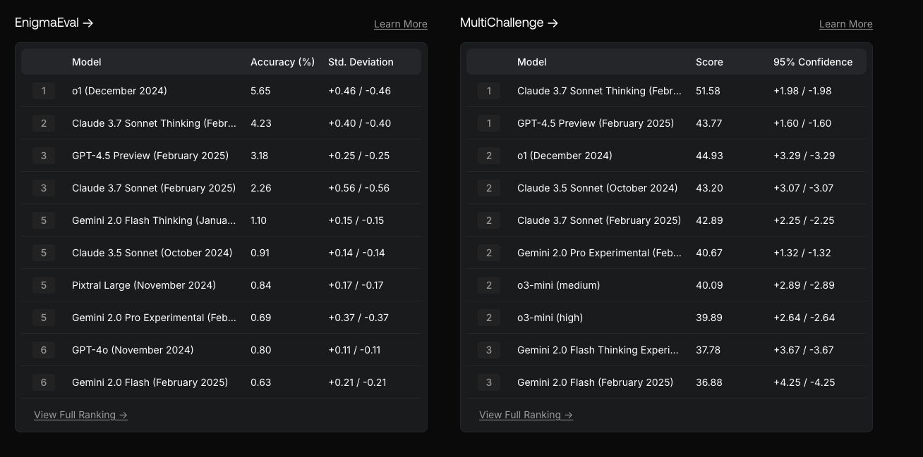
Leading LLMs

Slide 12
Sentiment Analysis
Domain-specific definition of sentiment
prompt_base = f"""
Act as a policy researcher, you will classify the sentiment in the interviews of educational policy stakeholders as: “Positive”, “Negative”, or “Neutral”. Here is a statement from a policy stakeholder:
[TextGoHere]
To warrant “Positive” sentiment, the statement has to: (1) include the interviewee’s satisfaction about an educational policy (policies) and program(s), or (2) express an enhancement or potential to enhance the quality or equity of student learning or school system, or (3) identify an improvement from past practice. To warrant “Negative”, the statement describes the interviewees’ dissatisfactions, or identifies problems/issues/challenges, or suggests areas needed for further improvement. When the interviewee just states the fact without expressing either positive or negative sentiment, you can classify as “neutral”. When multiple sentiments are observed in one statement, identify the most prevailing sentiment. Explain your reasoning for your analysis."""
​​
Lexical-based sentiment analysis:
nltk.sentiment.vader package in Python

Slide 13
From Voices to Validity: Leveraging Large Language Models (LLMs) for Textual Analysis of Policy Stakeholder Interviews
Liu, A., & Sun, M. (2023). From Voices to Validity: Leveraging Large Language Models (LLMs) for Textual Analysis of Policy Stakeholder Interviews. arXiv preprint arXiv:2312.01202.
This study is supported by the Baller Group and William T. Grant Foundation (Grant No. 190735) and the National Science Foundation (Grant No. 2055062). Any opinions, findings, and conclusions or recommendations expressed in this material are those of the authors and do not necessarily reflect the views of the funders.
Liu & Sun assume equal authorship.

Slide 14
Introduction
1. One important source of data to support policy discourse and decision-making involves stakeholders’ lived experiences about the implementation of current policy and their opinions about how to improve.
2. Stakeholders’ voices may be collected from interviews, open-ended survey responses, or texts obtained from social media posts.
3. The cost of manually analyzing even a moderately sized text may hinder the actual use of stakeholders’ voices.
4. Data science methods—like topic modeling (LDA), sentiment analysis, and large language models (LLMs, notably ChatGPT)—may offer the efficiency, but can be constrained by the lack of domain and contextual knowledge.
5. The central aim of this study is to examine the validity of LLMs to analyze interview data about a specific domain—education policies and programs—in a specific context—Washington state’s K-12 school system.

Slide 15
Research Questions
A large study of identifying policies and programs that either advance or hinder racial and economic equity in Washington (WA) State’s K-12 public school system in 2022.
Substance Research Questions:
What are the key themes that WA stakeholders voiced about K-12 public school system?
Which themes did stakeholders recognize as advancing educational equity (positive)? Conversely, which areas were mentioned as needing improvement or hinder (negative) educational equity?
Methodological Research Questions:
How accurate and valid are GPT-4 labels of key themes when comparing to human experts’ labels and traditional topic modeling results?
How accurate and valid are GPT-4 sentiment classifications when comparing to human experts’ and lexicon-based sentiment analysis?
Notes:
Situated in

Slide 16
Data Collection and Preprocessing
1. 24 interviews (45-60 minutes) with stakeholders:
  Administrators: state legislators, other state-level policymakers, school district administrators;
  Non-Profit and Advocates: teacher union representatives, policy advocates, and community leaders;
  Educators: teachers, teacher coaches or mentors
2. Tidytext-format data contains about 1,700 entries (i.e. documents).
  One complete thought (one long or several short sentences)
  Filtered out stop words and words like “um,” “so,” and “you know”
  Stemming
3. Contains interviewees’ research ID, demographics, job roles, and job location.
Notes:
corpus might not be considered as being “big”, they provide enough data for computational methods to produce meaningful results but not so much data that iterative human coding becomes intractable. The dataset also includes interviewees’ research ID, demographics, job roles, and job location.

Slide 17
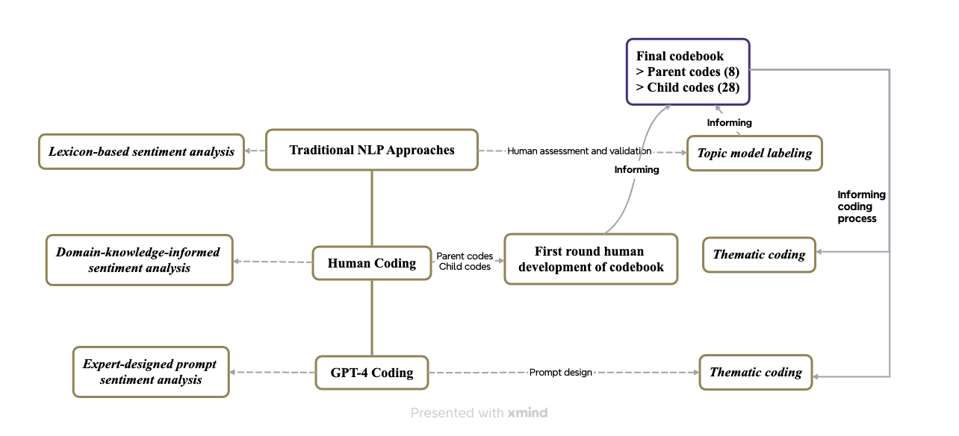
Methods: Human-Computer Interactive Approach
“This human-computer partnership approach (socio-technical) perspective on learning highlights how technology exerts agency in a relationship with educators and learners, as generative AI learns more with the quantity and quality of what humans provide to the technology, and vice versa. The reciprocal nature of AI learning and teaching interactions means that less bias and more flexibility in the tool are possible with increased human use.”
-- Katie Headrick Taylor, Alex Liu, Min Sun
Notes:
Human coding at the center of our approach– first round of codebook development, LDA
The final codebook then feed into the human coding, asking for 3 most salient themes; and GPT-4 coding– mimick human coding behaviors.
Sentiment analysis
Lastly, we compare and evaluate

Slide 18
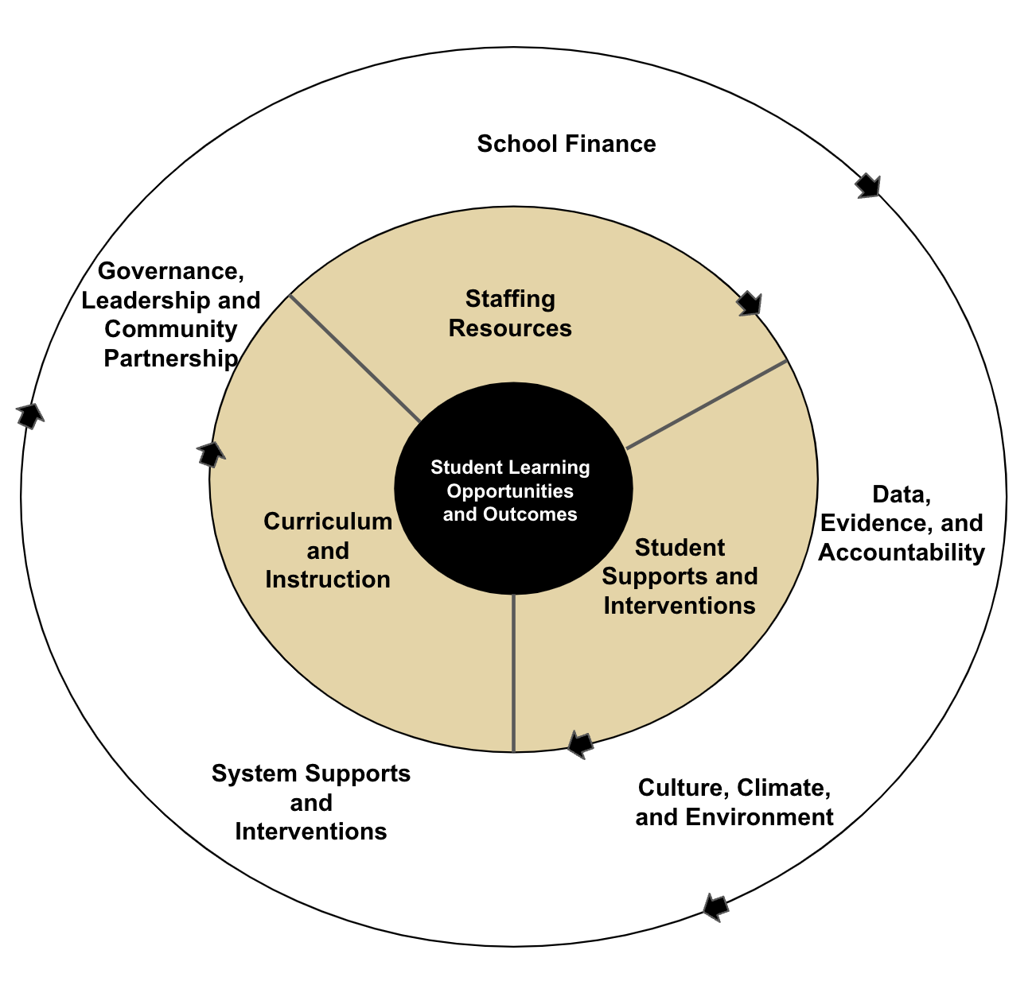
Conceptual Framework
Resources Equity Framework Embedded in a Data-Informed Iterative Improvement Cycle

Slide 19
LDA
Input
Pre-processing
Topic modeling
Output
Validation
  Unorganized messy conversational texts
  Remove stop words
  Stemming
  Human validation
  Human labeling and making sense of the topics
  List of coherent, valid topics
  Proportion distribution of documents to topics
  Summarizing topic proportions by subgroups of interviewees
  Alignment with human coding

Slide 20
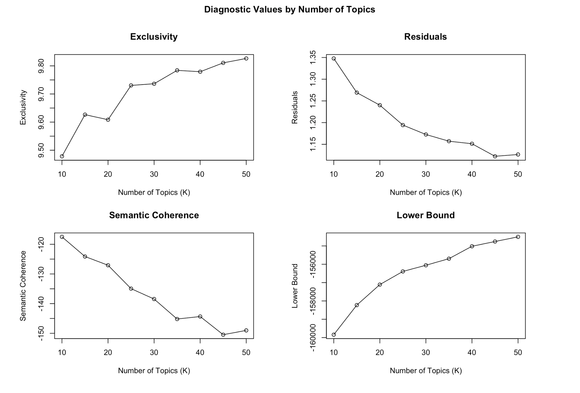
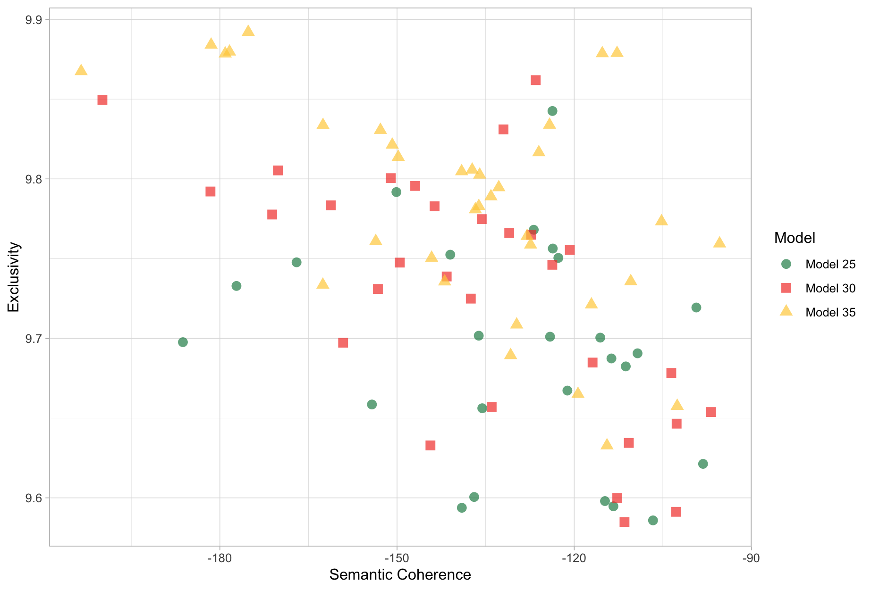
LDA
Exclusivity vs. Semantic Coherence
Diagnostic Values for a Number of Topics

Slide 21
Prompt Engineering
Zero-shot
  Use the codebook to label three child and/or parent codes for each document; if no child code works, only label the parent codes.
Few shot:
  Zero shot + here are a few examples.
Chain of thoughts
  Step 1: label three parent codes with reasoning; Step 2: label child code within each parent code. If none of the child code applies, keep the parent code.
Resources to learn more about prompt engineering:
https://www.deeplearning.ai/short-courses/chatgpt-prompt-engineering-for-developers/
https://www.youtube.com/watch?v=dOxUroR57xs&ab_channel=ElvisSaravia

Slide 22
GPT-4 Thematic Analysis: Chain-of-Thought (CoT) Prompt
prompt_base = f"""
Task: As a policy researcher, you’ve been provided with a paragraph extracted from an interview with an education policy stakeholder. Utilize the attached “Voice to validity codebook “ (in excel format) to code the paragraph. The Codebook comprises four columns: ‘Parent’, ‘Child’, ‘Child_description’, and ‘Key words’.
Steps:
1. Identify Salient Themes:
Understand the paragraph’s content within the context of the Washington State K-12 public school system.
Refer to the ‘Parent’ column in the Codebook for broader thematic categories.
Pinpoint up to three salient themes from these ‘Parent’ categories.
These themes should highlight the most significant ideas in the paragraph.
Label the paragraph with the chosen ‘Parent’ themes.
2. Dive into Child Themes:
The ‘Child’ column in the Codebook lists detailed thematic subcategories, which fall under the broader ‘Parent’ categories.
The ‘Child_description’ elaborates on the ‘Child’ categories, and the ‘Key words’ column lists pertinent terms for each ‘Child’ category.
3. Associate with Child Categories:
Revisit the paragraph, keeping the Washington State K-12 public school system context in mind.
For each previously identified ‘Parent’ theme, pinpoint the appropriate ‘Child’ subcategories from the Codebook. The ‘Child_description’ and ‘Key words’ columns can aid your decision.
Ensure the ‘Child’ categories align with the paragraph’s content. If there’s no fit or you’re uncertain, label it as ‘None’.
From your identified ‘Parent’ and ‘Child’ pairs, pick the top three pairs that encapsulate the paragraph’s central ideas.
Label the paragraph with these three ‘Parent’ and corresponding ‘Child’ pairs.
Codebook: see attachment
Paragraph for Analysis:
[[[TEXTGOHERE]]]
Response Format:
Frame your answer as a JSON object containing the keys: ‘Parent 1’, ‘Child 1’, ‘Parent 2’, ‘Child 2’, ‘Parent 3’, ‘Child 3’, and ‘Reasoning’.
"""
Role, context, and overall task

Slide 23
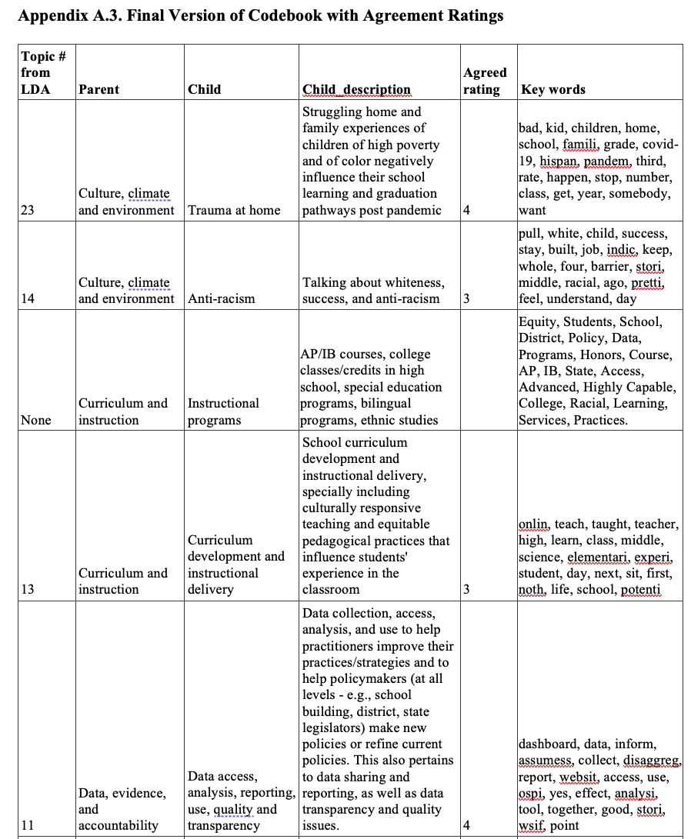
Codebook
Snippet of the codebook

Slide 24
Interactive Demo and Self-Practice
(10 mins)
Sample Interview quotes:
“I think the thing that we have been able to do in that shifting, in that transition, is really clarify our commitment to bilingualism. And especially for our families who are second language, around that is your heritage language, that is the language of your ancestors. That is what connects us to who we are and the generations who came before us, and how important that is.”
“when you are looking at funding, we have put in almost $10 billion in the last 10 years, but there is really no accountability system to that. We still have 23 different accounting systems that feed into OSPI, and then they have to figure it out.”

Slide 25
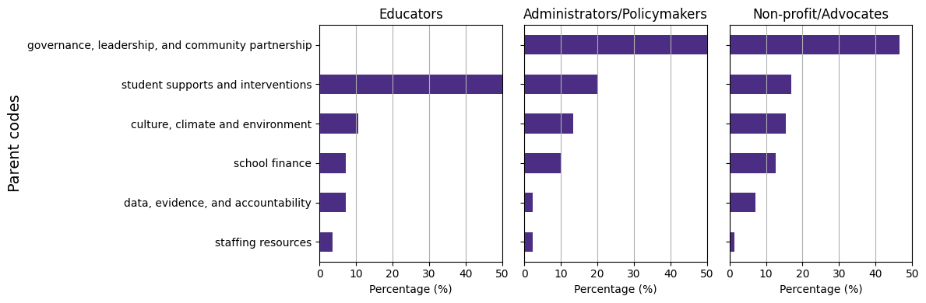
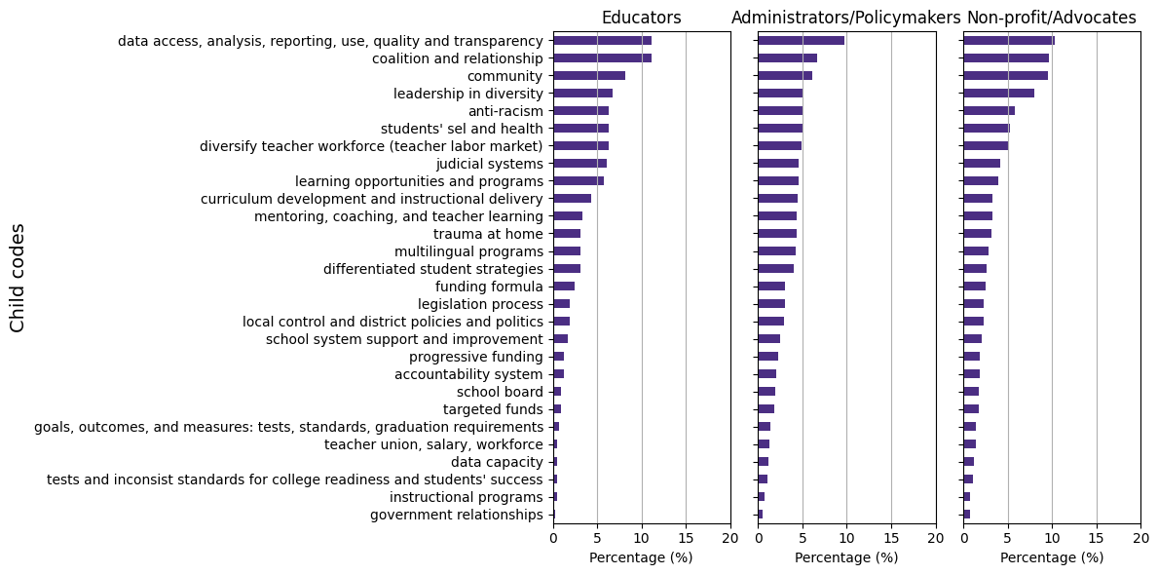
Results– SRQ1
What are the key themes that WA stakeholders voiced about K-12 public school system?

Slide 26
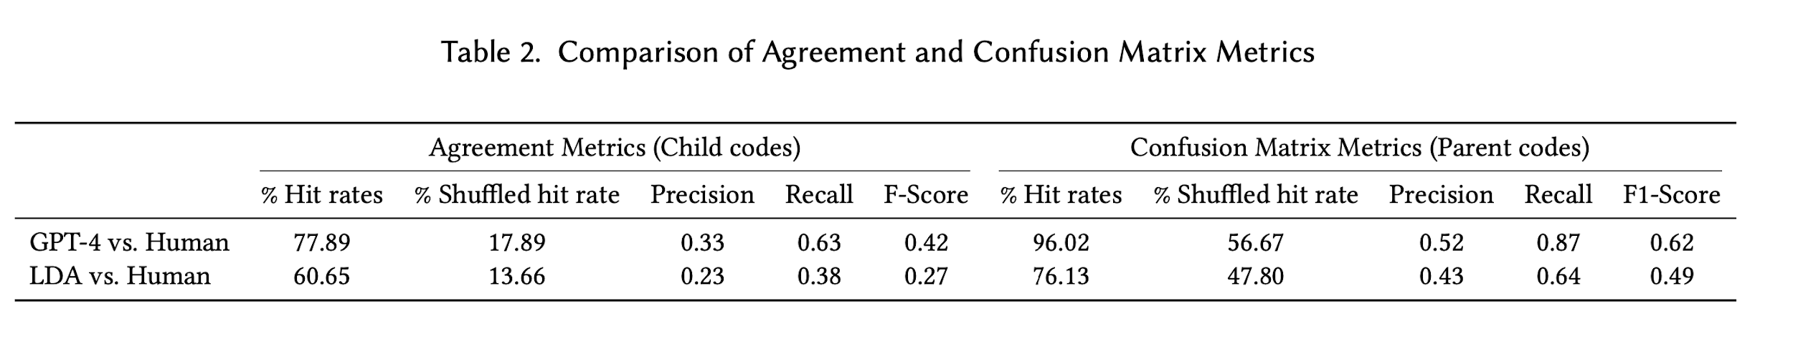
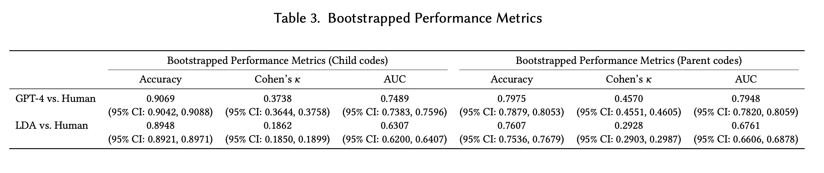
Results– MRQ1
How accurate and valid are GPT-4 labels of key themes when comparing to human experts’ labels and traditional topic modeling results?
Notes:
1. Hit Rate
Hit rate, can be seen as a measure of how many times a system successfully recommends items of interest out of all the opportunities it had to make such recommendations. It is closely related to recall but is more commonly used in scenarios like movie or product recommendations.
we calculated hit rates, which measured the percentage of machine-labeled themes that corresponded with human-labeled themes. Table 2 illustrates that, on average, approximately 78% of GPT-4 annotated child codes matched those annotated by humans for each paragraph
Given that up to three child codes were assigned to each paragraph, these results indicate a significant overlap at child code level about detailed themes, with GPT-4 and human coders identifying at least two identical themes per paragraph. The LDA approach also demonstrated a high rate of overlap, aligning with human annotations for more than half of the child codes. Hit rates for both computer-assisted methods increased when comparing the broad themes (parent codes). In particular, GPT-4 parent code labels nearly fully cover the human experts’ coded parent codes.
Accuracy: TP+TN/ TP+TN+FP+FN
2. Precision: Precision is the fraction of relevant instances among the retrieved instances. It is defined as: Precision=TP/TP+FP where: TP (True Positives) is the number of correct positive predictions; FP (False Positives) is the number of incorrect positive predictions. Precision thus measures the accuracy of positive predictions, indicating the percentage of your positive predictions that were correct.
3. Recall: Recall, also known as sensitivity or the true positive rate, is the fraction of relevant instances that have been retrieved over the total amount of relevant instances. It is defined as: Recall=TP/(TP+FN) where: TP (True Positives) is as defined above; FN (False Negatives) is the number of positive instances that were incorrectly predicted as negative.Recall measures the ability of a model to find all the relevant cases within a dataset. It is especially important in situations where the cost of missing a positive instance (such as in disease screening) is high.
4. F-Score (F1 Score); The F-Score, or F1 Score, is the harmonic mean of precision and recall, offering a balance between the two by taking both false positives and false negatives into account. It is defined as: F1=2×((Precision×Recall)/(Precision+Recall); The F1 Score reaches its best value at 1 (perfect precision and recall) and worst at 0. It is a useful measure when you need to balance precision and recall, often in situations where there is an uneven class distribution, or when the costs of false positives and false negatives are very different.
An AUC of 1 indicates a perfect model; an AUC of 0.5 suggests no discriminative power, equivalent to random guessing.

Slide 27
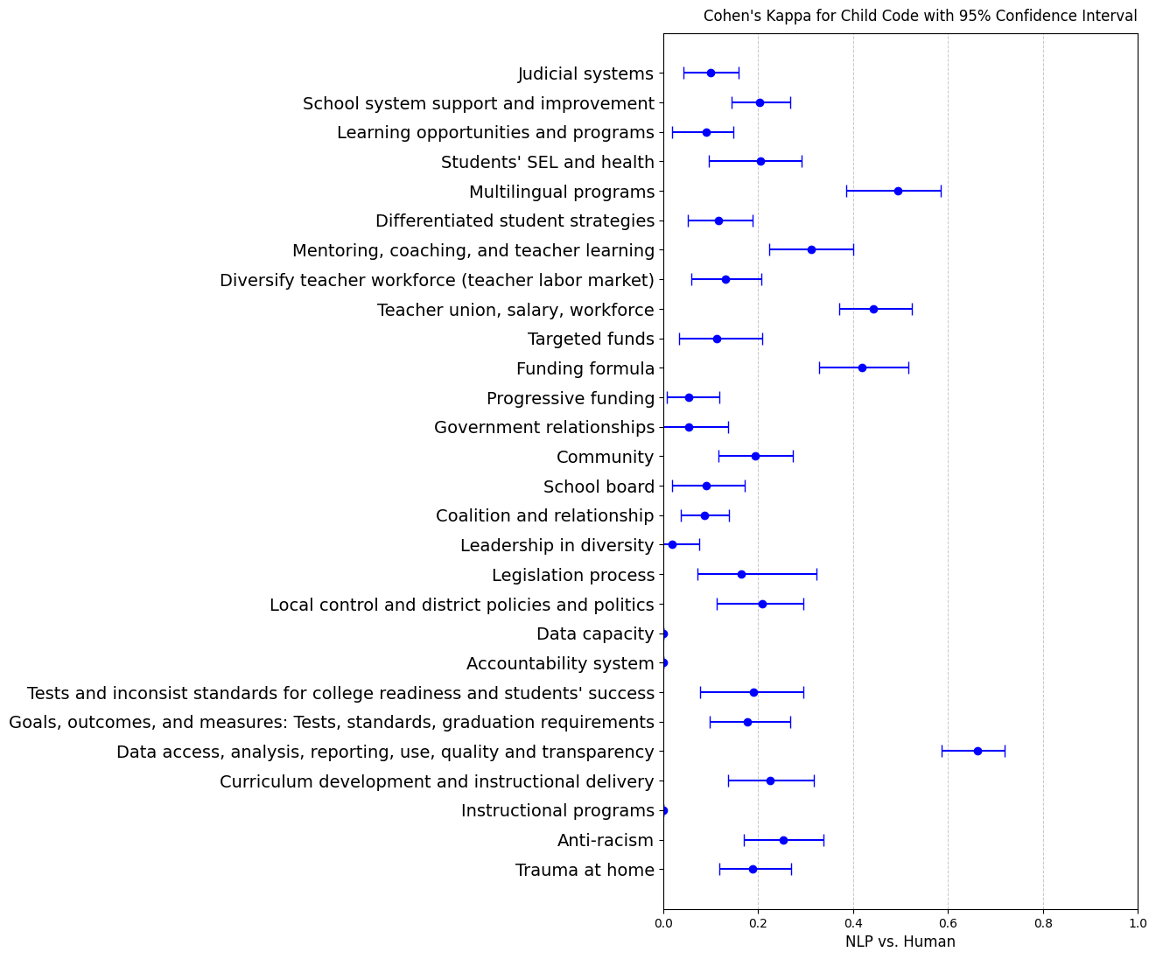
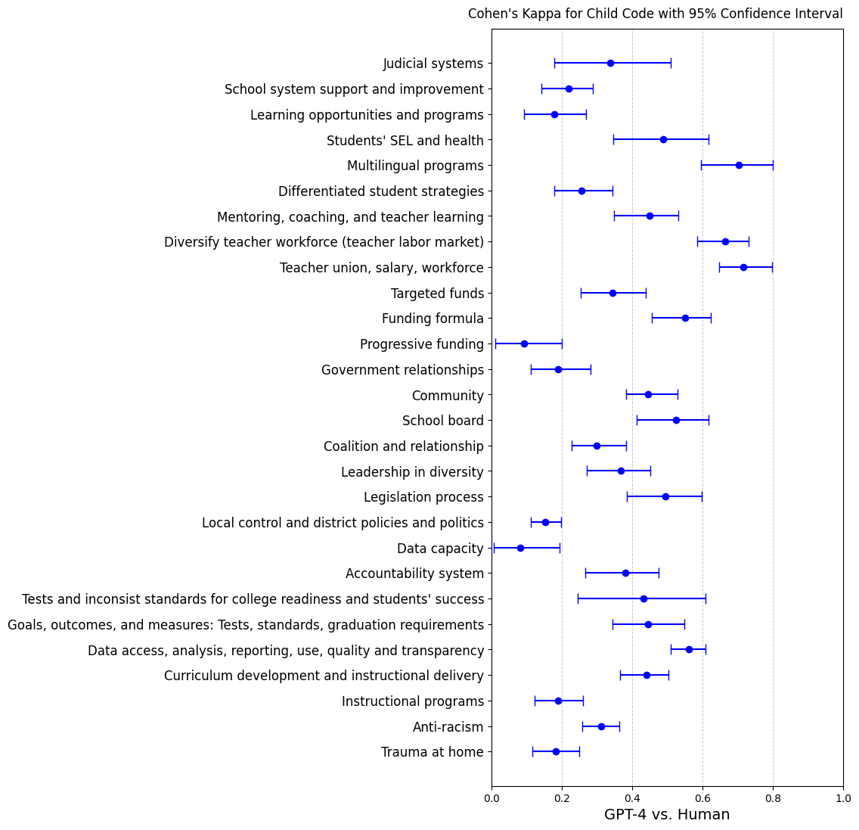
GPT-Human vs LDA- Human Cohen’s K by Child Code
LDA vs. Human
Notes:
Cohen's Kappa is a statistic that measures inter-annotator agreement for categorical items. It is more robust than simple percent agreement calculation since it takes into account the agreement occurring by chance. Cohen's Kappa adjusts for the agreement that could happen by chance, thus providing a more accurate measure of the actual agreement between two raters or a rater and a predictive model. A kappa value of 1 indicates perfect agreement, while a value of 0 indicates agreement equivalent to chance. Negative values indicate agreement less than chance, which signifies systematic disagreement.

Slide 28
Distribution of GPT-Human Cohen’s K by Child Code
The agreement varies greatly by themes.
  Higher agreement on themes that are less domain specific, including multilingual programs; diversity teacher workforce; teacher union, salary workforce; funding formula; school board; data access, analysis, reporting, use, quality, and transparency.
  Low agreement on themes that are more domain specific themes , including progressive funding; local control and district policies and politics; data capacity; trauma at home, instructional programs.

Slide 29
Sentiment Analysis
Confusion Matrix and Performance Metrics for Sentiment Analysis
 | GPT-4 → |  |  | Lexicon → |  |  | Performance Metrics
Human ↓ | Positive | Negative | Neutral | Positive | Negative | Neutral |  | Accuracy | Cohen's κ
Positive | 218 | 4 | 20 | 215 | 11 | 16 | GPT-4 vs.Human | 0.58 | 0.38
Negative | 71 | 322 | 162 | 347 | 151 | 57 | LDA vs. Human | 0.31 | 0.09
Neutral | 31 | 31 | 215 | 405 | 64 | 43
​​
GPT-4 is doing much better job than lexicon-based approach.
Agarwal et al. [2019] saw 𝜅 = 0.44 for news sentiment

Slide 30
Discussion
LLMs’ performance is sensitive to prompts.
  The utility of LLMs to assist domain-specific data analysis hinges on the integration of domain knowledge to inform prompt development
  GPT-4 classifications are more accurate and valid for themes that are less domain specific.
(LLM vs Human) compares with (Traditional NLP vs Human)
  LLM, to some degree, understand the meaning of the language and contexts, which traditional LDA or lexicon-based analysis are not able to.
  Human experts have theoretical and domain knowledge and lived experience in ed policy.
Sentiment analysis
  GPT and human have a higher agreement on either positive or negative, but lower agreement on neutral.
  Traditional lexicon-based approach couldn’t capture domain-specific sentiment.

Slide 31
Code Demo
LLM using API
STM

Slide 32

LLM-Assisted Qualitative Coding:
A Hands-on Training Workshop
Alex Liu

Slide 33
1
Workshop Setup and Overview
2
Exploratory Analysis Demo
3
Codebook-Based Analysis
4
Practical Exercise

Slide 34

Workshop Setup and Overview
Part.
1

Slide 35
Getting Started
Environment Check
Workshop Goals
Ensure participants have access to web-based GPT interface or alternative LLM tools
Verify sample datasets are downloaded and accessible
Confirm access to provided code templates and notebooks
If you do not have LLM API access, use website-based chatbot.
Practice implementing LLM-assisted coding workflows
Gain hands-on experience with both codebook and exploratory approaches
Learn troubleshooting techniques for common challenges
For each approach, I will describe the workflow first. Then I will show the code in Google Colab using LLM API. Last, I will show the equivalent approach using website-based chatbot.

Slide 36
Choosing Your Coding Approach
Open Coding Situations
examine data (like interviews, observations, or texts) without preconceived categories, allowing themes and patterns to emerge naturally from the data itself.
Codebook-Based Situations
examine data (like interviews, observations, or texts) with preconceived categories
Exploring new or understudied phenomena where existing frameworks may not apply
Generating theory from ground-up through inductive analysis
Initial phase of mixed-methods research to identify emerging themes
Working with diverse or unexpected data patterns
Testing existing theoretical frameworks or hypotheses
Replication studies requiring consistent coding schemes
Large-scale projects with multiple coders needing standardization
Comparative analysis across multiple datasets or time periods
Next:
Part 2. Open coding with LLM to establish codebook
Part 3. Use codebook for codebook-based coding

Slide 37
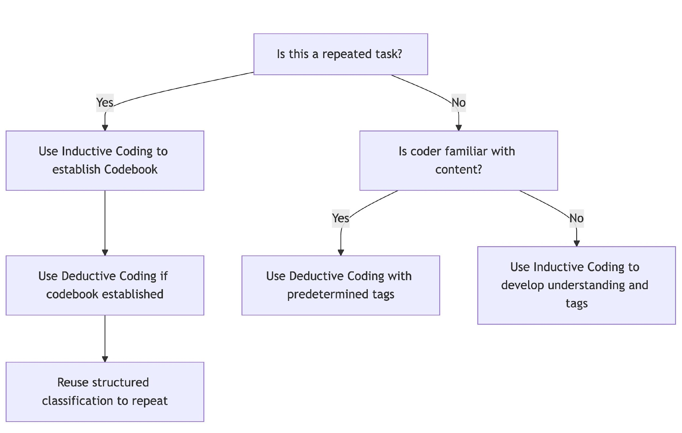
Choosing Your Coding Approach
Next:
Part 2. Open coding with LLM to establish codebook
Part 3. Use codebook for codebook-based coding

Slide 38
Exploratory Analysis Demo
Part.
2

Slide 39
Open Coding with LLM Support
Topic discovery
Two LLM Conceptualization Approaches
Pattern Recognition
Identify recurring concepts and relationships
Map connections between themes
If needed, create visual representation of findings
Clean up and preprocess text data
Configure LLM for unsupervised analysis
Alternative: STM or LDA topic modeling approaches
Code in your folder:
ISEA_LDA.ipynb
ISEA_STM_topic_model.Rmd
Generate initial topic/theme clusters
Provide context and one row/document at a time. Ask LLM to provide contextual labels and descriptions for each row.
Provide combined text to LLM. Ask LLM to generate themes and descriptions based on the entire text. To verify, you need to select a sample to label based using the identified themes.
Validation Techniques
Cross-reference with manual coding samples
Apply intercoder reliability checks
Document LLM decision patterns

Slide 40
DEMO - Open Coding with LLM Support
In ISEA_topic_code_using_openai.ipynb, you need section load data and LLM API Integration/open coding for open coding on a DataFrame using an LLM API.
The script follows these steps:
Load Data: Reads a CSV file containing qualitative data.
Preprocess Data: Cleans and structures text for input into the LLM.
LLM API Integration: Set up functions and parameters to Configure LLM. Sends each text entry to an LLM for open coding.
Extract Codes: Parses and structures the generated codes.
Create a Codebook: Aggregates extracted codes into a structured format.
Render Final Codebook: Exports the final codebook as a structured DataFrame.

Slide 41
Hands-on Demo: Codebook-Based Analysis
Part.
3
If your dataset is small and open coding is a one-time task, you can apply open coding to the entire dataset, eliminating the need for codebook-based coding. However, if your dataset is large and your open coding sample does not cover the entire data, or if you need to repeat the coding process on different datasets (e.g., annual reviews), you need to use the established codebook to code additional data.

Slide 42


Working with Structured Codes
Setting Up the Environment
Running the Analysis
Quality Control
Load sample interview transcripts into working environment
Import pre-defined codebook
Configure LLM parameters for optimal analysis
Execute initial coding pass using LLM
test on samples
Review auto-coded segments
you can request confidence scores
If you are repeatedly coding similar but not identical data, provide an "Other" label option
Implement human validation workflow
Invite people who know the context of the work but not previously participated in the coding process
and/or, manually label a random sample using the codebook and compare with AI labels
Check for coding consistency
Address edge cases and ambiguous segments
Document decision rules for future reference
Notes:
Confidence Scores: The model assigns a confidence level (0-1) for each theme.
Interpreting Confidence Scores:
High Confidence (0.9–1.0 or 90–100%) → The model is very sure about the classification.
Moderate Confidence (0.7–0.89 or 70–89%) → The theme fits, but there may be some ambiguity.
Low Confidence (0.5–0.69 or 50–69%) → Uncertain classification; human review recommended.
Below 0.5 (less than 50%) → The model is guessing; consider manual review.
Why Confidence Scores Matter:
Prioritizes Human Review → Focuses human validation on low-confidence cases.
Enhances Trust → Users can assess how reliable an LLM-generated theme is.
Improves Repeat Coding → Can set thresholds (e.g., accept classifications with >80% confidence automatically).
"Other" Labeling: If a text does not match any codebook category with high confidence, the model will return "Other".

Slide 43
DEMO - Codebook-based Coding with LLM Support
In ISEA_topic_code_using_openai.ipynb, you need section load data, load codebook and LLM API Integration/codebook-based coding for codebook-based coding on a DataFrame using an LLM API.
The script follows these steps:
Load Data: Reads a CSV file containing qualitative data.
Preprocess Data: Cleans and structures text for input into the LLM.
LLM API Integration:
Set up functions and parameters to Configure LLM.
Sends each text entry to an LLM for open coding.
Prompt design incorporating established codebook
Extract Codes: Parses and structures the coding results.

Slide 44
DEMO - Example of Zero-shot Prompt with confident scores and “Other”
### Step 2: Code the Paragraph using the Codebook:
a. Read the Paragraph carefully, considering its context within the Washington State K-12 public school system.
b. Identify the **top three most salient themes** from the 'Child' categories, using 'Child_description' and 'Key words' as references.
c. If **no appropriate Child category fits**, use the Parent category instead.
d. If **neither Parent nor Child categories fit**, label the Paragraph as **"Other"** with brief specification.
e. Assign a **confidence score (0 to 1)** to each assigned theme, representing how certain you are about the classification.
f. Provide a reasoning statement justifying your theme selections.
### Step 3: Review and ensure that the assigned themes accurately represent the Paragraph.
- If a Paragraph does not fit any Codebook category, return `"Other: specification` as the theme.
*unchanged*
### Expected JSON Output Format:
{{ "Theme 1": "Selected Theme or 'Other'",
"Theme 2": "Selected Theme or 'Other'",
"Theme 3": "Selected Theme or 'Other'",
"Confidence Scores": [0.92, 0.85, 0.65],
"Reasoning": "Brief explanation of why these themes were selected."}}

Slide 45
Practical Exercise
Part.
4

Slide 46

Hands-on Application
Apply learned techniques to sample_interview_data.csv.
First, implement exploratory approaches (open coding) to establish a codebook. Then, apply the codebook for a more structured coding process.
Your codebook does not need to follow the structure of the provided codebook. For example, it does not require a two-layer format. Instead, it should reflect the characteristics of the data sample and include Codes and Descriptions.
Conduct sentiment analysis on the dataset. You can define any sentiment you want to explore.
Discovery the connection between themes and sentiments.
Experiment with different LLM settings, including various models, parameters (if applicable), and prompts. Document your coding decisions, rationale, and validation process throughout the analysis.
Submit a write-up of your coding results and a description of your codebook (single-spaced, no longer than two pages).
Best Practices
Maintain consistent validation protocols
Document LLM configuration settings
Create reproducible workflows

Slide 47
Next Week
RADAR for more accurate and personalized recommendation:
    Retrieve
    Assess (with cosine similarity)
    Decide (recommend, augment, or generate)
    Augment (if necessary)
    Regenerate (from scratch if below threshold)

