Slide 1
Personalizing Educational Content through Retrieval Augmented Generation ISEA Session 8 Min Sun and Shawon Sarkar University of Washington March 15, 2024

Slide 2
Housekeeping
Hackweek lodging and travel information collection:
Claude—another LLM model that gains popularity

Slide 3
Overview of today
Sentiment analysis performed by LLMs
RADAR for personalized search and content generation
Model evaluation
Notes:
Question: From the perspective of evolutionary biology, are organisms designed? Why or why not?

Slide 4
Sentiment Analysis
Confusion Matrix and Performance Metrics for Sentiment Analysis
 | GPT-4 → |  |  | Lexicon → |  |  | Performance Metrics
Human ↓ | Positive | Negative | Neutral | Positive | Negative | Neutral |  | Accuracy | Cohen's κ
Positive | 218 | 4 | 20 | 215 | 11 | 16 | GPT-4 vs.Human | 0.58 | 0.38
Negative | 71 | 322 | 162 | 347 | 151 | 57 | LDA vs. Human | 0.31 | 0.09
Neutral | 31 | 31 | 215 | 405 | 64 | 43
​​
GPT-4 is doing much better job than lexicon-based approach.
Agarwal et al. [2019] saw 𝜅 = 0.44 for news sentiment
Notes:
1. Hit Rate
Hit rate, can be seen as a measure of how many times a system successfully recommends items of interest out of all the opportunities it had to make such recommendations. It is closely related to recall but is more commonly used in scenarios like movie or product recommendations.
2. Precision: Precision is the fraction of relevant instances among the retrieved instances. It is defined as: Precision=TP/TP+FP where: TP (True Positives) is the number of correct positive predictions; FP (False Positives) is the number of incorrect positive predictions. Precision thus measures the accuracy of positive predictions, indicating the percentage of your positive predictions that were correct.
3. Recall: Recall, also known as sensitivity or the true positive rate, is the fraction of relevant instances that have been retrieved over the total amount of relevant instances. It is defined as: Recall=TP/(TP+FN) where: TP (True Positives) is as defined above; FN (False Negatives) is the number of positive instances that were incorrectly predicted as negative.Recall measures the ability of a model to find all the relevant cases within a dataset. It is especially important in situations where the cost of missing a positive instance (such as in disease screening) is high.
4. F-Score (F1 Score); The F-Score, or F1 Score, is the harmonic mean of precision and recall, offering a balance between the two by taking both false positives and false negatives into account. It is defined as: F1=2×((Precision×Recall)/(Precision+Recall); The F1 Score reaches its best value at 1 (perfect precision and recall) and worst at 0. It is a useful measure when you need to balance precision and recall, often in situations where there is an uneven class distribution, or when the costs of false positives and false negatives are very different.
An AUC of 1 indicates a perfect model; an AUC of 0.5 suggests no discriminative power, equivalent to random guessing.
Cohen's Kappa is a statistic that measures inter-annotator agreement for categorical items. It is more robust than simple percent agreement calculation since it takes into account the agreement occurring by chance. Cohen's Kappa adjusts for the agreement that could happen by chance, thus providing a more accurate measure of the actual agreement between two raters or a rater and a predictive model. A kappa value of 1 indicates perfect agreement, while a value of 0 indicates agreement equivalent to chance. Negative values indicate agreement less than chance, which signifies systematic disagreement.
Accuracy = (Number of Correct Predictions) / (Total Number of Predictions)
For example, if a binary classification model predicts 80 instances correctly out of 100 total instances, its accuracy would be 0.8 or 80%.

Slide 5
Sentiment Analysis
Domain-specific definition of sentiment
prompt_base = f"""
Act as a policy researcher, you will classify the sentiment in the interviews of educational policy stakeholders as: “Positive”, “Negative”, or “Neutral”. Here is a statement from a policy stakeholder:
[TextGoHere]
To warrant “Positive” sentiment, the statement has to: (1) include the interviewee’s satisfaction about an educational policy (policies) and program(s), or (2) express an enhancement or potential to enhance the quality or equity of student learning or school system, or (3) identify an improvement from past practice. To warrant “Negative”, the statement describes the interviewees’ dissatisfactions, or identifies problems/issues/challenges, or suggests areas needed for further improvement. When the interviewee just states the fact without expressing either positive or negative sentiment, you can classify as “neutral”. When multiple sentiments are observed in one statement, identify the most prevailing sentiment. Explain your reasoning for your analysis."""
​​
Lexical-based sentiment analysis:
nltk.sentiment.vader package in Python

Slide 6
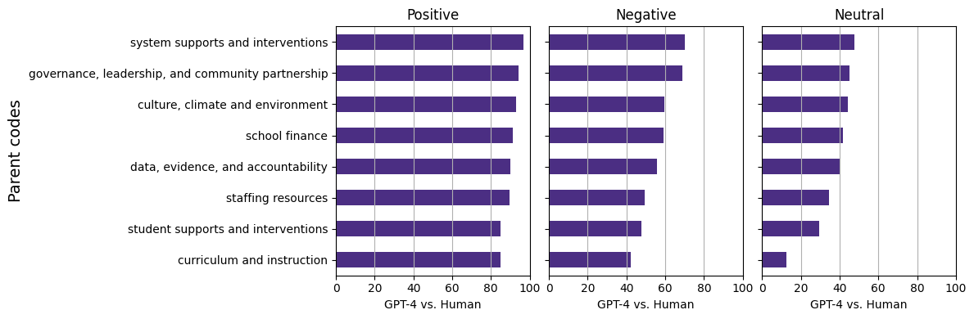
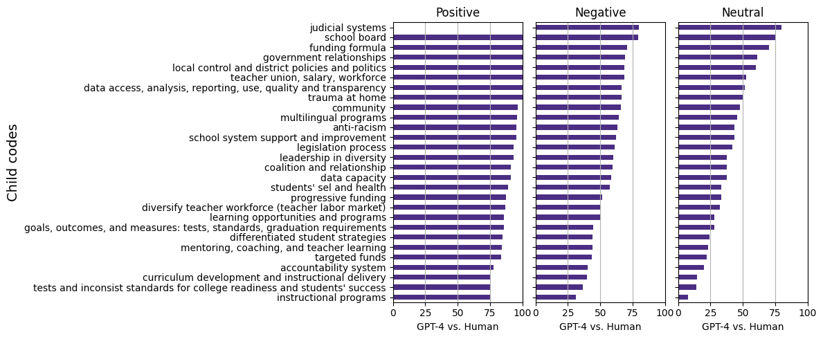
Associating topics and sentiment

Slide 7
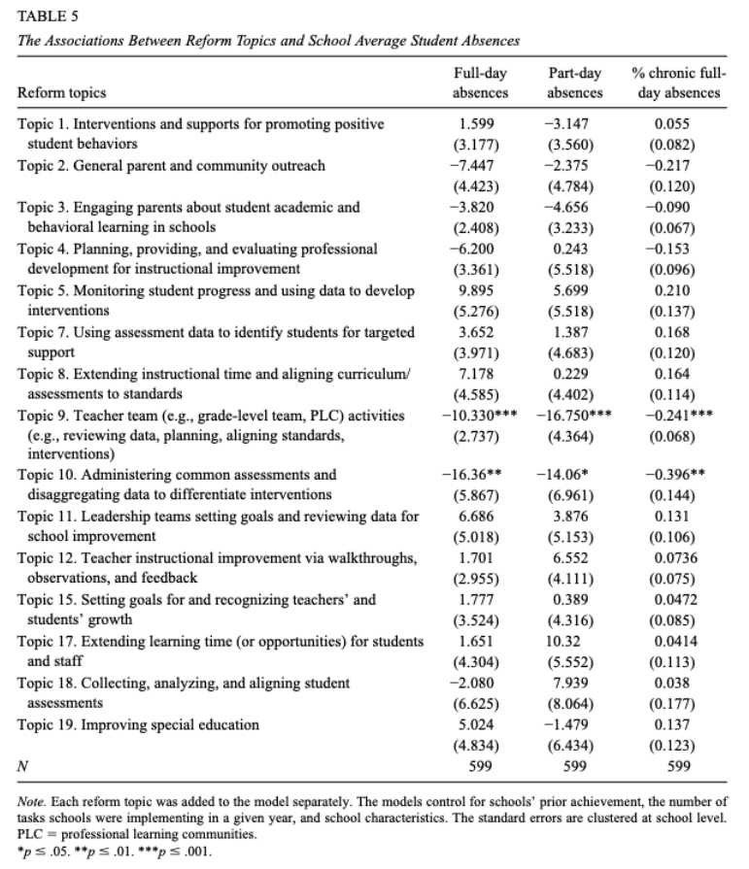
Associating with outcome measures
Sun, M., Liu, J., Zhu, J., & LeClair, Z. (2019). Using a text-as-data approach to understand reform processes: A deep exploration of school improvement strategies. Educational evaluation and policy analysis, 41(4), 510-536.

Slide 8
AI’s Use in Education: Motivate Today’s Topic
Generative AI’s excitement centers on its capacity for “personalization” and “adaptivity”, which leads to “efficiency” in teaching and learning.
To achieve this, needs tons of data analytics.
Let’s use Colleague.AI as a demo to see the problem space
Brainstorm: Decompose this task, what components do you need to personalize the recommendation?
Citation: Cardona, M. A., Rodríguez, R. J., & Ishmael, K. (2023). Artificial intelligence and the future of teaching and learning: Insights and recommendations.

Slide 9
AI’s Use in Education: Motivate Today’s Topic
Keep in mind the goal: “Personalization”, “Adaptivity”, “High Quality”, and “Relevance” or “Accuracy”.
Teacher needs
Content features
Personalized generation or recommendation
Student needs

Slide 10
RAG: The Problem to be Solved
Retrieved information may be more accurate and specific, but not be as relevant or personalized enough.
Generated information can be relevant or personalized, dynamic, but may be less accurate or specific.
Hallucinate
Limited by context length
RAG (Retrieval augmented generation)
Recommend relevant and personalized content
(May or may not) Reduce the computational cost
Combat hallucination and context length constraint
Embed domain knowledge into this process

Slide 11
RADAR
Retrieve
Assess (with cosine similarity)
Decide (recommend, augment, or generate)
Augment (if necessary)
Regenerate (from scratch if below threshold)
Citation: Sarkar, S., Sun, M., He, J., & Liu, A. (2024). Unlocking educational materials with RADAR: Personalized and Accurate math lesson plan search and generation.

Slide 12
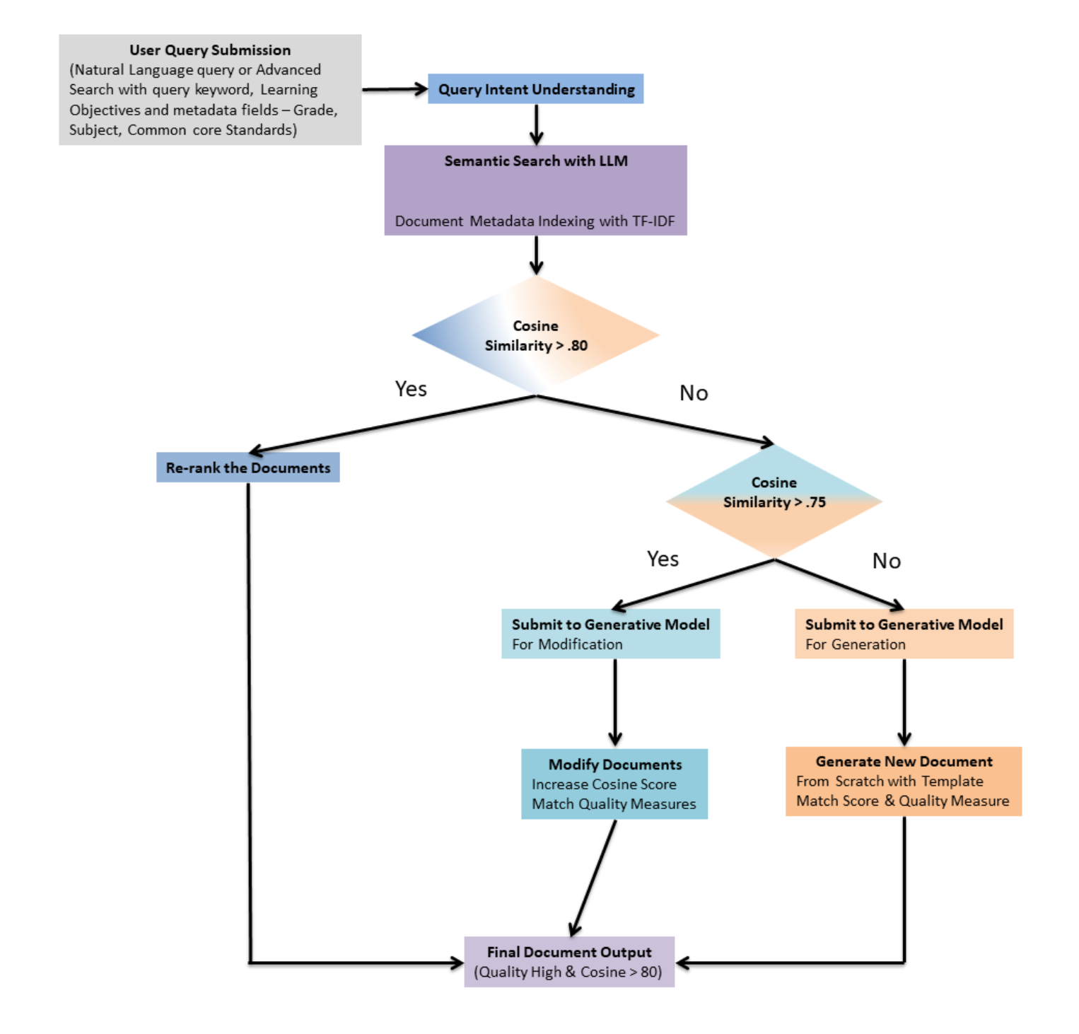
RADAR in Colleague.AI
Domain knowledge (quality math instruction) embedded in the model
Citation: Sarkar, S., Sun, M., He, J., & Liu, A. (2024). Unlocking educational materials with RADAR: Personalized and Accurate math lesson plan search and generation.

Slide 13
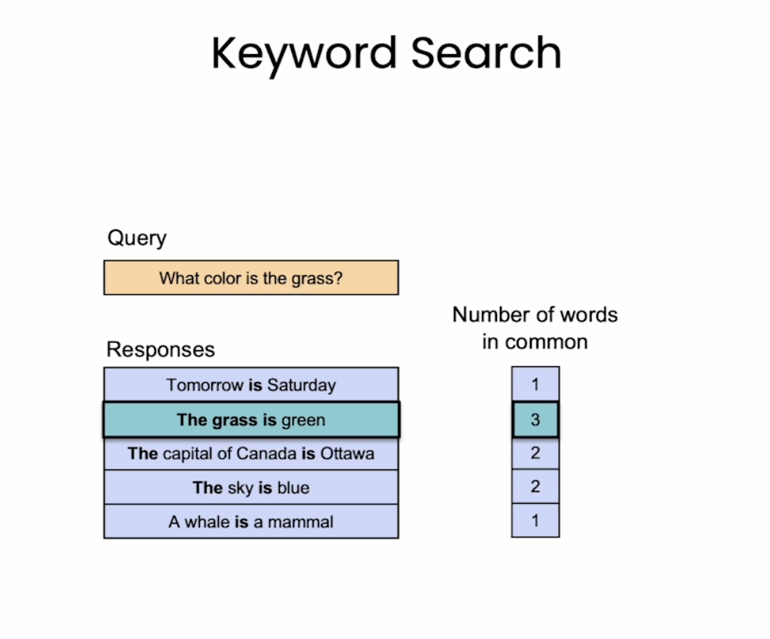
Semantic Search
Keyword search doesn’t account for the context.
Semantic search understanding context and intent better: Utilizing the context surrounding a query and the user’s intent to deliver more accurate results
Geographical location, search history, and the textual context of the query
Cite: https://learn.deeplearning.ai/courses/large-language-models-semantic-search/lesson/1/introduction

Slide 14
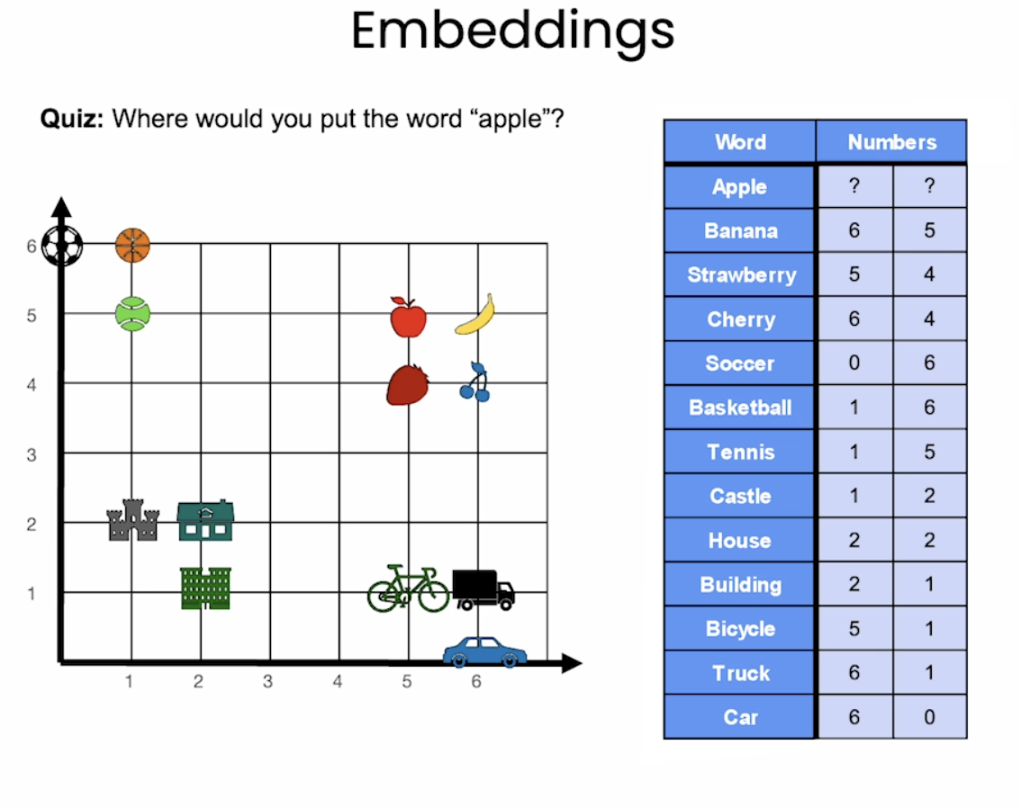
Semantic Search
Vector Search and Embeddings: Converts queries and documents into vectors, numerical representations that allows for the comparison of their semantic similarities.
Cite: https://learn.deeplearning.ai/courses/large-language-models-semantic-search/lesson/1/introduction

Slide 15
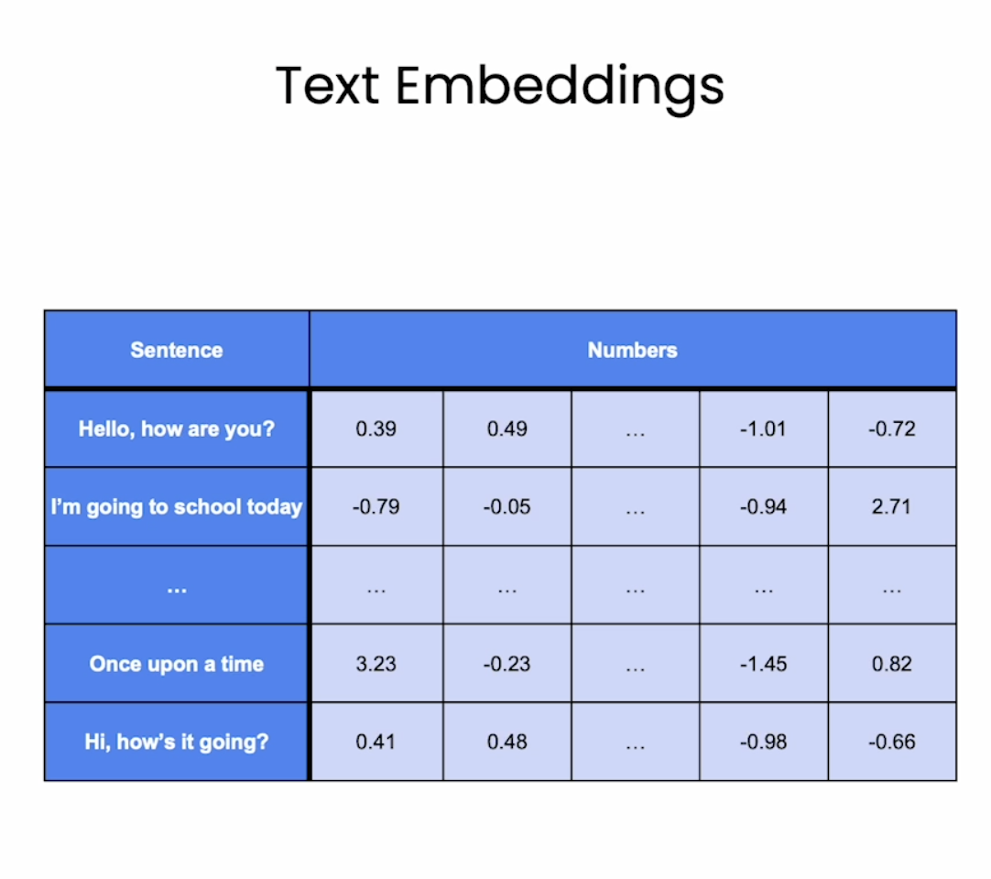
Text Embeddings
Cite: https://learn.deeplearning.ai/courses/large-language-models-semantic-search/lesson/1/introduction

Slide 16
Embeddings
Embedding methods refer to techniques used to represent data in a dense vector space, where similar items are mapped to nearby points (vectors) and dissimilar items are mapped to distant points. Word2Vec, GloVe (Global Vectors for Word Representation), and FastText
BERT (Bidirectional Encoder Representations from Transformers): A transformer-based model that learns contextual embeddings through self-attention and bidirectional training.
Pros: State-of-the-art performance on many NLP tasks, captures long-range dependencies
Cons: Large model size, requires significant computational resources
Best for: High-performance NLP tasks like text classification, sentiment analysis
GPT (Generative Pre-trained Transformer): A transformer-based language model that generates contextual embeddings and can be fine-tuned for various tasks.
Pros: Excels at text generation, can be fine-tuned for various tasks
Cons: Large model size, can be resource-intensive
Best for: Text generation, summarization, translation, question answering
https://platform.openai.com/docs/guides/embeddings/what-are-embeddings

Slide 17
Cosine Similarity in Semantic Search
Using algorithms like k-nearest neighbors (kNN) or cosine similarity to find and rank the most conceptually relevant documents
Cosine Similarity Calculation: The cosine similarity between the vector of the search query and the vectors of each document in the dataset is calculated. This similarity score ranges from -1 to 1, where 1 indicates identical direction (high similarity), 0 indicates orthogonality (no similarity), and -1 indicates opposite direction (high dissimilarity).
Ranking: Documents are ranked based on their cosine similarity scores with respect to the search query vector. Higher scores indicate more relevant documents to the query's semantic content.
Retrieval: The ranked list of documents is presented as search results, with the most conceptually relevant documents appearing at the top.

Slide 18
Retrieval with LLM
Data: A collection of documents or information items we want to search through
Preprocess data: Clean and prepare the data (e.g., normalization, tokenization)
Embedding generation: Use a LLM to generate embeddings for each document
Index embeddings: Store the generated embeddings and metadata in an index
Process query: Clean and preprocess query (similar to data preprocessing)
Generate query embedding: Use the same LLM to embed the query
Similarity calculation: Compare the query embedding to the document embeddings using a similarity measure (e.g., cosine similarity) to determine relevance
Rank retrieve results: Order the documents based on their similarity scores, with the highest scores indicating the most relevant documents
Return results: Present the ranked list of documents to the user
embedding_model = "text-embedding-3-small"
embedding_encoding = "cl100k_base"
max_tokens = 8000
Source: OpenAI
distances = distances_from_embeddings(query_embedding, doc_embedding, distance_metric="cosine")
Source: OpenAI
Notes:
Information items - texts, images, videos, audios, e.g., - web page retrieved by search engine, item images and metadata recommended by and e-commerce site.

Slide 19
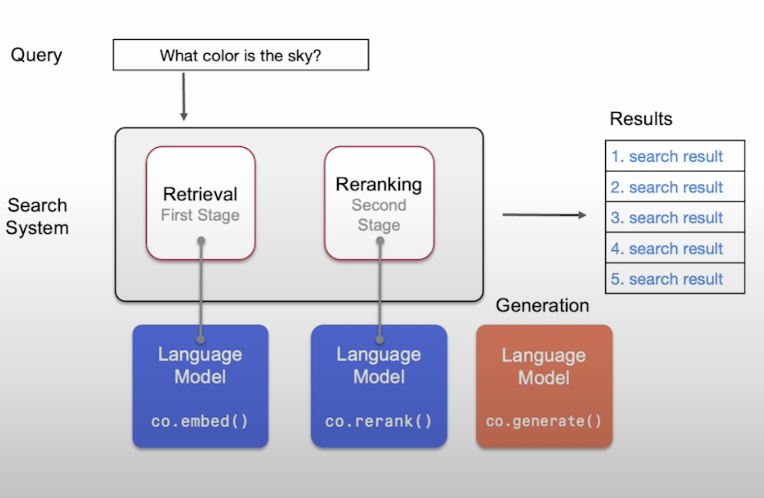
Language Models can Improve both Search Stages

Slide 20
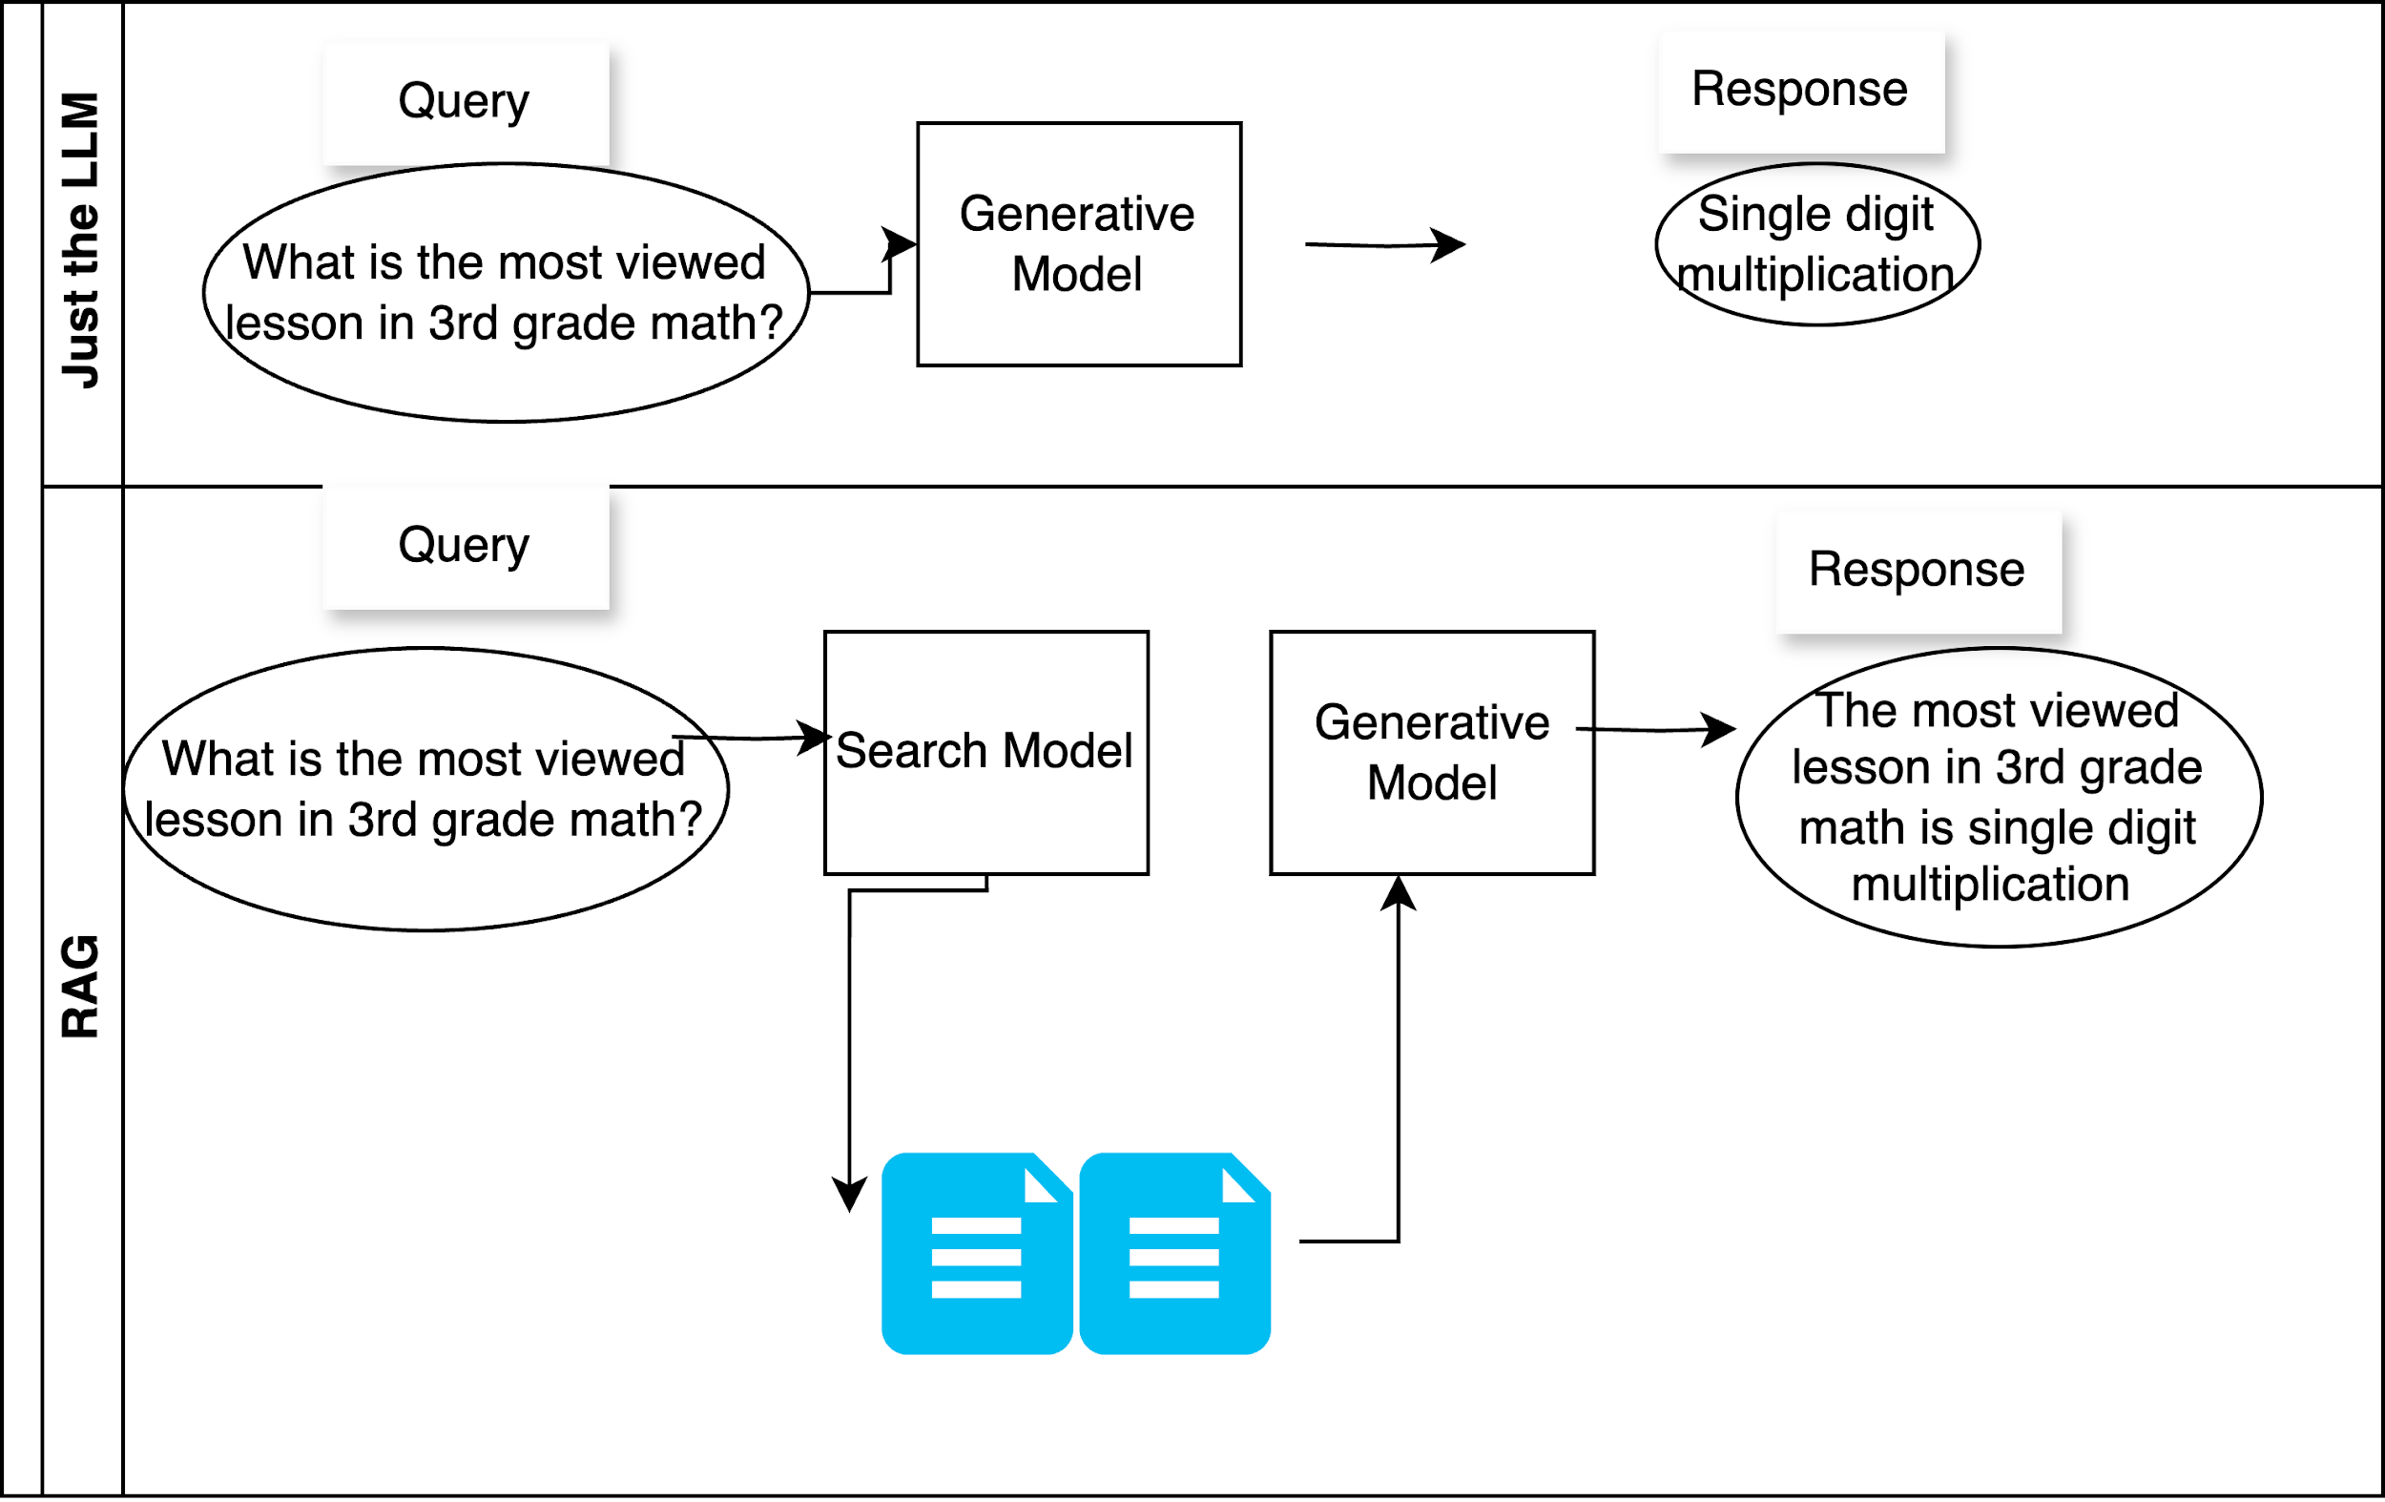
RAG with LLM

Slide 21
Modification with Prompt-tuning LLM
Choose a pre-trained LLM suitable for the task
Design prompt: Design and experiment with different prompts
Input to a generative model: A user query, a document template, a custom prompt and a similarity threshold
Similarity Calculation: If the document's similarity score meets or exceeds the similarity threshold, finalize and return the lesson plan
Continue Refinement: Refine the document by reiterating generation and assessment steps until it meets the threshold or the process is manually stopped
prompt = f"Refine the following document to improve its similarity with the query: \nDocument: {top_document}\nQuery: {user_query}\n”
refined_document = interact_with_gpt3.5(prompt, dataset, user_query, threshold_high)

Slide 22
Generation with Prompt-tuning LLM
Choose a pre-trained LLM suitable for the task
Design prompt: Design and experiment with different prompts
Input to a generative model: A user query, a document template, a custom prompt and a similarity threshold
Similarity Calculation: If the document's similarity score meets or exceeds the similarity threshold for query, finalize and return the document
Continue Refinement: Refine the document by reiterating generation and assessment steps until it meets the threshold or the process is manually stopped
prompt = "Create a new document based on the following information:\n"
template = "Title: [Title of the document]\nLearning Objectives: [Main learning objectives]\nSection1: [….]\nSection2: [….]”
new_document_info = generate_gpt3_response(prompt + template)

Slide 23
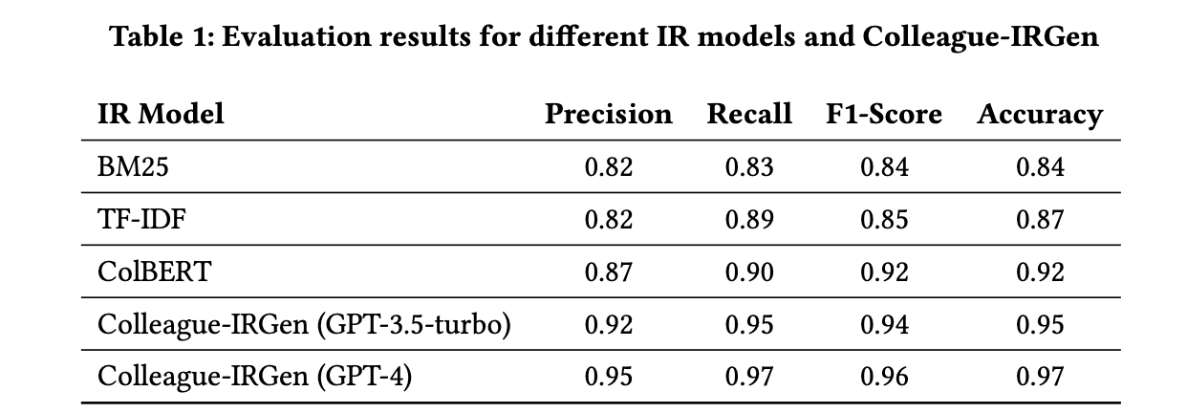
Evaluation – Performance Statistics
Notes:
2. Precision: Precision is the fraction of relevant instances among the retrieved instances. It is defined as: Precision=TP/TP+FP where: TP (True Positives) is the number of correct positive predictions; FP (False Positives) is the number of incorrect positive predictions. Precision thus measures the accuracy of positive predictions, indicating the percentage of your positive predictions that were correct.
3. Recall: Recall, also known as sensitivity or the true positive rate, is the fraction of relevant instances that have been retrieved over the total amount of relevant instances. It is defined as: Recall=TP/(TP+FN) where: TP (True Positives) is as defined above; FN (False Negatives) is the number of positive instances that were incorrectly predicted as negative.Recall measures the ability of a model to find all the relevant cases within a dataset. It is especially important in situations where the cost of missing a positive instance (such as in disease screening) is high.
4. F-Score (F1 Score); The F-Score, or F1 Score, is the harmonic mean of precision and recall, offering a balance between the two by taking both false positives and false negatives into account. It is defined as: F1=2×((Precision×Recall)/(Precision+Recall); The F1 Score reaches its best value at 1 (perfect precision and recall) and worst at 0. It is a useful measure when you need to balance precision and recall, often in situations where there is an uneven class distribution, or when the costs of false positives and false negatives are very different.
Accuracy = (Number of Correct Predictions) / (Total Number of Predictions)
For example, if a binary classification model predicts 80 instances correctly out of 100 total instances, its accuracy would be 0.8 or 80%.

Slide 24
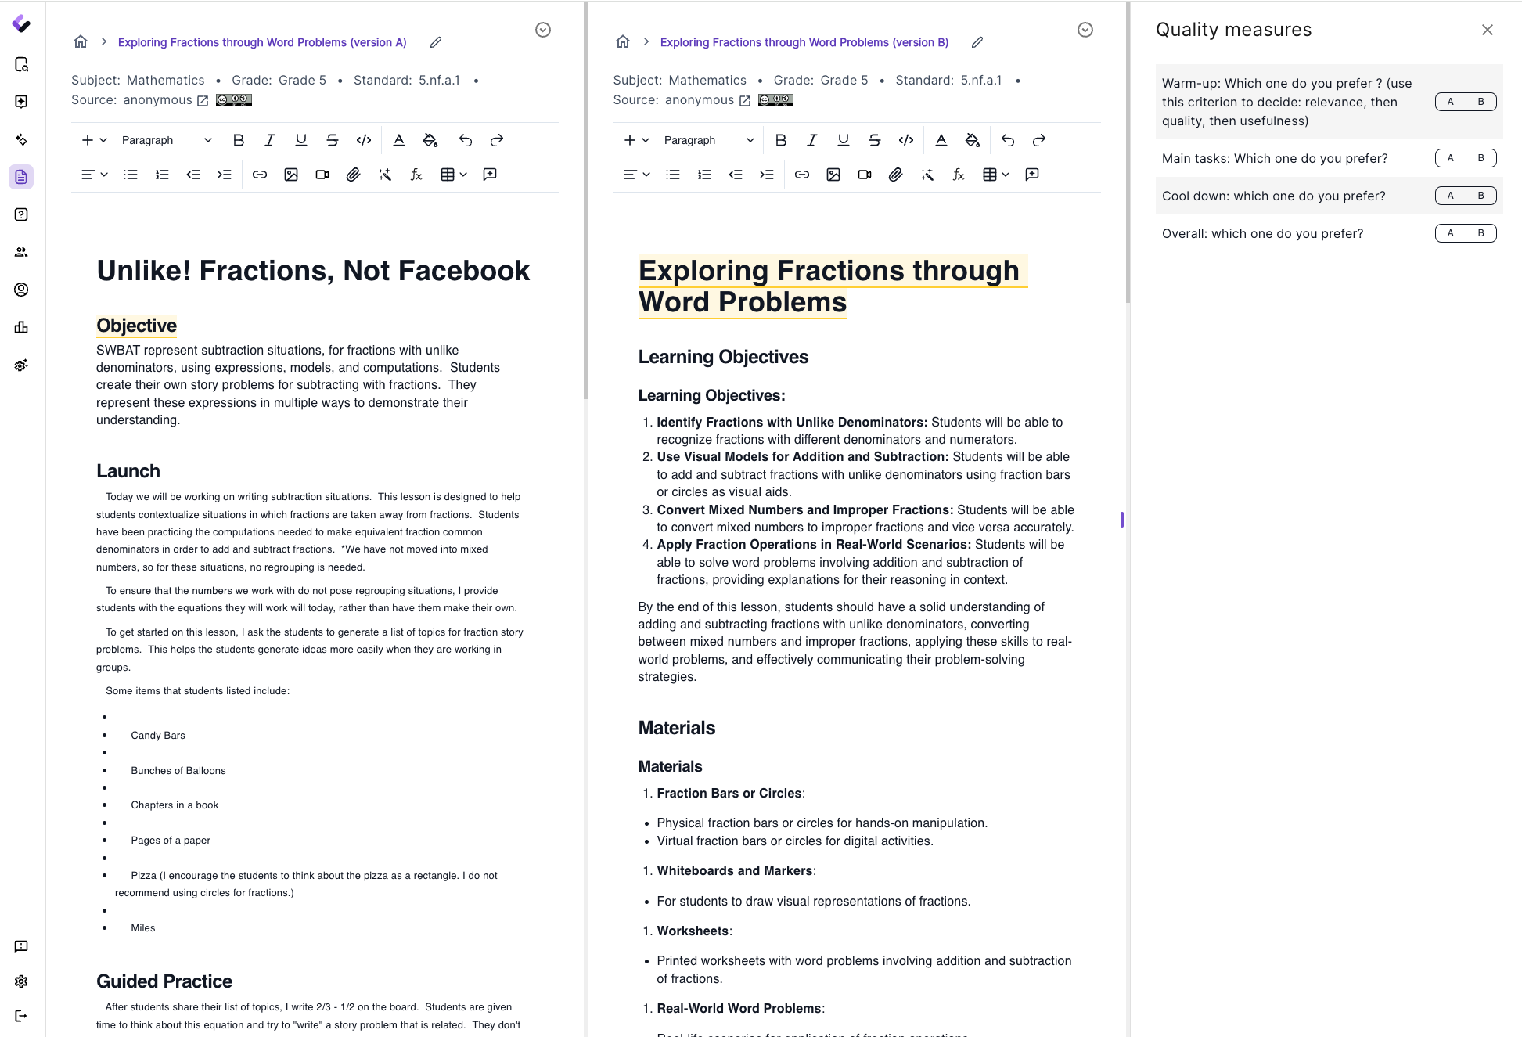
Evaluation -2: Human Judgement and Feedback

Slide 25
Code Demo
Github repo for some illustrative code, additional readings, and toy data.

Slide 26
Assignment
1. Review the first six weeks’ materials.
2. Particularly if you do not have time to try out the codes and programs, please use this time to do so.
3. Catch up on additional readings.
4. Prepare for the session after Spring Break

