Slide 1
ISEA Week 9 – Causal Inference, RCT, A/B Testing
Dr. Chris Candelaria, Vanderbilt University

Slide 2
Agenda
Logistics
A/B testing vs RCTs
RCTs in Education Policy

Slide 3
Logistics
Lodging and travel for Hackweek.
Mid-session fellows’ feedback and adjustment.
ISEA will offer Digital Badge
Requirements: fellows need to turn in homework, attend 90% of the web sessions, and use Tutoring and Study Hall sessions to practice coding, and complete Hackweek.
Hackweek recruitment is here. Distribute widely or submit your own project.
Video posting.
Please use all the resources available to you! Webinar is not the only thing!
Teams Channel for Peer Learning, messaging, and sharing resources.
Study Hall for Peer Learning.
Tutoring sessions for practicing and learning about coding.
Turn-in homeworks to receive feedback.
Extra study materials will be provided through Teams, Canvas, and Footnotes on session slidedeck.

Slide 4
A/B Testing
Study Design
Decide what features to test
Recruit participants
Determine the length of one round of A/B testing (e.g., 4 weeks using by Colleague.AI)
Design what data to collect and how: Google Analytics and surveys.
Analyze data in rapid cycle: t-test; regression
Decide how many rounds
Conduct power analysis to find the ideal sample size if possible.
In reality, get as many users as possible, because the sample size varies depending on how sensitive a tested feature is, the unit of the analysis (at individual user level or a given task level), and the duration of the testing session.
Minimizing contamination
Kohavi, R., & Longbotham, R. (2015). Online controlled experiments and A/B tests. Encyclopedia of machine learning and data mining, 1-11.
Larsen, N., Stallrich, J., Sengupta, S., Deng, A., Kohavi, R., & Stevens, N. T. (2023). Statistical challenges in online controlled experiments: A review of a/b testing methodology. The American Statistician, 1-15.

Slide 5
Outcome differences between A/B tests and RCTs: Let’s Brainstorm!
A/B Testing Outcomes
RCT Education Outcomes

Slide 6









Randomized Controlled Trials (RCT): The Problem of Selection Bias
T
Y
Potential Outcomes Framework: (Holland, 1986)
Use difference in averages to estimate the ATE?
If
:
:
Assuming constant treatment effect:
Average Treatment Effect (ATE):
ATE
Selection Bias!
RCTs remove selection bias. Why?

Slide 7


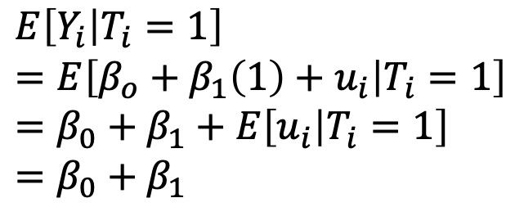
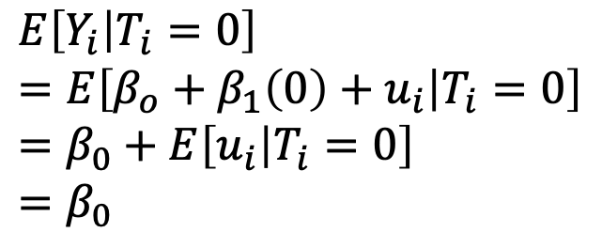

RCTs: A Population Regression Framework
If
Then:
and

Slide 8

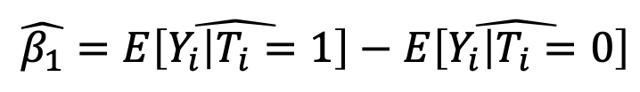


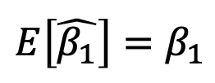
RCTs: OLS Estimator
If
Then:
and
OLS Estimation:
Unbiased Estimator:
We identify the Average Treatment Effect (ATE)

Slide 9
RCTs: Inference
Before implementing an RCT or A/B test, need to ensure you have sufficient power to conduct hypothesis tests:
Power: Probability of rejecting the null hypothesis, given that the null hypothesis is false
One way to increase power: increase the sample size
Typical power threshold: 80 percent
Resource: PowerUp!
https://www.causalevaluation.org/power-analysis.html

Slide 10
RCTs in Education Policy Settings
Before we think about methodology, let’s consider some potential blemishes of the so-called gold standard:
Ethical issues
Compliance/Fidelity to treatment
Attrition
Experiment bias
External validity
Mechanisms?

Slide 11
RCT Example: FAFSA Article (Bettinger et al., 2012)
In education policy, there has been a push to increase college going rates
Example: The Tennessee Higher Education Commission set goals to increase the college-going rate for the class of 2023 to at least 60 percent
However, there are substantive impediments that affect college access
Process of applying for both financial aid and college is difficult
Misinformation about the true cost of college
Education research: Could a simplified application process significantly improve college going rates?
Goal: Reduce asymmetric information to help students (and parents)

Slide 12
Bettinger et al. (2012): RCT Design
Authors examine whether an intervention of information or direct assistance in filling out financial aid could improve college going rates
H&R Block experiment
Approximately 17,000 individuals
Individuals came from households earning less than $45,000 a year with at least one household member between the ages of 15 and 30 without a bachelor’s degree
Participation Gift: $20
Randomization to treatment based on social security number
Three treatment arms/groups
(A) Personal assistance in filling out financial aid form and filing it; (B) Information
Information only: Potential financial aid amounts and tuition estimates for local colleges
Control group: Information on the importance of college and financial aid brochure

Slide 13
Bettinger et al. (2012): Results
Relative to the control group, 17-year-old high school seniors who received the FAFSA intervention more likely to:
Submit the FAFSA: 39% increase (56 vs. 40 percent)
Attend college: 7 percentage point increase (34 vs. 27 percent)
Enroll in college for two consecutive years: 8 percentage point increase (36 vs. 28 percent)
No significant differences between information-only and control group
Cost:

Slide 14
Setting Standards: What Works Clearinghouse (WWC)
To assess the strength of an RCT in education policy, WWC follows 5 steps
Review outcome measures and check for confounding factors
Assess the assignment to treatment conditions
Assess compositional change
Meet a baseline equivalence standard

Slide 15
Step 1: Review outcome measures and check for confounding factors
Outcome Measure Standards
Standard 1: Face Validity
Does the outcome measure what it claims to measure?
Standard 2: Reliability (Concept from classical test theory)
Does the measure yield similar results/scores across different administrations?
Standard 3: Not over-aligned
Does the outcome measure privilege one randomization group over the other?
Is the outcome tailored to the treatment condition?
Standard 4: Consistent data collection procedures

Slide 16
Step 1: Review outcome measures and check for confounding factors
Confounding factors
According to WWC, A confounding factor has the following characteristics:
It is observed
It aligns completely with only one study condition
It is not part of the intervention the study is testing
Source: WWC Manual, Version 5.0 (p. 29)
Examples?

Slide 17
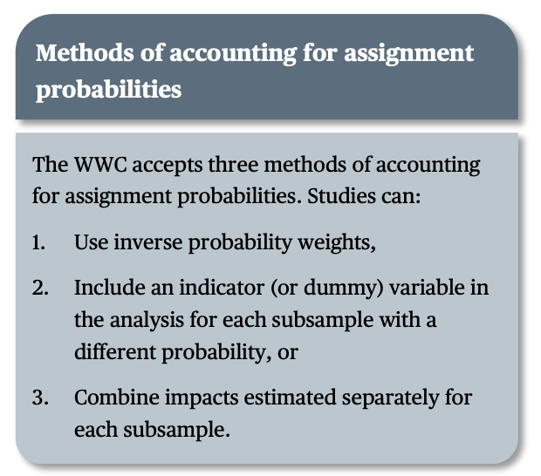
Step 2: Assess the assignment to treatment conditions
Random assignment is properly done if one of the following two conditions are met:
Unit assignment to treatment/control is entirely random (e.g., random number generator)
If unit assignment to treatment/control not entirely random, there must be a nonzero probability of being assigned to the conditions
Source: WWC Manual, Version 5.0 (p. 32)

Slide 18
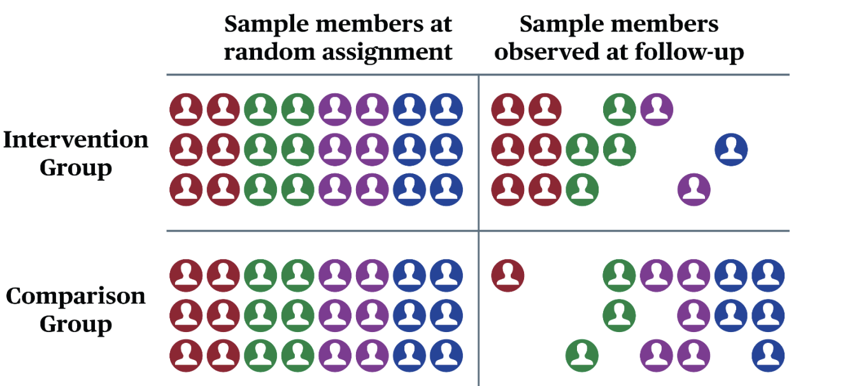
Step 3: Assess compositional change
Key idea: To what extent might sample attrition affect estimated results of the intervention or treatment?
Two types of attrition:
Overall attrition
Differential attrition
Source: Figure 6. WWC Procedures and Standards Handbook, Version 5.0

Slide 19
Step 4: Meet a baseline equivalence standard
Key idea:

Slide 20
Time to code!
Access the Google Colab site for examples

Slide 21
Assignment
Design an educational RCT:
Consider how you would design your study to satisfy the four requirements from the WWC
Use PowerUp! to determine the sample size needed for a given effect size
Work through the school district hypothetical exercise
Experiment with the Google Collab Code and change parameters to work with a unique data set

