Slide 1
LLM Specialization and Human-Feedback Evaluation
ISEA Session 12
Dr. Min Sun & Dr. Shawon Sarkar
University of Washington
04.18.2025

Slide 2
Learning Objectives
Embedding domain knowledge into foundational LLMs
Customized prompts
Instructional Fine-tuning
Evaluating your LLM models using human feedback

Slide 3
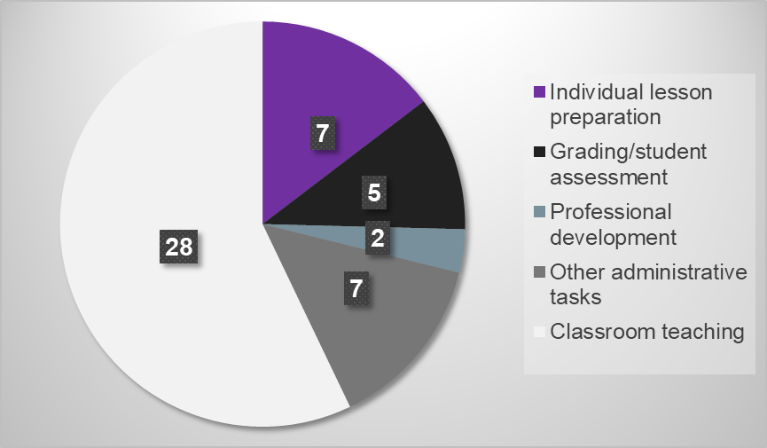
Problem 1: Technology can augment lesson planning to optimize teachers’ time allocations
Teachers spent 7 hours per week on individual lesson planning and additional 3 more hours per week if they serve students with diverse learning needs in terms of language, disability, and prior academic learning .
Although these tasks are essential, they take away teachers’ time from the most rewarding part of their profession—engaging students in the classroom.

Slide 4
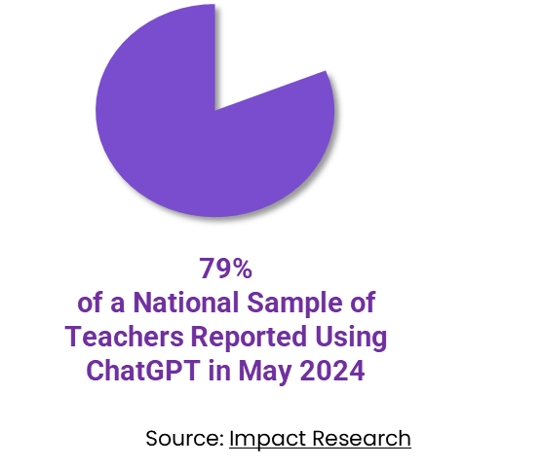
Problem 2: Foundational LLMs Have Not Solved the Problem, Particularly in Math Education
Schools are concerned about teachers’ overreliance, because ChatGPT:
Lacks specificity and depth of math tasks,
Contains mathematical errors,
Has inadequate understanding of pedagogy and student learning progression,
K-12 education rightfully deserves better technology!

Slide 5
Three Lesson Plan Sources
Customized GPT 4
Fine-tuned LLaMA 2-13b
Baseline: Human curriculum designer

Slide 6
Customized GPT 4
Prompt-engineered GPT-4 with structured, domain-aligned prompts
Same input template used across all lesson plans generation: subject, grade, title, learning objectives, and CCSSM
Optimized to generate plans in 4 structured sections: warm-up, main tasks (explain + reinforce), cool-down

Slide 7
Fine-tuned LLaMA 2 13b
Fine-tuned on open-source math lesson plans curated and revised by educators
Followed standard training process using supervised fine-tuning
(Model card) (Meta fine-tuning guide)
PEFT, or Parameter Efficient Fine Tuning
There are two important PEFT methods: LoRA (Low Rank Adaptation) and QLoRA (Quantized LoRA), where pre-trained models are loaded to GPU as quantized 8-bit and 4-bit weights, respectively.
Same input template used across all lesson plans generation: subject, grade, title, learning objectives, and CCSSM
Optimized to generate plans in 4 structured sections: warm-up, main tasks (explain + reinforce), cool-down

Slide 8
Human Curriculum Designer
Lesson plans sourced from repositories like Illustrative Mathematics
Reviewed and selected by researchers for pedagogical quality and grade appropriateness
Lesson plans filtered using semantic similarity search with text embeddings

Slide 9
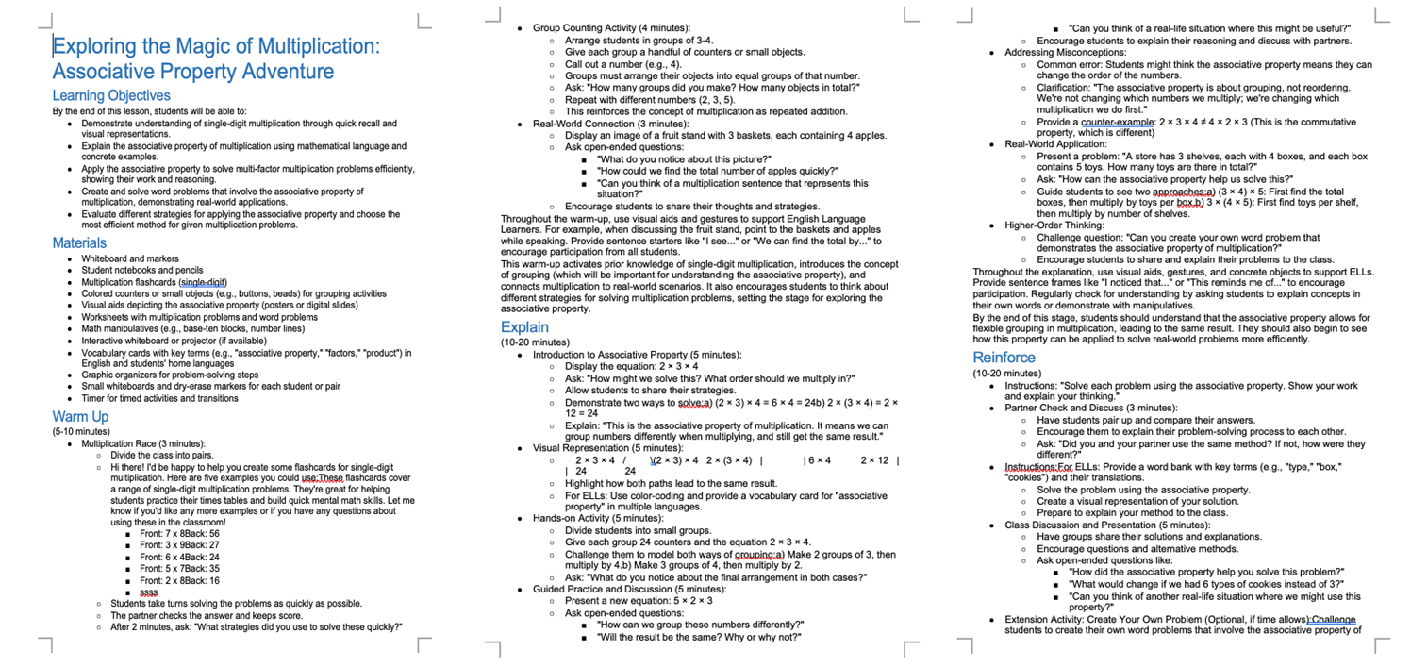
Lesson Plan

Slide 10
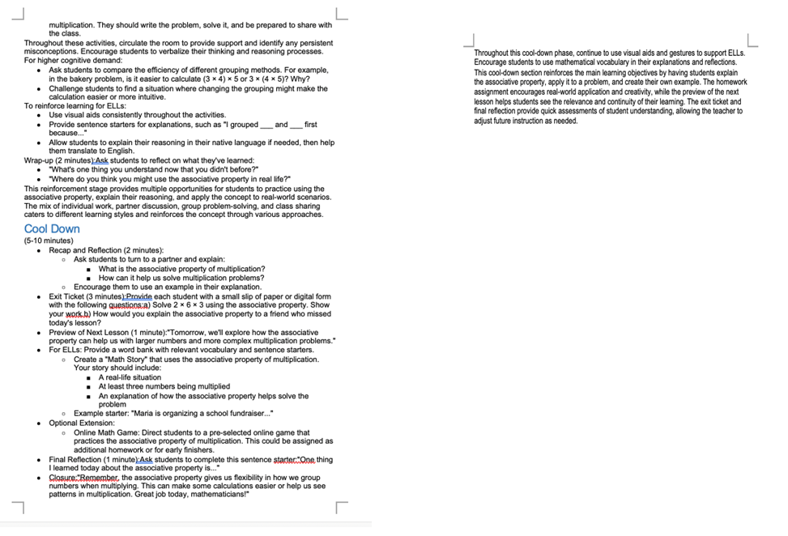
Lesson Plan (contd.)

Slide 11
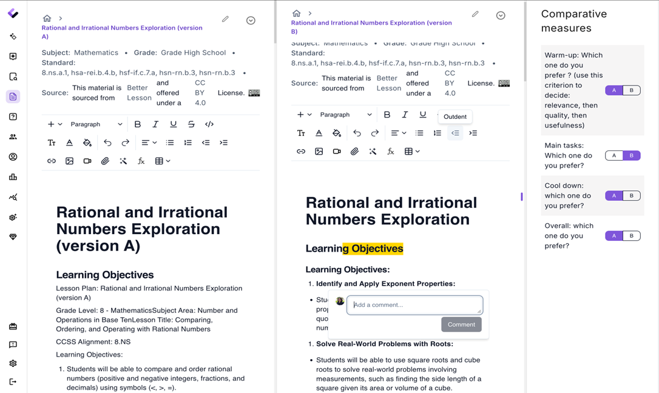
Study Design
20 experienced math teachers evaluated model performance and collect data for human feedback reinforcement learning to refine the model.
Binary preference rating

Slide 12
LLM Evaluation with Human Feedback
Human preference served as evaluation signal across structured lesson plan components
Educators assessed lesson quality: warm-up, main tasks, cool-down, and overall
Feedback collected via binary ratings and open-ended comments
Enabled evaluation of: Prompted vs. fine-tuned model performance
Grade-level and section-level alignment with educator expectations
Pedagogical coherence, rigor, and support for diverse learners

Slide 13
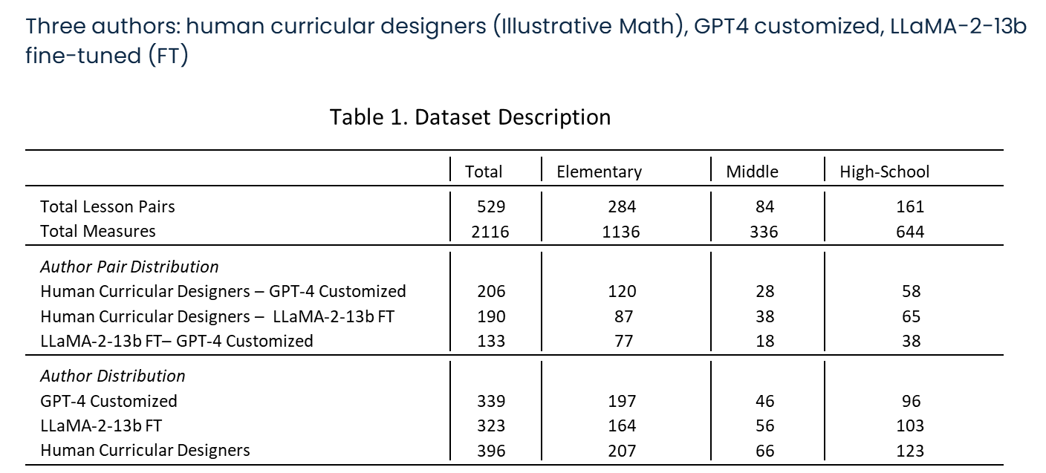
Data Collection

Slide 14
Activity: Breakout Room
In groups of 3-4, examine and evaluate AI-generated educational content through the lens of your professional expertise
Group Task: Analyze sample lesson plans linked
Lesson Plan 1, Lesson Plan 2
Critically reflect on either:
LLM specialization strategy
the design of this study

Slide 15
Activity: Breakout Room
Discussion Prompts:
LLM specialization
> Any questions about the basic logic of system prompt specialization
> Any questions about basic flow of fine-tuning
Human-feedback evaluation:
What kinds of educator feedback should future LLM evaluation pipelines capture?
In your role, what criteria do you currently use to evaluate the effectiveness of AI generated resources or tools?

Slide 16
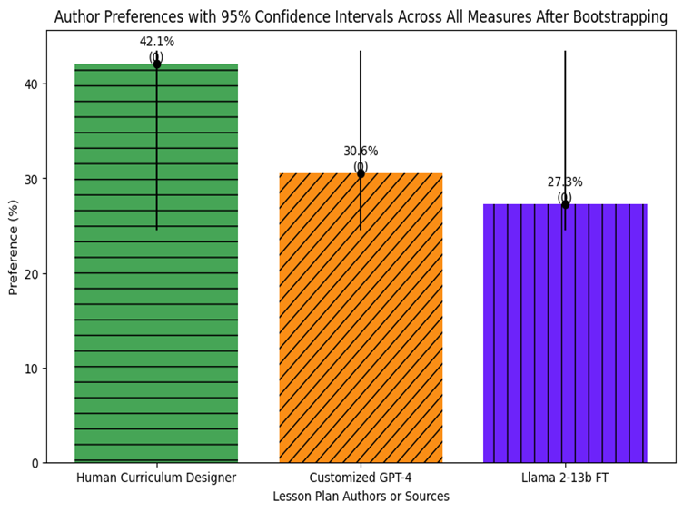
Result 1: Overall Model Performance by Authors
Human created content is overall preferred. Raw differences is about ~12% between human and customized GPT-4 and ~15% with LLaMA 2-13b fine-tuned model (FT).

Slide 17
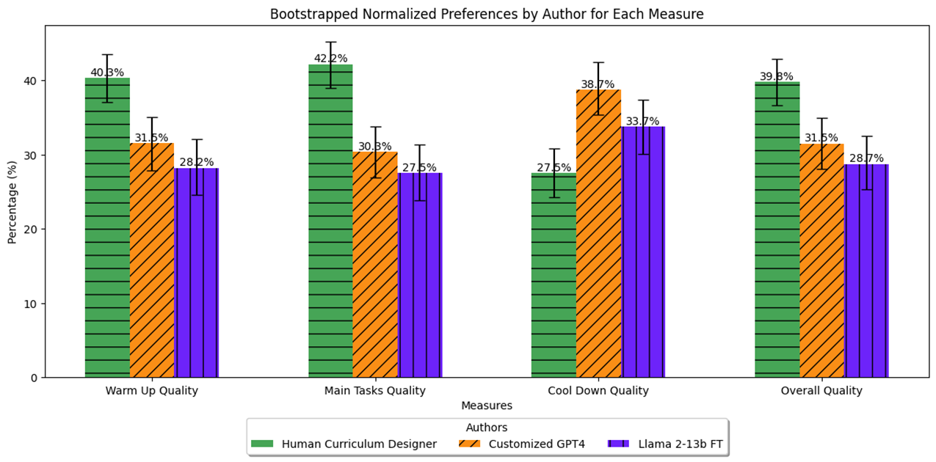
Result 2: Overall Performance by Authors and Measures
Although human-created content is preferred overall, AI generated cool-down section is preferred on average.

Slide 18
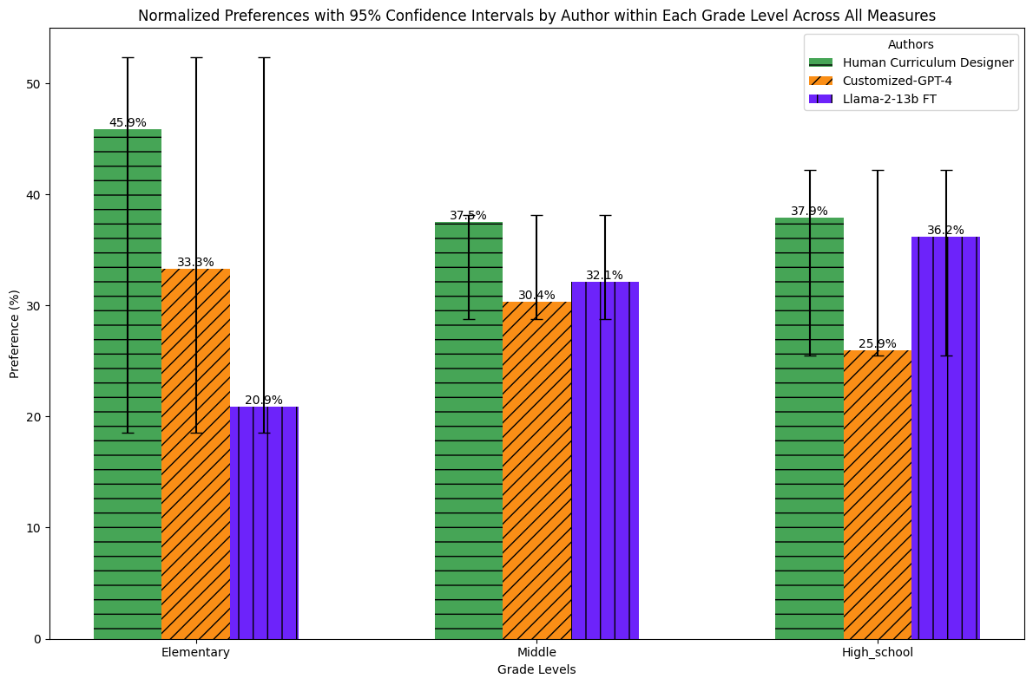
Result 3. Overall Performance By Educational Levels
The preference gap mainly exists in elementary (k-5) lesson plans, while the gaps in secondary levels (middle and high school) are significantly smaller.

Slide 19
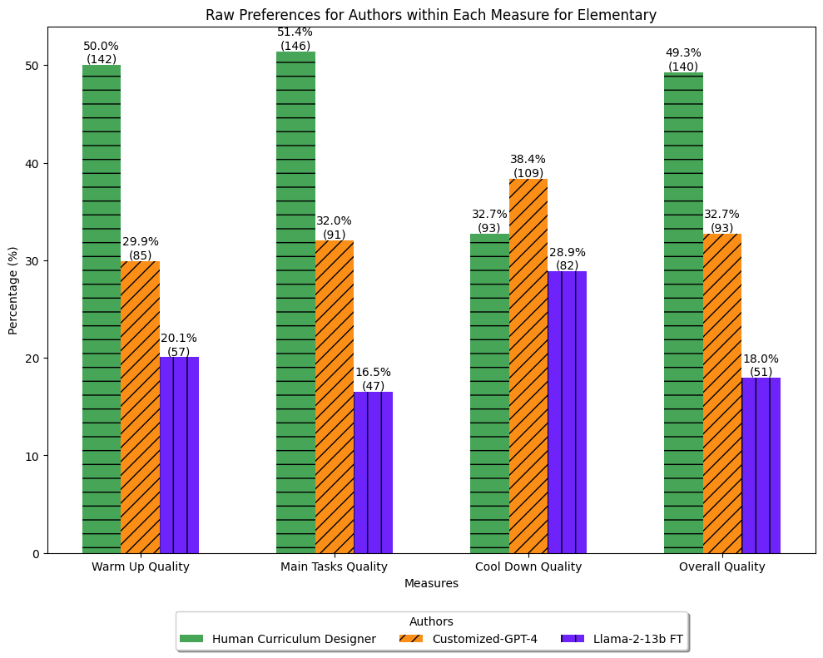
Result 4. Overall Performance at Elementary Level By Measures
At elementary level, human-created warm up, main tasks, and overall quality are preferred by experience teachers, while AI-generated cool down is preferred.

Slide 20
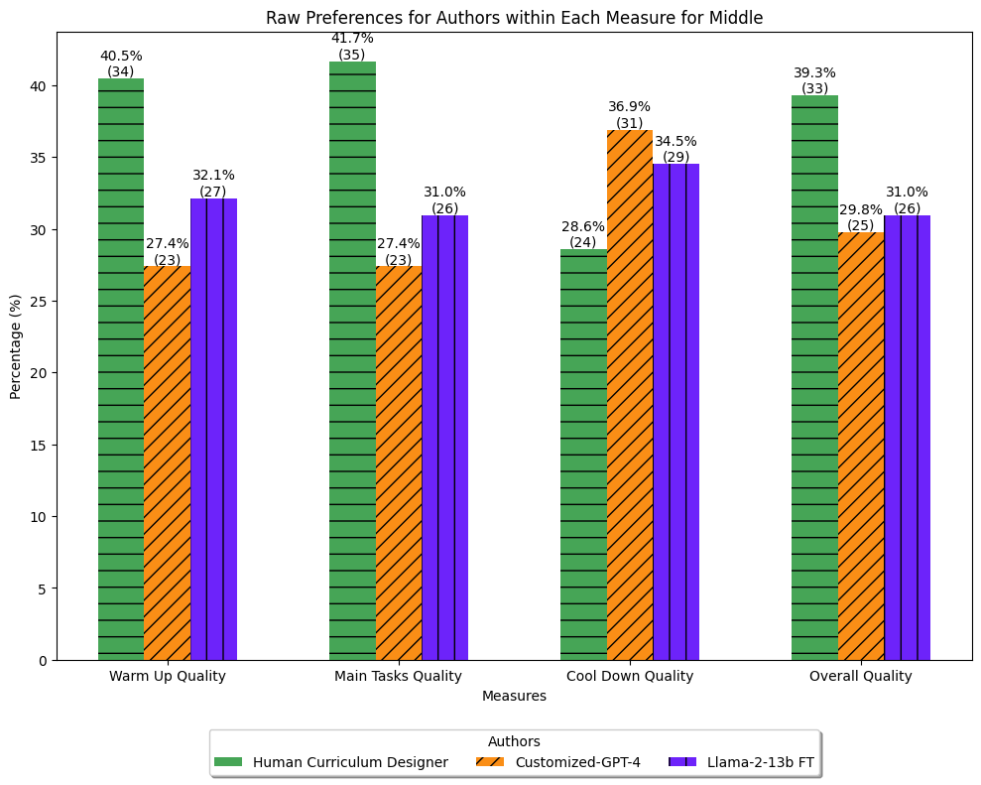
Result 5. Overall Performance at Middle Grade Level By Measures
At middle grade level, in addition to outperformed AI-generated cool down, there are smaller preference gaps between AI-generated and human created in other measures too, The two AI authors are largely at a similar level of performance.

Slide 21
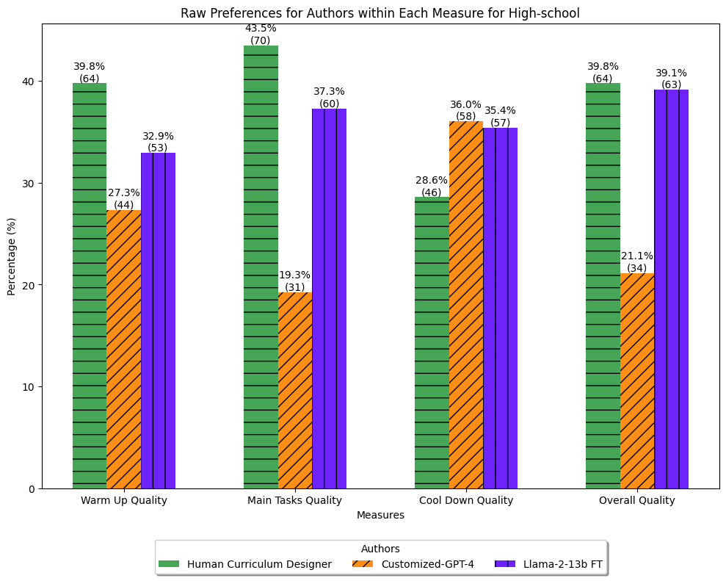
Result 5. Overall Performance at High School Level By Measures
At high school level, a noticeable pattern is that Llama FT outperformed GPT-4 on warm up and main task quality, on par on cool down, thus, significantly outperformed on overall quality than GPT-4 and on par with human-created lessons.

Slide 22
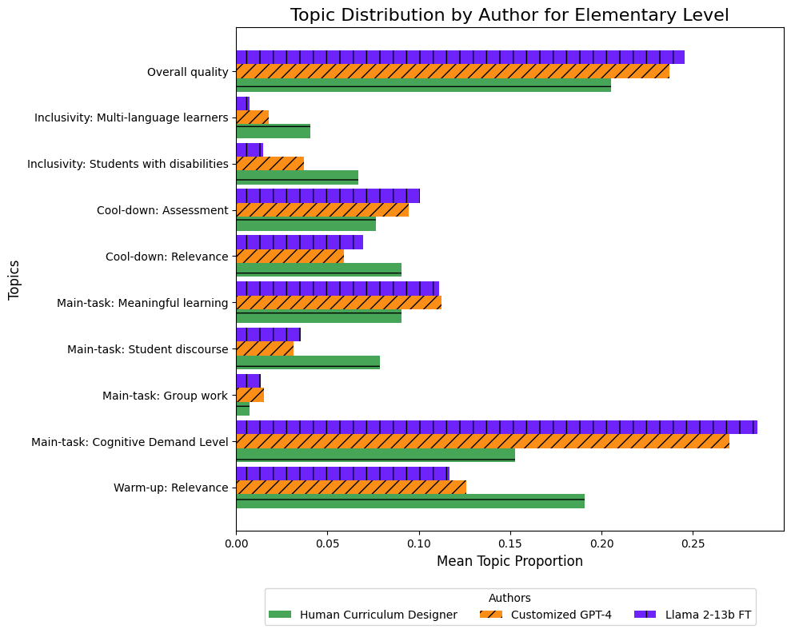
Teachers’ Comments and Justifications of Their Choice
Elementary teachers mainly commented on overall quality, main-task cognitive demand level, meaningful learning, warm-up relevance and cool-own assessment and relevance.
Notes:
2979 comments

Slide 23
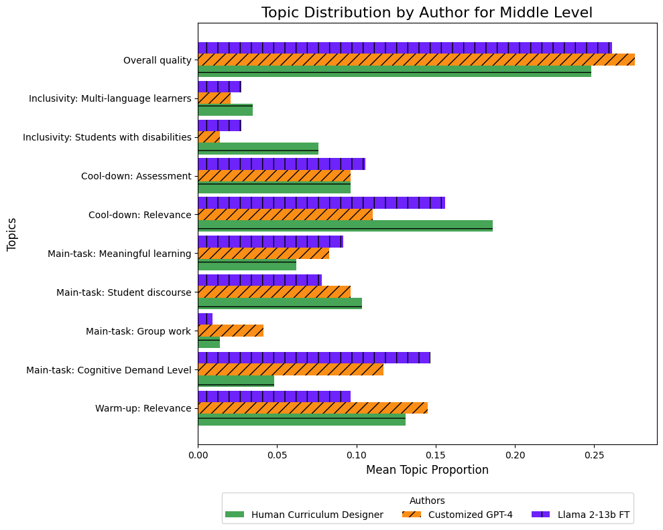
Teachers’ Comments and Justifications of Their Choice
Middle grade teachers mainly commented on overall quality, cool down, then cognitive demand level.

Slide 24
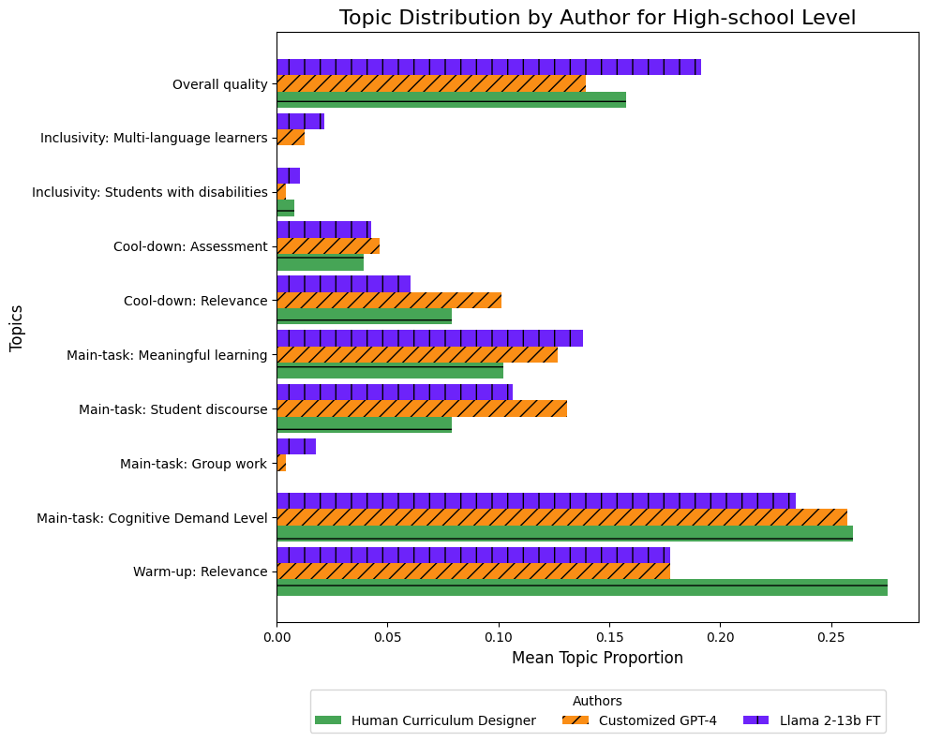
Teachers’ Comments and Justifications of Their Choice
High school teachers mainly commented on main-task cognitive demand level, warm-up relevance, overall quality main task: meaningful learning, and student discourse.
Topic Modeling (LDA)
Applied LDA on educator feedback comments
Extracted key themes: student discourse, scaffolded support, group work, etc.
Validated topics using manual thematic coding

Slide 25
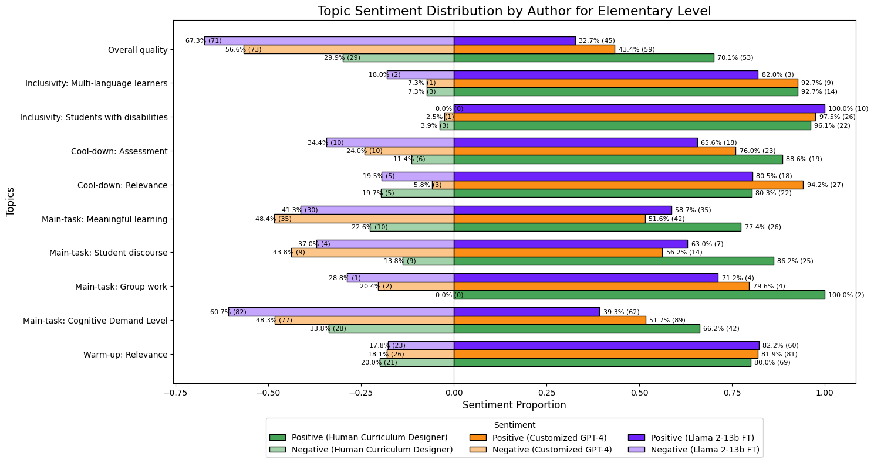
Teachers Justifications by Sentiment
At Elementary school level, teachers consistently praised human created lessons having higher quality of main task: cognitive demand level, meaningful learning activities, and effective group work, as well as cool down assessment

Slide 26
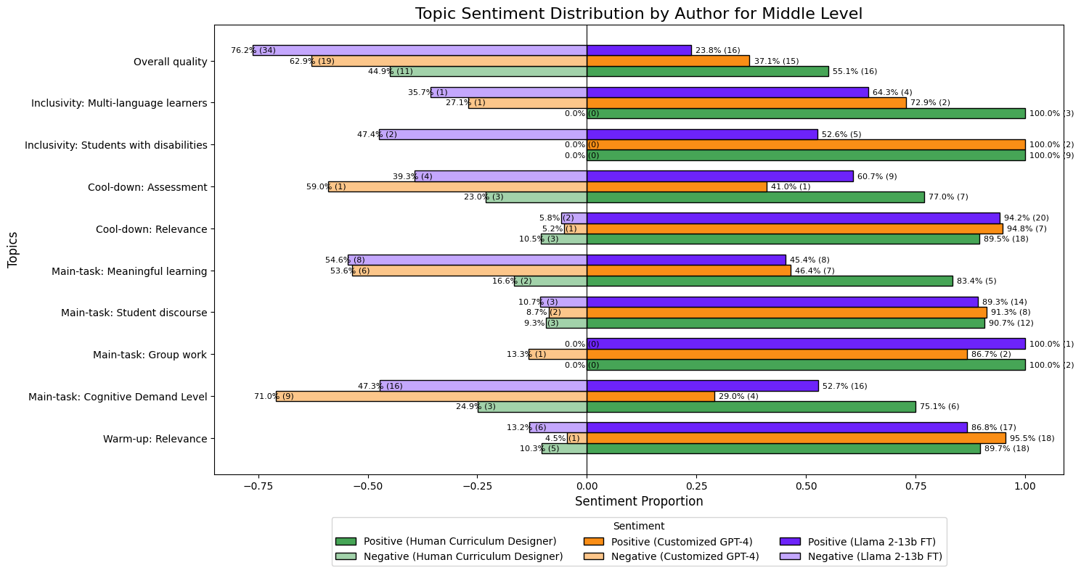
Teachers Justifications by Sentiment
At middle school level, teachers rated the main task- meaningful learning, group work at the similar level as human-created ones, although they still preferred human-created main task cognitive demand level.

Slide 27
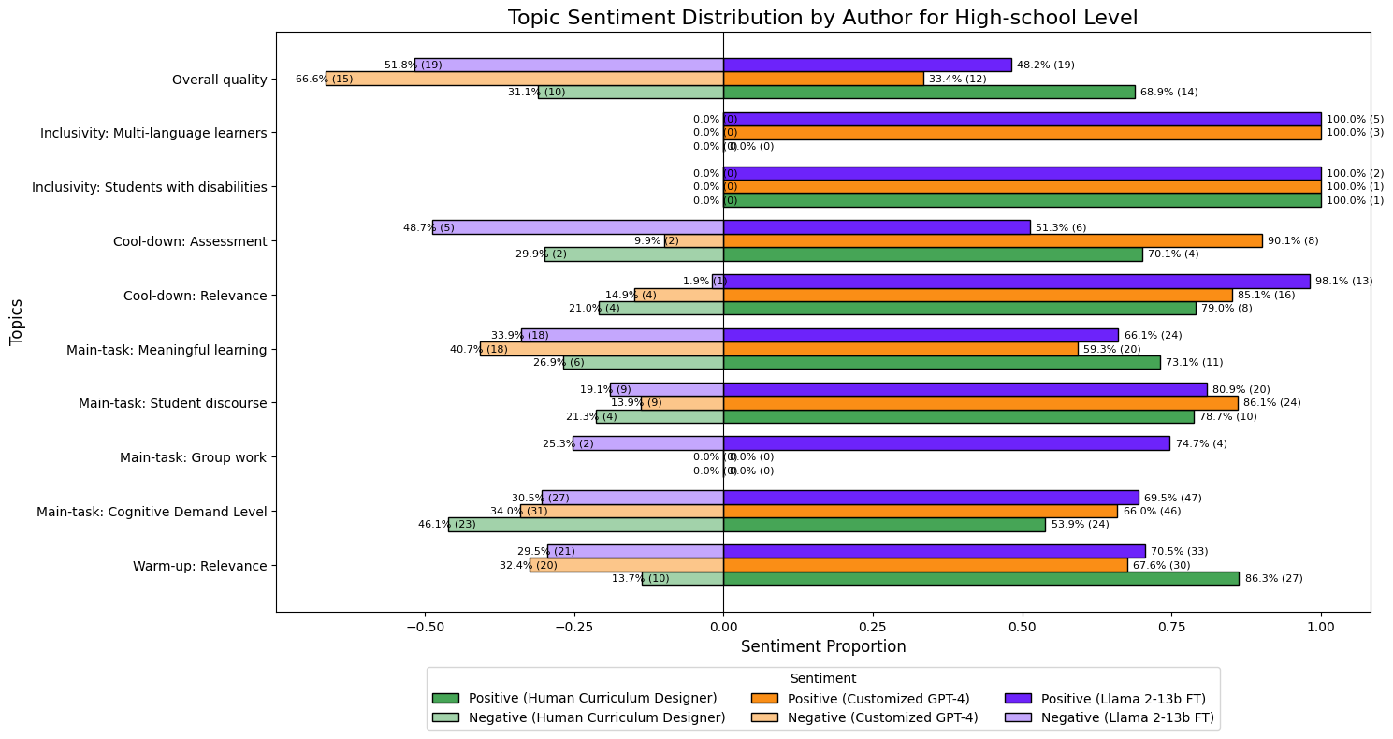
Teachers’ Justifications by Sentiment
At high school level, surprisingly, teachers commented more positively on the AI-generated main task cognitive demand level even than human created ones, on par with human-created main task student discourse and meaningful learning. Customized GPT-4 generated higher quality cool down assessment than the other two authors.

Slide 28
Summary of Key Takeaways
Overall, teachers preferred math lessons created by human curriculum designers.
However, even with a relatively low effort of specializing AI models using domain knowledge and labelled data, AI is able to generate lesson materials that are better or on par with human-created ones.
Cool down section
Secondary level, particularly high school
LlaMa FT’s higher performance for high school lessons suggests that for highly domain-specific tasks, instructional fine-tuning with high-quality data can be a cost-effective approach to improve model performance.

Slide 29
Hackweek Project Proposal
Propose your own Project for the Hackweek
Make the proposal meets the hackweek criteria: https://www.amplifylearn.ai/isea/isea-summer-hackweek/
Fill out the form: Application

Slide 30
No Assignment
Catch up with the past assignments
They will give you hands-on practice that will come useful during hackweek

