Slide 1
ISEA Logistics and Overview of AI/ML in Education ISEA Session 1
Dr Min Sun and Dr Lovenoor Aulck
University of Washington
1.26.2024

Slide 2
Learning Objectives/Agenda
Introduce the instructors and the students to each other
Introduce foundational concepts: data science, AI, ML and human-centered, domain specific data science, data science in education
Introduce the human-centered data science cycle and Emphasize the role of governance and responsible AI/ML
Provide an overview of the ISEA schedule and resources
Get organized: logistics, data collection efforts

Slide 3
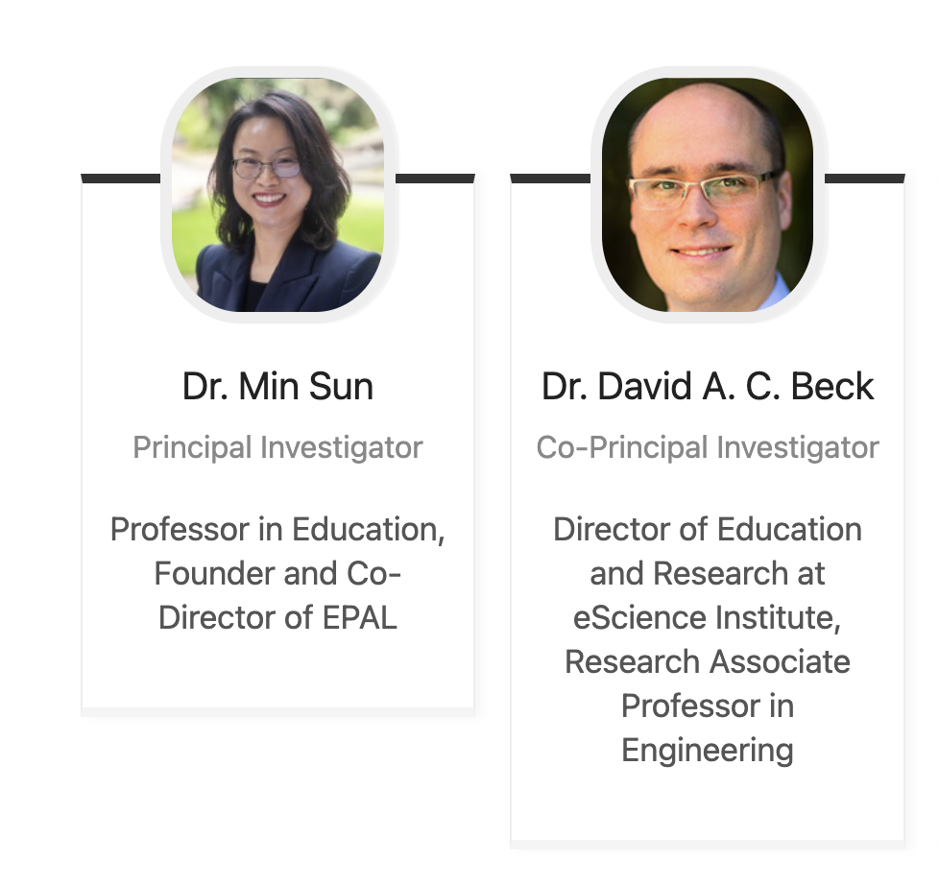
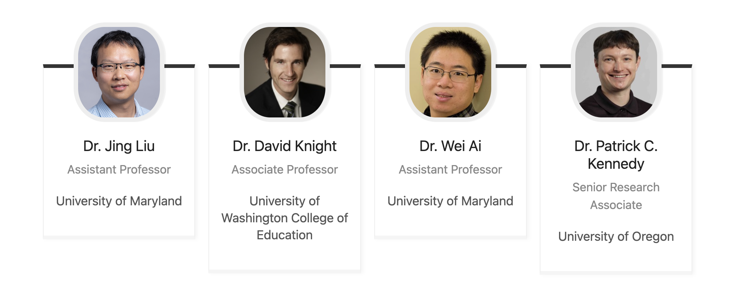
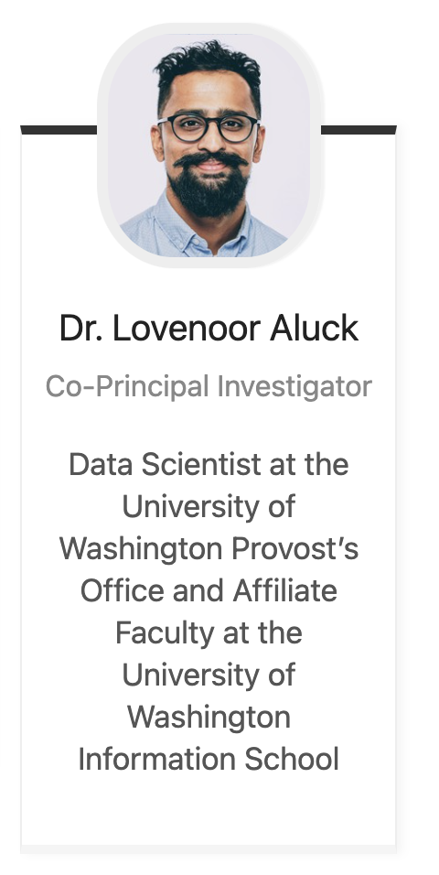
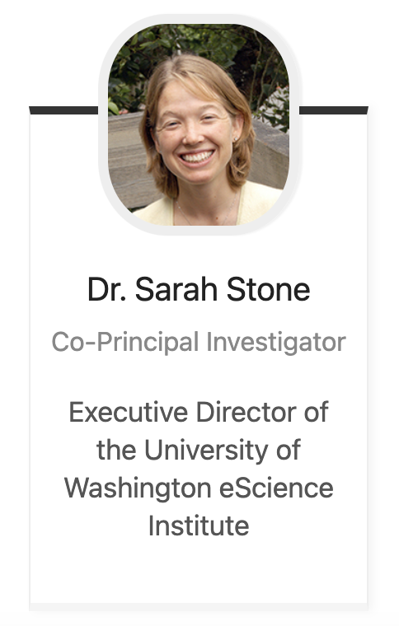
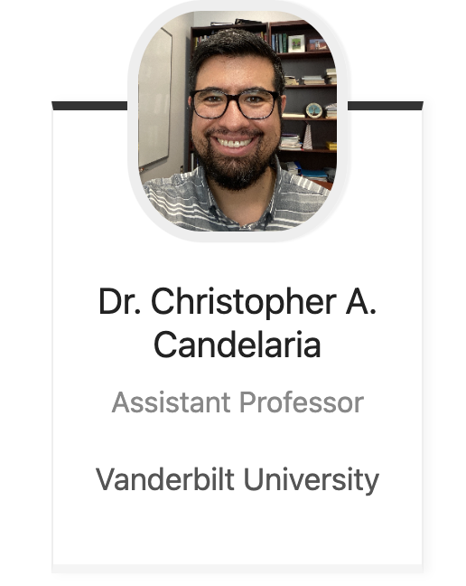
Instructors
Dr. Lovenoor Aulck

Slide 4
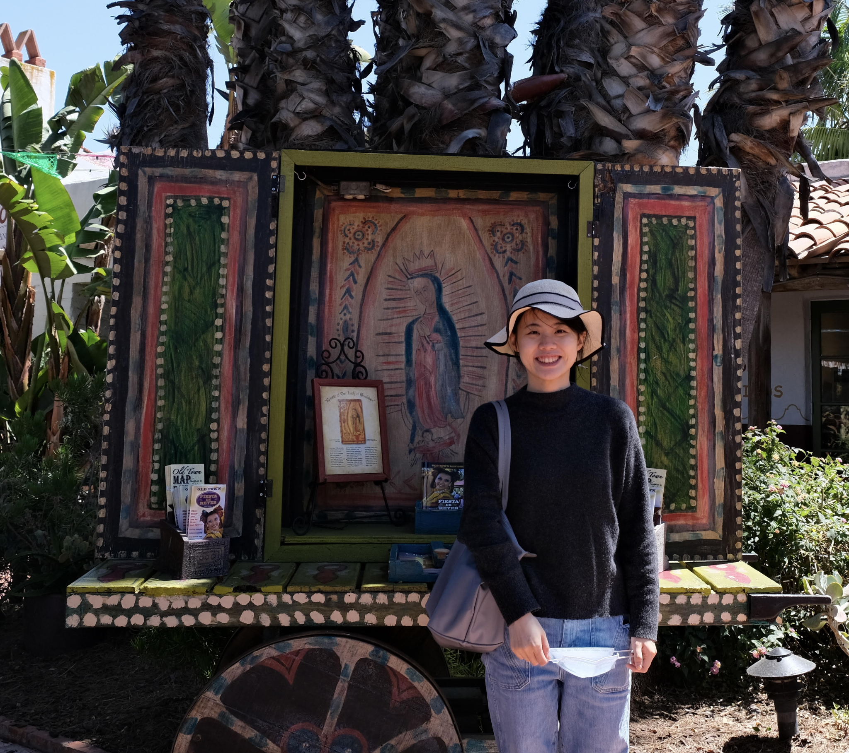
Tutors
Jiaying Xiao
jxiao6@uw.edu
PhD Candidate
College of Education
Edouard (Ed) Seryozhenko
edouas@uw.edu
MS Student
Data Science
Notes:
Will give tutors a few minutes to introduce themselves

Slide 5
What is ISEA?
A multidisciplinary, multisector intersection focus
Education and Learning Sciences
Artificial Intelligence (AI)
Data Science
Software Engineering
Machine Learning (ML)

Slide 6
My Feeling About This Field:
This field is moving so RAPIDLY!
The lines of different disciplines will blur even more.
A new generation of scholars and edtech workforce emerges.

Slide 7
AI and ML-Powered Data Science Methods Can Influence Many Aspects of Classroom Instruction
Teacher
- AI coaching and feedback (e.g., TeachFX and Edthena)
- Teachers’ engagement with the materials, adoption, and feedback/Iteration
(e.g., Colleague)
- Communication with parents
- Feedback to students
Content
- Curriculum and instructional material analysis and generation
Student
- Personalized and adaptive learning
(e.g., Dreambox)
- Multi-tiered supporting mechanisms (Panorama etc)
- Formative assessment,
- Auto-grading,
- Tutoring and feedback (e.g., Khanmigo)
Notes:
(1) Instructional core: teacher, content, student; their interactions among them. AI has transformed all of them.
(2) You cannot change one thing without changing others. For example, if we encourage adopting AI to personalized and adaptive learning and multi-tiered peer assistance without building educator and administrators’ capacity to appropriately and effectively use AI

Slide 8
AI and ML-Powered Data Science Methods Can Influence Administration/Policy
Human resources management
Student admission/placement
Financial resources allocations

Slide 9
AI in Education Policy and Guidelines
TeachAI Initiative
OSPI’s AI Guideline
Council of the Great City Schools
UNESCO’s AI Guideline

Slide 10
Goals Of ISEA Web Sessions
Stimulate your interests in the intersection of AI/ML, data science, software engineering, and education.
Introduce use cases and develop fellows’ ability to apply technical skills to solve educational problems.
Develop fellows’ critical thinking and creativity.
Co-construct knowledge and learning among ISEA fellows and instructors.

Slide 11
A Human-Centered Partnership Model of Education Data Science
The human-centered partnership model: people, computer, and domain knowledge interact at every stage of data pipeline to enhance learning opportunity, human decision-making efficiency, and organization performance, and system-level equity.

Slide 12
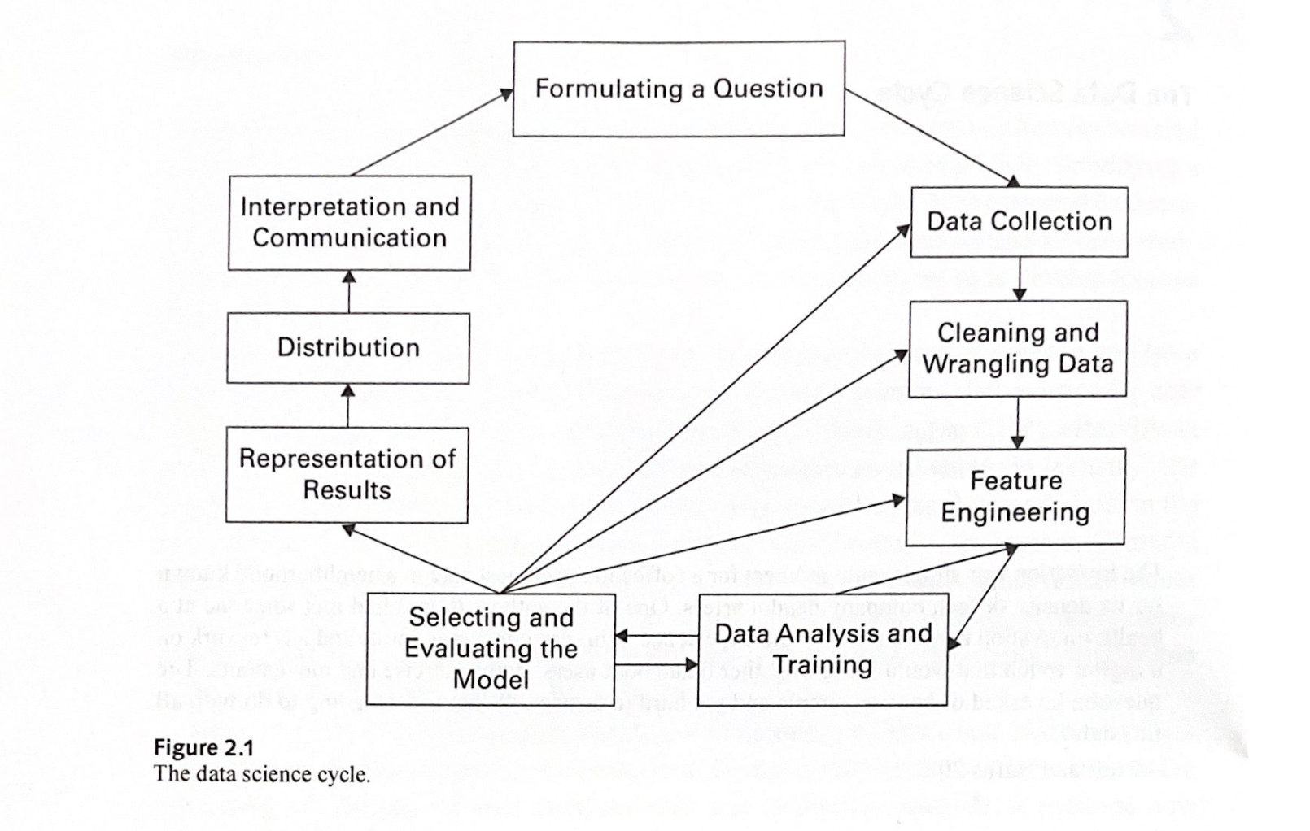
Human-Centered Data Science Cycle
Aragon, C., Guha, S., Kogan, M., Muller, M., & Neff, G. (2022). Human-centered data science: an introduction. MIT Press. p.14

Slide 13
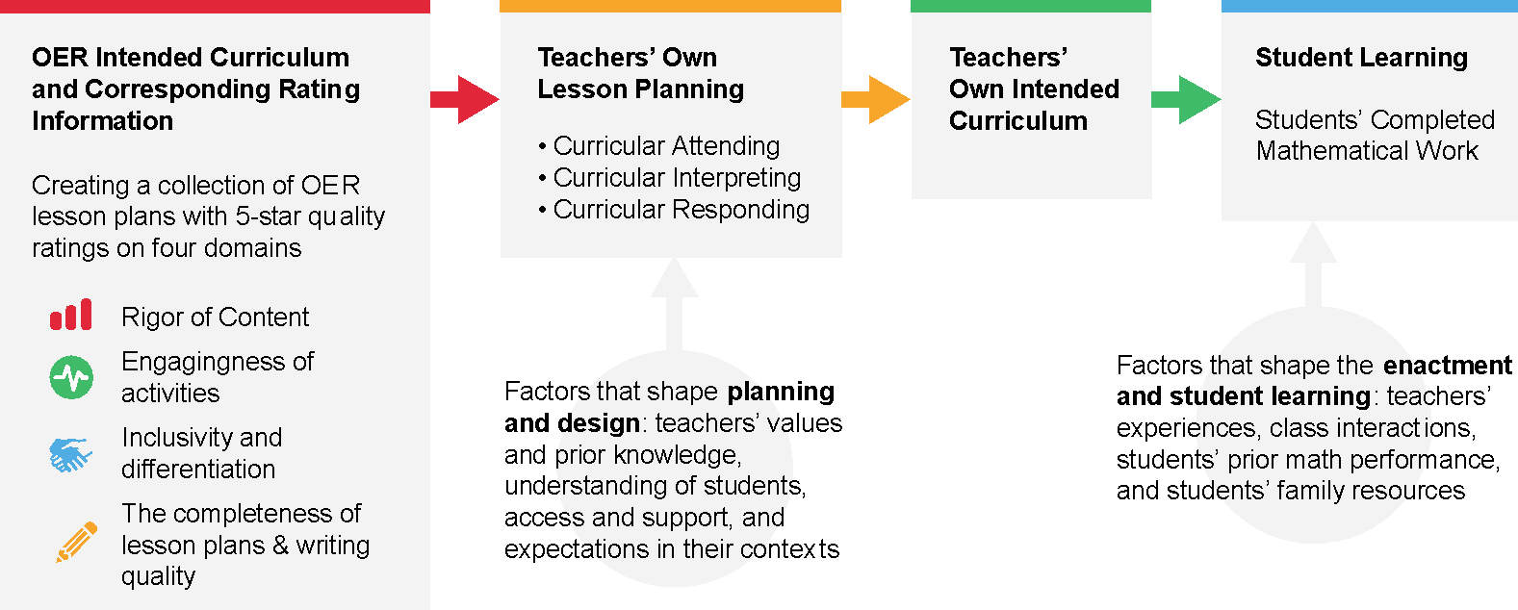
Example: Math Lesson Plan Quality Data Pipeline
Sun, M., Ai, W., Liu, J., Males, L., & Boston, M. (2022). Integration of computer-assisted methods and human interactions to understand lesson plan quality and teaching to advance middle-grade mathematics instruction. https://www.nsf.gov/awardsearch/showAward?AWD_ID=2300291

Slide 14
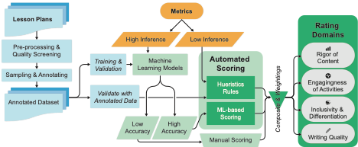
Example: Math Lesson Plan Quality Data Pipeline
Sun, M., Ai, W., Liu, J., Males, L., & Boston, M. (2022). Integration of computer-assisted methods and human interactions to understand lesson plan quality and teaching to advance middle-grade mathematics instruction. https://www.nsf.gov/awardsearch/showAward?AWD_ID=2300291

Slide 15
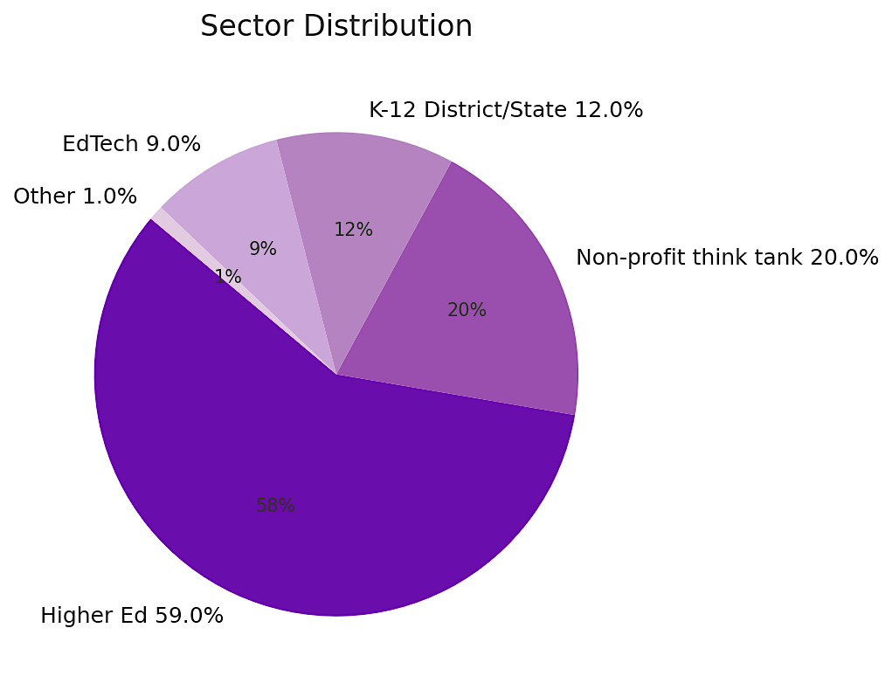
Educational Data Science and AI Training
For the inaugural cohort, ISEA attracted 186 well-qualified applicants across four sectors: Higher education, non-profit think tanks and research institutions, K-12 district and state agencies, and EdTech industries.
Notes:
Do we give each of the fellows a bit of time to introduce themselves?

Slide 16
Fellow Introduction and Break
If you haven’t done so already, please share your name, organization, role, and your learning interests in data science in education in the Teams space
A small group activity (5 mins)
Introduce yourself
What drove you to ISEA?
How do you think about the human-centered data science cycle, and how might you use some of the concepts to inform your work?
Notes:
Do we give each of the fellows a bit of time to introduce themselves?

Slide 17
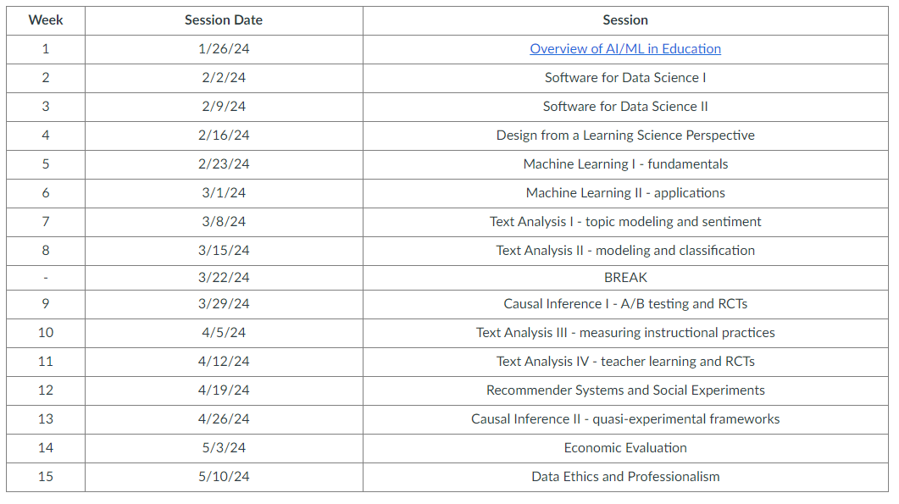
Session Overview
Notes:
Will walk through overall schedule of the program and topics

Slide 18
Individual Think and Share
Use this link:
Which are the three topics you are most excited about?
Which are the three topics that are most relevant to your work?
Any other topics of interests you wish to discuss?
Any recommendations /expectations on teaching styles and methods?

Slide 19
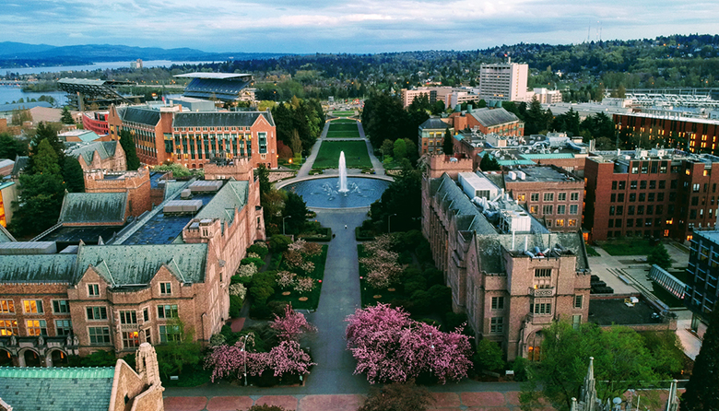
Hackweek
Week of July 8th-12th on the University of Washington campus in Seattle
We will share additional details as they’re finalized

Slide 20
Resources
Teams: Your primary means of communication with those in the program. Feel free to send Lavi a direct message about any program-related issue or question. Feel free to also reach out to your tutors using Teams
Canvas: Your primary means of managing all the content from the program. Slides and videos will be shared here. Schedules will be updated here (if/when needed)
Computational resources: more on this soon!

Slide 21
Program Data Collection
Emily
Data Collection for IES

Slide 22
Homework
Preview next week’s materials (will be posted soon)
Learning about the basics of python programming and Colab environments:
https://pandas.pydata.org/Pandas_Cheat_Sheet.pdf
https://jakevdp.github.io/PythonDataScienceHandbook/
https://colab.research.google.com/
https://www.statlearning.com/
Complete the surveys
Survey about your interests
Pre-test of data science knowledge and skills

