Slide 1
Learning Theories and Learning Engineering ISEA Session 4 Min Sun and Katie Hendrick Taylor University of Washington 2.16.2024

Slide 2
Overview of today
What are popular learning theories informing ed tech development, implementation, and evaluation?
Nudging theory to illustrate
Notes:
Question: From the perspective of evolutionary biology, are organisms designed? Why or why not?

Slide 3
Dr. Taylor’s Work
Associate Professor of Learning Sciences and Human Development at UW, focuses on digitally mediated, intergenerational learning, and learning with technology that foreground race, gender, class, culture, and place.

Slide 4
Educational Software Development Cycle
Planning
(Market Research)
Learning science concepts can inform each step of this process
Implementation, Evaluation, and Updating
Analysis
(use cases, persona)
Testing and integration
Design, Prototyping
Engineering and Development

Slide 5
Apps/Tech Solution Built on Learning Science Theories
Nudge⁴
READY4K!
Colleague
Elinor’s Talking to me! Conversational AI into Children’s Narrative Science Programming
Ask questions stimulates thoughtful responses
Feedback continues the conversation around the particular topic
Scaffolding helps children better participate

Slide 6
Nudging Theory Key Components
Insufficient information
The limited information processing capabilities of the human mind. In the face of cognitively demanding tasks—such as tasks requiring a substantial amount of choice and continuous, ongoing tasks—individuals tend to make choices based on faulty heuristics, or they avoid making decisions altogether (Mullainathan and Thaler 2000).
Limited time, limited attention
Self-control and inconsistency
Hard to see the benefit in the near term

Slide 7
READY4K!
2013-14 and 2015-16 school years, Randomized Controlled Trials (RCTs) of the program in SFUSD
Between the two years, 1,031 parents and guardians agreed to participate in the study, and a randomly select half to receive the program
Each week, parents received three texts about an academic skill or set of skills:
Control group: The “placebo” text to parents in every two weeks, often pertaining to the district’s kindergarten enrollment process or required vaccinations

Slide 8
Examples of the texts
A “Fact” text designed to inform and motivate parents.
FACT: Letters are the building blocks of written language. Children need to know the letters to learn how to read & write.
A “TIP” text that aimed to minimize the cognitive, emotional, and tie burdens of engaged parenting by providing parents with highly specific activities that build on existing family routines;
TIP: Point out the first letter in your child’s name in magazines, at the store & on signs. Have your child try. Make it a game. Who can find the most?
“GROWTH” text, which provides parents with encouragement and reinforcement as well as a follow-up tip
GROWTH: Keep pointing out letters. You’re preparing your child 4K! Now when you point out a letter, ask: What sound does it make?

Slide 9
Colleague’s Persona

Slide 10
Colleague’s Nudging Design
Users’ Problem Space
Teachers’ lack of time or capacity to vet online materials
Teachers’ overreliance on AI-generated content
Technology solution to:
Motivate teachers to critically examine the quality of lesson materials and iteratively refine them, YET with small amount of time needed from teachers

Slide 11
Idealization, Prototyping design
03
User Study
Close study with diverse, representative users
Idealization
Translate User Needs into Functions/Components
01
Prototyping them
Figma.
02
Low Fidelity Prototype
Mid Fidelity Prototype
High Fidelity Prototype

Slide 12
Colleague’s Nudging Design
Transitioning to thecolleague.ai

Slide 13
Analysing this design using nudging theory
What can make this design effective?
What would still make this design ineffective?

Slide 14
Analysing the Design using nudging theory
What can make this design effective?
Offer information: Quality measures
AI prompt to suggestion possible actions and solutions to address the weakness of the lesson
What would still make this design ineffective?
The errors in the quality measures may deter information take-ups
Uncertainty to transfer into real actions
Doesn’t have reinforcement mechanisms

Slide 15
Gen-AI Prompt Design
The AI’s role: math teachers
Context: 4th grade math; 60% of students who are multi-language learners; the entire lesson itself as the context
Information: The quality measure that is lacking/insufficient
Action: generate content that addresses the insufficient quality measure and entails high-quality instruction
Resources to learn more about prompt engineering:
https://www.deeplearning.ai/short-courses/chatgpt-prompt-engineering-for-developers/
https://www.youtube.com/watch?v=dOxUroR57xs&ab_channel=ElvisSaravia

Slide 16
Prompt Design (2 minutes)
Write your own prompt, building on this:
The AI’s role: math teachers
Context: 4th grade math; 60% of students who are multi-language learners; the entire lesson itself as the context
Information: The quality measure that is lacking/insufficient
Action: generate content that addresses the insufficient quality measure and entails high-quality instruction

Slide 17
User Testing
Qualitative+Quantitative methods
Cognitive Interviews
Surveys
App tracking user behaviors
Ranking and preferences
A/B testing: on the App or in the software settings
RCTs: in authentic school settings

Slide 18
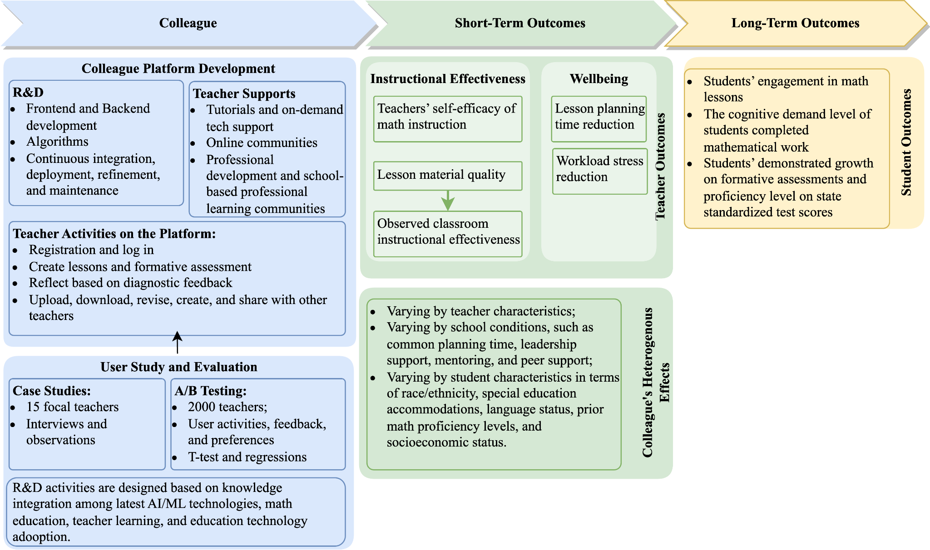
Theory of Change for Testing and Evaluation
Add:
Economic values;
Sociential values
Citation: Sun, Min, et al. (2024). Colleague.AI’s theory of action. Seattle, WA: AmplifyLearn.AI

Slide 19
Assignment
Based on your Week 2&3’s use case and component design, you can choose to:
Apply learning science theories (either we introduced today or other ones relevant to your work) to further your user study
Or
Apply learning science theories to product/algorithm design

Slide 20
Prepare for Next Week’s Session
Beef up with your coding skills
Set up Colab or python or jupyter notebook

