Slide 1
ISEA Week 5 – Machine Learning Fundamentals
Lovenoor (Lavi) Aulck

Slide 2
Outline
Level-setting
Model Selection
Warm Up Exercise
Machine Learning Overview
Basics
Programming Exercise

Slide 3
Who Am I?
BS in BioE
BA in Comp. Religion
MS in BioE from UW
Whitaker International Research Fellowship in Amsterdam, NL
Research Engineer at UW Medical Center
PhD Student at UW
Focus on how higher ed institutions can better use their data
Data Scientist in UW Provost’s Office
2011
2012
2013
2014
2014 - 19
2019 - Now

Slide 4
You Will Need…
You will need to have the following python packages installed and working for the demos:
pandas
numpy
seaborn (and/or matplotlib)
sklearn
statsmodels
random

Slide 5
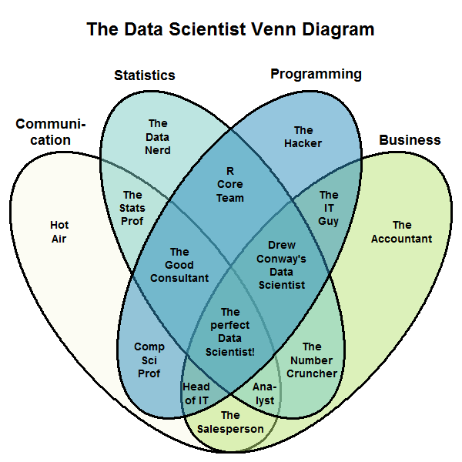
A Data Scientist
Stephan Kolassa

Slide 6
A Data Scientist
Domain expertise
Stephan Kolassa

Slide 7
A Data Scientist
Domain expertise
Critical thinking, creativity, and experimental design?
Stephan Kolassa

Slide 8
A Data Scientist
Domain expertise
Critical thinking, creativity, and experimental design?
Stephan Kolassa

Slide 9
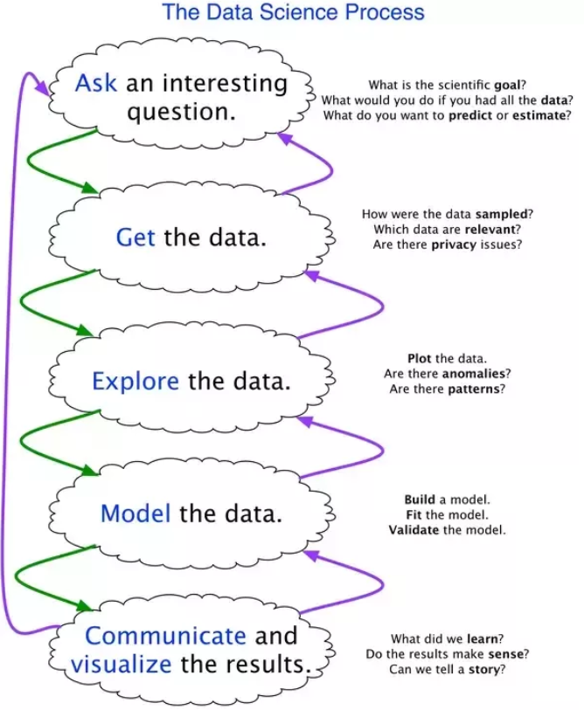
A Data Scientist
Joe Blitzstein

Slide 10
A Data Scientist
Ask an interesting question
Get the data
Explore the data
Model the data
Communicate and visualize

Slide 11
A Data Scientist
Ask an interesting question
Get the data
Clean/Curate the data
Explore the data
Model the data
Communicate and visualize

Slide 12
A Data Scientist
Data ethics
Ask an interesting question
Get the data
Clean/Curate the data
Explore the data
Model the data
Communicate and visualize

Slide 13
A Data Scientist
Data ethics
Ask an interesting question
Get the data
Clean/Curate the data
Explore the data
Model the data
Communicate and visualize

Slide 14
How To Build A Model (A Game)
Examine outputs from regression model
Build a regression model using explanatory variables of interest
Expand and iterate on model
Clean/curate the data
Explore the data and calculate descriptive statistics of the variables in the dataset
Examine outputs from expanded regression model
We specify a question and ensure we have the data to answer the question

Slide 15
How To Build A Model (A Game)
We specify a question and ensure we have the data to answer the question
Clean/curate the data
Explore the data and calculate descriptive statistics of the variables in the dataset
Build a regression model using explanatory variables of interest
Examine outputs from regression model
Expand and iterate on model
Examine outputs from expanded regression model

Slide 16
Multiple Paradigms of Regression
Statistics/economics: explain a relationship
Ties in with the idea of inference

Slide 17
Multiple Paradigms of Regression
Statistics/economics: explain a relationship
Ties in with the idea of inference
Machine learning: predict the future
Ties in with the idea of prediction

Slide 18
Example: Earnings
Inference
What are the determinants of income?
Do people with children earn more?
On average, how much more will a person earn for each additional year of schooling?

Slide 19
Example: Earnings
Inference
What are the determinants of income?
Do people with children earn more?
On average, how much more will a person earn for each additional year of schooling?
Prediction
What is the predicted income for person X?
What are the descriptors of a person with income Y?

Slide 20
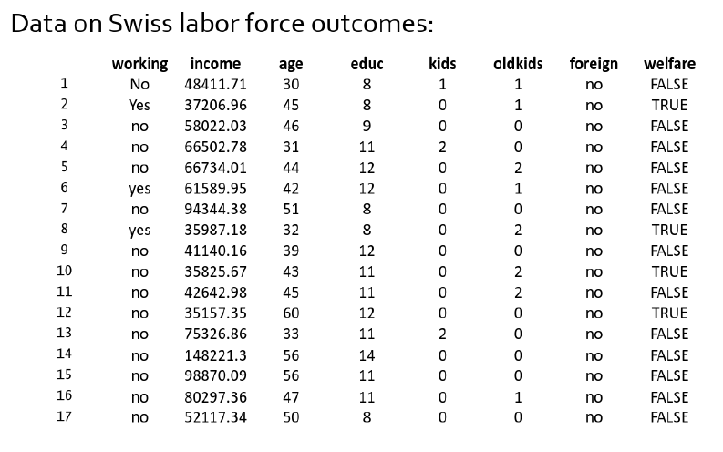
Example: Earnings

Slide 21
Example: Earnings
Linear regression offers a concise summary of the mean of one variable as a function of the other variable(s) through two parameters: the slope and intercept of the line

Slide 22
Example: Earnings
Linear regression offers a concise summary of the mean of one variable as a function of the other variable(s) through two parameters: the slope and intercept of the line
Model:

Slide 23
Example: Earnings
Linear regression offers a concise summary of the mean of one variable as a function of the other variable(s) through two parameters: the slope and intercept of the line
Model:
Have we measured the causal effect of an additional year of education on wages?

Slide 24
Example: Earnings
Linear regression offers a concise summary of the mean of one variable as a function of the other variable(s) through two parameters: the slope and intercept of the line
Model:
Have we measured the causal effect of an additional year of education on wages?
With another year of education, will I definitely earn $2,518 more?

Slide 25
The Model Is Right…?
“All models are wrong but some are useful”
- George Box
“… all models are limited by the validity of the assumptions on which they ride”
- Collier, Sekhon, and Stark
“Assumptions behind models are rarely articulated, let alone defended.”
- David Freedman

Slide 26
Models for Predictions
All models are, in small or large part, wrong
Miss features, omit dependencies, make assumptions, etc

Slide 27
Models for Predictions
All models are, in small or large part, wrong
Miss features, omit dependencies, make assumptions, etc
Models provide a simplification
Require assumptions
Require some understanding/intuition

Slide 28
Models for Predictions
All models are, in small or large part, wrong
Miss features, omit dependencies, make assumptions, etc
Models provide a simplification
Require assumptions
Require some understanding/intuition
But… what do we need for prediction?

Slide 29
Models for Predictions
But… what do we need for prediction?
If all we care about is predicting some target variable, maybe we can just ignore some of the messy assumptions and focus on specific metrics?

Slide 30
Models for Predictions
But… what do we need for prediction?
If all we care about is predicting some target variable, maybe we can just ignore some of the messy assumptions and focus on specific metrics?
A critical concern of machine learning is the ability to build models that accurately generalize while a critical concern of econometrics is the ability to build models that capture relationships

Slide 31
What is Machine Learning?
Machine learning is the science of getting computers to act without being explicitly programmed
Machine learning is a scientific discipline that explores the construction and study of algorithms that learn from data
Machine learning is a natural outgrowth at the intersection of computer science and statistics

Slide 32
What is Machine Learning?
Artificial Intelligence
Machine Learning
Deep Learning
??
1950s
2010s
Borrowed from Nvidia

Slide 33
What is Machine Learning?
Traditional Programming
Data
Computer
Output
Program
Machine Learning
?

Slide 34
What is Machine Learning?
Traditional Programming
Data
Computer
Output
Program
Machine Learning
Data
Computer
Program
Output

Slide 35
What is Machine Learning?
“Learning is (like) farming, which lets nature do most of the work. Farmers combine seeds and nutrients to grow crops. Learners combine knowledge with data to grow programs.”
- Pedro Domingos

Slide 36
“Flavors” of Machine Learning
Supervised learning
Unsupervised learning
Semi-supervised learning
Reinforcement learning

Slide 37
Supervised Learning
We know the “correct” answer for values
We’re trying to model the input (independent) variables as they relate to the output (dependent) variables
Examples
Predicting whether a student will graduate from a university
Predicting salary upon graduation
Other examples?

Slide 38
Unsupervised Learning
We don’t know the “correct” answer for values
We’re trying to discover underlying structure
Examples
Extracting topics/themes from textual surveys of students
Understanding the relationships between different departments/programs
Finding bottlenecks in student course offerings

Slide 39
“Pop” Quiz
Would you address each of the below with a supervised or unsupervised learning algorithm?
Given email labelled spam or not, build a spam detector
Given news articles on the web, group them into sets based on topic
Given a database of customer data, find market segments/customer groups
Given patients with a disease, determine if new patients have the disease
Given phone records of individuals, determine which are the wealthiest
Given phone records of individuals and survey data about their income, predict the incomes of new subscribers

Slide 40
Semi-supervised Learning
We know the “correct” answer for some values
The input data contains both labelled and unlabeled instances
Examples?

Slide 41
Reinforcement Learning
We develop “agents” that seek to maximize “reward”
We’re trying to build models that will seek to maximize some gain
Examples
Creating personalized curricula for students
Creating educational content for students

Slide 42
ML Basics
Thousands of ML algorithms
No one knows them all
Often tweaks or small improvements to existing approaches

Slide 43
ML Basics
Thousands of ML algorithms
No one knows them all
Often tweaks or small improvements to existing approaches
Every ML algorithm has three components
The representation (the model)
The evaluation (the cost/objective function)
The optimization (the search)

Slide 44
Designing for Prediction: Key Ideas
Generalization and overfitting
Training, validation, and test data
Evaluation metrics
Baselines
Error analysis

Slide 45
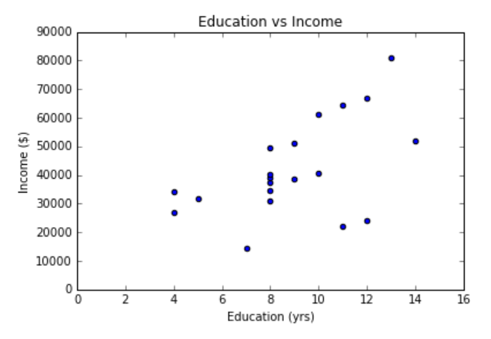
Modeling Education and Income

Slide 46
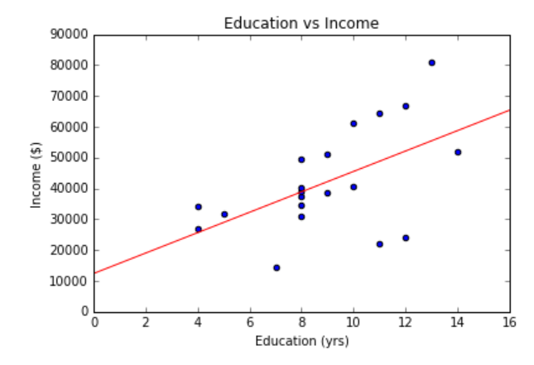
Modeling Education and Income

Slide 47
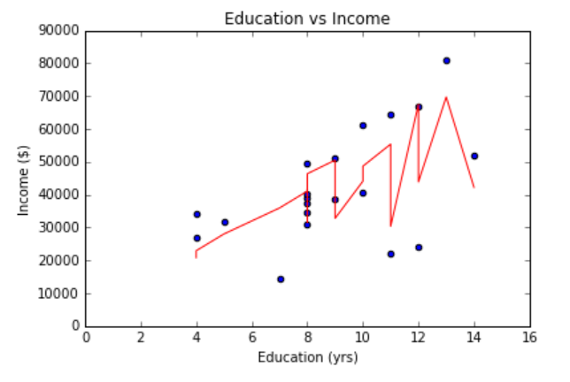
Modeling Education and Income

Slide 48
Modeling Education and Income
Plotting
One Variable
“Kitchen Sink”

Slide 49
Modeling Education and Income
Plotting
One Variable
“Kitchen Sink”
Which of these would you trust for predictions when education is 8 years?

Slide 50
Modeling Education and Income
Plotting
One Variable
“Kitchen Sink”
Which of these would you trust for predictions when education is 8 years?
What about 16 years? What about 0 years?

Slide 51
Notebook #1

Slide 52
Determining Model Fit
Adding more features will generally improve the “fit” of your model

Slide 53
Determining Model Fit
Adding more features will generally improve the “fit” of your model
As the number of features we have approaches or exceeds the number of observations, the model can fit really, really well
Of course, M > N can also lead to non-unique solutions!

Slide 54
Determining Model Fit
Adding more features will generally improve the “fit” of your model
As the number of features we have approaches or exceeds the number of observations, the model can fit really, really well
Of course, M > N can also lead to non-unique solutions!
Should we keep adding features? Is this what we want?

Slide 55
The ML Dilemma
We want to find a balance between modeling the data we have while also being able to generalize to unseen data
What we built our model on
Population
The data we want to predict

Slide 56
The ML Dilemma
We want to find a balance between modeling the data we have while also being able to generalize to unseen data
What we built our model on
Population
The data we want to predict

Slide 57
The ML Dilemma
variance
We want to find a balance between modeling the data we have while also being able to generalize to unseen data
bias
What we built our model on
Population
The data we want to predict

Slide 58
Bias-Variance Tradeoff
holehouse.org
Bias-Variance Tradeoff: the problem of simultaneously minimizing two sources of error that prevent generalization

Slide 59
Overfitting and Underfitting
More formally: overfitting is when we have too high of variance in our model with respect to bias
More formally: underfitting is when we have too high of bias in our model with respect to variance

Slide 60
Overfitting and Underfitting
More formally: overfitting is when we have too high of variance in our model with respect to bias
More formally: underfitting is when we have too high of bias in our model with respect to variance
How do we know?

Slide 61
Overfitting and Underfitting
More formally: overfitting is when we have too high of variance in our model with respect to bias
More formally: underfitting is when we have too high of bias in our model with respect to variance
How do we know? Validation!

Slide 62
Training, Validation, and Test Data
Training set: a set of examples used for learning, to which we fit parameters of a model

Slide 63
Training, Validation, and Test Data
Training set: a set of examples used for learning, to which we fit parameters of a model
Validation set: a set of examples used to tune model hyperparameters of a model (often a subset of the training set)

Slide 64
Training, Validation, and Test Data
Training set: a set of examples used for learning, to which we fit parameters of a model
Validation set: a set of examples used to tune model hyperparameters of a model (often a subset of the training set)
Test set: a set of examples used only to assess the performance of a fully-specified model. DO NOT look at the test data to guide model design!!

Slide 65
Training, Validation, and Test Data
Training set: a set of examples used for learning, to which we fit parameters of a model
Validation set: a set of examples used to tune model hyperparameters of a model (often a subset of the training set)
Test set: a set of examples used only to assess the performance of a fully-specified model. DO NOT look at the test data to guide model design!!

Slide 66
Test Data
Until you’re ready to report final results…
Do not peek at your test data!! Do not peek at your test data!! Do not peek at your test data!! Do not peek at your test data!! Do not peek at your test data!! Do not peek at your test data!! Do not peek at your test data!! Do not peek at your test data!! Do not peek at your test data!! Do not peek at your test data!! Do not peek at your test data!! Do not peek at your test data!! Do not peek at your test data!! Do not peek at your test data!! Do not peek at your test data!! Do not peek at your test data!! Do not peek at your test data!! Do not peek at your test data!!

Slide 67
How Prediction Experiments Work
ML experiments typically separate data into a training/test set
Model is fit on training set
Validation set is often used to fine tune
Performance is measured on the test set
This gives something of a “real-world” approximation of how well the model performs
Test error
Error rate
Training error
Underfit
Overfit
Model complexity

Slide 68
A Typical (Supervised) ML Experiment
Features
Data with labelled instances
Split into training, validation, and test sets
Training Set
Observations
Validation Set
Test Set

Slide 69
A Typical (Supervised) ML Experiment
Features
Data with labelled instances
Split into training, validation, and test sets
Training your model
Estimate parameters on training set
Tune hyperparameters on the validation set
Report results on the test set
Training Set
Observations
Validation Set
Test Set

Slide 70
A Typical (Supervised) ML Experiment
Features
Data with labelled instances
Split into training, validation, and test sets
Training your model
Estimate parameters on training set
Tune hyperparameters on the validation set
Report results on the test set
Evaluation
Many metrics and context-dependent
Ideally, what we use to train should be our final evaluation criteria
Training Set
Observations
Validation Set
Test Set

Slide 71
What is a Hyperparameter?
Parameter:
A value for the model that is derived via training
Inherent to the data
Example: beta coefficients in regression

Slide 72
What is a Hyperparameter?
Parameter:
A value for the model that is derived via training
Inherent to the data
Example: beta coefficients in regression
Hyperparameter:
A value that is set before the learning process
External to the data
Often tuned with a particular end result in mind
Example: regularization strength in regression

Slide 73
Bootstrapping
Given unlimited data, it’s easy to get new test data (assuming IID). What if you have limited data?

Slide 74
Bootstrapping
Given unlimited data, it’s easy to get new test data (assuming IID). What if you have limited data?
Your “random” sample of training data may still not be representative
Remember: GIGO! (Garbage in, garbage out)

Slide 75
Bootstrapping
Given unlimited data, it’s easy to get new test data (assuming IID). What if you have limited data?
Your “random” sample of training data may still not be representative
Remember: GIGO! (Garbage in, garbage out)
Bootstrapping can help us recycle and maximize data usage
It also allows us an easy avenue to tune hyperparameters

Slide 76
K-Fold Cross Validation
A form of bootstrapping
Uses K “folds”
K is typically 3, 5, or 10

Slide 77
K-Fold Cross Validation
A form of bootstrapping
Uses K “folds”
K is typically 3, 5, or 10
The process:
Randomly partition your (training) data into K subsamples of equal size
Use each of the K folds as your validation set once
Average your performance across the K test runs

Slide 78
K-Fold Cross Validation
A form of bootstrapping
Uses K “folds”
K is typically 3, 5, or 10
The process:
Randomly partition your (training) data into K subsamples of equal size
Use each of the K folds as your validation set once
Average your performance across the K test runs
Involves fitting and re-fitting the model K times!
Can be computationally cumbersome

Slide 79
K-Fold Cross Validation
Round 1
Round 2
Round 3
Round 10
Validation
Validation
Validation
Validation

Slide 80
K-Fold CV to Sweep
KFCV can be used to identify which hyperparameter settings work best

Slide 81
K-Fold CV to Sweep
KFCV can be used to identify which hyperparameter settings work best
Process:
Start at a value of interest for hyperparameter(s) of interest
Use KFCV to evaluate
Adjust hyperparameters
Repeat
Use optimized hyperparameters to train the final model
Ideal graph
Error rate on validation
Hyperparameter value

Slide 82
Evaluation Metrics
Figuring out which to use can be critical for evaluation
Can also weigh multiple metrics at once

Slide 83
Evaluation Metrics
Figuring out which to use can be critical for evaluation
Can also weigh multiple metrics at once
Classification:
Accuracy
Precision/recall
AUROC
Regression:
MSE/RMSE

Slide 84
Evaluation Metrics
Figuring out which to use can be critical for evaluation
Can also weigh multiple metrics at once
Classification:
Accuracy
Precision/recall
AUROC
Regression:
MSE/RMSE
Log loss for either
Many, many more

Slide 85
Baselines
We also often need to quantify progress (accuracy, correctness) relative to something meaningful. The following are often used:
vs random guessing
vs most likely label
vs state of the art
vs something else simple/intuitive

Slide 86
Baselines
We also often need to quantify progress (accuracy, correctness) relative to something meaningful. The following are often used:
vs random guessing
vs most likely label
vs state of the art
vs something else simple/intuitive
Example: if our dataset has 90% of students retained, is an accuracy of 90% when predicting retention really all that great?

Slide 87
Error Analysis
Error analysis tries to explain the gap between current and perfect performance
Why is the model incorrect?
Where is it incorrect?
What types of observations does it need more leverage for?
Things rarely work out of the box
Be ready to tune/tweak and re-tweak

Slide 88
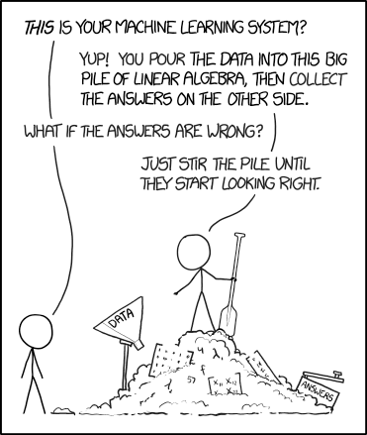
Error Analysis

Slide 89
The Workflow*
Repeat for as many ML models/algos as you’d like
Get/Collect/Scrape data. Clean/curate it.
Make Train/Test split (unless already done)
Perform K-Fold CV. Get the h-params with the lowest avg “error”
Retrain model using all training data and params from K-Fold CV.
Report (final) stats on the test set.
This is the test set. DON’T PEEK!
*not always the workflow

Slide 90
Notebook #2

Slide 91
Ethics
Beware of black boxes

Slide 92
Ethics
Beware of black boxes
Pay attention to “explainable” ML
Just because something predicts well, doesn’t mean we can’t understand it

Slide 93
Ethics
Beware of black boxes
Pay attention to “explainable” ML
Just because something predicts well, doesn’t mean we can’t understand it
Pay attention to biases in your data!
Your models will always reflect the biases they inherit
This can also relate to blindspots in your data

Slide 94
Homework
Your homework for next week:
On the back end of the second notebook
Do the readings/watch the videos

Slide 95
Wrapping Up
Level-setting
Model Selection
Warm Up Exercise
Machine Learning Overview
Basics
Programming Exercise

