Slide 1
ISEA Week 6 – Machine Learning Applications
Lovenoor (Lavi) Aulck

Slide 2
Recap

Slide 3
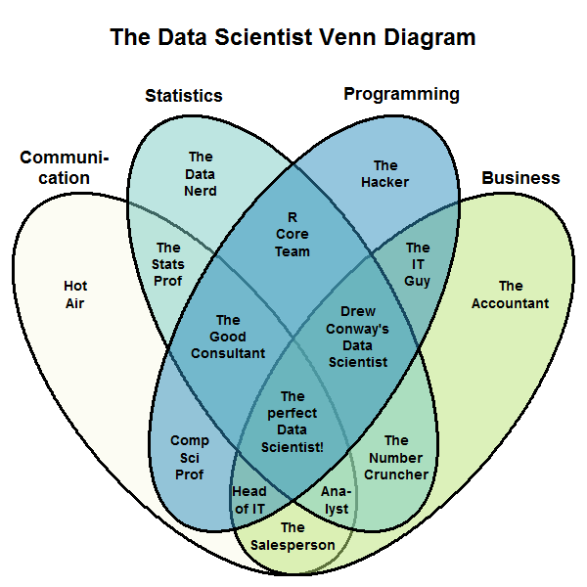
A Data Scientist
Domain expertise
Critical thinking, creativity, and experimental design?
Stephan Kolassa

Slide 4
A Data Scientist
Data ethics
Ask an interesting question
Get the data
Clean/Curate the data
Explore the data
Model the data
Communicate and visualize

Slide 5
Models for Predictions
All models are, in small or large part, wrong
Miss features, omit dependencies, make assumptions, etc
Models provide a simplification
Require assumptions
Require some understanding/intuition
But… what do we need for prediction?

Slide 6
Models for Predictions
But… what do we need for prediction?
If all we care about is predicting some target variable, maybe we can just ignore some of the messy assumptions and focus on specific metrics?
A critical concern of machine learning is the ability to build models that accurately generalize while a critical concern of econometrics is the ability to build models that capture relationships

Slide 7
“Flavors” of Machine Learning
Supervised learning
Unsupervised learning
Semi-supervised learning
Reinforcement learning

Slide 8
Designing for Prediction: Key Ideas
Generalization and overfitting
Training, validation, and test data
Evaluation metrics
Baselines
Error analysis

Slide 9
The ML Dilemma
variance
We want to find a balance between modeling the data we have while also being able to generalize to unseen data
bias
What we built our model on
Population
The data we want to predict

Slide 10
Training, Validation, and Test Data
Training set: a set of examples used for learning, to which we fit parameters of a model
Validation set: a set of examples used to tune model hyperparameters of a model (often a subset of the training set)
Test set: a set of examples used only to assess the performance of a fully-specified model. DO NOT look at the test data to guide model design!!

Slide 11
Bootstrapping
Given unlimited data, it’s easy to get new test data (assuming IID). What if you have limited data?
Your “random” sample of training data may still not be representative
Remember: GIGO! (Garbage in, garbage out)
Bootstrapping can help us recycle and maximize data usage
It also allows us an easy avenue to tune hyperparameters

Slide 12
K-Fold Cross Validation
Round 1
Round 2
Round 3
Round 10
Validation
Validation
Validation
Validation

Slide 13
Evaluation Metrics
Figuring out which to use can be critical for evaluation
Can also weigh multiple metrics at once
Classification:
Accuracy
Precision/recall
AUROC
Regression:
MSE/RMSE
Log loss for either
Many, many more

Slide 14
Baselines
We also often need to quantify progress (accuracy, correctness) relative to something meaningful. The following are often used:
vs random guessing
vs most likely label
vs state of the art
vs something else simple/intuitive
Example: if our dataset has 90% of students retained, is an accuracy of 90% when predicting retention really all that great?

Slide 15
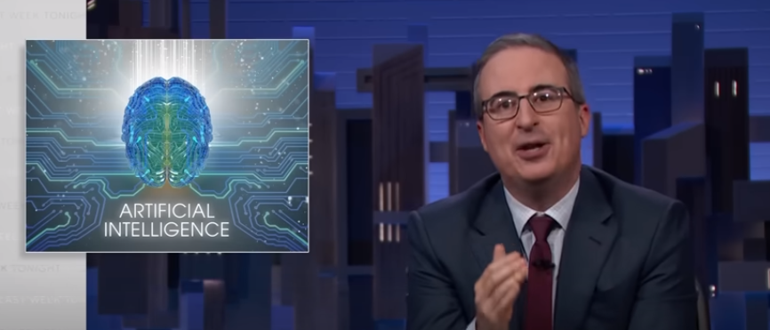
Ethics
Beware of black boxes
Pay attention to “explainable” ML
Just because something predicts well, doesn’t mean we can’t understand it
Pay attention to biases in your data!
Your models will always reflect the biases they inherit
This can also relate to blindspots in your data

Slide 16
In The News

Slide 17
In The News

Slide 18
Outline
Recap
Continuing Modeling Exercise
Break/Discussion
Neural Networks
Break
Neural Network Flavors
Programming Exercise (time permitting)

Slide 19
You Will Need…
You will need to have the following python packages installed and working for the demos:
pandas
numpy
seaborn (and/or matplotlib)
sklearn
statsmodels
random
torch
pytorch_tabnet

Slide 20
Notebook

Slide 21
Break
During break, think about an application of machine learning in your work
What would you try to predict/group/optimize?
What are some potential gains from this work?
What are some roadblocks?

Slide 22
Break
During break, think about an application of machine learning in your work
What would you try to predict/group/optimize?
What are some potential gains from this work?
What are some roadblocks?
For Lavi:
Predict students’ major enrollment

Slide 23
Break
During break, think about an application of machine learning in your work
What would you try to predict/group/optimize?
What are some potential gains from this work?
What are some roadblocks?
For Lavi:
Predict students’ major enrollment
Allows for better resource allocation and planning

Slide 24
Break
During break, think about an application of machine learning in your work
What would you try to predict/group/optimize?
What are some potential gains from this work?
What are some roadblocks?
For Lavi:
Predict students’ major enrollment
Allows for better resource allocation and planning
Resources. Also, students are (very) unpredictable!

Slide 25
Neurons
“I could not help but wonder if this new ‘Deep Learning’ was anything fancy or just a scaled up version of the ‘artificial neural nets’ that were already developed by the late 80s. And let me tell you, the answer is quite a story — the story of not just neural nets, not just of a sequence of research breakthroughs that make Deep Learning somewhat more interesting than ‘big neural nets’, but most of all of how several unyielding researchers made it through dark decades of banishment to finally redeem neural nets and achieve the dream of Deep Learning.”
- Andrey Kurenkov

Slide 26
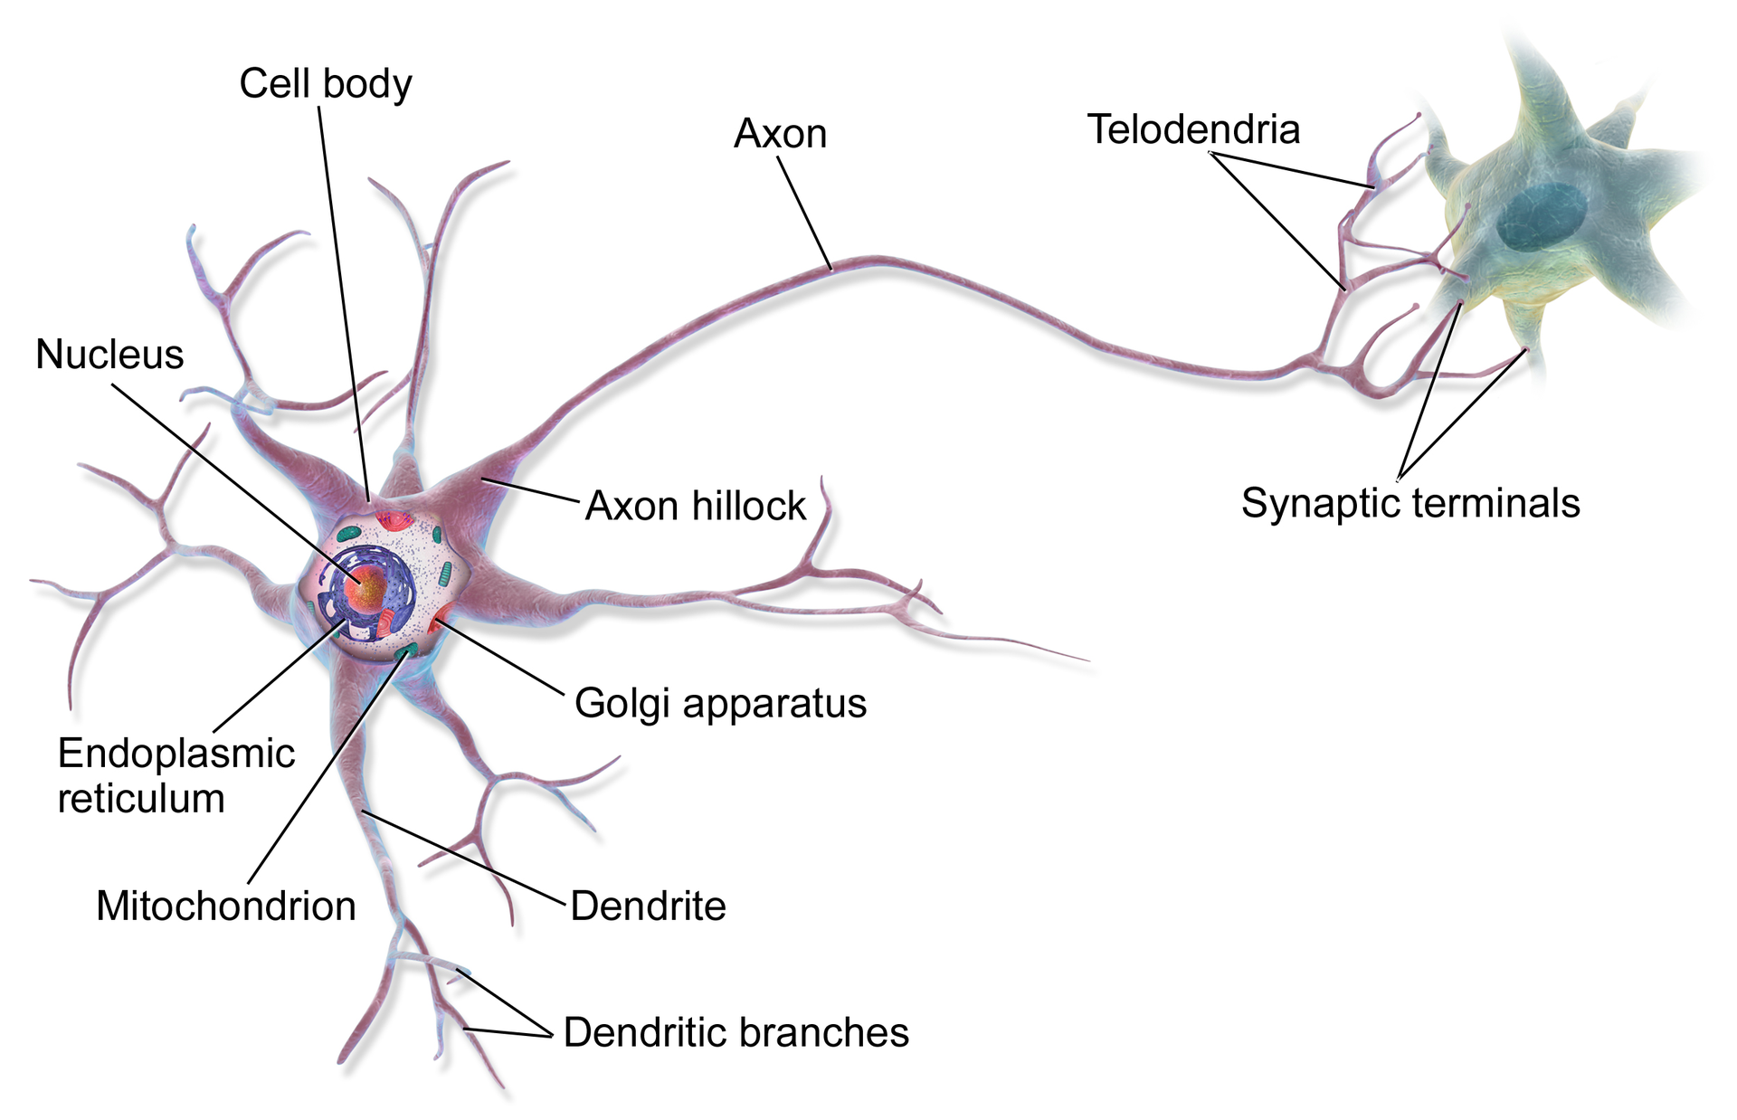
Neurons
Blausen Medical

Slide 27
Neurons
All neurons are electrically excitable, maintaining voltage gradients across their membranes via metabolically-driven ion pumps

Slide 28
Neurons
All neurons are electrically excitable, maintaining voltage gradients across their membranes via metabolically-driven ion pumps
If the voltage changes by a large enough amount, an action potential is generated
Action potentials are all-or-nothing responses

Slide 29
Neurons
All neurons are electrically excitable, maintaining voltage gradients across their membranes via metabolically-driven ion pumps
If the voltage changes by a large enough amount, an action potential is generated
Action potentials are all-or-nothing responses
These action potentials move along axons and activate synaptic connections with other neurons

Slide 30
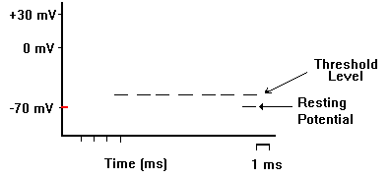
Neurons
Eric Chudler

Slide 31
The Perceptron
Rosenblatt’s (a psychologist’s) attempt at trying to mathematically model a neuron

Slide 32
The Perceptron
Rosenblatt’s (a psychologist’s) attempt at trying to mathematically model a neuron
The perceptron takes in a set of inputs, multiplies them by a weight, and then aggregates
Keep this process in mind! It is central to how neural networks work!

Slide 33
The Perceptron
Rosenblatt’s (a psychologist’s) attempt at trying to mathematically model a neuron
The perceptron takes in a set of inputs, multiplies them by a weight, and then aggregates
Keep this process in mind! It is central to how neural networks work!
Perceptron “fires” if the aggregate reaches some threshold
Very much like the all-or-nothing response of a neuron

Slide 34
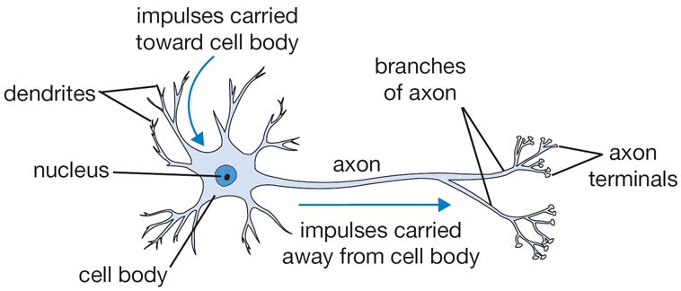
The Perceptron

Slide 35
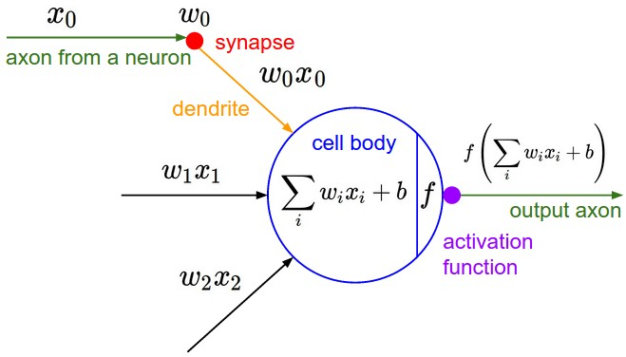
The Perceptron
Stanford CS231n

Slide 36
The Perceptron
Stanford CS231n

Slide 37
Perceptrons For Logic
X1 | X2 | Output
1 | 1 | 1
1 | 0 | -1
0 | 1 | -1
0 | 0 | -1

Slide 38
Perceptrons For Logic
AND
X1 | X2 | Output
1 | 1 | 1
1 | 0 | -1
0 | 1 | -1
0 | 0 | -1

Slide 39
Perceptrons For Logic
AND
X1 | X2 | Output
1 | 1 | 1
1 | 0 | -1
0 | 1 | -1
0 | 0 | -1

Slide 40
Perceptrons For Logic
X₀
w₀
X₁
w₁
Σ
> θ?
AND
X1 | X2 | Output
1 | 1 | 1
1 | 0 | -1
0 | 1 | -1
0 | 0 | -1
w₂
X₂

Slide 41
Perceptrons For Logic
X₀
w₀
X₁
w₁
Σ
> θ?
AND
X1 | X2 | Output
1 | 1 | 1
1 | 0 | -1
0 | 1 | -1
0 | 0 | -1
w₂
X₂
(sum of our components >= threshold?)
(X₀w₀ + X₁w₁ + X₂w₂) >= threshold
X₀w₀ + X₁w₁ + X₂w₂ >= θ (T: y = 1; F: y = -1)
w₀ + w₁ + w₂ >= θ
w₀ + w₁ < θ
w₀ + w₂ < θ
w₀ < θ

Slide 42
How Perceptrons Learned
In essence, the perceptron was a translation of inputs into outputs

Slide 43
How Perceptrons Learned
In essence, the perceptron was a translation of inputs into outputs
The weights needed to perform these translations could be learned based on available data

Slide 44
How Perceptrons Learned
In essence, the perceptron was a translation of inputs into outputs
The weights needed to perform these translations could be learned based on available data
One way: Rosenblatt’s algorithm from the 50s
Showed convergence when two criteria are met: data is linearly separable and step size is sufficiently (in the proof, infinitely) small

Slide 45
Perceptrons For Logic
X₀
w₀
X₁
w₁
Σ
> θ?
XOR
X1 | X2 | Output
1 | 1 | 1
1 | 0 | -1
0 | 1 | -1
0 | 0 | 1
w₂
X₂

Slide 46
Perceptrons For Logic
X₀
w₀
X₁
w₁
Σ
> θ?
XOR
X1 | X2 | Output
1 | 1 | 1
1 | 0 | -1
0 | 1 | -1
0 | 0 | 1
w₂
X₂
Not linearly separable!

Slide 47
The First “AI Winter”
Minsky and Papert published Perceptrons: an introduction to computational geometry in 1969
Presented an analysis on opportunities and limitations of perceptrons (including, among other things, their inability to work on XOR logic)
During the 1960s, the US government was also interested in machine translation (particularly language to language)
Why? It was the Cold War
A confluence of circumstances led to a decreased interest (and funding) in AI and neural networks for much of the 70s

Slide 48
The Thaw of The First “AI Winter”
The first AI winter eventually ended
Spurred by the development of expert systems (which weren’t necessarily based neural nets)
There was a rapid growth in the commercialization of AI-related products and conferences through the 1980s
Many of the top conferences today were established: AAAI and NeurIPS
Through the first AI Winter and AI Spring, there were also developments in neural networks

Slide 49
Multi-Layer Networks
Minskey and Papert argued that a multi-layered network was needed to capture XOR logic
Spurred by the development of expert systems (which weren’t necessarily based neural nets)

Slide 50
Multi-Layer Networks
Minskey and Papert argued that a multi-layered network was needed to capture XOR logic
Spurred by the development of expert systems (which weren’t necessarily based neural nets)
What is a multi-layered network?
Between the inputs and the aggregation, add a layer of neurons
This layer can be of arbitrary length but is connected to the input layer

Slide 51
Multi-Layer Networks
Minskey and Papert argued that a multi-layered network was needed to capture XOR logic
Spurred by the development of expert systems (which weren’t necessarily based neural nets)
What is a multi-layered network?
Between the inputs and the aggregation, add a layer of neurons
This layer can be of arbitrary length but is connected to the input layer
Neural networks with a single hidden layer are universal approximators
They can mimic any(!!!) function (provided enough neurons)

Slide 52
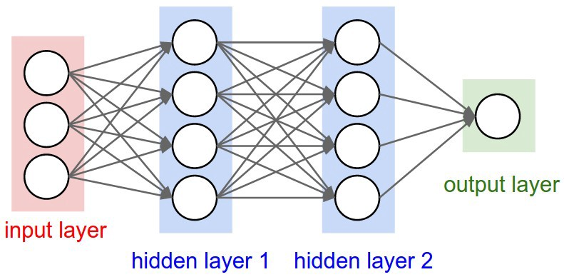
Multi-Layer Networks
Modified from Stanford CS231n

Slide 53
Taking A Step Back
Neural networks are just that – a network of neurons
Neurons are represented as perceptrons
Sometimes also called artificial neural networks (ANNs)
Sometimes also called multi-layer perceptrons (MLPs; though MLPs are often vanilla architectures)
Neurons are also called “units”

Slide 54
Taking A Step Back
Neural networks are just that – a network of neurons
Neurons are represented as perceptrons
Sometimes also called artificial neural networks (ANNs)
Sometimes also called multi-layer perceptrons (MLPs; though MLPs are often vanilla architectures)
Neurons are also called “units”
What is deep learning?
Generally, neural networks with a large number of hidden layers! (thus, “deep”)

Slide 55
Training Multi-Layer Networks
Forward propagation
Pass the input data through the network and calculate outputs (ŷ)
Basically “make predictions”

Slide 56
Training Multi-Layer Networks
Forward propagation
Pass the input data through the network and calculate outputs (ŷ)
Basically “make predictions”
Calculate error
Determine how far off from y we are with ŷ

Slide 57
Training Multi-Layer Networks
Forward propagation
Pass the input data through the network and calculate outputs (ŷ)
Basically “make predictions”
Calculate error
Determine how far off from y we are with ŷ
Backpropagation (Backward propagation)
Update weights/biases based on the error

Slide 58
Training Multi-Layer Networks

Slide 59
Training Multi-Layer Networks
Forward Propagation

Slide 60
Training Multi-Layer Networks
Forward Propagation
Calculate Error

Slide 61
Training Multi-Layer Networks
Forward Propagation
Calculate Error
Backward Propagation

Slide 62
The Second AI Winter
Some time after the first AI Spring, a second AI winter came about
Multi-layered networks could be trained (in theory); however, they took a lot of computational resources
Alternatively, there became a growing interest in SVMs and Bayesian approaches
At some point, NeurIPS (which was founded a conference on neural networks) was accepting more papers in non-neural domains than neural domains
On the flip side, commercialization of expert systems stalled

Slide 63
The Second “AI Spring”
Several additional key developments brought about the growth of “Deep Learning”

Slide 64
The Second “AI Spring”
Several additional key developments brought about the growth of “Deep Learning”
Rethinking activation functions (using ReLUs allowed for faster training/less leakage)
1
1
0
0

Slide 65
The Second “AI Spring”
Several additional key developments brought about the growth of “Deep Learning”
Rethinking activation functions (using ReLUs allowed for faster training/less leakage)
Video games

Slide 66
The Second “AI Spring”
Several additional key developments brought about the growth of “Deep Learning”
Rethinking activation functions (using ReLUs allowed for faster training/less leakage)
Video games GPUs

Slide 67
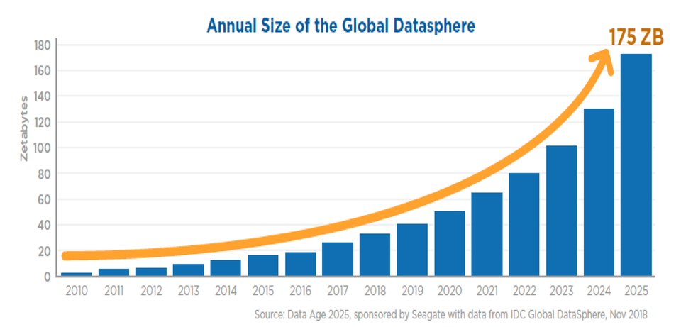
The Second “AI Spring”
Several additional key developments brought about the growth of “Deep Learning”
Rethinking activation functions (using ReLUs allowed for faster training/less leakage)
Video games GPUs
More data

Slide 68
The Second “AI Spring”
Several additional key developments brought about the growth of “Deep Learning”
Rethinking activation functions (using ReLUs allowed for faster training/less leakage)
Video games GPUs
More data
Rebranding

Slide 69
The Second “AI Spring”
Several additional key developments brought about the growth of “Deep Learning”
Rethinking activation functions (using ReLUs allowed for faster training/less leakage)
Video games GPUs
More data
Rebranding
Numerous other advancements in optimization theory and approaches

Slide 70
Break
During break, ensure you have all packages installed locally and/or ready to go on colab

Slide 71
Flavors Of Neural Networks
Autoencoders
Convolutional Neural Networks
Recurrent Neural Networks
Generative Adversarial Networks
Transformers

Slide 72
Autoencoders
An autoencoder is a neural network whose output is the same as its input

Slide 73
Autoencoders
An autoencoder is a neural network whose output is the same as its input
What’s the point?
Dimensionality reduction
Using a more constrained model to represent data inputs
Can be used for clustering
Anomaly detection
If the autoencoder can’t reconstruct the output, maybe it’s dissimilar to the training data?

Slide 74
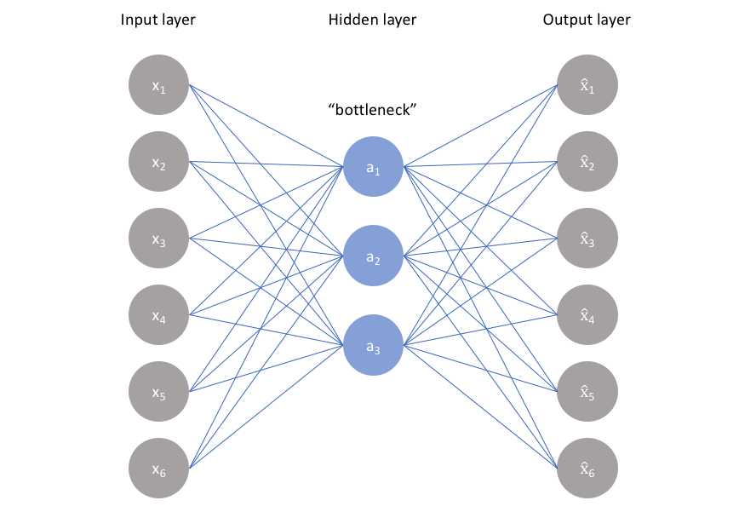
Autoencoders
Jeremy Jordan

Slide 75
Convolutional Neural Networks
Convolutional neural networks are networks that employ a convolution function at some point
Similar to the convolution used in signal processing
Focus on small, simple patterns in the data
Thus, they are very effective for images and videos
Allows us to take into account spatial structures
Generally involve successive convolution and pooling of features

Slide 76
Convolutional Layer
The convolutional layer can be thought of as a filter that passes over the input
This zeros in on locality – we focus on small activation maps

Slide 77
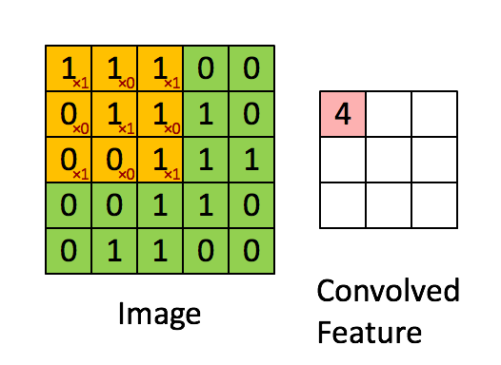
Convolutional Layer
The convolutional layer can be thought of as a filter that passes over the input
This zeros in on locality – we focus on small activation maps
Sumit Saha

Slide 78
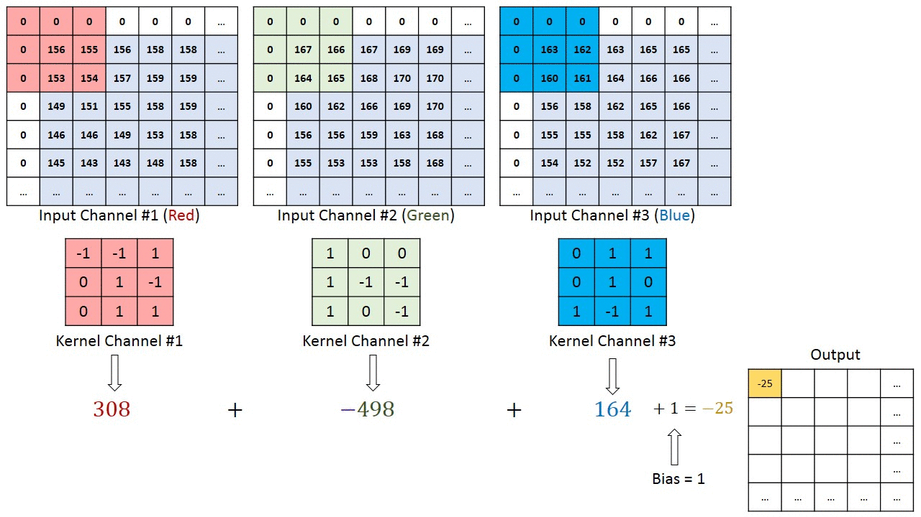
Convolutional Layer
The convolutional layer can be thought of as a filter that passes over the input
This zeros in on locality – we focus on small activation maps
Sumit Saha

Slide 79
Convolutional Neural Networks

Slide 80
Recurrent Neural Networks
Take in an input as a temporal sequence
The order of the input matters and aids in predictions
Thus, they are very effective for tasks involving natural language

Slide 81
Recurrent Neural Networks
Take in an input as a temporal sequence
The order of the input matters and aids in predictions
Thus, they are very effective for tasks involving natural language
Michael Nguyen

Slide 82
Recurrent Neural Networks
fdeloche

Slide 83
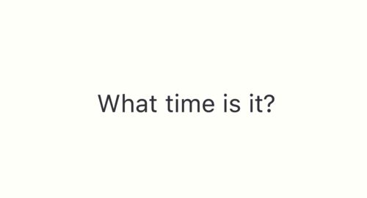
Recurrent Neural Networks
Michael Nguyen

Slide 84
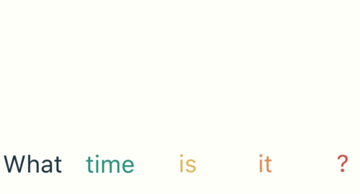
Recurrent Neural Networks
Michael Nguyen

Slide 85
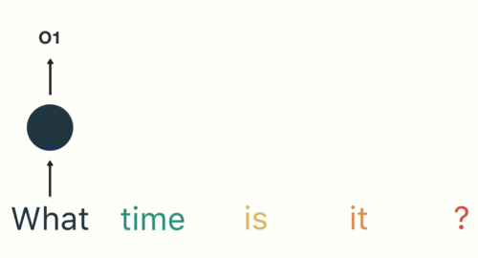
Recurrent Neural Networks
Michael Nguyen

Slide 86
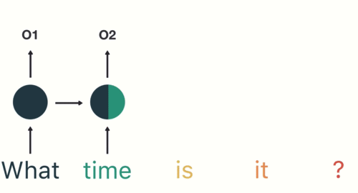
Recurrent Neural Networks
Michael Nguyen

Slide 87
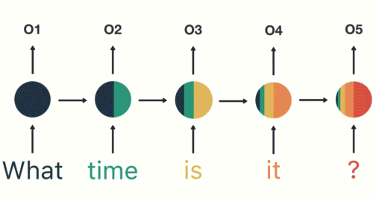
Recurrent Neural Networks
Michael Nguyen

Slide 88
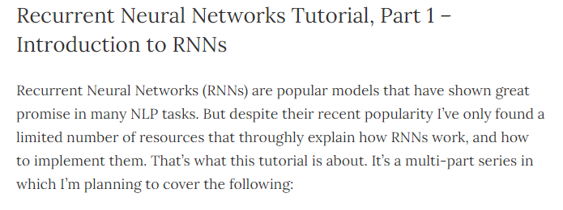
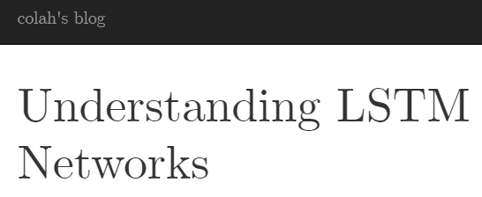
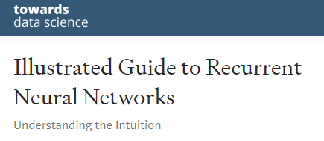
Recurrent Neural Networks

Slide 89
Generative Adversarial Networks
Broadly: composed of two neural networks
A generator network which generates data
A discriminator network which classifies data

Slide 90
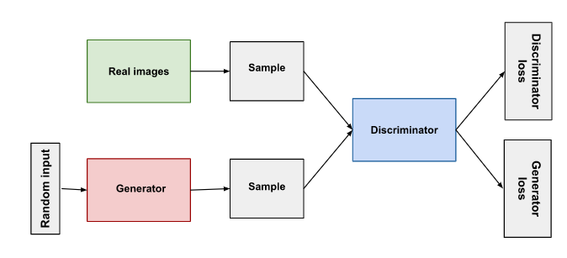
Generative Adversarial Networks
Broadly: composed of two neural networks
A generator network which generates data
A discriminator network which classifies data

Slide 91
Generative Adversarial Networks
The generator learns to generate plausible data
Its job is to fool the discriminator

Slide 92
Generative Adversarial Networks
The generator learns to generate plausible data
Its job is to fool the discriminator
The discriminator learns to distinguish the generator’s data from real data
Its job is to detect data from the generator

Slide 93
Generative Adversarial Networks
The generator learns to generate plausible data
Its job is to fool the discriminator
The discriminator learns to distinguish the generator’s data from real data
Its job is to detect data from the generator
Google

Slide 94
Generative Adversarial Networks
The generator learns to generate plausible data
Its job is to fool the discriminator
The discriminator learns to distinguish the generator’s data from real data
Its job is to detect data from the generator
Google

Slide 95
Generative Adversarial Networks
The generator learns to generate plausible data
Its job is to fool the discriminator
The discriminator learns to distinguish the generator’s data from real data
Its job is to detect data from the generator
Google

Slide 96
Generative Adversarial Networks
The generator learns to generate plausible data
Its job is to fool the discriminator
The discriminator learns to distinguish the generator’s data from real data
Its job is to detect data from the generator
Google

Slide 97
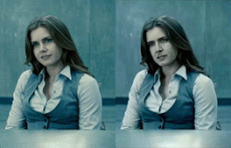
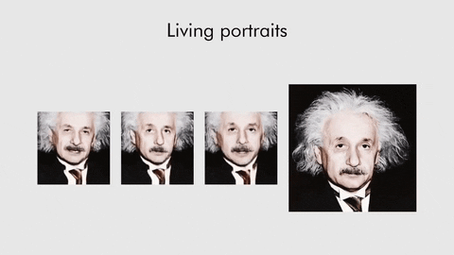
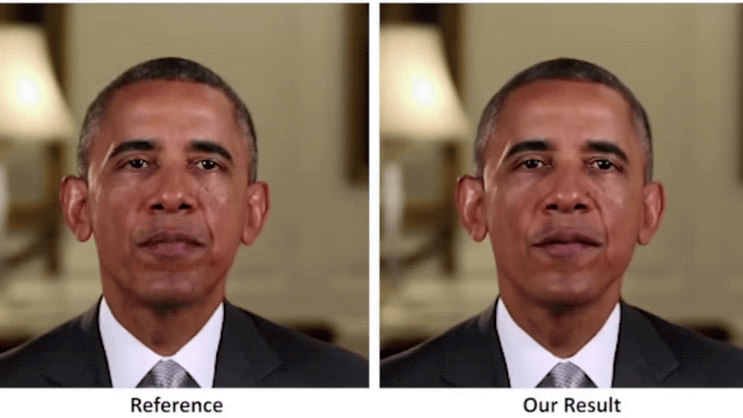
Generative Adversarial Networks
Derpfakes
Samsung
Kim et al

Slide 98
Generative Adversarial Networks

Slide 99
Transformers
Basis of much of modern “AI” and LLMs

Slide 100
Transformers
Basis of much of modern “AI” and LLMs
General idea:
A neural network that learns context by tracking relationships in sequential data
Traditional AI frameworks often rely on encoder/decoder relationships
Attention: allows a model to pay “attention” to different parts of a sequence at once

Slide 101
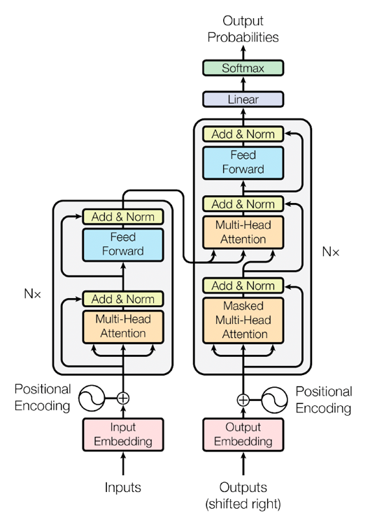
Transformers
AWS

Slide 102
Transformers
AWS

Slide 103
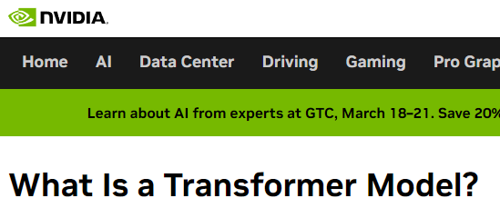
Transformers

Slide 104
Notebook

Slide 105
Outline
Recap
Continuing Modeling Exercise
Break/Discussion
Neural Networks
Break
Neural Network Flavors
Programming Exercise (time permitting)

