Slide 1
Learning Theories and Learning Engineering ISEA Session 7 Min Sun and Alex Liu University of Washington 3.8.2024

Slide 2
Warm Up
Is programming a skill still needed in the AI era, particularly with the unprecedented speed of advancement of Large Language Modeling (LLM)?

Slide 3
Today’s Agenda
Natural Language Processing (NLP)
Theme identification, text summarization
Traditional NLP—Topic Modeling
LLM Prompting Engineering
Application in one paper: analyzing interview data
The benefits of human and computer interactive learning in the AI era
Code and program
Classification Models (next week)
Lexicon-based sentiment analysis versus LLM
Multi-tasks classification based on neural network models
RADAR for personalization
Code

Slide 4
Natural Language Processing (NLP)
“Natural language processing (NLP) combines computational linguistics, machine learning, and deep learning models to process human language.”
Amazon Web Services (AWS)

Slide 5
Natural Language Processing (NLP)
Computational linguistics: the science of understanding and constructing human language models with computers and software tools. Tools like: Language translators, Text-to-speech synthesizers; Speech recognition software are based on computational linguistics.
Machine Learning: A technology trains a computer with sample data to improve its efficiency. Machine learning (ML) methods teach NLP applications to recognize and accurately understand human language.
Deep Learning: A subset of machine learning that teaches computers to learn, think, act like humans. It involves neural network models to enable computers to recognize, classify, and co-relate complex patterns in language data.

Slide 6
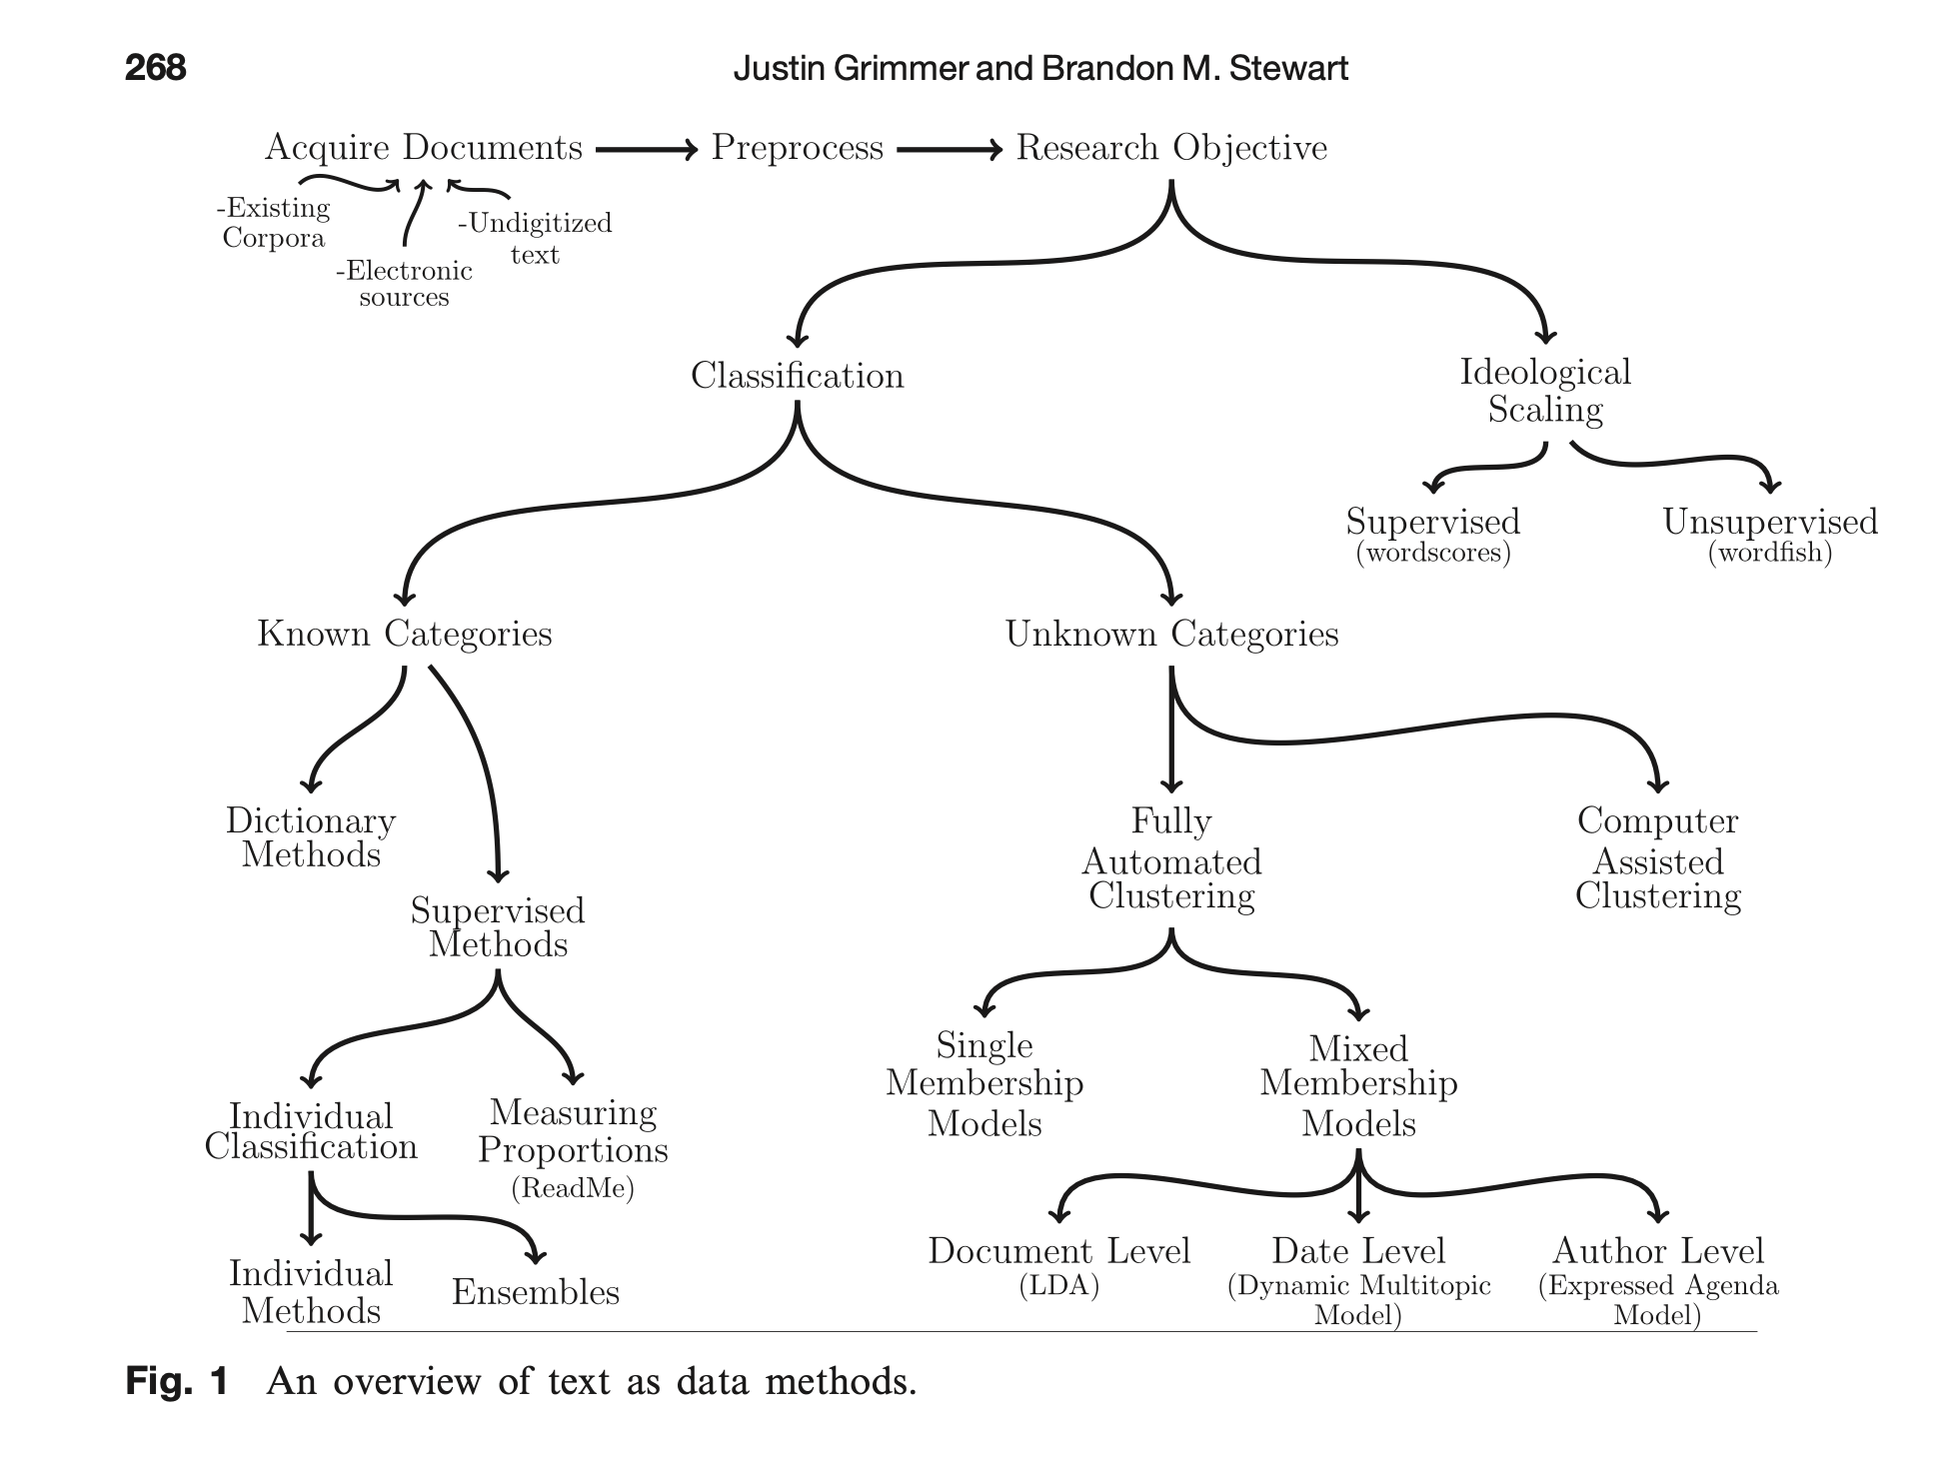
Traditional Text as Data Methods
Grimmer, J., & Stewart, B. M. (2013). Text as data: The promise and pitfalls of automatic content analysis methods for political texts. Political analysis, 21(3), 267-297.

Slide 7
Topic Modeling: latent Dirichlet allocation (LDA, see Blei, 2012; Blei, Ng, & Jordan, 2003)
LDA is a generative statistical model that identifies the latent topics and corresponding proportions that compose a document.
LDA assumes that each document is a mixture of topics. For each document, π_{ik}, represents the proportion of task i dedicated to topic k. Each task collects the proportions across topics, as π_{i}= (π_{i1,} π_{i2, …,} π_{ik}). LDA represents a given task as a set of topic weights, rather than assigning it to one of those topics.
(see an example next slide)
Notes:
In contrast to other clustering methods that assign documents to one topic only, LDA analysis aims to discover the latent topics across all documents, and
Simultaneously derive the composition of topics for each text entry (each task).
It is a generalization of older approach of probabilistic latent semantic analysis.

Slide 8
Text Analysis: latent Dirichlet allocation (LDA, see Blei, 2012; Blei, Ng, & Jordan, 2003)
Topic 1: Leadership | Topic 2: Teacher Capacity Building | Topic 3: Engaging Parents
0.6 | 0.1 | 0.3
0.4 | 0.5 | 0.1
0.1 | 0.1 | 0.8

Slide 9
Large Language Models (LLM)
Andrej Karpathy (2023): Intro to LLM for busy people. https://www.youtube.com/watch?v=zjkBMFhNj_g&ab_channel=AndrejKarpathy

Slide 10
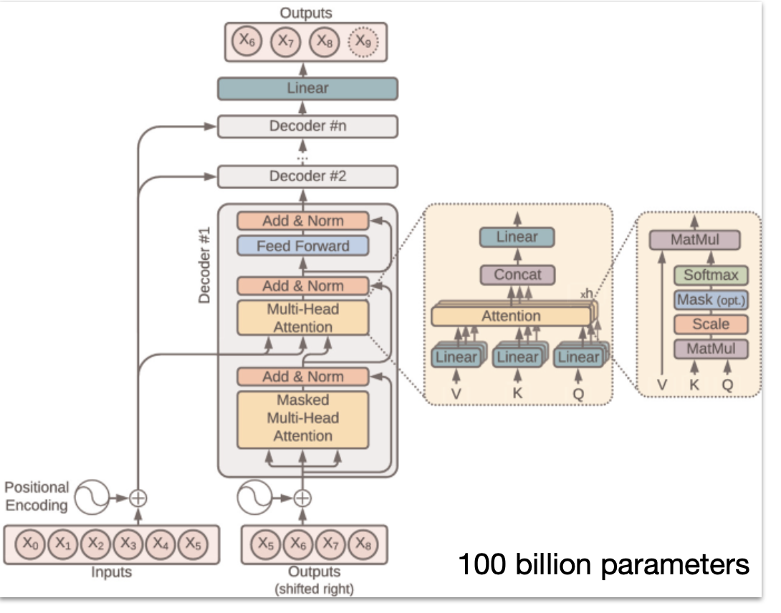
LLM: How does it work?
“Little is known in full detail...
Billions of parameters are dispersed through the network.
We know how to iteratively adjust them to make it better at prediction. We can measure that this works, but we don’t really know how the billions of parameters collaborate to do it.
They build and maintain some kind of knowledge database, but it is a bit strange and imperfect.”
Andrej Karpathy (2023): Intro to LLM for busy people. https://www.youtube.com/watch?v=zjkBMFhNj_g&ab_channel=AndrejKarpathy
Vaswani, A., Shazeer, N., Parmar, N., Uszkoreit, J., Jones, L., Gomez, A. N., ... & Polosukhin, I. (2017). Attention is all you need. Advances in neural information processing systems, 30. https://arxiv.org/pdf/1706.03762.pdf

Slide 11
From Voices to Validity: Leveraging Large Language Models (LLMs) for Textual Analysis of Policy Stakeholder Interviews
Liu, A., & Sun, M. (2023). From Voices to Validity: Leveraging Large Language Models (LLMs) for Textual Analysis of Policy Stakeholder Interviews. arXiv preprint arXiv:2312.01202.
This study is supported by the Baller Group and William T. Grant Foundation (Grant No. 190735) and the National Science Foundation (Grant No. 2055062). Any opinions, findings, and conclusions or recommendations expressed in this material are those of the authors and do not necessarily reflect the views of the funders.
Liu & Sun assume equal authorship.

Slide 12
Introduction
1. One important source of data to support policy discourse and decision-making involves stakeholders’ lived experiences about the implementation of current policy and their opinions about how to improve.
2. Stakeholders’ voices may be collected from interviews, open-ended survey responses, or texts obtained from social media posts.
3. The cost of manually analyzing even a moderately sized text may hinder the actual use of stakeholders’ voices.
4. Data science methods—like topic modeling (LDA), sentiment analysis, and large language models (LLMs, notably ChatGPT)—may offer the efficiency, but can be constrained by the lack of domain and contextual knowledge.
5. The central aim of this study is to examine the validity of LLMs to analyze interview data about a specific domain—education policies and programs—in a specific context—Washington state’s K-12 school system.

Slide 13
Research Questions
A large study of identifying policies and programs that either advance or hinder racial and economic equity in Washington (WA) State’s K-12 public school system in 2022.
Substance Research Questions:
What are the key themes that WA stakeholders voiced about K-12 public school system?
Which themes did stakeholders recognize as advancing educational equity (positive)? Conversely, which areas were mentioned as needing improvement or hinder (negative) educational equity?
Methodological Research Questions:
How accurate and valid are GPT-4 labels of key themes when comparing to human experts’ labels and traditional topic modeling results?
How accurate and valid are GPT-4 sentiment classifications when comparing to human experts’ and lexicon-based sentiment analysis?
Notes:
Situated in

Slide 14
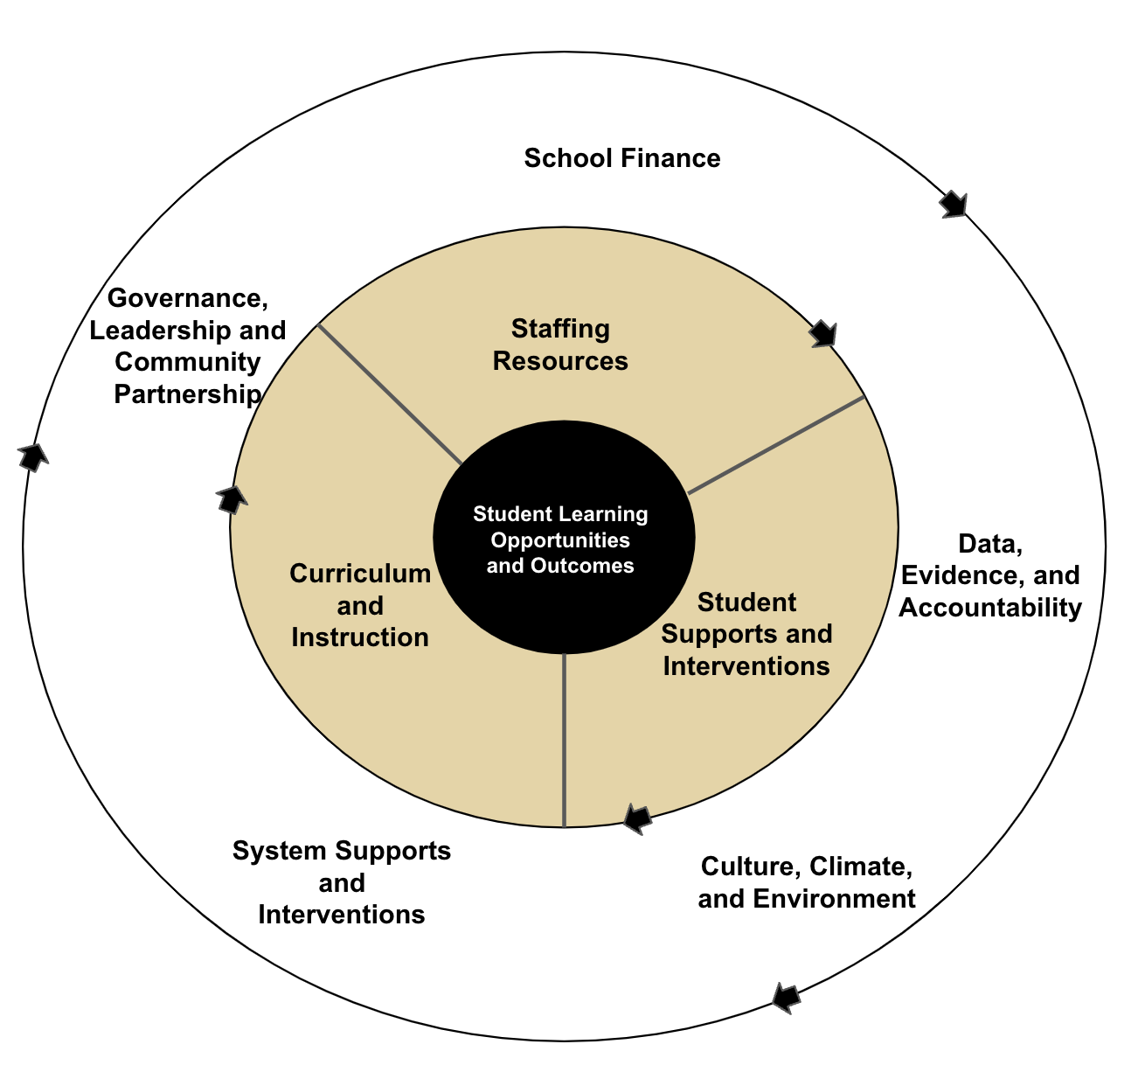
Conceptual Framework
Resources Equity Framework Embedded in a Data-Informed Iterative Improvement Cycle

Slide 15
Data Collection and Preprocessing
1. 24 interviews (45-60 minutes) with stakeholders:
Administrators: state legislators, other state-level policymakers, school district administrators;
Non-Profit and Advocates: teacher union representatives, policy advocates, and community leaders;
Educators: teachers, teacher coaches or mentors
2. Tidytext-format data contains about 1,700 entries (i.e. documents).
One complete thought (one long or several short sentences)
Filtered out stop words and words like “um,” “so,” and “you know”
Stemming
3. Contains interviewees’ research ID, demographics, job roles, and job location.
Notes:
corpus might not be considered as being “big”, they provide enough data for computational methods to produce meaningful results but not so much data that iterative human coding becomes intractable. The dataset also includes interviewees’ research ID, demographics, job roles, and job location.

Slide 16
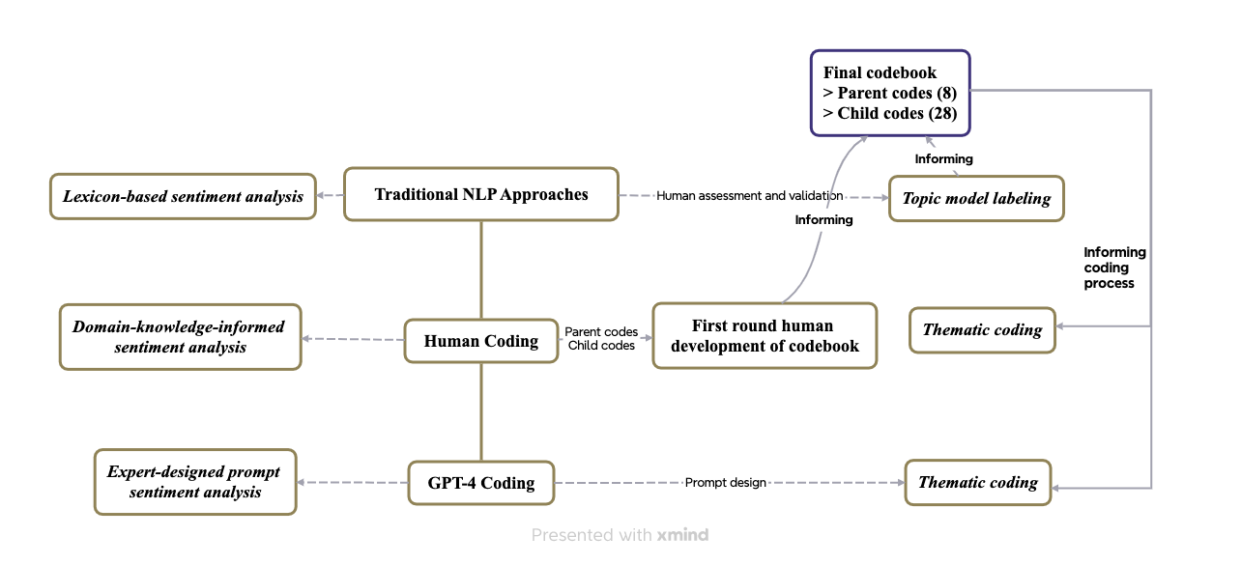
Methods: Human-Computer Interactive Approach
“This human-computer partnership approach (socio-technical) perspective on learning highlights how technology exerts agency in a relationship with educators and learners, as generative AI learns more with the quantity and quality of what humans provide to the technology, and vice versa. The reciprocal nature of AI learning and teaching interactions means that less bias and more flexibility in the tool are possible with increased human use.”
-- Katie Headrick Taylor, Alex Liu, Min Sun
Notes:
Human coding at the center of our approach– first round of codebook development, LDA
The final codebook then feed into the human coding, asking for 3 most salient themes; and GPT-4 coding– mimick human coding behaviors.
Sentiment analysis
Lastly, we compare and evaluate

Slide 17
LDA
Input
Pre-processing
Topic modeling
Output
Validation
Unorganized messy conversational texts
Remove stop words
Stemming
Human validation
Human labeling and making sense of the topics
List of coherent, valid topics
Proportion distribution of documents to topics
Summarizing topic proportions by subgroups of interviewees
Alignment with human coding

Slide 18
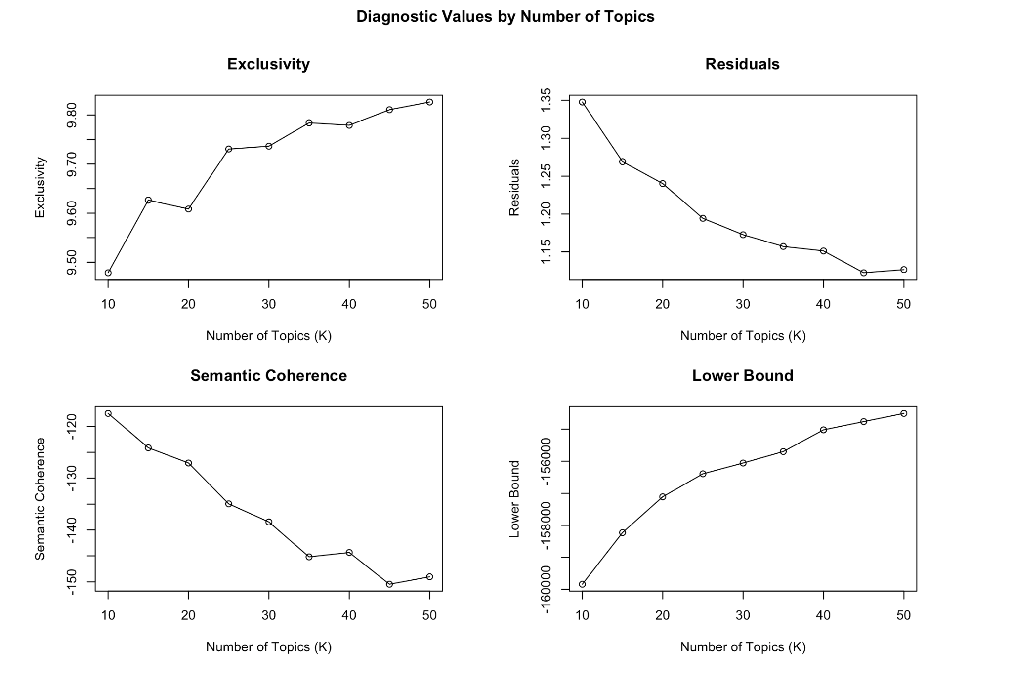
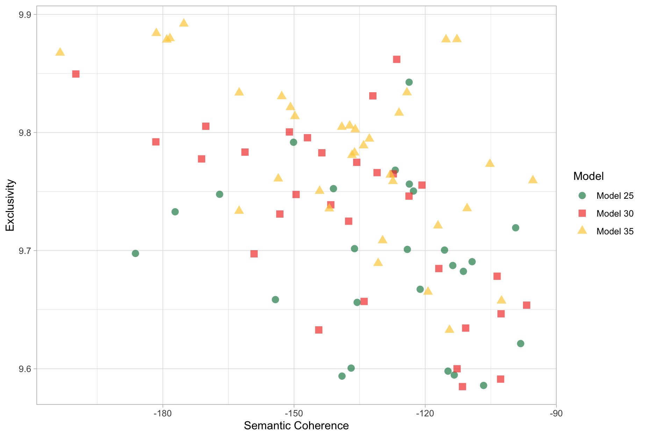
LDA
Exclusivity vs. Semantic Coherence
Diagnostic Values for a Number of Topics

Slide 19
Prompt Engineering
Zero-shot
Use the codebook to label three child and/or parent codes for each document; if no child code works, only label the parent codes.
Few shot:
Zero shot + here are a few examples.
Chain of thoughts
Step 1: label three parent codes with reasoning; Step 2: label child code within each parent code. If none of the child code applies, keep the parent code.
Resources to learn more about prompt engineering:
https://www.deeplearning.ai/short-courses/chatgpt-prompt-engineering-for-developers/
https://www.youtube.com/watch?v=dOxUroR57xs&ab_channel=ElvisSaravia

Slide 20
GPT-4 Thematic Analysis: Chain-of-Thought (CoT) Prompt
prompt_base = f"""
Task: As a policy researcher, you’ve been provided with a paragraph extracted from an interview with an education policy stakeholder. Utilize the attached “Voice to validity codebook “ (in excel format) to code the paragraph. The Codebook comprises four columns: ‘Parent’, ‘Child’, ‘Child_description’, and ‘Key words’.
Steps:
1. Identify Salient Themes:
Understand the paragraph’s content within the context of the Washington State K-12 public school system.
Refer to the ‘Parent’ column in the Codebook for broader thematic categories.
Pinpoint up to three salient themes from these ‘Parent’ categories.
These themes should highlight the most significant ideas in the paragraph.
Label the paragraph with the chosen ‘Parent’ themes.
2. Dive into Child Themes:
The ‘Child’ column in the Codebook lists detailed thematic subcategories, which fall under the broader ‘Parent’ categories.
The ‘Child_description’ elaborates on the ‘Child’ categories, and the ‘Key words’ column lists pertinent terms for each ‘Child’ category.
3. Associate with Child Categories:
Revisit the paragraph, keeping the Washington State K-12 public school system context in mind.
For each previously identified ‘Parent’ theme, pinpoint the appropriate ‘Child’ subcategories from the Codebook. The ‘Child_description’ and ‘Key words’ columns can aid your decision.
Ensure the ‘Child’ categories align with the paragraph’s content. If there’s no fit or you’re uncertain, label it as ‘None’.
From your identified ‘Parent’ and ‘Child’ pairs, pick the top three pairs that encapsulate the paragraph’s central ideas.
Label the paragraph with these three ‘Parent’ and corresponding ‘Child’ pairs.
Codebook: see attachment
Paragraph for Analysis:
[[[TEXTGOHERE]]]
Response Format:
Frame your answer as a JSON object containing the keys: ‘Parent 1’, ‘Child 1’, ‘Parent 2’, ‘Child 2’, ‘Parent 3’, ‘Child 3’, and ‘Reasoning’.
"""
Role, context, and overall task

Slide 21
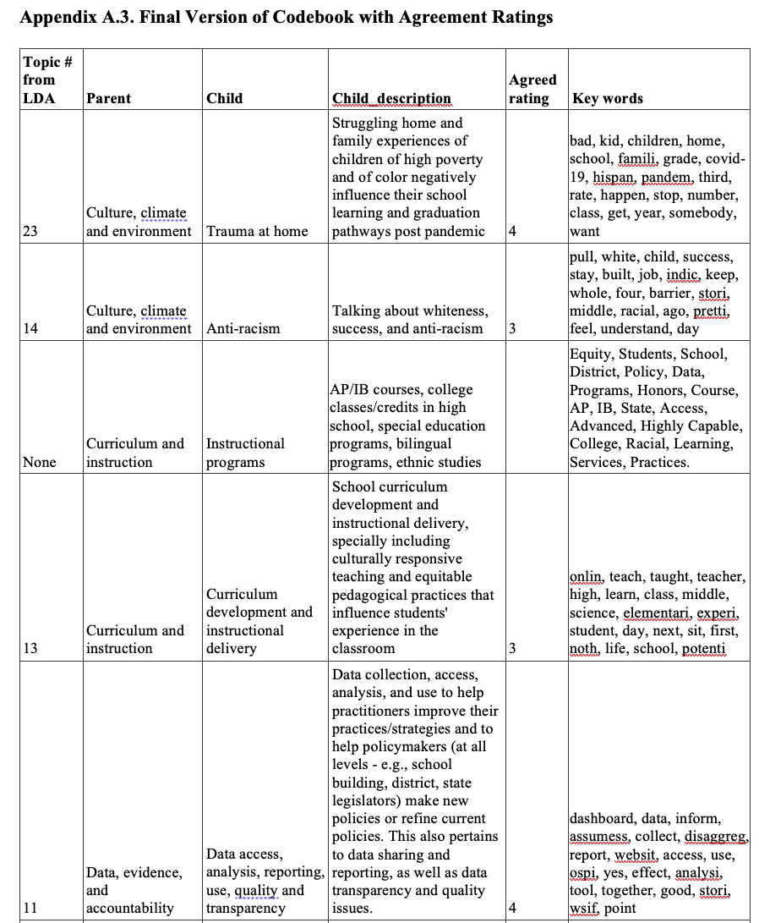
Codebook
Snippet of the codebook

Slide 22
Interactive Demo (10 mins)
Min will prepare codebook in excel.
2-3 interviews.
Prompt

Slide 23
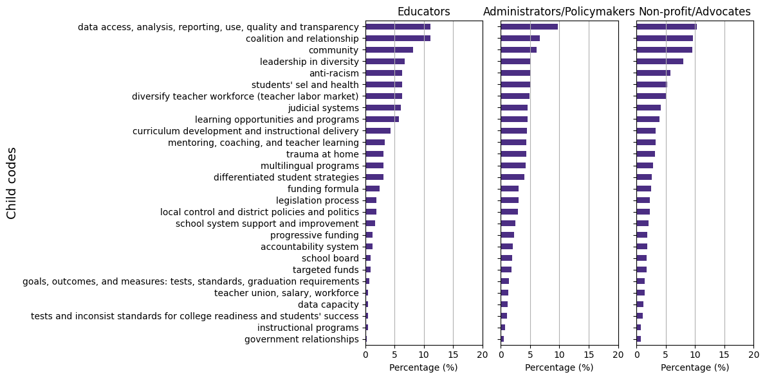
Results– SRQ1
What are the key themes that WA stakeholders voiced about K-12 public school system?

Slide 24
Results– MRQ1
How accurate and valid are GPT-4 labels of key themes when comparing to human experts’ labels and traditional topic modeling results?
Notes:
1. Hit Rate
Hit rate, can be seen as a measure of how many times a system successfully recommends items of interest out of all the opportunities it had to make such recommendations. It is closely related to recall but is more commonly used in scenarios like movie or product recommendations.
2. Precision: Precision is the fraction of relevant instances among the retrieved instances. It is defined as: Precision=TP/TP+FP where: TP (True Positives) is the number of correct positive predictions; FP (False Positives) is the number of incorrect positive predictions. Precision thus measures the accuracy of positive predictions, indicating the percentage of your positive predictions that were correct.
3. Recall: Recall, also known as sensitivity or the true positive rate, is the fraction of relevant instances that have been retrieved over the total amount of relevant instances. It is defined as: Recall=TP/(TP+FN) where: TP (True Positives) is as defined above; FN (False Negatives) is the number of positive instances that were incorrectly predicted as negative.Recall measures the ability of a model to find all the relevant cases within a dataset. It is especially important in situations where the cost of missing a positive instance (such as in disease screening) is high.
4. F-Score (F1 Score); The F-Score, or F1 Score, is the harmonic mean of precision and recall, offering a balance between the two by taking both false positives and false negatives into account. It is defined as: F1=2×((Precision×Recall)/(Precision+Recall); The F1 Score reaches its best value at 1 (perfect precision and recall) and worst at 0. It is a useful measure when you need to balance precision and recall, often in situations where there is an uneven class distribution, or when the costs of false positives and false negatives are very different.
An AUC of 1 indicates a perfect model; an AUC of 0.5 suggests no discriminative power, equivalent to random guessing.

Slide 25
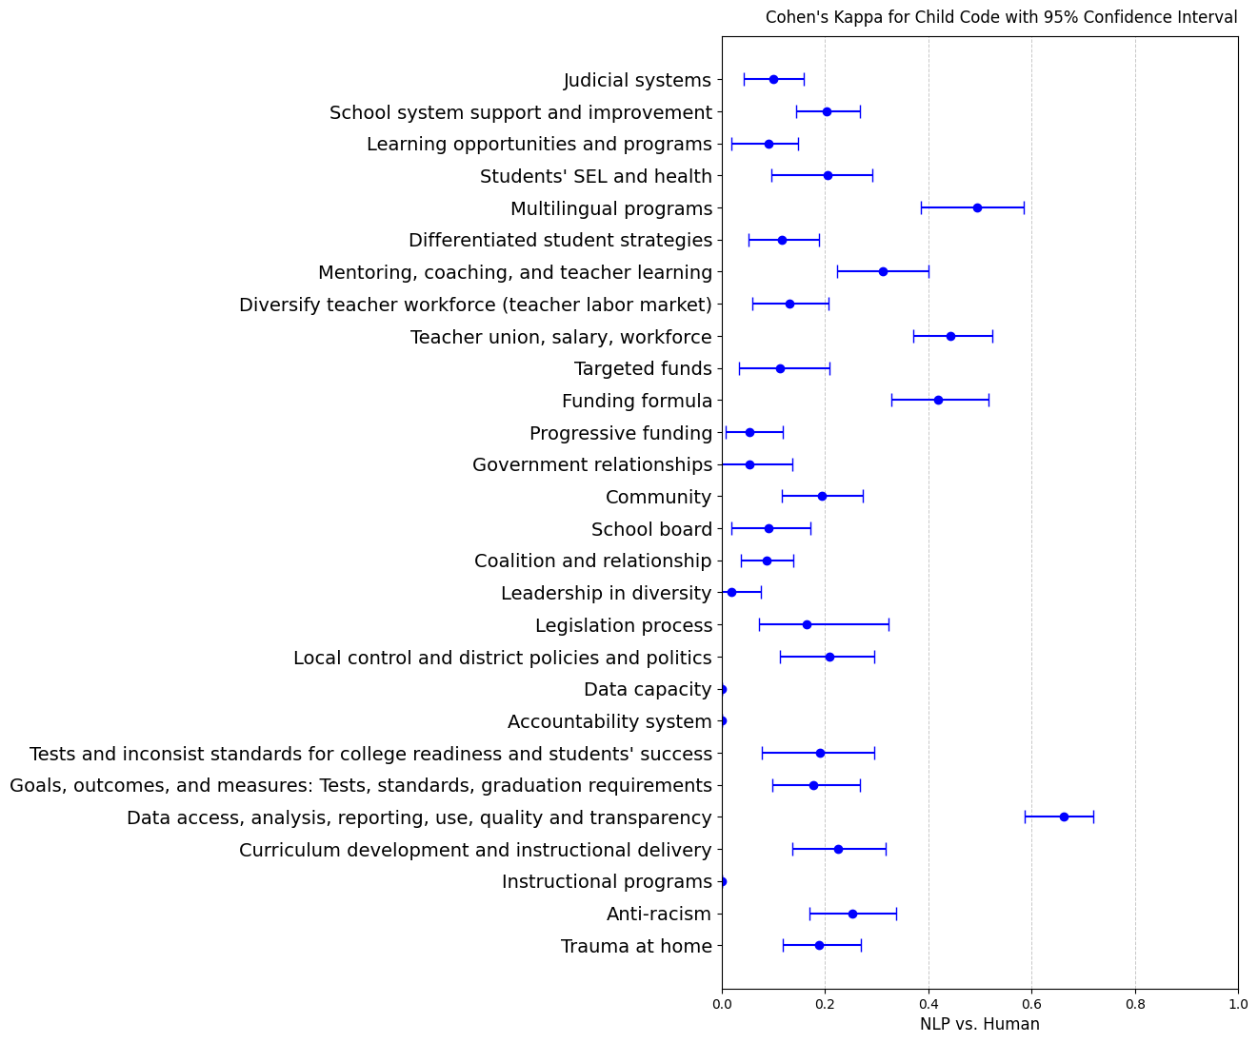
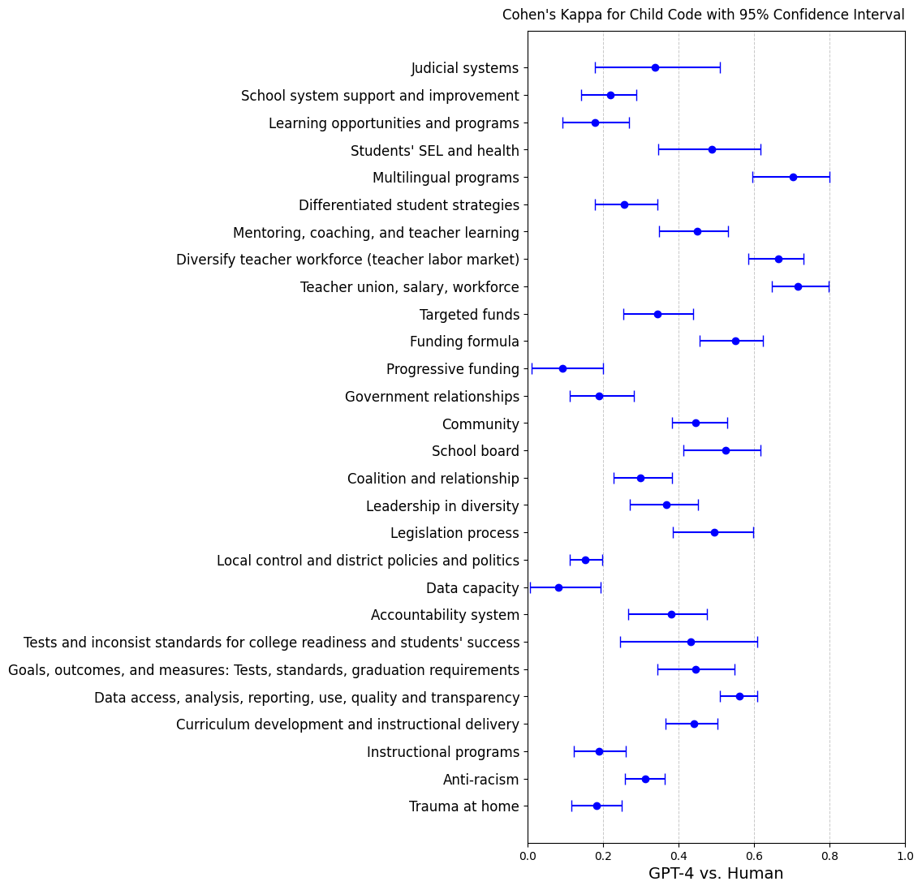
GPT-Human vs LDA- Human Cohen’s K by Child Code
LDA vs. Human
Notes:
Cohen's Kappa is a statistic that measures inter-annotator agreement for categorical items. It is more robust than simple percent agreement calculation since it takes into account the agreement occurring by chance. Cohen's Kappa adjusts for the agreement that could happen by chance, thus providing a more accurate measure of the actual agreement between two raters or a rater and a predictive model. A kappa value of 1 indicates perfect agreement, while a value of 0 indicates agreement equivalent to chance. Negative values indicate agreement less than chance, which signifies systematic disagreement.

Slide 26
Distribution of GPT-Human Cohen’s K by Child Code
The agreement varies greatly by themes.
Higher agreement on themes that are less domain specific, including multilingual programs; diversity teacher workforce; teacher union, salary workforce; funding formula; school board; data access, analysis, reporting, use, quality, and transparency.
Low agreement on themes that are more domain specific themes , including progressive funding; local control and district policies and politics; data capacity; trauma at home, instructional programs.

Slide 27
Discussion
LLMs’ performance is sensitive to prompts.
The utility of LLMs to assist domain-specific data analysis hinges on the integration of domain knowledge to inform prompt development
GPT-4 classifications are more accurate and valid for themes that are less domain specific.
(LLM vs Human) compares with (Traditional NLP vs Human)
LLM, to some degree, understand the meaning of the language and contexts, which traditional LDA or lexicon-based analysis are not able to.
Human experts have theoretical and domain knowledge and lived experience in ed policy.
Sentiment analysis
GPT and human have a higher agreement on either positive or negative, but lower agreement on neutral.
Traditional lexicon-based approach couldn’t capture domain-specific sentiment.

Slide 28
Code Demo
STM
LLM using API

Slide 29
Assignment
See Github site
Conduct a comprehensive thematic analysis on COVID-related research article titles using topic modeling and LLM.
Data Provided: You are given a dataset comprising 50,000 titles from COVID-related research articles. To facilitate a more efficient analysis, you are recommended to use a random sample for your study. The suggested sample size is as follows:
For Topic Modeling: Consider using a subset of less than 5,000 titles.
For Large Language Model (LLM) Analysis: The subset size of titles for analysis may vary depending on the version of ChatGPT or a similar LLM you are utilizing. A smaller subset from the topic modeling results might be necessary.
Research Question: Identify the prevailing topics in COVID-related research articles.

Slide 30
Next Week
Classification models:
Sentiment analysis
Multi-task classifier using transformer models
Validation
RADAR for more accurate and personalized recommendation:
Retrieve
Assess (with cosine similarity)
Decide (recommend, augment, or generate)
Augment (if necessary)
Regenerate (from scratch if below threshold)

Slide 31
Sentiment Analysis
Domain-specific definition of sentiment
prompt_base = f"""
Act as a policy researcher, you will classify the sentiment in the interviews of educational policy stakeholders as: “Positive”, “Negative”, or “Neutral”. Here is a statement from a policy stakeholder:
[TextGoHere]
To warrant “Positive” sentiment, the statement has to: (1) include the interviewee’s satisfaction about an educational policy (policies) and program(s), or (2) express an enhancement or potential to enhance the quality or equity of student learning or school system, or (3) identify an improvement from past practice. To warrant “Negative”, the statement describes the interviewees’ dissatisfactions, or identifies problems/issues/challenges, or suggests areas needed for further improvement. When the interviewee just states the fact without expressing either positive or negative sentiment, you can classify as “neutral”. When multiple sentiments are observed in one statement, identify the most prevailing sentiment. Explain your reasoning for your analysis."""
​​
Lexical-based sentiment analysis:
nltk.sentiment.vader package in Python

Slide 32
Sentiment Analysis
Confusion Matrix and Performance Metrics for Sentiment Analysis
 | GPT-4 → |  |  | Lexicon → |  |  | Performance Metrics
Human ↓ | Positive | Negative | Neutral | Positive | Negative | Neutral |  | Accuracy | Cohen's κ
Positive | 218 | 4 | 20 | 215 | 11 | 16 | GPT-4 vs.Human | 0.58 | 0.38
Negative | 71 | 322 | 162 | 347 | 151 | 57 | LDA vs. Human | 0.31 | 0.09
Neutral | 31 | 31 | 215 | 405 | 64 | 43
​​
GPT-4 is doing much better job than lexicon-based approach.
Agarwal et al. [2019] saw 𝜅 = 0.44 for news sentiment

