Slide 1

Session 14: Economic Evaluation

Slide 2
Goals for today regarding cost analysis:
Learn about economic evaluation research and where this work fits within the broader academic literature
Understand the basic steps to complete a cost analysis
Practice using the results of cost analysis to make an educational decision

Slide 3
Agenda
Mini-lecture with intermittent discussion (12:00 – 12:30 pm)
Activity, short break (12:30 – 1:20 pm)
Presentations (12:30 – 1:20 pm)
Summary and wrap up (1:20 – 1:30 pm)

Slide 4

What is “economic evaluation”?
Definition: Economic evaluation is evaluation that incorporates a measurement of cost, in addition to impact. You can also call it cost analysis.
…so, what’s evaluation?
Evaluation simply refers to the assessment of whether a product, practice, intervention, program, or policy is effective at producing the intended outcomes
https://www.nytimes.com/2024/04/24/opinion/ed-tech-classroom.html?unlocked_article_code=1.nk0.lA7D.mAjHIhj6X6YS&smid=url-share
…so, what do you mean by “intended outcomes”?
Evaluators must determine the specific outcomes that users of a product, practice, intervention, program, or policy are hoping to achieve (e.g., increased test scores, graduation rates, postsecondary enrollment, labor market outcomes
Notes:
So if you think we should be doing more qualitative work… that actually fits within CEA since it involved studying the implementation.

Slide 5
Outline of lecture/ discussion
Background on economic evaluation
Key concepts and basic steps for how to conduct an economic evaluation
Practice using the results of economic evaluation
Notes:
So if you think we should be doing more qualitative work… that actually fits within CEA since it involved studying the implementation.

Slide 6
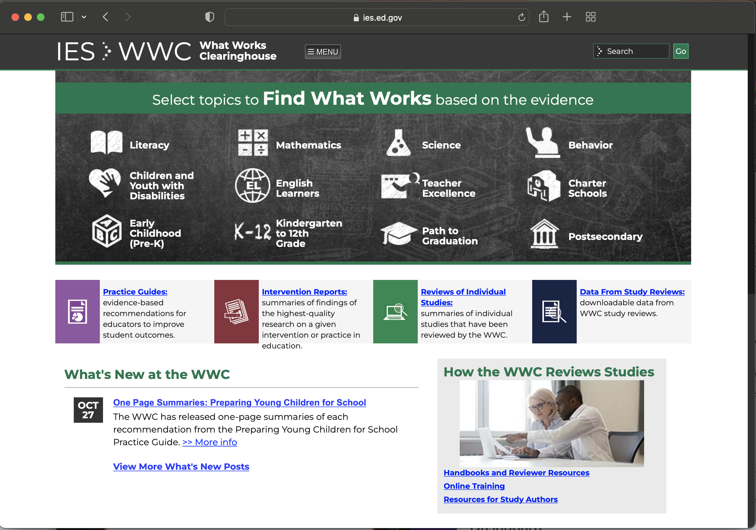


Does the government keep a list of programs that “work” in K-12 education?
Yes, the the What Works Clearinghouse includes a list of educational products or programs that have shown positive impacts on student outcomes through rigorous evaluation
Do they really call it the What Works Clearinghouse?
https://ies.ed.gov/ncee/WWC
https://marketbrief.edweek.org/marketplace-k-12/works-clearinghouse-looking-costs-implementing-interventions/

Slide 7


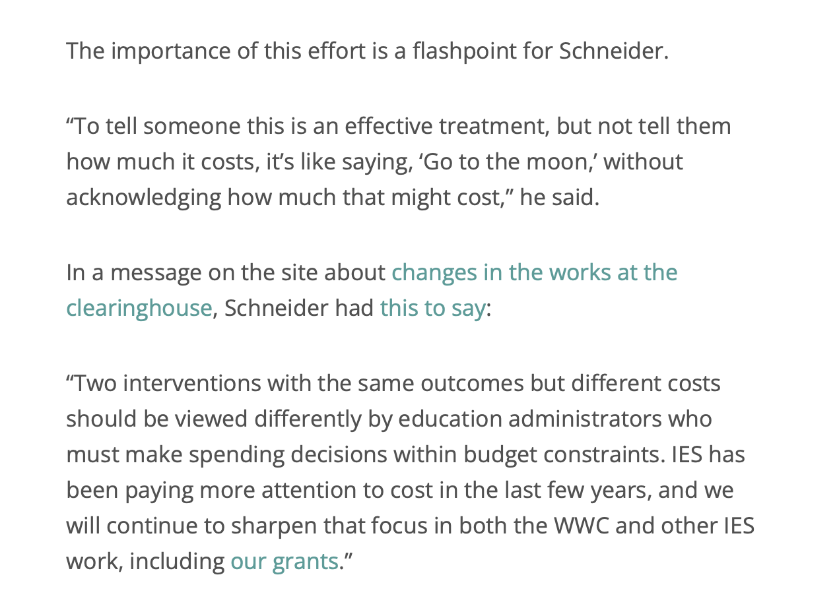
Does the government keep a list of programs that “work” in K-12 education?
https://marketbrief.edweek.org/marketplace-k-12/works-clearinghouse-looking-costs-implementing-interventions/

Slide 8
Where does cost analysis / econ. eval. fit within the broader education policy literature?
Much of educational research involves the evaluation of policies or programs;
Evaluation can be quantitative, qualitative, or mixed;
Quantitative evaluations generally come in two forms*:
1. Policy evaluation
2. Program or intervention evaluation
- What was the impact of NCLB?
- What is the impact of affirmative action?
- What is the effect of teacher tenure reform?
- Are alt-cert teachers as effective as traditionally prepared teachers?
- What is the impact of class size reduction?
- What is the impact of Guided Math for fourth graders?
- What is the effect of the AI curriculum planner tool?
- Is instructional coaching more effective than traditional teacher workshops?
* CEA can be used in both but is generally a much better fit for #2.
Notes:
So if you think we should be doing more qualitative work… that actually fits within CEA since it involved studying the implementation.

Slide 9
Where does cost analysis / econ. eval. fit within the broader education policy literature?
Mostly rhetoric
More studies emerging

Slide 10

Rhetorical Use of the term “Cost-Effective”
NCATE’s 2010 report:
National Council for Accreditation for Teacher Education (2010). Transforming Teacher Education Through Clinical Practice: A National strategy to prepare effective teachers. Report of the Blue Ribbon Panel on Clinical Preparation and Partnerships for improved student learning.
http://caepnet.org/~/media/Files/caep/accreditation-resources/blue-ribbon-panel.pdf
Notes:
http://caepnet.org/~/media/Files/caep/accreditation-resources/blue-ribbon-panel.pdf

Slide 11

Rhetorical Use of the term “Cost-Effective”
NCATE’s 2010 report:
http://caepnet.org/~/media/Files/caep/accreditation-resources/blue-ribbon-panel.pdf
Notes:
http://caepnet.org/~/media/Files/caep/accreditation-resources/blue-ribbon-panel.pdf

Slide 12
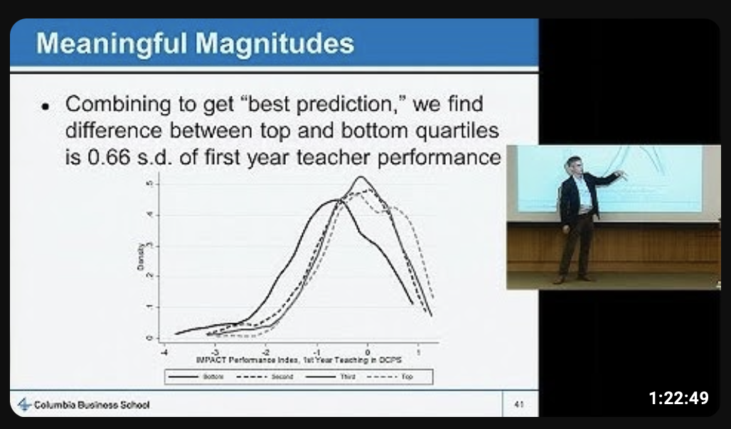

Rhetorical Use of the term “Cost-Effective”
Jonah Rockoff’s (2015) presentation for Stanford CEPA
NO!!!!!
https://www.youtube.com/watch?v=8p4xzKiftIU
Notes:
http://caepnet.org/~/media/Files/caep/accreditation-resources/blue-ribbon-panel.pdf

Slide 13
Rhetorical Use of the term “Cost-Effective”
What the author usually means:
Adopting a policy that appears “cost free”
Something that is low expense (vs. low cost)
Other examples of people incorrectly saying something is necessarily more “cost-effective”?
Asking principals to use an AI-based tool to building lesson plans
Implementing a new low-cost technology tool
Choosing more effective job applicants
Laying off less-effective teachers
Improving teacher professional development

Slide 14
Outline of lecture / discussion
Background on economic evaluation
Key concepts and basic steps for how to conduct an economic evaluation
Practice using the results of economic evaluation
Notes:
So if you think we should be doing more qualitative work… that actually fits within CEA since it involved studying the implementation.

Slide 15
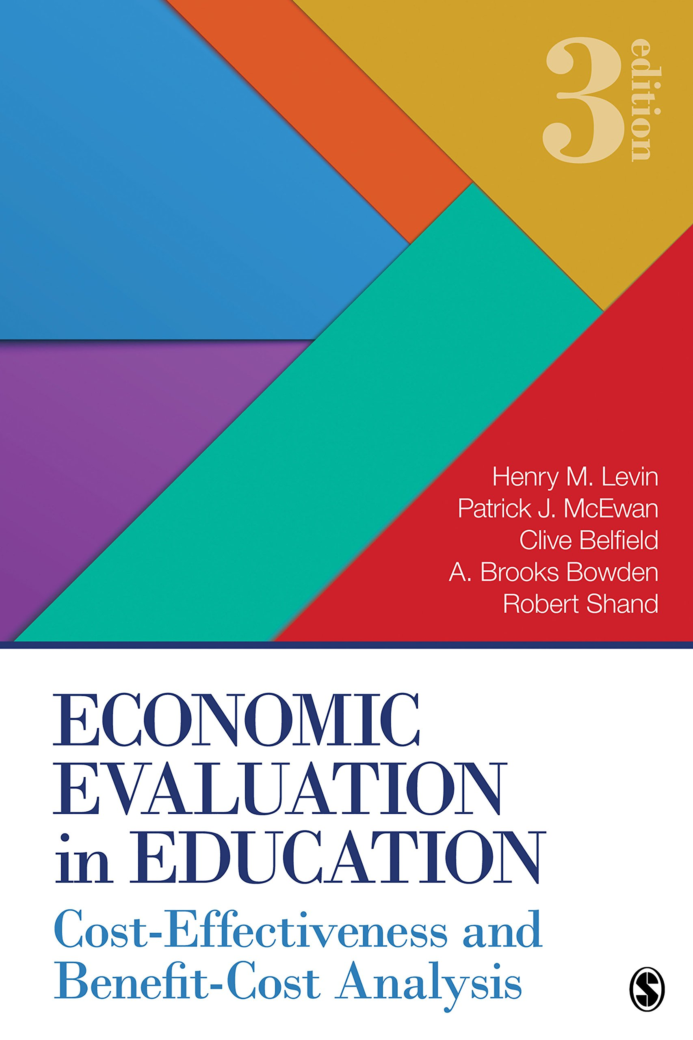
Types of Cost Analysis
  The main two:
  Cost-Effectiveness Analysis (CEA)
  Benefit Cost Analysis (BCA)
  Other kinds
  Cost Analysis (when you don’t have impact measure)
  Cost-Feasibility Analysis (less common)
  Cost-Utility Analysis (rarely used)
  “Cost of quality” studies in early childhood education
  Cost of adequacy studies for K-12 school finance litigation or finance formula calibration
Notes:
On

Slide 16



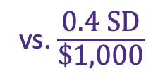

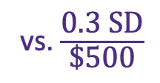
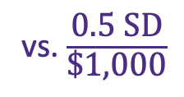
Types of Cost Analysis
  Cost-Effectiveness Analysis (CEA)
Compares multiple products/ interventions that have a common outcome measure, such as increase in test scores. Example:
  Benefit Cost Analysis (BCA)
EC ratios: $\frac{\text{0.2 }\text{SD} \text{test} \text{scores} \text{increase}}{\text{\$500} \text{per} \text{student} \text{per} \text{year}}$
vs. $\frac{\text{0.3 }\text{SD}}{\text{\$500}}$
vs. $\frac{\text{0.4 }\text{SD}}{\text{\$1,000}}$
vs. $\frac{\text{0.5 }\text{SD}}{\text{\$1,000}}$
BC ratio: $\frac{\text{2.7 }\text{pp} \text{incr} \text{in} \text{HS} \text{grad}\text{ , }\text{which} \text{increase} \text{wages} \text{by}\text{ \$52,000 }}{\text{\$}\text{8}\text{00} \text{per} \text{student} \text{per} \text{year}}$
$\frac{\text{\$52,000 }}{\text{\$}\text{8}\text{00} }$ = $6.50
=
Notes:
On

Slide 17
Key concepts
Ingredients method: how costs are measured
Ingredient: a resource used as part of a policy, practice, intervention, or program
Shadow pricing: estimating the price of something when a market doesn’t exist, e.g., parent volunteer, old school building, used computers, certain skill sets
Annualization: adjusting the price of an ingredient
Notes:
On

Slide 18
Basic steps to complete a cost analysis
The ingredients method (three steps):
  Identify all the resources required to implement the program, including the quantity of those resources and quantity per student
  Determine the price of those resources
  Multiply all prices by quantities; determine who bears the costs
Considerations
National average salaries vs. local salaries
Adjust for inflation
Annualize materials lasting multiple years
Scale staff investments over number of students served
Notes:
Does everyone understand these basic steps? (they’re pretty straightforward…)
Economic evaluation
Cost-benefit analysis -
Cost-effectiveness analysis

Slide 19
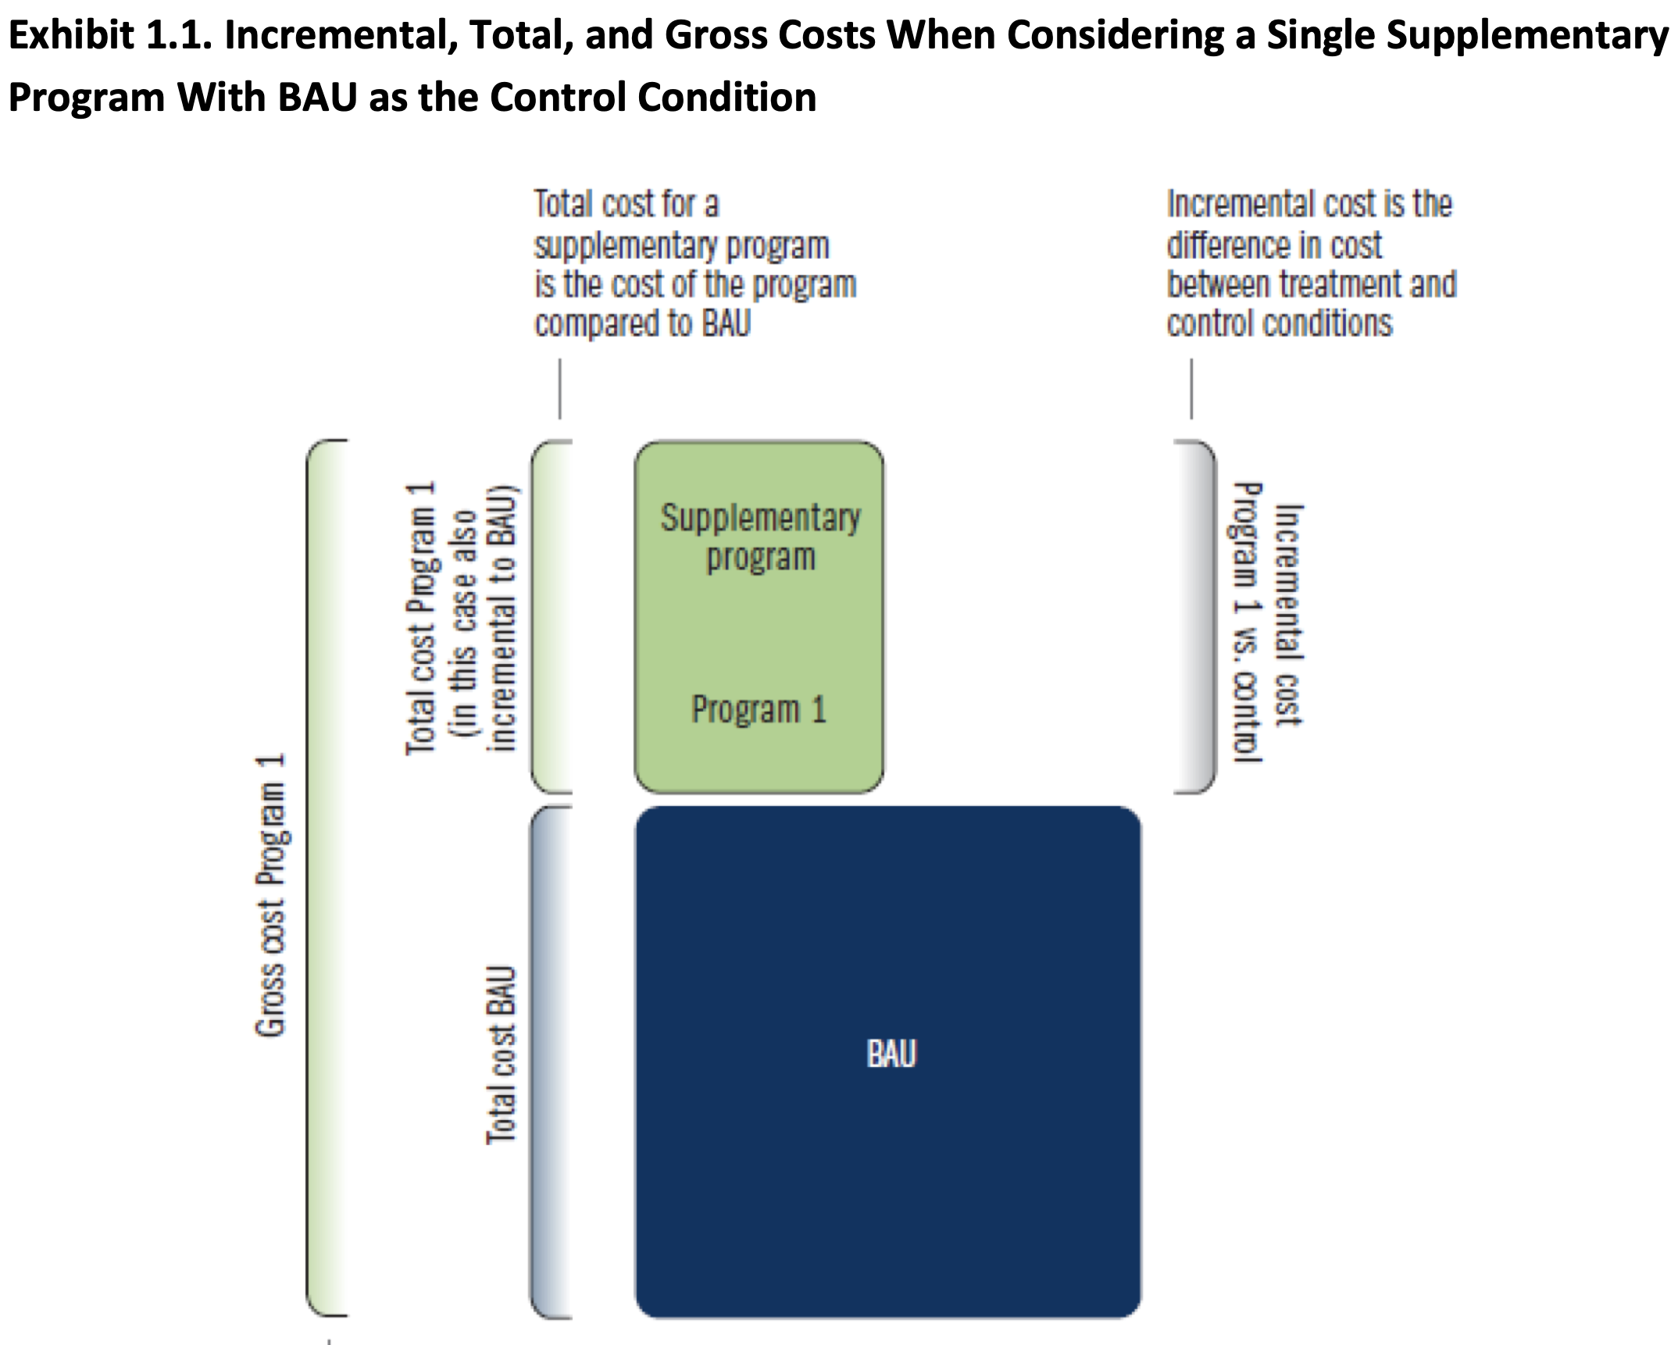
Conceptual framework: Many products are not “supplementary,” but actually “partially substituting”
Example of a program that fits neatly on top of existing practice
Source: https://www.air.org/sites/default/files/Standards-for-the-Economic-Evaluation-of-Educational-and-Social-Programs-CASP-May-2021.pdf

Slide 20
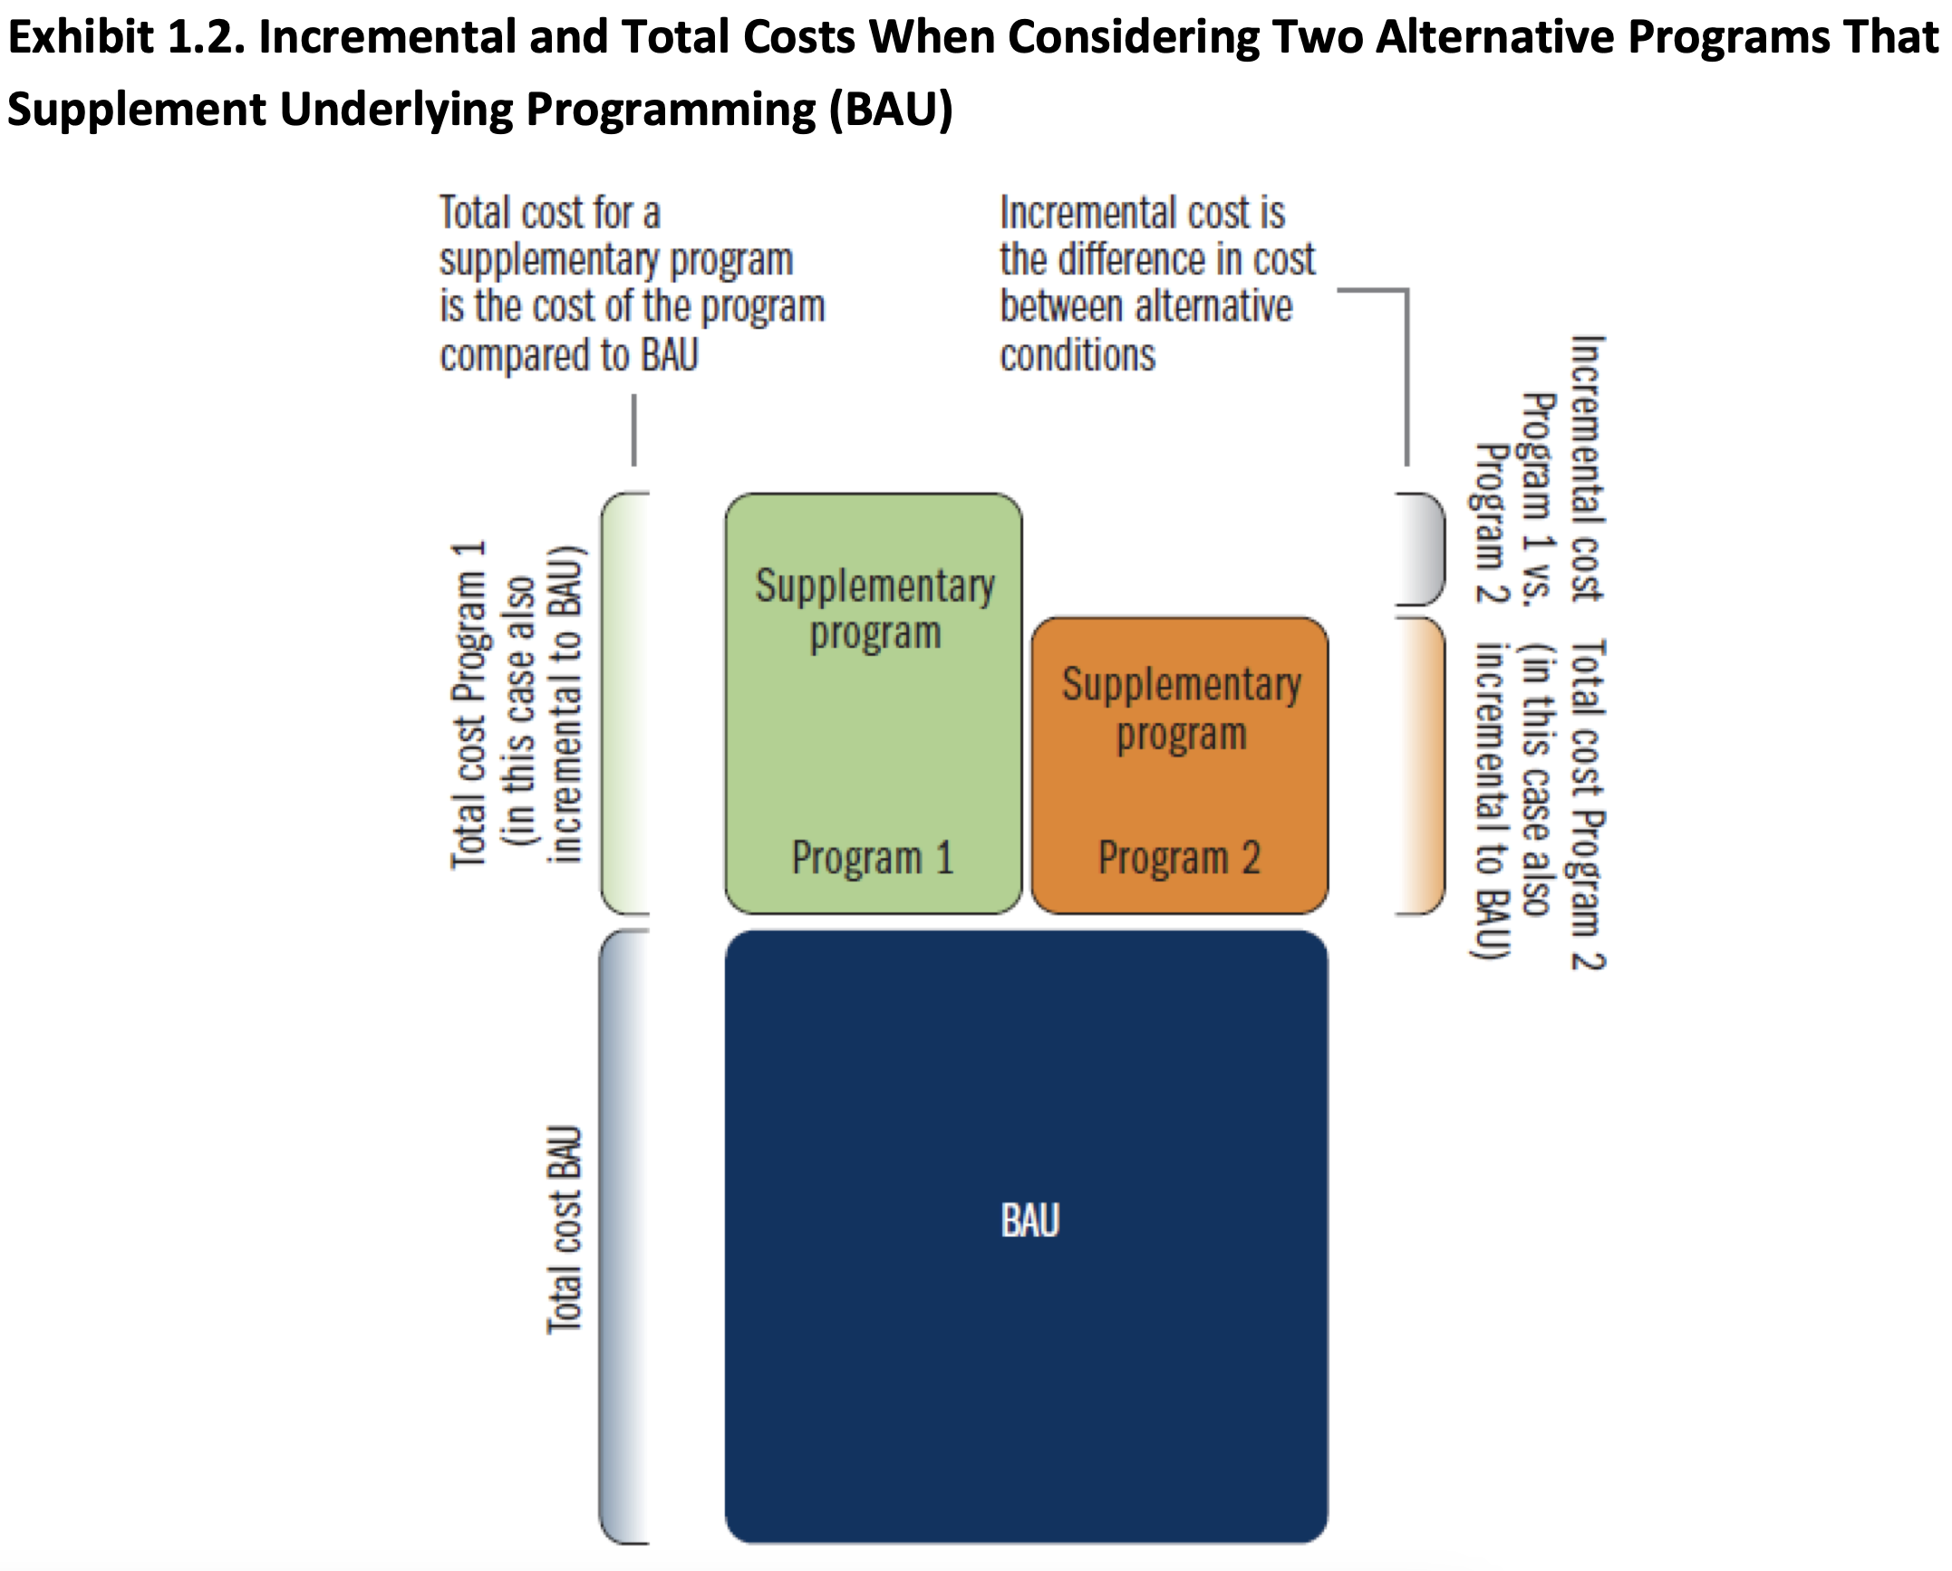
Conceptual framework: Many products are not “supplementary,” but actually “partially substituting”
Example of a program that fits neatly on top of existing practice
Source: https://www.air.org/sites/default/files/Standards-for-the-Economic-Evaluation-of-Educational-and-Social-Programs-CASP-May-2021.pdf

Slide 21
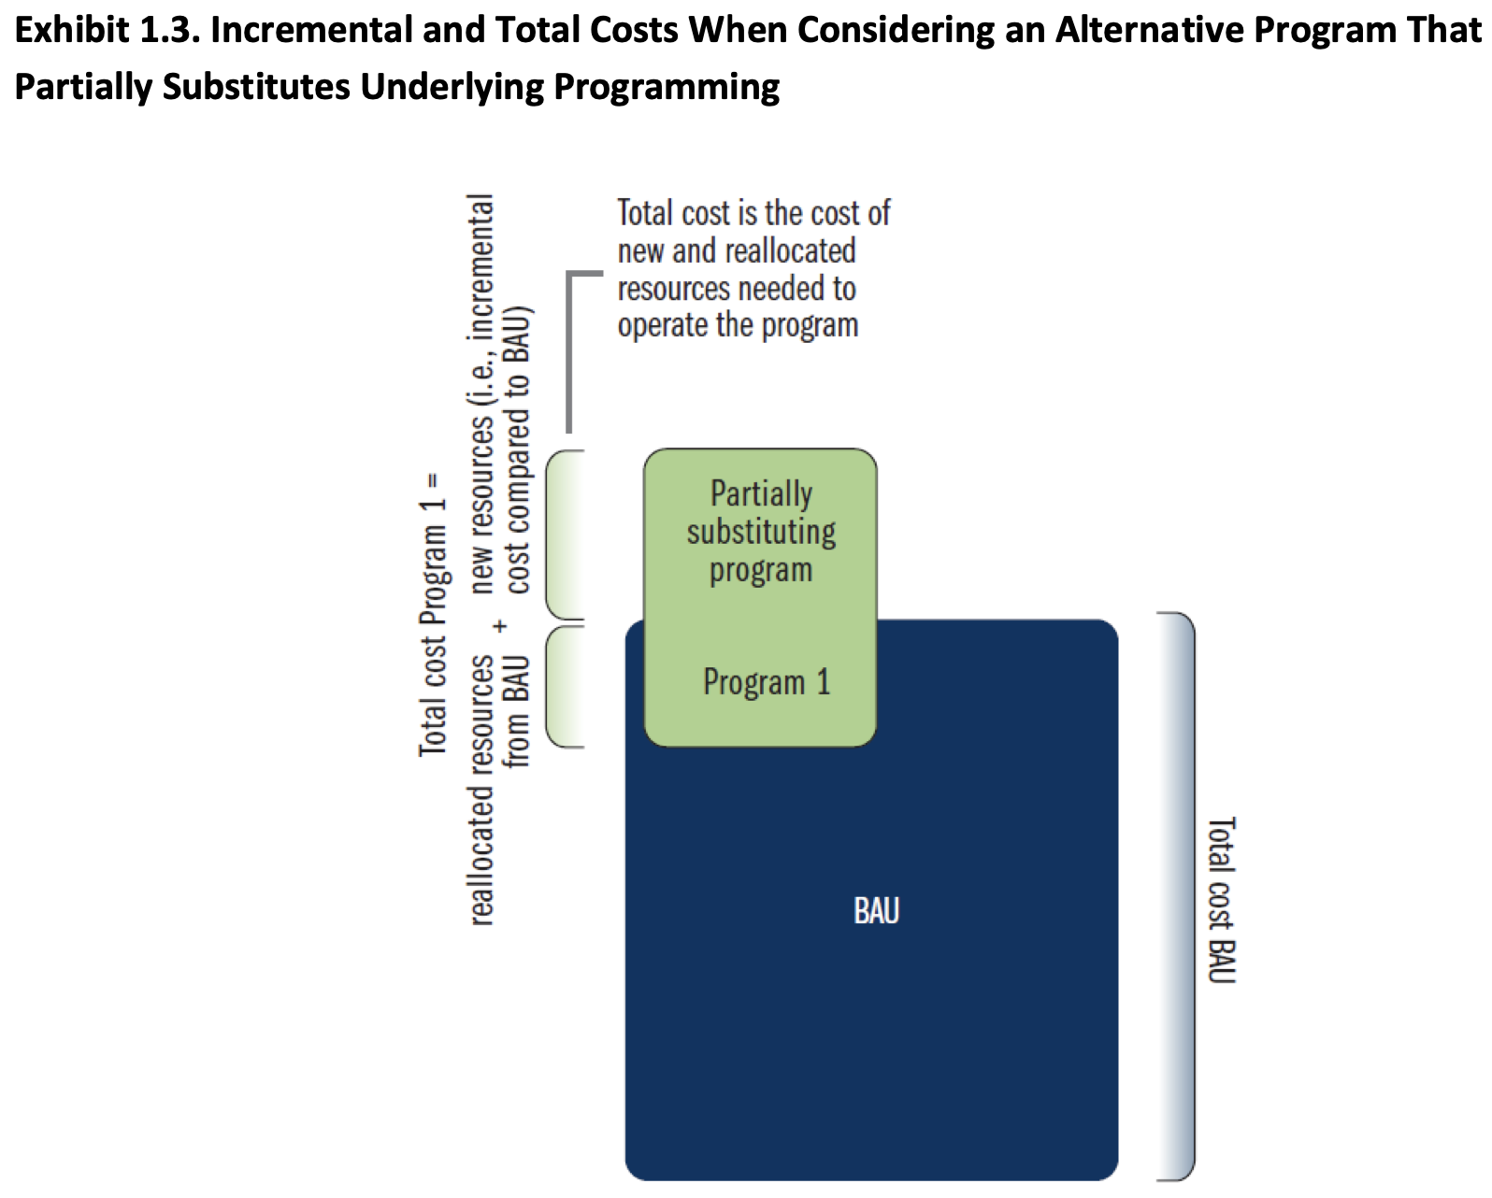
Conceptual framework: Many products are not “supplementary,” but actually “partially substituting”
Example of a program that is partially substituting
Source: https://www.air.org/sites/default/files/Standards-for-the-Economic-Evaluation-of-Educational-and-Social-Programs-CASP-May-2021.pdf

Slide 22

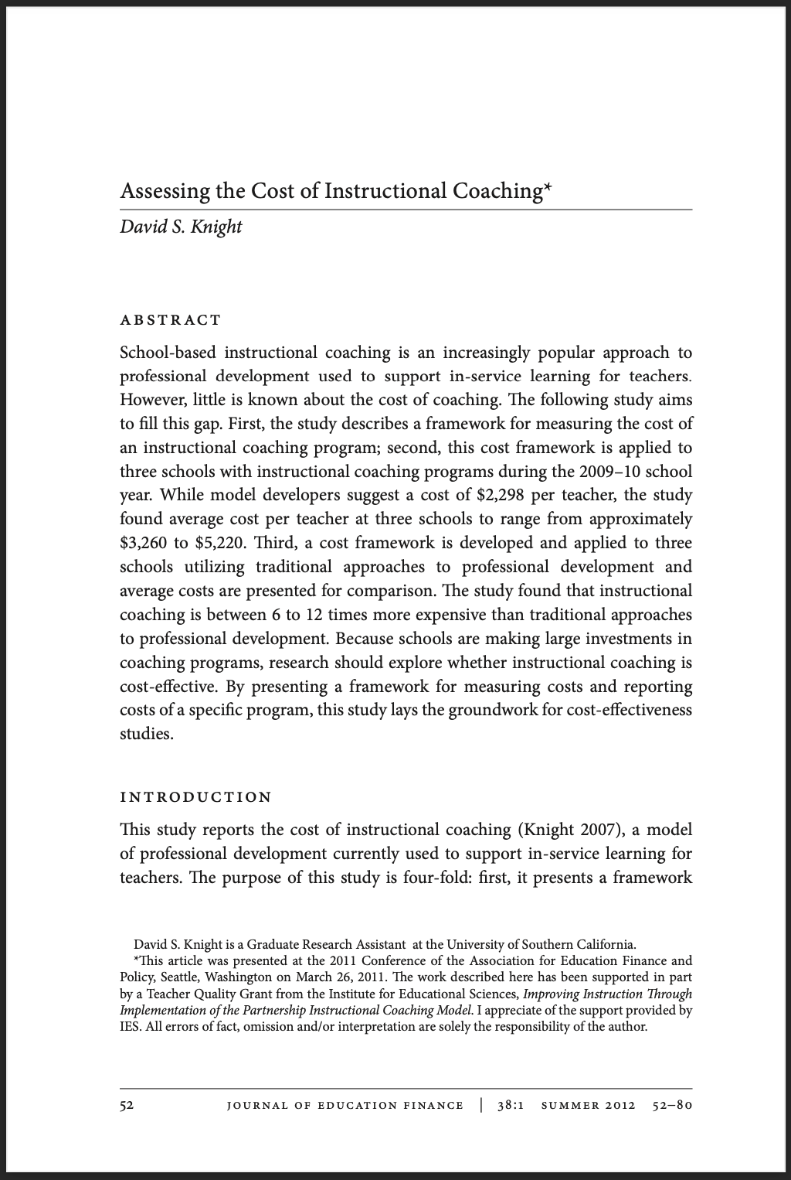
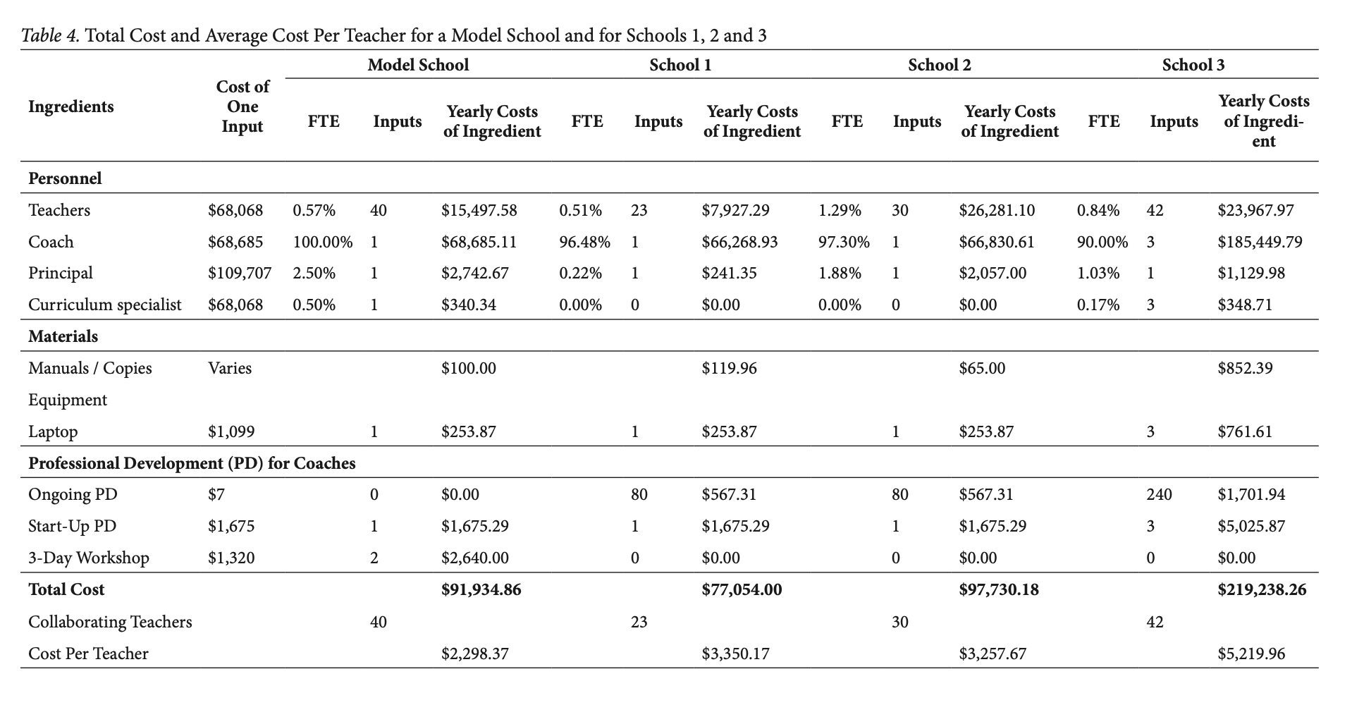
Example of a cost table
Notes:
Does everyone understand these basic steps? (they’re pretty straightforward…)
Economic evaluation
Cost-benefit analysis -
Cost-effectiveness analysis

Slide 23
Outline of lecture / discussion
Background on economic evaluation
Key concepts and basic steps for how to conduct an economic evaluation
Practice using the results of economic evaluation
Notes:
So if you think we should be doing more qualitative work… that actually fits within CEA since it involved studying the implementation.

Slide 24
Practice using the results of cost analysis to make an educational decision
Imagine you are the Director of a Head Start center…
You have received ESSER funds that amount to a 20% increase in your typical funding level…

Slide 25
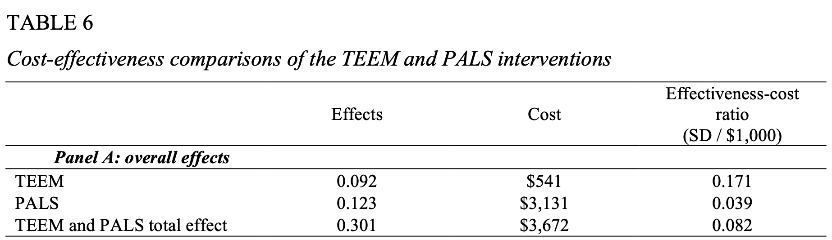
Practice using the results of cost analysis to make an educational decision
You are trying to decide how best to invest funds. You are considering teacher professional development (called TEEM), a home visit and parent coaching program (called PALS), or both…
You’re handed the following research findings…
TABLE 5
Effectiveness of two pre-school interventions on child outcomes, and their combined effect
(Texas Early Education Model)
(Play and Learning Strategies)
(Kids who received both had synergistic effects)
Source: Knight, D. S., Landry, S. H., Zucker, T. A., Merz, E. C., Guttentag, C. L. & Taylor, H. B. (2019). Cost-effectiveness of early childhood interventions to enhance preschool: Evidence from a randomized experiment in Head Start centers enrolling historically underserved populations. Journal of Policy Analysis and Management, 38(4), 891-917. DOI: 10.1002/pam.22145.

Slide 26
Practice using the results of cost analysis to make an educational decision
You are trying to decide how best to invest funds. You are considering teacher professional development, a home visit program, or both
You’re handed the following research findings…
Source: Knight, D. S., Landry, S. H., Zucker, T. A., Merz, E. C., Guttentag, C. L. & Taylor, H. B. (2019). Cost-effectiveness of early childhood interventions to enhance preschool: Evidence from a randomized experiment in Head Start centers enrolling historically underserved populations. Journal of Policy Analysis and Management, 38(4), 891-917. DOI: 10.1002/pam.22145.

Slide 27
An example of a benefit-cost analysis (Miller et al., 2018)
Background: Texas expanded dual credit education, which are courses that provide both high school and college credit. Was that a wise investment?
FINDINGS
Students who took DC courses finished their 4-year degree 1.0 months earlier on average.
Students who took DC courses were 2.2 percentage points more likely to finish a 2-year degree.
Our cost analysis showed that the resources allocated toward DC summed to a total value of $121 million, or about $111 per semester credit hour.
Source: Miller, T., Kosiewicz, H., Tanenbaum, C., Atchison, D., Knight, D. S., Ratway, B., Delhommer, S., & Levin, J. (2018). Dual-Credit education programs in Texas: Phase II. Washington, D.C.: American Institutes for Research..
Notes:
Students who took DC courses were also 2.2 percentage points more likely to finish a 2-year degree.
Our cost analysis showed that the resources allocated toward DC summed to a total value of $121 million, or about $111 per semester credit hour.

Slide 28
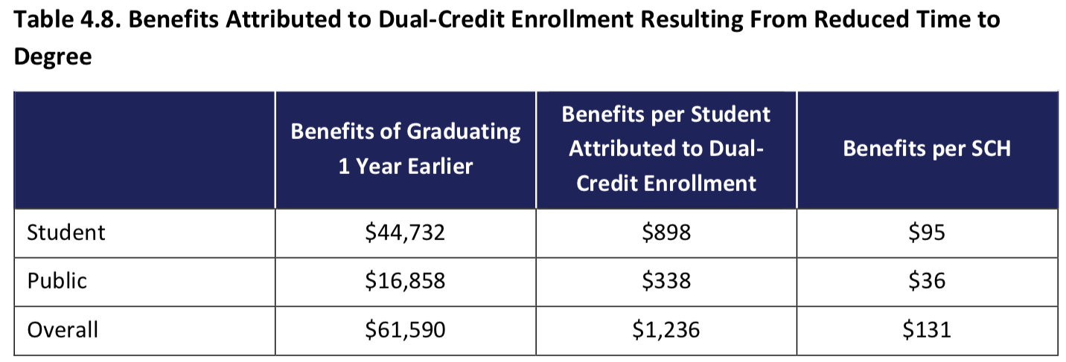
Examples of cost analyses from the literature
Background: Texas expanded dual credit education, which are courses that provide both high school and college credit. Was that a wise investment?
Source: Miller, T., Kosiewicz, H., Tanenbaum, C., Atchison, D., Knight, D. S., Ratway, B., Delhommer, S., & Levin, J. (2018). Dual-Credit education programs in Texas: Phase II. Washington, D.C.: American Institutes for Research..
Notes:
Note: The “benefits of graduating 1 year earlier” are the total benefits of a single student graduating 1 year earlier. The “benefits per student attributed to dual-credit enrollment” are the total benefits shown in the first column multiplied by the impact of less time to completion for four-year graduates (0.102 fewer years) and the proportion of dual-credit students this impact applies to (0.25). The “benefits per SCH” are the benefits attributed to dual credit divided by 9.5 (the average number of SCHs taken by dual-credit students).

Slide 29
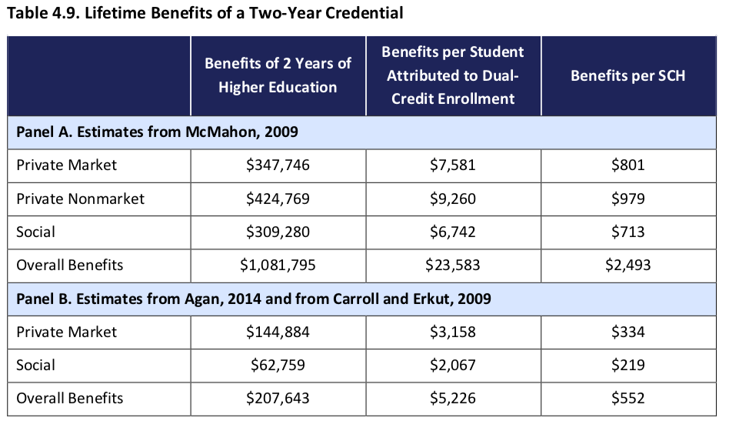
Examples of cost analyses from the literature
Background: Texas expanded dual credit education, which are courses that provide both high school and college credit. Was that a wise investment?
Students who took DC courses were also 2.2 percentage points more likely to finish a 2-year degree.
Our cost analysis showed that the resources allocated toward DC summed to a total value of $121 million, or about $111 per semester credit hour.
Source: Miller, T., Kosiewicz, H., Tanenbaum, C., Atchison, D., Knight, D. S., Ratway, B., Delhommer, S., & Levin, J. (2018). Dual-Credit education programs in Texas: Phase II. Washington, D.C.: American Institutes for Research..
Notes:
Note: All dollars represent net present value $2017 dollars. The “benefits of 2 years of higher education” are the total benefits of a single student obtaining 2 years of higher education compared with a high school graduate. The “benefits per student attributed to dual-credit enrollment” are the total benefits shown in the first column multiplied by the impact of dual-credit on obtaining a two-year credential (0.0218). The “benefits per SCH” is the benefits attributed to dual-credit divided by 9.5 (the average number of SCHs taken by dual-credit students).

Slide 30
Examples of cost analyses from the literature
Background: Texas expanded dual credit education, which are courses that provide both high school and college credit. Was that a wise investment?
Benefit type | Monetary Value per SCH | Cost per SCH | Benefit-cost ratio
Reduced time to 4-year degree | $131 | -- | $1.18
More 2-year degrees | $552 | -- | $4.98
Total | $683 | $111 | $6.15
Source: Miller, T., Kosiewicz, H., Tanenbaum, C., Atchison, D., Knight, D. S., Ratway, B., Delhommer, S., & Levin, J. (2018). Dual-Credit education programs in Texas: Phase II. Washington, D.C.: American Institutes for Research..

Slide 31
What questions do you have about cost-effectiveness analysis in education?
What about program evaluation and the WWC?

Slide 32
Wrapping up…

Slide 33

Pop quiz!
When poll is active respond at: PollEv.com​/davidknight790
https://www.polleverywhere.com/activities
https://www.polleverywhere.com/competitions/cAwucSUyqYhoQOCDqennv

Slide 34
Extra slides

Slide 35

We can measure cost and “outcomes” at the school level and create a scatter plot showing different “school-level effectiveness-cost ratios”
But first a quick note about “productivity” in education
“Productivity” = “efficiency” = $\frac{\text{Outcomes}}{\text{Spending} \text{per} \text{student}}$

Slide 36
We can measure cost and “outcomes” at the school level and create a scatter plot showing different “school-level effectiveness-cost ratios”
But first a quick note about “productivity” in education

Slide 37
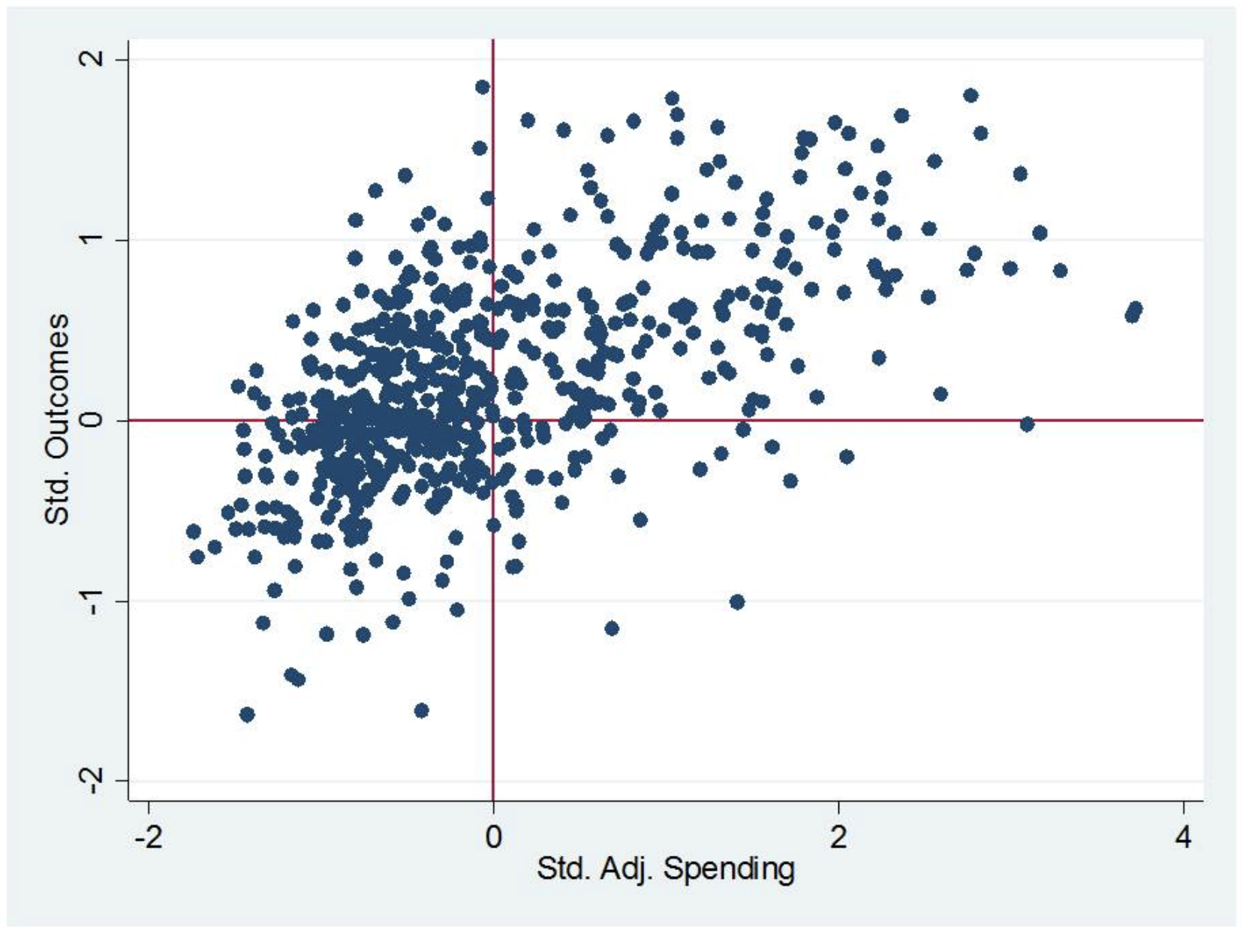
Small Group Activity: Tradeoffs in School Budgets
But first a quick note about “productivity” in education

Slide 38

We can measure cost and “outcomes” at the school level and create a scatter plot showing different “school-level effectiveness-cost ratios”
But first a quick note about “productivity” in education
Imagine you are a school that is high spending but has high outcomes (the green happy face).

Slide 39

We can measure cost and “outcomes” at the school level and create a scatter plot showing different “school-level effectiveness-cost ratios”
But first a quick note about “productivity” in education
Your goal is to move from the green happy face, over to the green sunglasses happy face.
[Cut spending without reducing outcomes]

Slide 40

We can measure cost and “outcomes” at the school level and create a scatter plot showing different “school-level effectiveness-cost ratios”
But first a quick note about “productivity” in education
You want to avoid cutting resources that would move you to the red frowny face.
[Cutting spending but reducing outcomes; honor equity]

Slide 41
Belfield and Bowden (2019) article
Six domains in which cost analysis can contribute to educational evaluation
Outcome specification
Treatment contrast
Implementation fidelity
Role of mediators
Statistical vs. economic power
Meta analysis

Slide 42
Belfield and Bowden (2019) article
Six domains in which cost analysis can contribute to educational evaluation
Outcome specification: test scores vs. behavior changes
Treatment contrast: what is the control group
Implementation fidelity: did the intervention take place as planned
Role of mediators: the why (e.g., vouchers or “mediated service interventions”
Statistical vs. economic power: MDES vs. MCES
Meta analysis: an average of good and bad studies and good and bad
interventions

