Slide 1
Machine Learning in Education I
ISEA Training Program 2026
Weeks 6
Lief Esbenshade

Slide 2
Topics
What is Machine Learning
  The field is moving fast
  Supervised, Unsupervised, Reinforcement, Generative
  Major Software Packages
Regression Models
  Gradient Descent Exercise
Binary Classification
Trees & Forests
Overfitting, Test/Train Splits
Accuracy, Confusion Matrix

Slide 3
What is Machine Learning?
“In basic terms, ML is the process of training a piece of software, called a model, to make useful predictions or generate content from data.” - Google Intro to ML Course Accessed Feb 17 2025
"Machine learning is the science of getting computers to act without being explicitly programmed." - Andrew Ng (2011)
Resource: Google Glossary of Machine Learning Terms

Slide 4

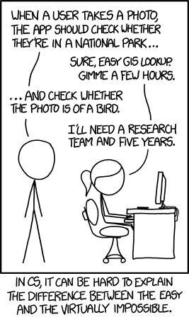
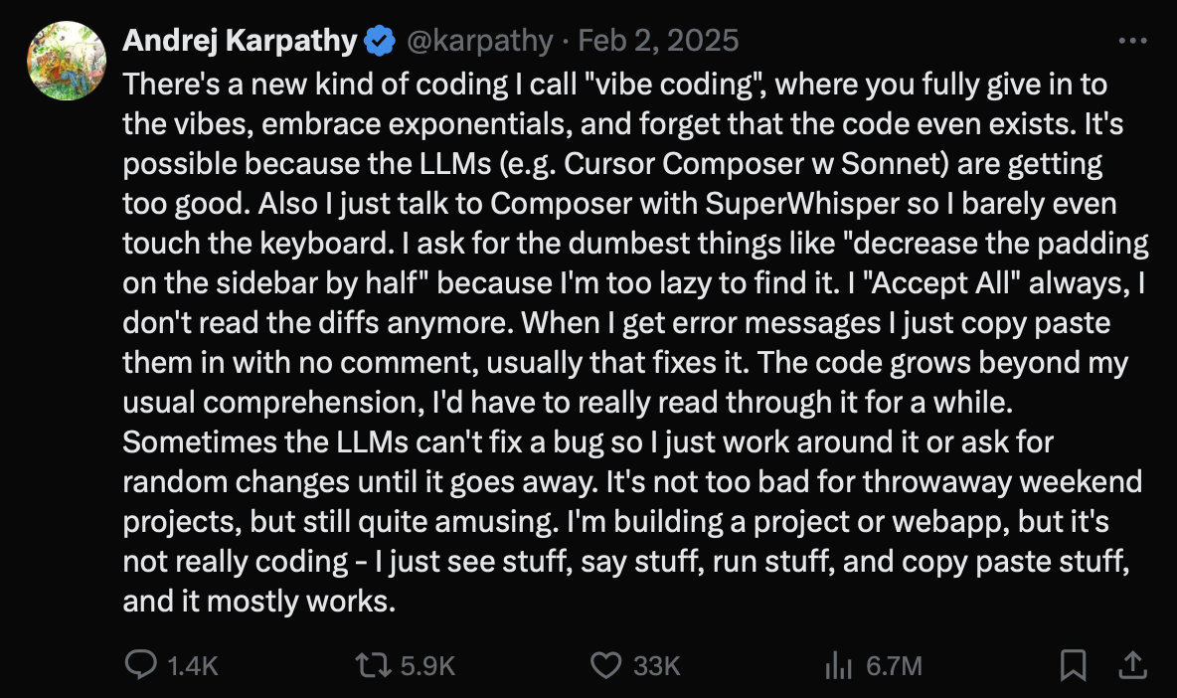

September 2014 a joke about something we can’t do
May 2017 - a joke about the current hot trend
Silicon Valley, S4E4
January 2021 past classification, now generation
https://xkcd.com/1425/
DALL-E 1 https://openai.com/index/dall-e/
3 Years
4 Years
4 Years
February 2025
Vibe Coding
Notes:
A lot of the mathematical techniques behind machine learning are actually pretty simple and were developed over the last century (e.g. neural networks in 1943). BUT they weren’t computationally feasible until much more recently.

Slide 5
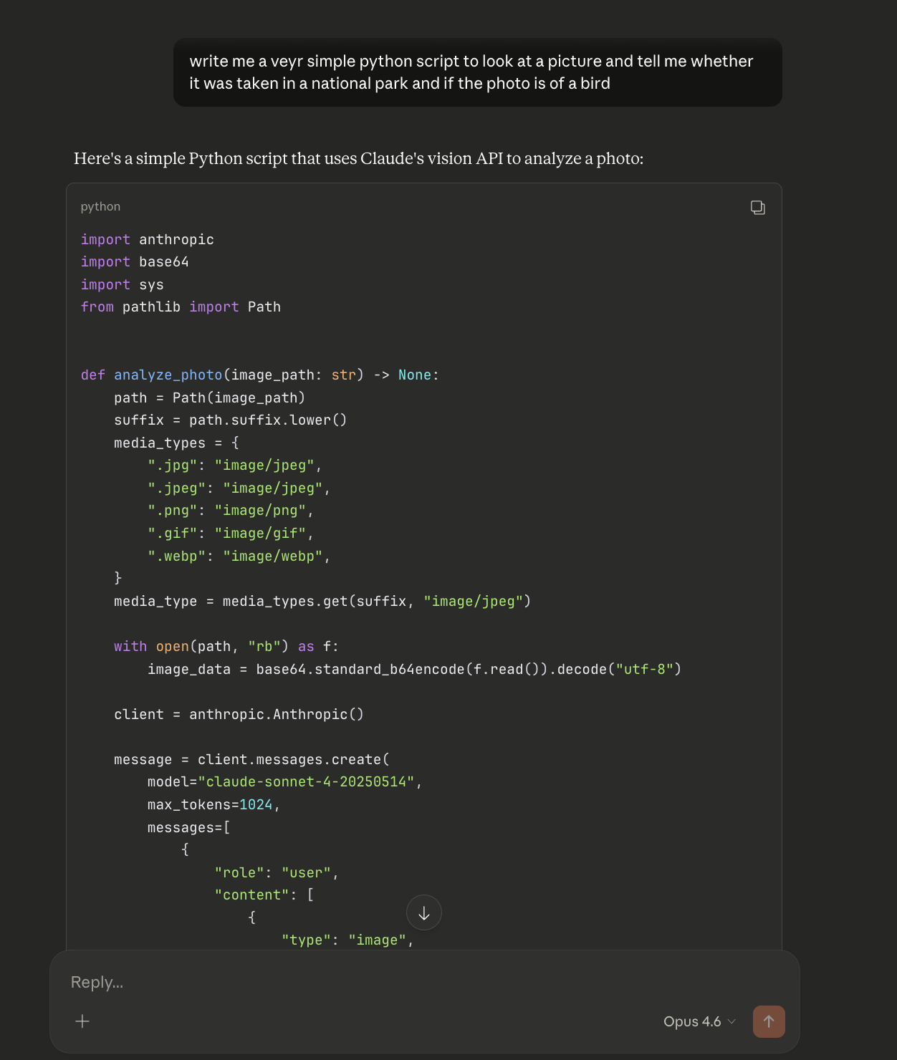
11 Years

Slide 6
4 Major Types of Machine Learning Models
Supervised: Models learn from labeled data to make predictions or classifications based on known input-output pairs
  OLS Regression, logistic regression, random forest, neural networks
  Predicting student graduation outcomes, Email spam filters
Unsupervised: Models identify patterns, structures, or groupings in unlabeled data without predefined outcomes.
  Examples: K-means clustering, Principal Component Analysis (PCA)
  Grouping students into learning clusters based on performance patterns to personalize instruction, Spotify music recommendations
Reinforcement: Models learn optimal decision-making by interacting with an environment and receiving rewards or penalties.
  Deep Q-Networks (DQN), Policy Gradient Methods
  Developing intelligent tutoring systems that adapt learning paths based on student interactions (Duolingo), Google AlphaGo
Generative: Models learn to generate new data similar to the training distribution, creating realistic text, images, or audio
  Generative Adversarial Networks (GANs), Large Language Models (LLMs)
  Colleague.AI, ChatGPT

Slide 7
Scikit-Learn
Major open source package in python for Machine Learning
Consistent API for ML work
Transform Data: X_scaled = StandardScaler().fit_transform(X)
Fit Models: DecisionTreeClassifier().fit(X, y)
Predict Outcomes: y_pred = model.predict(X)
Evaluate Models: acc = accuracy_score(y, y_pred)
Tune hyper-parameters:
  param_grid = {"max_depth": [1, 2, 3, 4, 5, None]}
  search = GridSearchCV(model, param_grid, cv=5).fit(X_scaled, y)
COLAB Example

Slide 8
Keras & Tensor Flow
Used for deep learning with ‘tensors’
A tensor is an n-dimensional data structure
  A single value (e.g. 9) is a 0 Dimensional tensor, a vector (e.g. [1, 2, 3, 4]) is 1D tensor, a matrix is 2D. If an image can be represented as a 2D matrix of pixels, how many dimensions is a GIF? What about one with sound?
Keras started out independent and has been integrated into TensorFlow
Consistent API for deep learning
Tensors for x and y
Layers
  model = tf.keras.Sequential([
  tf.keras.layers.Dense(64, activation='relu'),
  tf.keras.layers.Dense(10, activation='softmax') ])
Compilation and Optimization
  model.compile(
  optimizer='adam',
  loss='sparse_categorical_crossentropy',
  metrics=['accuracy'])
Fit, Evaluate, Predict
  model.fit(X_train, y_train, epochs=5)
  test_loss, test_acc = model.evaluate(X_test, y_test)
  predictions = model.predict(X_test)
COLAB Example
Notes:
PyTorch is an alternative to TensorFlow, more common in research settings.

Slide 9
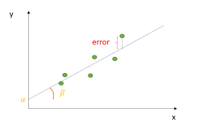
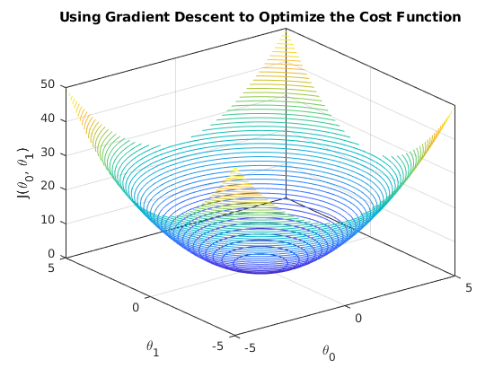
OLS Regression and Gradient Descent
Create a line (y = mx+b) through a distribution of x, y data points
  Has a slope (m) and an intercept (b)
Minimize the sum of the squared error (“Cost Function”)
  (Y - Predicted y )^2
Coefficients can be calculated directly - but matrix inversion can be computationally expensive
  Matrix inversion compute cost: O(n³)
Gradient descent use the slope of the cost function
  Can be faster with big n: O(k×n²) [k = iterations]
Gradient Descent is a generalizable optimization
Framework

Slide 10
Key Steps in Gradient Descent
Goal: Learn parameters for slope and intercept
Initialization: Start with random initial values for model parameters
Iterative Updating of Parameters:
  Compute the gradient of the cost function
  Update parameters using negative gradient and a learning rate
Convergence, repeat the process until:
  The cost function converges to a minimum
  specified number of iterations is reached
Colab Time
Split into groups after intro for 15 minutes
Reconvene at 12:50

Slide 11
5 minute break!
Return at 1:08

Slide 12
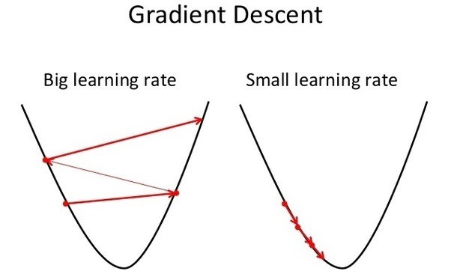
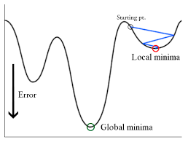
More on Gradient Descent
Choosing the Learning Rate
  Too small you take forever to converge, too large you can get divergent results
  Use learning rate schedules (step decay, adaptive methods)
Convergence Issues and Local Minima
  Momentum technique, adaptive optimizers (Adam, RMSprop)
Feature scaling
  Gradient descent can have issues when features are on very different scales
  Normalize or standardize your features (minmax, z-score)
Batch Size
  Batch (this is what we did) use the whole dataset to compute the gradient
    Can’t use this if your dataset is enormous and you can’t fit the x’s all in memory
    Can get stuck in local minima
  Stochastic Gradient Descent (SGD) updates parameters one randomly selected input row at a time
    very noisy, works with very large datasets
  Mini-batch breaks the data set up into multiple groups (‘batches’) and updates parameters one batch at a time
Notes:
Adam = Adaptive Moment Estimation, incorporates moving average into gradient updates of parameters
RMSProp adjusts learning rate for each param based on average of squared gradients

Slide 13
Classification
OLS, and many other models, create a numeric output, often we want to put data into a category, this is called Classification.
  Spam / Not Spam, At Risk / Not at Risk
OLS, Logistic Regression, Decision Trees, Random Forest, Support Vector Machine, Neural Networks are all models used in classification problems.
“Thresholding” is the term for converting a continuous score into a class by setting a decision threshold
  A simple version, predict "positive" if score > 0.5
  You can examine how categories change with different thresholds
  Can set multiple thresholds (high, medium, low risk)
  Can vary thresholds for different groups (e.g. for demographic parity)

Slide 14

Trees
Split data into hierarchical if-then rules based on feature values
Recursively split data to minimize impurity (e.g. Gini Index)
  Don’t use gradient descent
Non-linear!
  Nice trick for missing data, just put a value far outside the normal data range
Small trees are inherently interpretable
Very prone to overfitting
COLAB Example

Slide 15
Overfitting, Test/Train Splits
In supervised machine learning, we have a set of X features and y outcomes. The goal is not to predict the y outcomes we have already observed, but to build a model that can generalize to new X inputs and predict unseen y outcomes. If the new set of X and y were identical to the training data, we wouldn’t need ML, a lookup table would do!
It’s easy to forget this and overfit a model, meaning it learns patterns too perfectly in the training data, capturing noise or spurious relationships rather than real trends. This issue is particularly common in decision trees and neural networks but can also happen in regression when using excessive feature interactions or polynomial terms (do you really need x¹ to x¹³?).
To avoid overfitting, split data into training and test sets. Train the model using the training set, and evaluate its performance using the test set. The test set should only be used at the end; if you check accuracy on it too early, it essentially becomes part of the training data, leading to biased estimates of model performance.
A paper where I investigate overfitting questions in multi-year modelling scenarios

Slide 16
Random Forests
Decision trees are prone to overfitting their training data and generalize poorly
Random forests are ensembles (crudely averages) of many decision trees each trained on a random subset of the data.
They tend to be much more stable and generalize much better

Slide 17
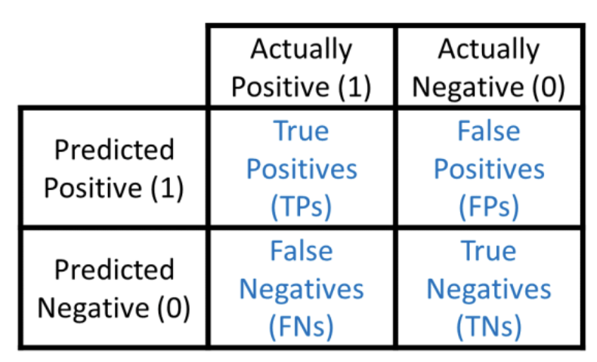
Measures of Classification Model Fit:
Accuracy, Precision, Recall
Accuracy: Number of correct predictions divided by the total number of cases predicted.
  (True Positives + True Negatives) / Total Cases
  Would you buy a model that predicts high school graduation rates with 90% accuracy?
  ‘Accuracy’ is not useful alone - beware when that’s the only evaluation number given
Precision: are we over-identifying positive cases?
  True Positives / (True Positives + False Positives)
Recall: are we missing positive cases?
  True Positives / (True Positives + False Negatives)
Lots of measures that build off the confusion matrix framework!
Also measures based on continuous scores:
  Demographic Parity, Calibration, AUC-ROC
Colab Simulation Comparing Fairness Metrics

Slide 18
Fairness Theory
Fairness is application specific, there is no one fairness measure to maximize
What are the consequences of your model’s predictions?
  How will impacts of the model be evaluated? ‘Fair’ in the historical administrative data isn’t the same as ‘Fair’ in use
    Paradox: If a model predicts outcome X for user A but not for user B, and users take actions to prevent outcome X from occurring for A, but it then occurs for B instead, should a retrospective analysis conclude that the model was wrong?
What is the data generating process (DGP) that your model relies on?
How does the use of your model connect to the DGP?

Slide 19
Fairness Measures
Demographic Parity
  Model’s predictions are independent of a sensitive attribute
  Positive predictions at equal rates across demographic groups
    Does this make sense in an unequal society?
Calibration Fairness
  Predicted risk (p’) is equal to probability of outcome (p)
  Measures quality of absolute risk score
AUC ROC
  Probability that a randomly selected dropout has a higher risk score than a randomly selected graduate
  Measures quality of relative ranking

Slide 20
HW - Student Risk Predictions
Rule based models like Allensworth & Easton (2009) “Chicago Model” were historically used in identifying students at risk of not graduating high school.
Mid 2010’s explosion in research in using ML models to predict dropout/persistence.
  Availability of longitudinal student administrative data
  Newly accessible ML techniques
  Lots of adoption and commercialization
For next session there are several readings about risk prediction systems and you will train two models of your choice (See canvas)
  I recommend sticking with sci-kit learn
  Look at the last section of the decision tree example if you are stuck getting started
Assignment details are on Canvas

