Slide 1
Machine Learning in Education II
ISEA Training Program
Weeks 7
Lief Esbenshade

Slide 2
Topics
Applied ML: Graduation/Dropout Risk Prediction
Neural Networks > perceptrons to LLM
Building Applications that Use Large Language Models
  We won’t talk about this in session, but there are slides at the end for you

Slide 3
Class Risk Prediction Models
Comparison of accuracy
  Logistic Regression:
    Train: 92%, 85, 86, .92, .93, 90, 92
    Test: 91%, 86, 83, .91, .91, 90, 91
  Tree
    Train: 100%, 89, 87, 100
    Test: 86%, 86, 81, 78
  Forest
    Train 90.2, 100, 100
    Test 90.2, 90, 83
Did anyone dig into thresholding, or just use the default?
  Logistic Regression is calculating a probability not a label!
  What is RF doing to aggregate the trees?
Which data to include?
  Did you exclude ‘Enrolled’ students? Contexts where continuing enrollment as an outcome might be important
    5th year seniors in High School
    Community Colleges with highly variable time to degree
    What is the process for labelling someone as a graduate or dropout?
  Typical data setup is to have features for year N and outcomes from year N+X - so for 9th grade risk prediction you would observe features about 9th graders and collect outcomes from when they were supposed to graduate 4 years later.

Slide 4
Class Risk Prediction Models
Time generalizability
  Are the structural factors influencing whether a student graduates or not changing? How exactly is the model working?
  See Esbenshade, L., Vitale, J., & Baker, R. S. (2024). Non-Overlapping Leave Future Out Validation (NOLFO): Implications for Graduation Prediction. In Proceedings of the 17th International Conference on Educational Data Mining (pp. 602-609).
    Models were way more stable than I expected
    Relative risk ranking, standardized features are the likely reasons why
I like normalizing the confusion matrix (display percentages instead of counts)
Be careful with FP / FN and what you are predicting
  ‘Negative’ is aligned with the 0 class NOT the “bad” outcome
  In graduation models you want to be clear on if you are predicting graduation or dropout it will flip around your FP/FN interpretations.
Role of theory in selecting features
  Applied ML is often aggressively a-theoretical and driven by empirical results - but maximizing fit metrics can get you into trouble when you need to explain and use the model - especially with education stakeholders!

Slide 5
Key points from Baker et al 2023
What is a ‘demographic’ variable
  ‘Information that provides context about students’ backgrounds and experiences’
  Non-mutable by the school (but ESL vs ELL, cohort-normed age)
Demographic variables don’t generally lead to more accurate models
Color blind racism?
  Excluding demographic variables could reify the idea that individuals are solely responsible for their negative outcomes
  OR including race could lead to minimization of factors that schools can change
Demographics are not actionable
Reinforcing bias in the training data
  Early LAK paper: Final course grade should be a mechanical composite of assignment grades and participation grades, but a prediction model that included race did better than one without. This is strong empirical evidence that the final grades were biased. Should a prediction model include race to (accurately) predict that students of the disfavored group will get lower final grades?
  When systems are biased, use demographics to show that the outcomes are biased and consider systematic interventions
Creating individual predictions because we want to intervene for the individual

Slide 6
Key Points from Perdomo et al 2023
Causal Estimation
  Uses a Regression Discontinuity Design - 2% to +12% treatment effect
    This estimate is local to the risk cut off!
  Measure effect estimate with all schools (intent to treat) or just schools that used it (treatment on the treated)
Risk prediction is miscalibrated!
  Dropout risk prediction is actually a sorting mechanism, we only care about relative risk, not absolute risk.
“Are individual risk scores necessary for effectively targeting interventions? We propose a simple mechanism that only uses information about students’ environments—such as their communities, schools, and districts—and argue that this mechanism can target interventions just as efficiently as the individual risk score based mechanism.”
  Community based interventions are easier and cheaper to implement
  Week 12: economic evaluation
Is this argument local to Wisconsin?
  “10% of all state dropouts come from just five schools” (WI has ~514 high schools)
  Wisconsin is one of the most segregated states - ranked 7th in one 2016 study (https://en.wikipedia.org/wiki/Education_segregation_in_Wisconsin)

Slide 7
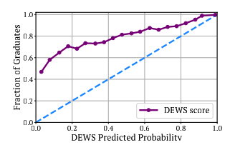
Student Risk Prediction
Prediction
  Can we accurately predict which students are at risk? Yes, high AUC - this is the typically used metric
    “Because counselors do not see predicted probabilities, but rather ordered GRAD scores, we chose the area under the receiver operating characteristic curve (AUC) metric that measures whether students’ predictions are ordered in terms of actual risk” - Christie et al 2019
    BUT models often miscalibrated - See perdomo fig 1 - relative risk vs absolute risk
  Are the predictions biased? Not very much, generally pretty similar across groups
Explainability
  Can the predictions be communicated to stakeholders? Yes, various risk buckets
    BUT explaining why a student is at risk is hard
Intervention
  Can individuals / schools do something with this data?
    BrightBytes tried integrating Risk prediction with Intervention Management tools
  Are these systems improving graduation rates?
    As of 2023, I know of no studies showing strong effects from graduation risk prediction systems (Note, that was when I last worked actively on this area, some quick recent searching has not uncovered strong new evidence)
Structural vs Individual
  Is this a problem that can be solved at the individual level?
  Does making it individual hide structural problems (consider the role of behavior incidents in risk prediction)?

Slide 8
Side note for industry folks - Publish!
Conferences often have Industry Track submissions, get your work out there!
Let academics see how people are really using their methods
  In my opinion, application is now the most important part of machine learning research in education
Create a public record of what you are doing

Slide 9
5 Minute Break
Return at 12:43

Slide 10
Introduction to Neural Networks
What is a Neural Network?
  A machine learning model inspired by the structure and function of the human brain. This is a loose metaphor!
  Composed of layers of interconnected "neurons" that process and learn patterns from data.
Biological Inspiration
  The brain consists of neurons that receive, process, and transmit information.
  Artificial neurons mimic this process using mathematical functions.
  Human brain has something on the order of 100 billion neurons and 100 Trillion - 1 quadrillion synapses.
Why Use Neural Networks?
  Traditional algorithms struggle with complex pattern recognition (e.g., images, speech, natural language).
  Neural networks excel at detecting patterns, generalizing from data, and making predictions.
Key Components of a Neural Network
  Input layer: Receives raw data (e.g., pixel values, words).
  Hidden layers: Perform computations and extract features.
  Output layer: Produces the final prediction (e.g., classification, probability).
  Weights & biases: Parameters adjusted during training to improve accuracy.
  Activation functions: Introduce non-linearity to model complex relationships.

Slide 11
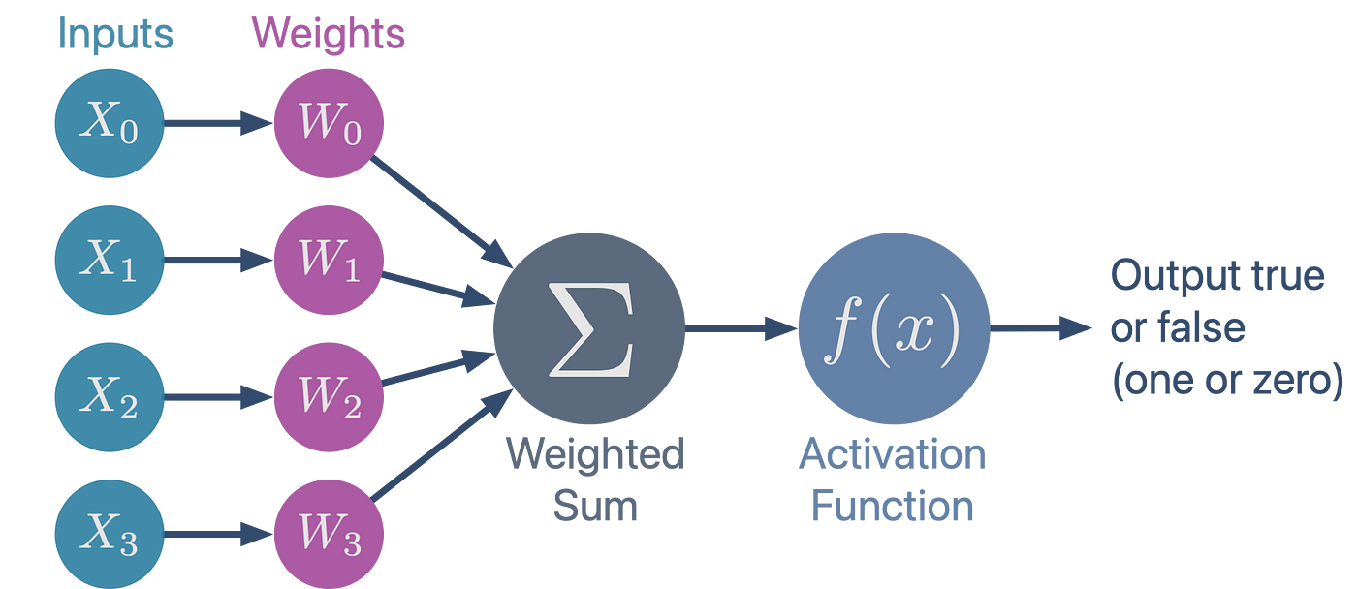
The Perceptron
Inputs are multiplied by weights and summed
Activation function > step function converting sum into binary 0/1 based on a threshold
Only works for linearly separable problems
Cannot solve complicated problems - invented in 1958!
z

Slide 12
Take a minute to solve this:
X1 = 2
W1 = 0.5
f(z)
?
X2 = 1
W2 = 1
f(z):
Z > 2 then 1
Z <= 2 then 0

Slide 13
Activation Functions
SO, we have inputs, we multiply them by weights and get a sum. Perceptron with binary output is too simple.
For neural networks we need to have an activation function
  Why? If we didn’t, we would just have a linear model, it would be just a really big logistic regression
  Adding activation functions lets us learn really complex, non-linear patterns
Sigmoid, Tanh are used
Most common is ReLU f(z) = max(0, z)
  If the sum of weights in a neuron is less than 0, output 0, otherwise output the sum of weights
Now we can solve problems that are more complex

Slide 14
Update the neural network with Backpropagation
Forward pass: Compute outputs (Pred Y)
Calculate Loss (lets use MSE again)
Compute Gradients
‘Backpropagate’: update the weights
And repeat

Slide 15

Backpropagation
Forward pass: Compute outputs (Pred Y)
X1 = 2
W1 = 0.5
f(z)
2
Y = 1
X2 = 1
W2 = 1
f(z): ReLU
max(0,z)
Pred Y
True Y
2) Calculate Loss (lets use half MSE again)
3) Compute Gradients, this is more involved with the final output, the activation function and the weight
DW1 = -2 * 1 * 0.5 = -1
DW2 = -2 * 1 * 1 = -2
½ (2 - 1)^2 = 0.5
Note: the only difference in the gradient is the dz/dwi component, so with OLS we could initialize with uniform weights but with neural nets we must use random weights

Slide 16
Backpropagation
4) Update weights, using gradient and learning rate
W1 = -2 * 1 * 0.5 = -1
W2 = -2 * 1 * 1 = -2
a = 0.1
X1 = 2
W1 = 0.4
f(z)
1.6
Y = 1
X2 = 1
W2 = 0.8
f(z): ReLU
max(0,z)
Pred Y
True Y
5) And repeat

Slide 17
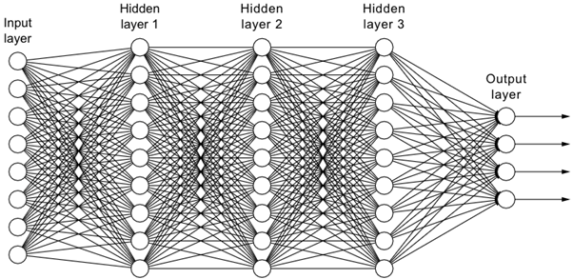
That was a simple network, and so is this
Many input X variables
The input layer represents variables, not rows!
‘Hidden layer’ are the nodes between the x input and y output
You can have many output nodes
  Multi-classification problems
  Predict multiple outcomes simultaneously
  Object detection
Parameters ~= number of connections between nodes
  270 parameters in this model

Slide 18
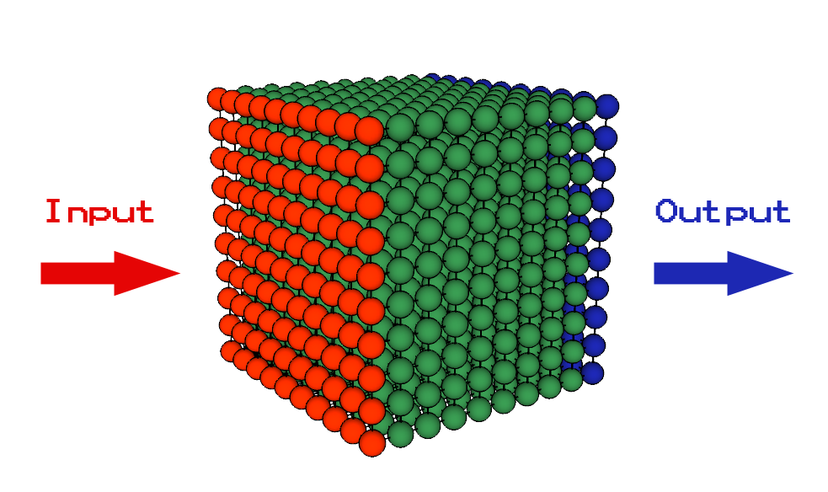
N Dimensional Tensors
The neural network structure easily generalizes to n dimensions
More input nodes and connections between them

Slide 19
More advanced Neural Nets
Convolutional
  Images, videos represented in grid-like data
  Moves a sliding window around over the data (See Hands-On Machine Learning)
Recurrent
  Time series, text analysis
  Processes sequences, predicts next word and maintains a memory state of prior words
Transformers
  RNN strongly focused on order, process one at a time with memory state
  Transformers use ‘Attention’ to estimate relationships between the tokens in a sequence -> current research is working on making the attention mechanism more efficient to allow for larger context windows

Slide 20
Machine Learning in Education Key Points
Supervised machine learning methods improved really fast
  Standardized tools (Sklearn, TensorFlow, PyTorch etc)
  Open datasets and competitions (Kaggle) to maximize metrics
Application is the most important issue for education
  What are you using ML for?
  What actions are going to come out of your system?
  Don’t be like ‘AlphaRoute’ that stranded Kentucky students and caused school to be cancelled for a week because they wrecked bus routes.
Fairness is really important and really hard
Basic model creation is now pretty easy with LLMs
  BUT - creating good models is still challenging, don’t think that a quick LLM generated random forest is going to be good enough to use on students! Real danger of people making models that they don’t understand. Edge cases matter when its real people you are impacting.
LLMs are really powerful, but they are slow and expensive and aren’t the best tool for everything. You could write a system prompt: “Here is student {name}, they got grades {grades} and attendance {attendance} are they likely to dropout?” and run it over all your students. I haven’t tried this, but I bet the results would be pretty bad and very expensive!

Slide 21
Bonus Slides - Programming with LLMS
Here is additional content about using LLMs programmatically in Python.
This will be helpful context to review for next weeks session
Example code is available here: https://github.com/ISEA-Repositories/MLsessions/tree/main/LLMCalling

Slide 22
Programming with Large Language Models
Cloud vs Local host
  Cutting edge models are mostly cloud hosted, limited in what you can run locally
There are a lot of providers for cloud hosted models (openAI, Anthropic, Google, AWS Bedrock and many others).
  Is it secure to use cloud hosted providers?
  Recommend reading: https://posit.co/blog/trust-llm-tools/
Ollama for local model hosting - limited by your computer, cant run cutting edge but there are a lot of small open source models out there
  Running through Ollama the processing is local and data doesn’t leave your computer
  https://ollama.com/ you can get up and running in under 10 minutes

Slide 23

Cloud Models need API Keys
An API Key is a secret password that lets your computer authenticate as you.
  When you first create an API key you need to save it securely somewhere, for example in a password manager. It will be a long random string.
This is how you will be billed for your LLM usage.
  SET USAGE LIMITS, you can do a lot with $10 a month of API credits. You can also make a mistake and run up a $100 bill with a bad while loop.
NEVER put your API key directly into code, not even in a simple test script.
  I use a .env file.
https://help.openai.com/en/articles/4936850-where-do-i-find-my-openai-api-key
https://www.merge.dev/blog/anthropic-api-key

Slide 24
Ollama / Local Running
Quickstart - Ollama
  A note on assistants & Coding agents don’t do this with ollama unless you really know what you are doing and understand sandboxes / virtual machines.
    DO NOT run openclaw - AgenticAI assistants are very risky right now
API allows you to call models through python - non agentic model calling is safe.

Slide 25
Python demonstration
callingAPIsDirectly.py
  Subtle differences between function calls for different providers, it gets annoying. This is mostly how I have worked over the last year.
callingLitellm.py
  Simple (light) wrapper around different llms methods allowing a standardized interface. Makes switching between models very easy.

Slide 26
System Prompts vs User Prompts
System prompt sets the initial instructions for the LLM to follow
The user prompt is variable and is the input that the LLM responds to.
In building a chatapp the system prompt might be something like ‘respond like a teacher to a student, help them but don’t give away the answer’.
In a research application, the system prompt could be quite long and used to extract information. The user prompts are the different documents to process.
system_prompt = """You are an experienced college administrator. Read the provided syllabus and determine: 1. Whether students are allowed to retake exams 2. If retakes are allowed, whether students can earn full points Respond in strict JSON format only: {"retake": 0 or 1, "full_points": 0 or 1} """

Slide 27
Observability - how do we monitor what the LLMs are doing?
As you iterate on system prompts and models how do you keep track of things?
  You can save each response to a text file but this becomes increasingly unwieldy. I have projects with folders like response/haiku35/sysprompt1/…
There are a lot of LLM observability tools out there
  I am currently using mlFlow. It is changing rapidly, but for simple python applications it can be set up very quickly and easily. MLFlow can do a lot and may be overwhelming feel free to look for and try other tools (I haven’t explored this space much in the last year so don’t have other recommendations to try)

