Slide 1
Overview of AI/ML in Education and ISEA Logistics
ISEA Session 1
Min Sun, Victor Tian, Lief Esbenshade
University of Washington
01.23.2026

Slide 2
Learning Objectives/Agenda
Introduce the instructors and the students to each other
Introduce foundational concepts: data science, AI, ML and human-centered, domain specific data science, data science in education
Introduce the human-centered data science cycle and emphasize the role of governance and responsible AI/ML
Provide an overview of the ISEA schedule and resources
Get organized: logistics, data collection efforts

Slide 3
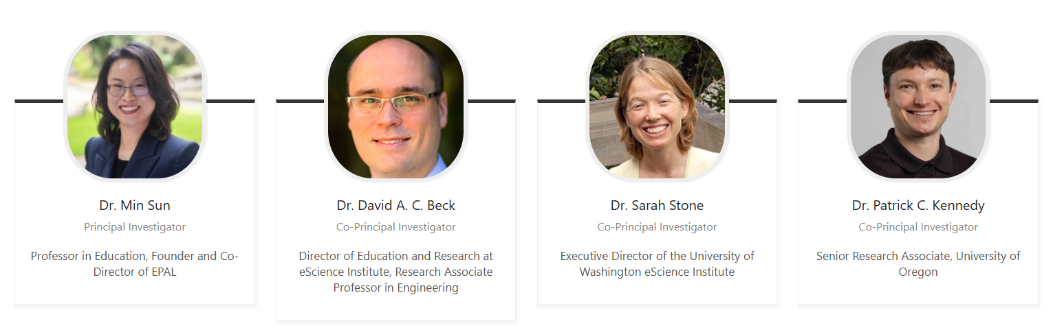
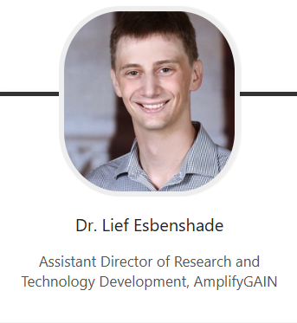
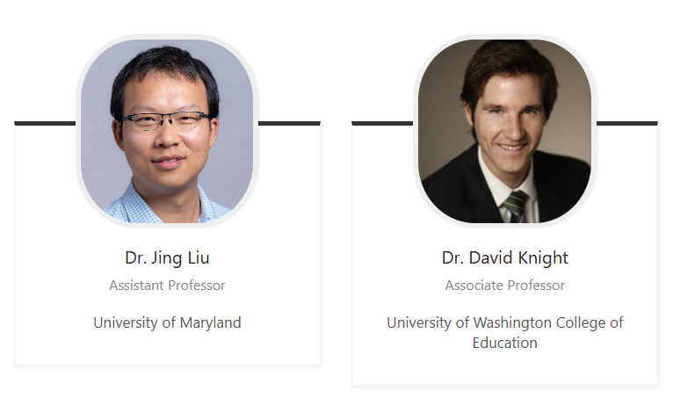
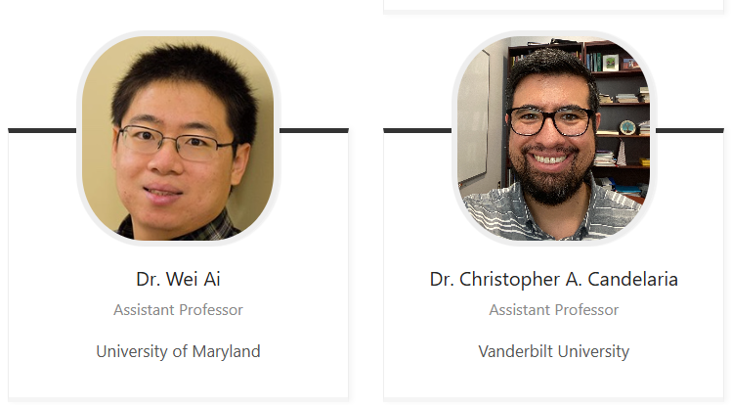

Instructors
Victor Tian
AI Edu Researcher

Slide 4
What is ISEA?
A multidisciplinary, multisector intersection focus in AI/ML in educational science and product development
Education and Learning Sciences
Artificial Intelligence (AI)
Data Science
Software Engineering
Machine Learning (ML)
Notes:
Min will fix this diagram

Slide 5
My Feeling About This Field:
This field is moving so RAPIDLY!
The lines of different disciplines will blur even more.
A new generation of scholars and edtech workforce emerges.

Slide 6
What is AI?
Understanding AI Simply
Artificial Intelligence (AI) is technology that helps computers think and learn in ways similar to humans.
At its core, AI uses math and computer code to:
  Find patterns in large amounts of information
  Learn from new information
  Make decision, predictions or suggestions.

Slide 7
AI and ML-Powered Data Science Methods Can Influence Many Aspects of Classroom Instruction
Comprehensive solutions: Colleague AI, MagicSchool, SchoolAI,
Operation systems: Microsoft, Google
Teacher
- AI coaching and feedback (e.g., TeachFX and Edthena)
- Teachers’ engagement with the materials, adoption, and feedback/Iteration
- Communication with parents
- Feedback to students
Content
- Curriculum and instructional material analysis and generation
(Canva, Pearson etc)
Student
- Personalized and adaptive learning
(e.g., Dreambox)
- Multi-tiered supporting mechanisms (Panorama etc)
- Formative assessment,
- Auto-grading,
- Tutoring and feedback (e.g., Khanmigo)
Notes:
(1) Instructional core: teacher, content, student; their interactions among them. AI has transformed all of them.
(2) You cannot change one thing without changing others. For example, if we encourage adopting AI to personalized and adaptive learning and multi-tiered peer assistance without building educator and administrators’ capacity to appropriately and effectively use AI

Slide 8
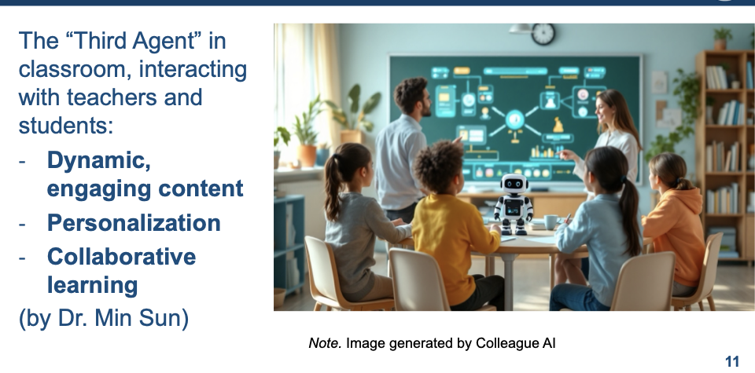
Dr. Sun’s Concept of AI As The Third Agent In Classroom Instruction: How AI will Transform Teaching and Learning?
See Dr. Sun’s Blog on Colleague AI’s Platform

Slide 9
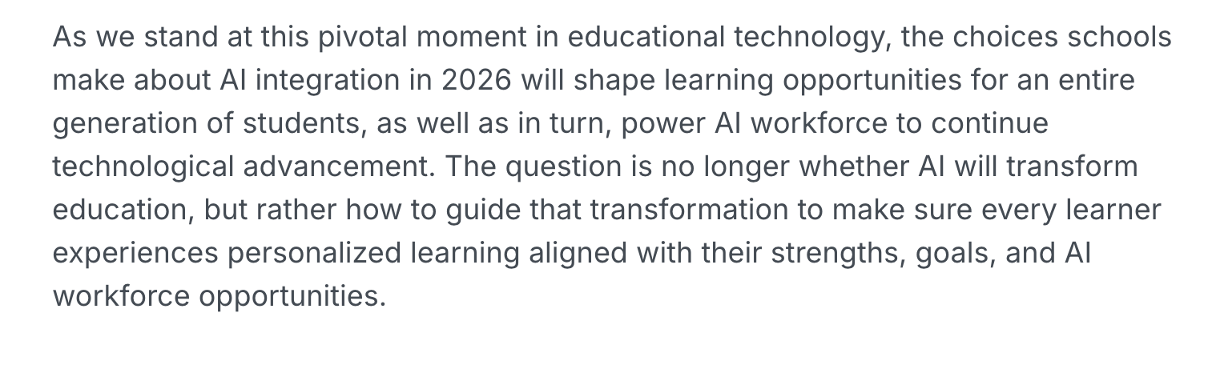
2026 AI Predictions and K-12 Implications

Slide 10
AI in Education Policy and Guidelines
Department of Education AI Guidance
  Artificial Intelligence and the Future of Teaching and Learning: Insights and Recommendations
  Designing for Education with Artificial Intelligence: An Essential Guide for Developers
OSPI’s AI Guideline
Council of the Great City Schools
UNESCO’s AI Guideline
Notes:
Min can update this later

Slide 11
Goals Of ISEA Web Sessions
Stimulate your interests in the intersection of AI/ML, data science, software engineering, and education.
Introduce use cases and develop fellows’ ability to apply technical skills to solve educational problems.
Develop fellows’ critical thinking and creativity.
Co-construct knowledge and learning among ISEA fellows and instructors.

Slide 12
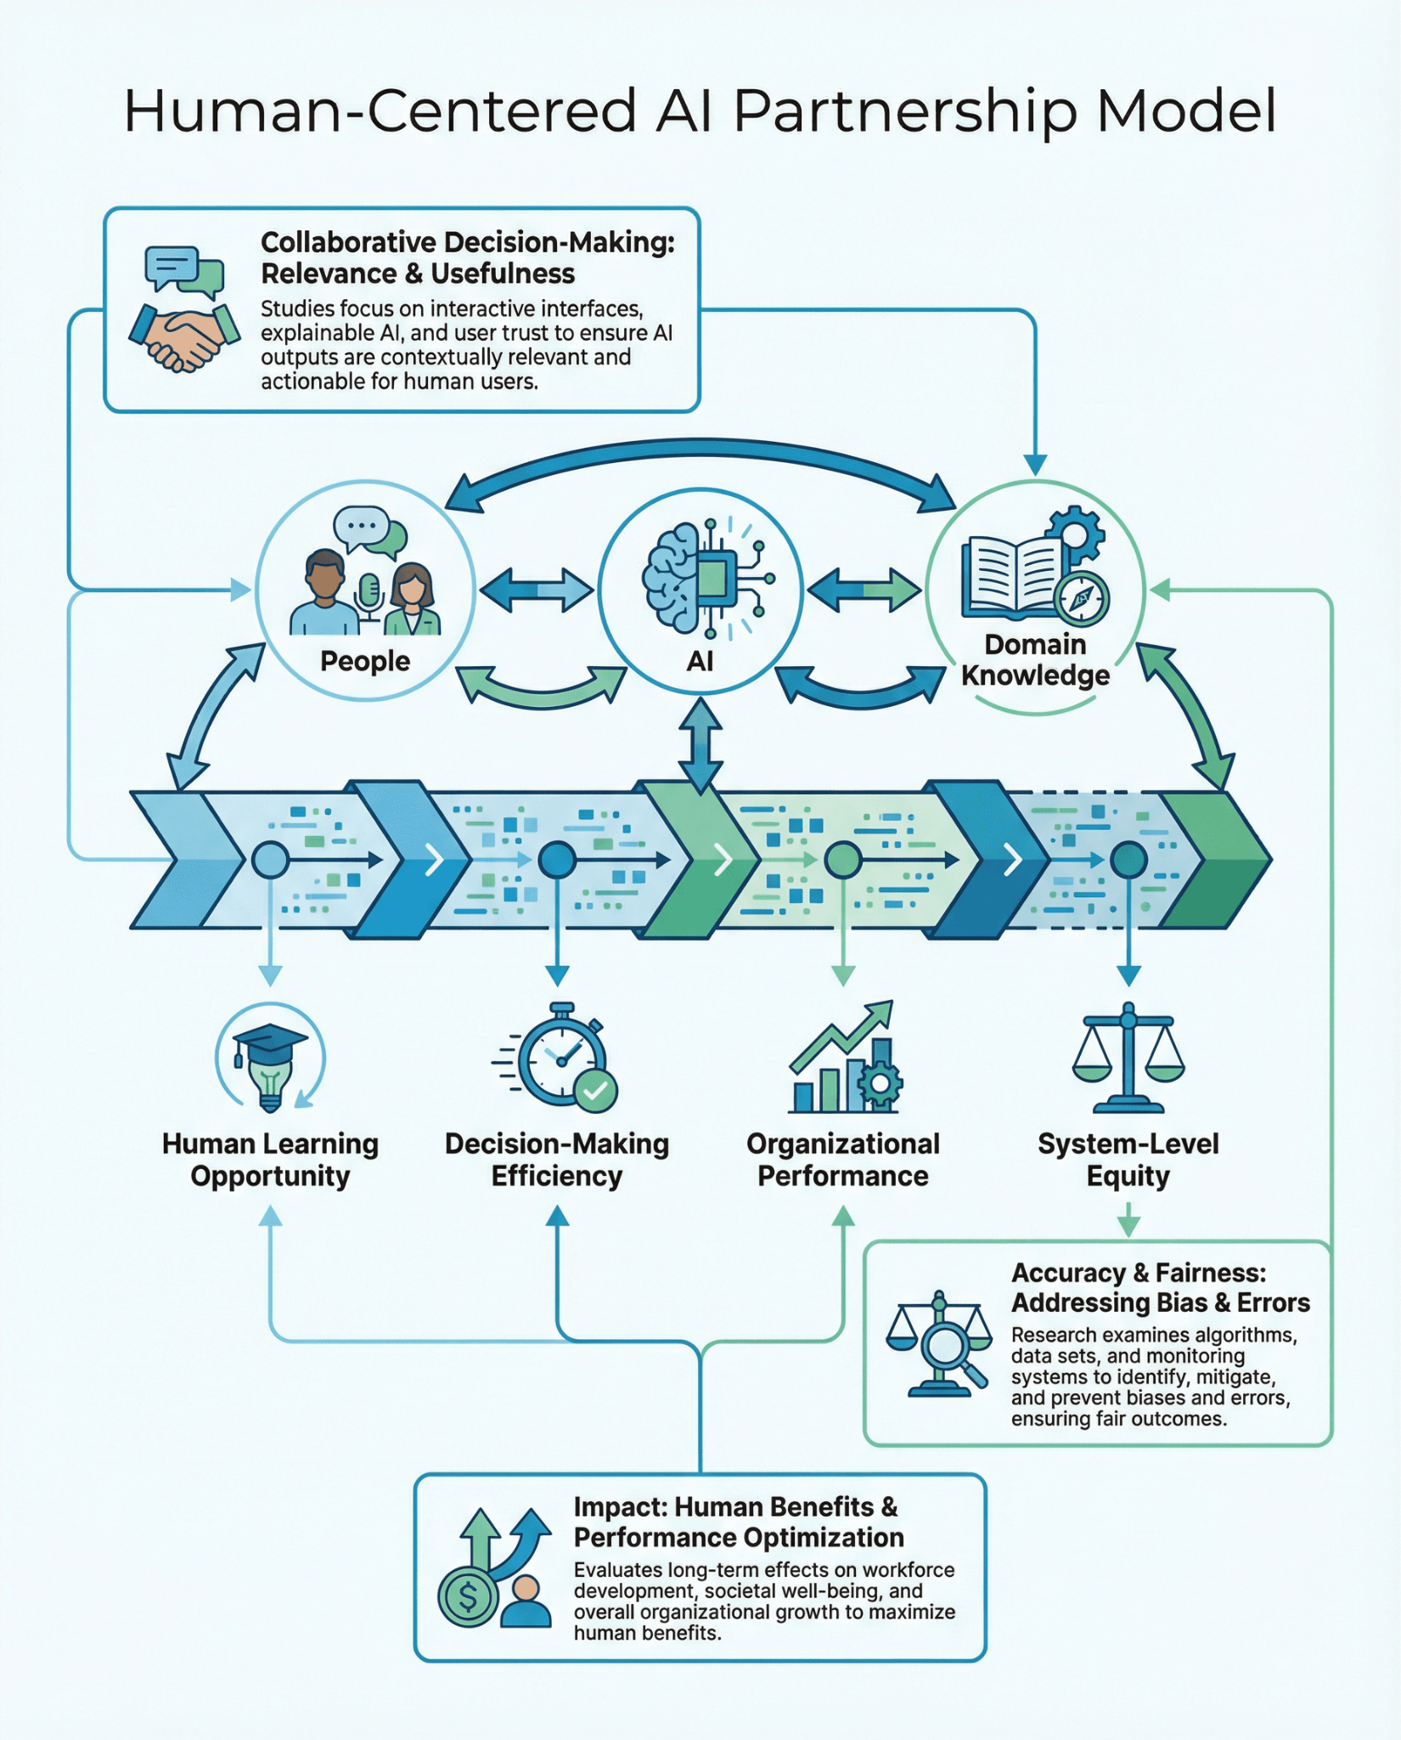
A Human-Centered Partnership Model of Education Data Science
The human-centered partnership model: people, computer, and domain knowledge interact at every stage of data pipeline to enhance learning opportunity, human decision-making efficiency, and organization performance, and system-level equity.

Slide 13
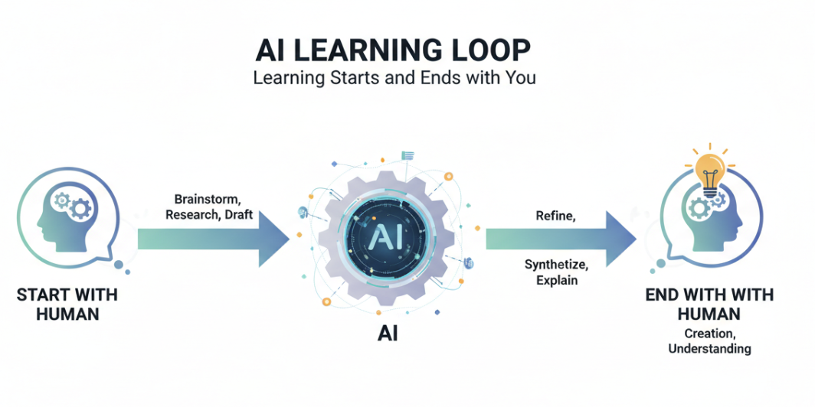

Slide 14
Session Overview
Week | Session Date | Topic
1 | 1/23/26 | Human Centered AI Partnership in Education Data Science
2 | 1/30/26 | Teaching and Learning Theories
3 | 2/6/26 | Software for Educational Data Mining I
4 | 2/13/26 | Software for Educational Data Mining II
5 | 2/20/26 | AI Data Science Project
6 | 2/27/26 | Machine Learning I - fundamentals
7 | 3/6/26 | Machine Learning II - what is an LLM and how to call one
8 | 3/13/26 | Text Analysis - modeling and classification
9 | 3/20/26 | Causal Inference/Evaluation - A/B testing and RCTs
- | 3/27/26 | BREAK (UW Spring Break 3/21 - 3/29)
10 | 4/3/26 | Multimodal Data Analysis
11 | 4/10/26 | Evaluating AI Powered Ed-Tech Tools
12 | 4/17/26 | Economic Evaluation & Cost Analysis
13 | 4/24/26 | Reproducible Pipeline for Large-scale Data Analysis
14 | 5/1/26 | Data ethics and professionalism
15 | 5/8/26 | Hackweek project team walkthrough
HACKWEEK | 6/22/26 | HACKWEEK 6/22 - 6/26 (Tentative)
Notes:
Will walk through overall schedule of the program and topics

Slide 15
Educational Data Science and AI Training
For the third cohort, ISEA attracted well-qualified applicants across four sectors: Higher education, non-profit think tanks and research institutions, K-12 district and state agencies, and EdTech industries.
We extended invitations to 10 candidates from previous cohorts
Final cohort: Graduate Students (5 candidates), School District/Public Sector (6 candidates), EdTech Industry (5 candidates), Ed Research Org (4 candidates).
Notes:
Do we give each of the fellows a bit of time to introduce themselves?

Slide 16
Fellow Introduction and Break
If you haven’t done so already, please share your name, organization, role, and your learning interests in data science in education in the Slack space
A small group activity (5 mins)
  Introduce yourself
  What drove you to ISEA?
  How do you think about the human-centered data science cycle, and how might you use some of the concepts to inform your work?
Notes:
Do we give each of the fellows a bit of time to introduce themselves?

Slide 17
Individual Think and Share
Use this Link:
Which are the three topics you are most excited about?
Which are the three topics that are most relevant to your work?
Any other topics of interests you wish to discuss?
Any recommendations /expectations on teaching styles and methods?

Slide 18
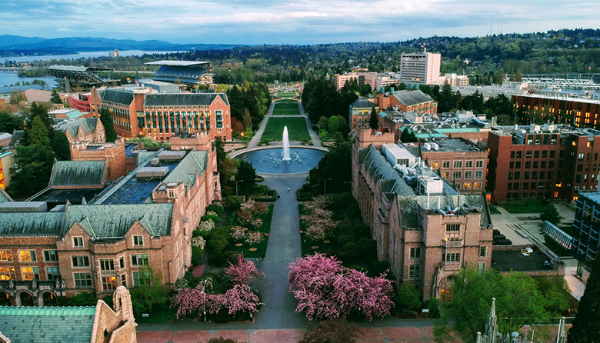
Hackweek
Week of June 22-26 on the University of Washington campus in Seattle
We will share additional details as they’re finalized

Slide 19
Resources
Slack: Your primary means of communication with those in the program. Feel free to send Victor a direct message about any program-related issue or question. Feel free to also reach out to your tutors using Slack
Canvas: Your primary means of managing all the content from the program. Slides and videos will be shared here. Schedules will be updated here (if/when needed)
Github: This GitHub repository serves as a location for the program-related codes:

Slide 20
Homework
Preview next week’s materials (will be posted soon)
Learning about the basics of python programming and Colab environments:
  https://pandas.pydata.org/Pandas_Cheat_Sheet.pdf
  https://jakevdp.github.io/PythonDataScienceHandbook/
  https://colab.research.google.com/
  https://www.statlearning.com/
Complete the surveys
  Survey about your interests (Link in slide #17)
  ISEA Pre-Test survey
  Pre-test of data science knowledge and skills

