Slide 1
Teaching and Learning Theories and Learning Engineering
ISEA Session 2
Min Sun
University of Washington
1.30.2026

Slide 2
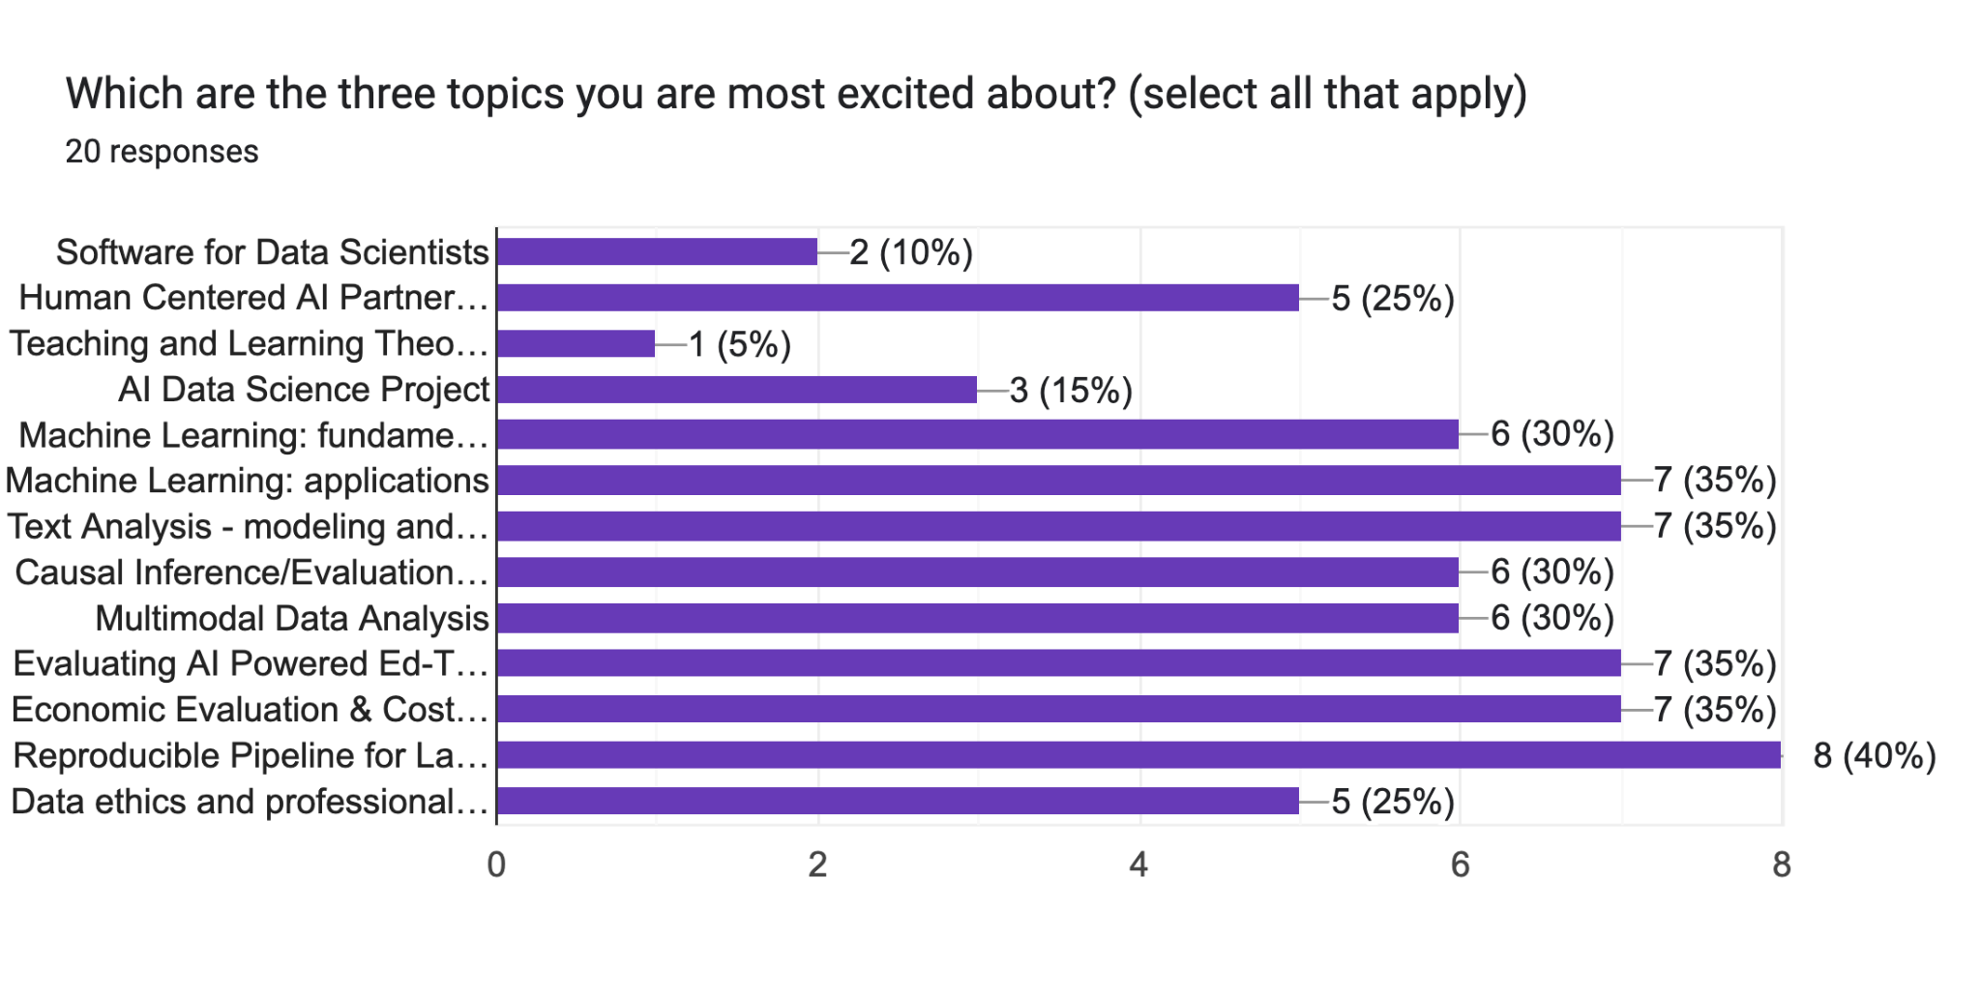
Data from the Week 1 Intake

Slide 3
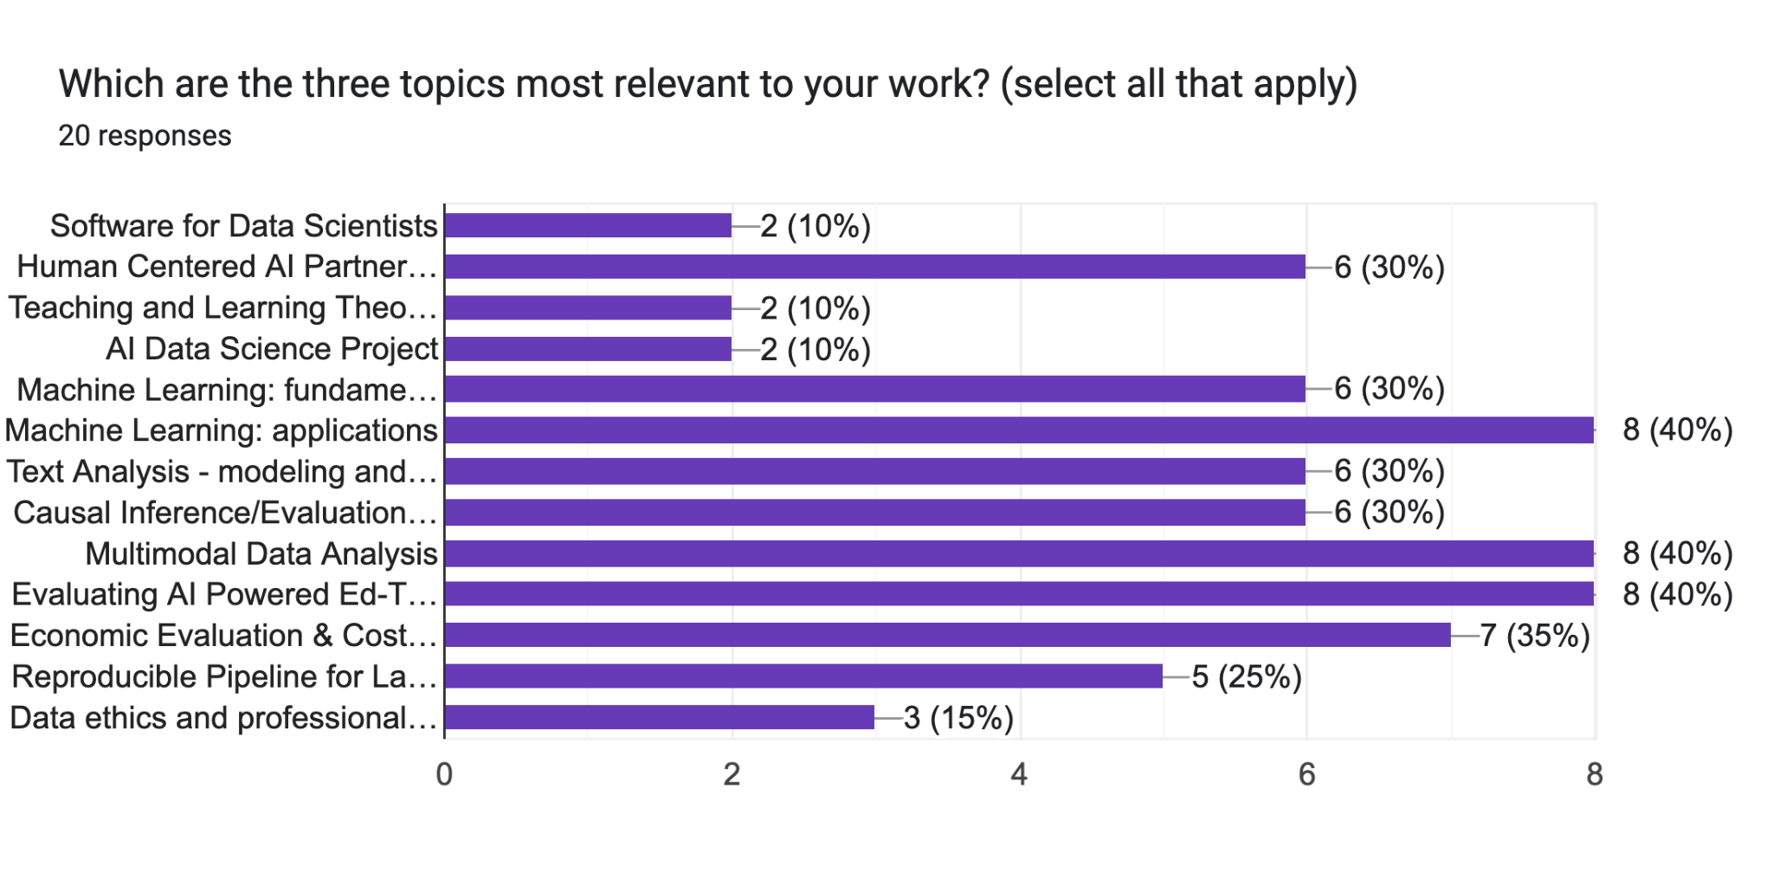
Data from the Week 1 Intake

Slide 4
Overview of today
Use Colleague AI as examples to illustrate
Analyze how foundational learning theories can be systematically integrated into educational technology design and data science applications within K-12 environments;
Examine three distinct scenarios involving math instruction generation, teacher professional development through behavioral nudging, and adaptive tutoring systems to determine which theoretical frameworks best support each educational context.
Create your own teaching and learning theory embedded tools using prompting

Slide 5
Educational Software Development Cycle
Planning
(Market Research)
Learning science concepts can inform each step of this process
Implementation, Evaluation, and Updating
Analysis
(use cases, persona)
Testing and integration
Design, Prototyping
Engineering and Development

Slide 6
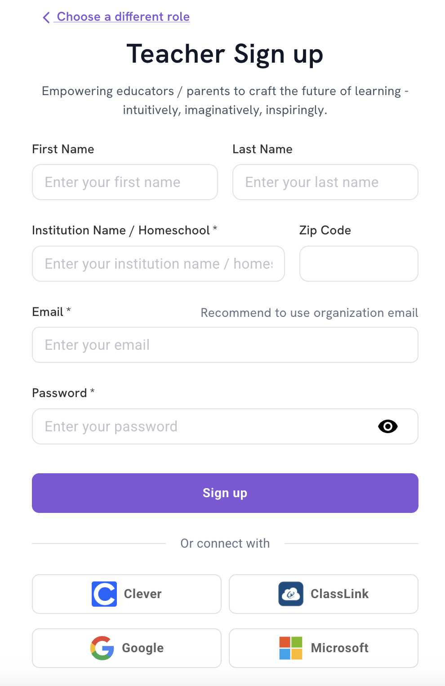
Colleague AI’s Tech Set Up
1. Login Colleague AI using Clever or the following link: https://www.colleague.ai
2. If you do not have an account yet, please register for free. Use your district/education organization email or SSO system

Slide 7
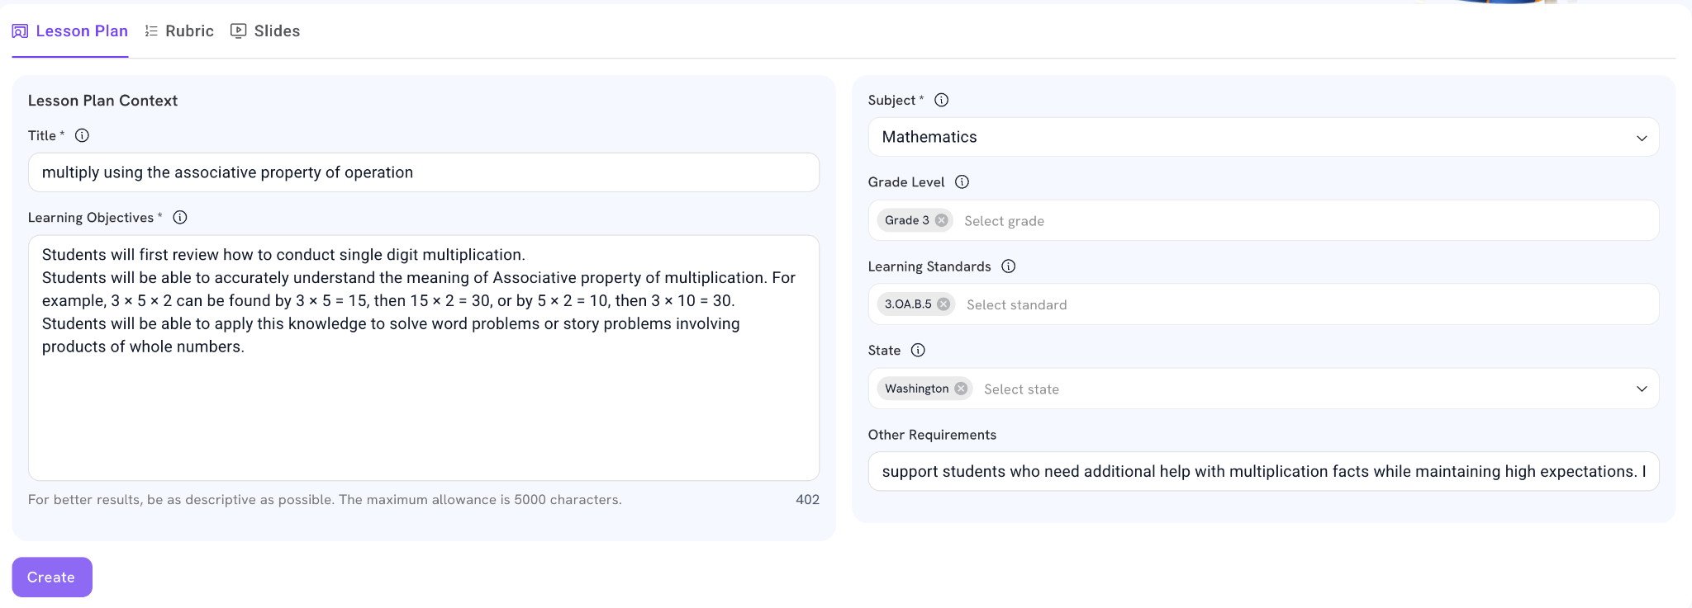
Use Case I: Effective Math Teaching
This function embeds research-based, subject-specific effective teaching to draft the entire standard-aligned lesson plan from scratch, based on your teaching style and your students’ needs.
You can ask AI to embed certain type of the support throughout the entire lesson, or customize the lesson in a variety of other ways!
Notes:
Copy and paste prompts - next slide
Title: multiply using the associative property of operation
Objectives:
Students will first review how to conduct single digit multiplication.
Students will be able to accurately understand the meaning of Associative property of multiplication. For example, 3 × 5 × 2 can be found by 3 × 5 = 15, then 15 × 2 = 30, or by 5 × 2 = 10, then 3 × 10 = 30.
Students will be able to apply this knowledge to solve word problems or story problems involving products of whole numbers.
Option, embedding support for English Language Learners at each stage of the lesson
3.oa.b.5

Slide 8
Generate Lessons Example Prompt (Elementary)
Title: multiply using the associative property of operation
Objectives:
Students will first review how to conduct single digit multiplication.
Students will be able to accurately understand the meaning of Associative property of multiplication. For example, 3 × 5 × 2 can be found by 3 × 5 = 15, then 15 × 2 = 30, or by 5 × 2 = 10, then 3 × 10 = 30.
Students will be able to apply this knowledge to solve word problems or story problems involving products of whole numbers.
3rd grade math; 3.oa.b.5
Option:
support multilingual learners while maintaining high expectations.

Slide 9
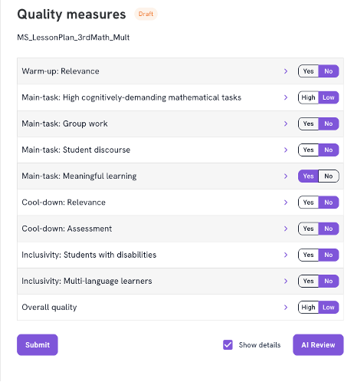
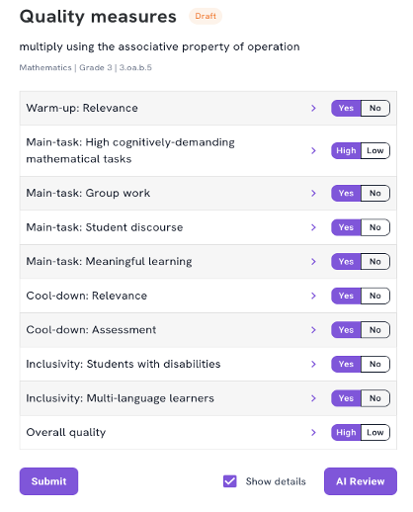
Lesson Plan Quality Measures
Lesson Plan Quality Generated by Another Platform
Lesson Plan Generated by Colleague AI

Slide 10
Use Case II. Nudging Theory Key Components
Insufficient information
  The limited information processing capabilities of the human mind. In the face of cognitively demanding tasks—such as tasks requiring a substantial amount of choice and continuous, ongoing tasks—individuals tend to make choices based on faulty heuristics, or they avoid making decisions altogether (Mullainathan and Thaler 2000).
Limited time, limited attention
Self-control and inconsistency
Need to have gradual, actionable information

Slide 11
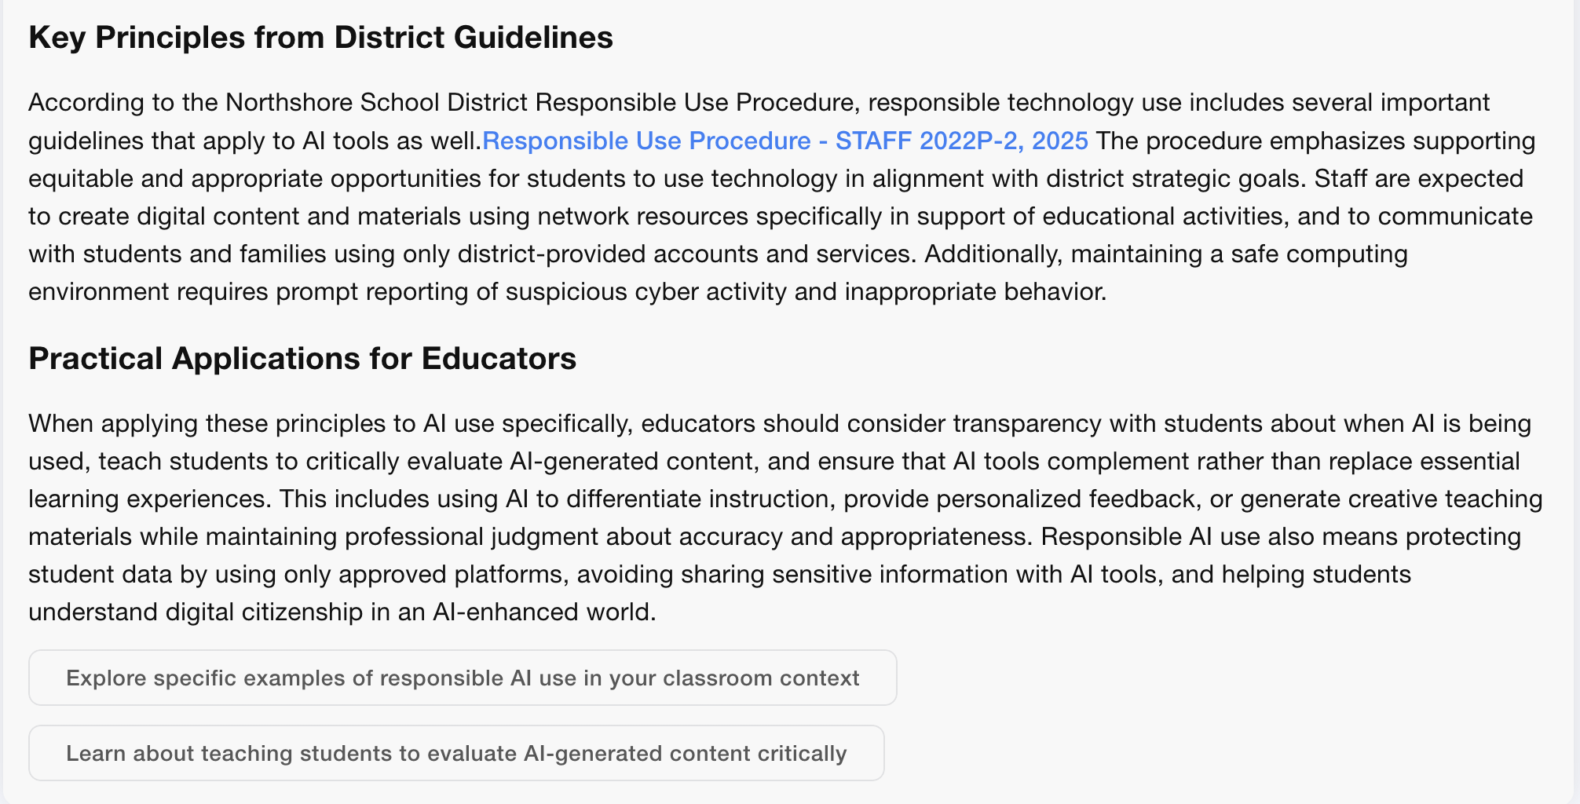
Examples of Nudging

Slide 12
Use Case III. Other Learning Science Theories Built into Technology
Elinor’s Talking to me! Conversational AI into Children’s Narrative Science Programming
  Ask questions stimulates thoughtful responses
  Feedback continues the conversation around the particular topic
  Scaffolding helps children better participate

Slide 13
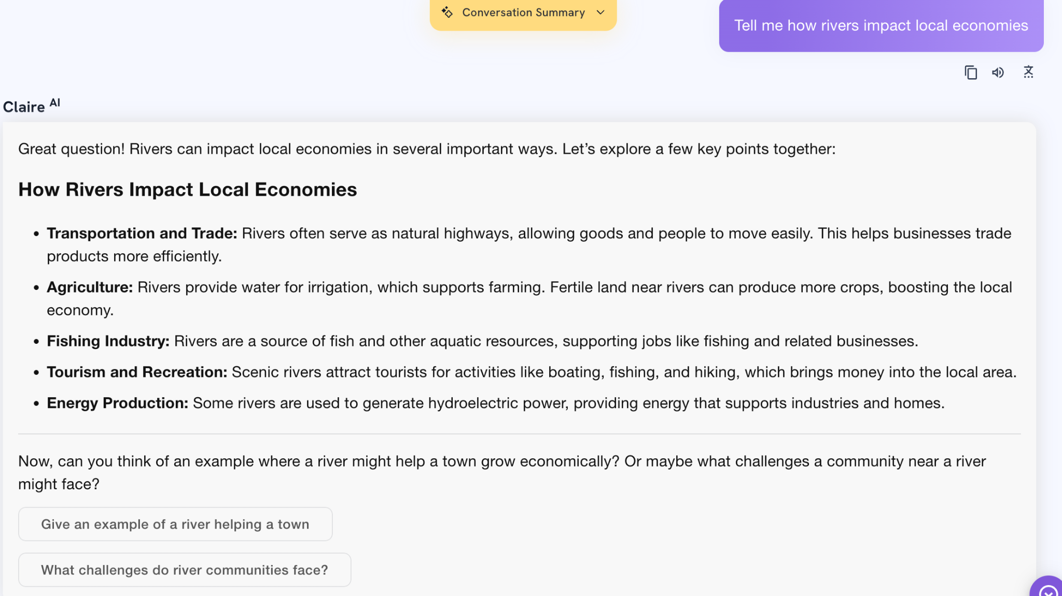
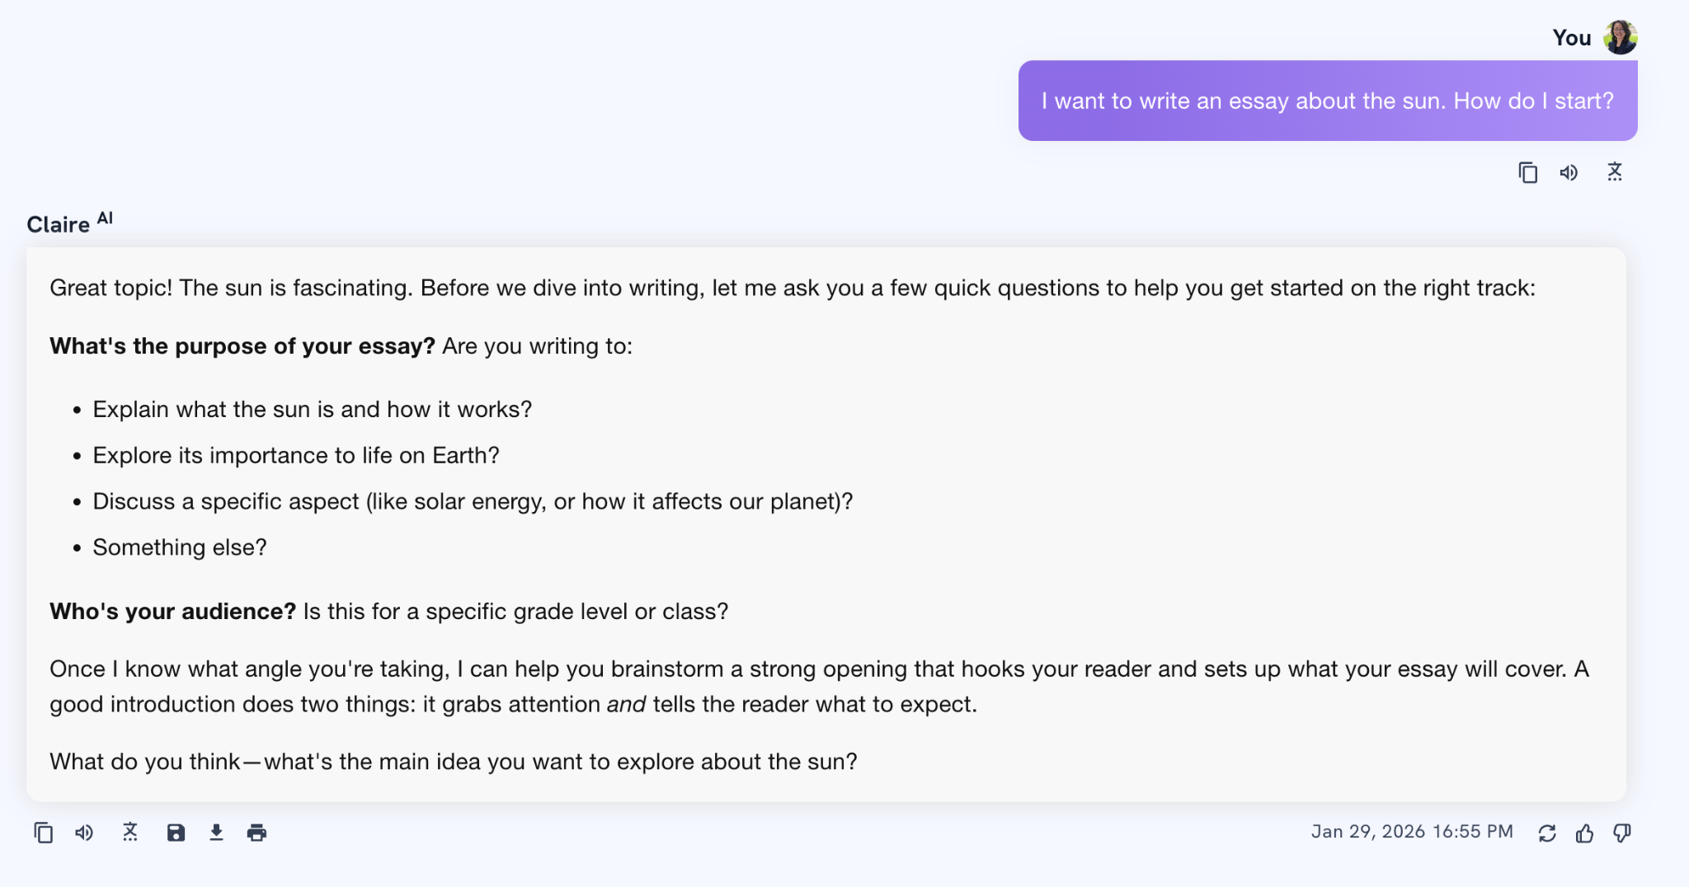
Colleague AI’s Tutoring
Zone of Proximal Concepts + Nudging + Socratic Questions

Slide 14
Section II. Build Your Own Tools

Slide 15
Gen-AI Prompt Design
How to write effective prompts. The video recording.
  Zero shot Prompting
  One or two shot prompting
  Chain of thought
Resources to learn more about prompt engineering:
https://www.deeplearning.ai/short-courses/chatgpt-prompt-engineering-for-developers/
https://www.youtube.com/watch?v=dOxUroR57xs&ab_channel=ElvisSaravia

Slide 16
Use Colleague AI Interactive to Build Some Tools
Build a homework submission and grading tool. The question is: the length of the Colorado River is about 1450___. A: inches B. feet C. yards, D miles.
The correct answer is D.
The workflow of tool is:
1. upload file function so that my students can upload their file.
2. once students uploaded, grade it.
3. print feedback to them. Using Vygotsky's Zone of Proximal Development, Generate feedback that: (1) identifies the specific error and the underlying misconception , (2) poses one Socratic question that guides the student to recognize their error without giving the answer, (3) includes one encouraging statement that frames the error as a learning opportunity. Use language accessible to 2nd graders and maintain a warm, growth-oriented tone. Avoid: giving the correct answer directly, using discouraging language, or overwhelming the student with multiple concepts at once.

Slide 17
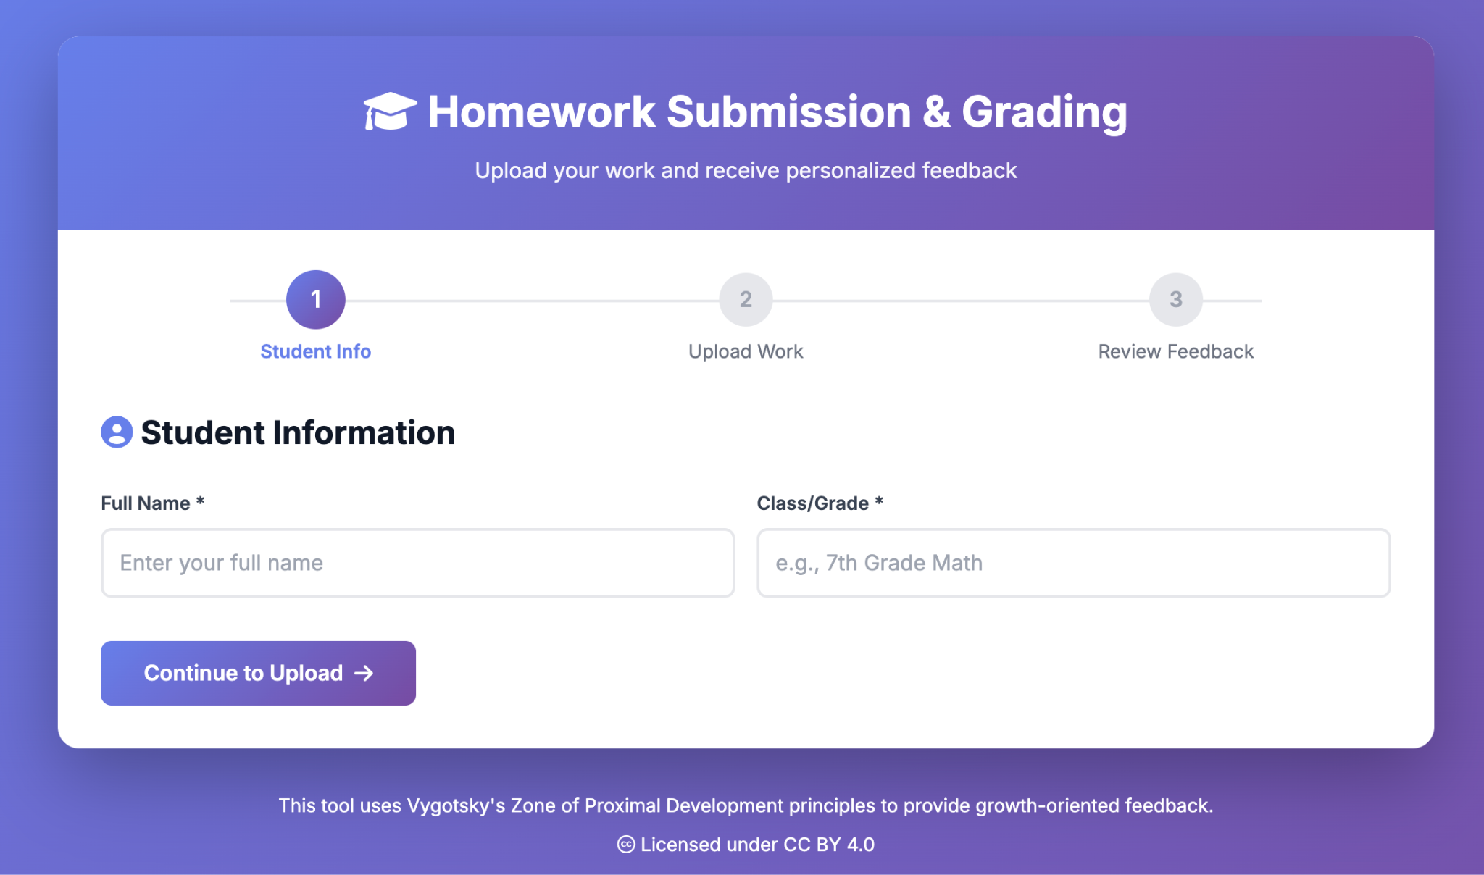
Colleague AI Homework Submission Tool

Slide 18

Resources Allocation
Context:
You are an expert in school finance and resources allocation. The Superintendent, Mr M, provides you a set of information, as attached. The district is conducting strategic planning to optimize resources to improve student performance on state standardized test scores and graduation rate.
The District's Challenge:
The district has fixed amount of resources as indicated by the expenditure per pupil annually. However, inflation is increasing operational costs. Mr M must optimize resources to:
1. Maintain high-quality instruction.
2. Support growing needs in multilingual learners (MLs).
3. The district will be soon asked to implement new state learning standards without additional new funding.
4. Address staff requests for professional development in AI integration and project-based learning.
Key Constraints:
1. Fixed Costs: Salaries and benefits consume 82% of the total budget.
2. Restricted Funds: Title I and Title III allocations must specifically support low-income and multilingual learner programs.
Decision Points for The Superintendent:
Mr. M has about $550,000 of discretionary funds after accounting for fixed and restricted costs. He must decide how to allocate this among several competing priorities:
1. Expanding after-school tutoring and Saturday math academies. Estimated cost: $200,000.
2. Technology Upgrade to incorporate AI tools and training for staff. Estimated cost: $220,000.
3. Support new state learning standards implementation: Estimated cost: $180,000.
Your tasks:
1. Develop a budget allocation proposal that balances instructional quality, equity, technology, and student support. The main idea is to leverage AI to improve staff efficiency and personalize learning for diverse learners. If you use any formula or prediction, please make sure to reveal the equation and be explicit.
2. Justify trade-offs to the school board and community stakeholders.
3. Demonstrate how the chosen allocation will optimize resources to raise student achievement and graduation rate.

Slide 19
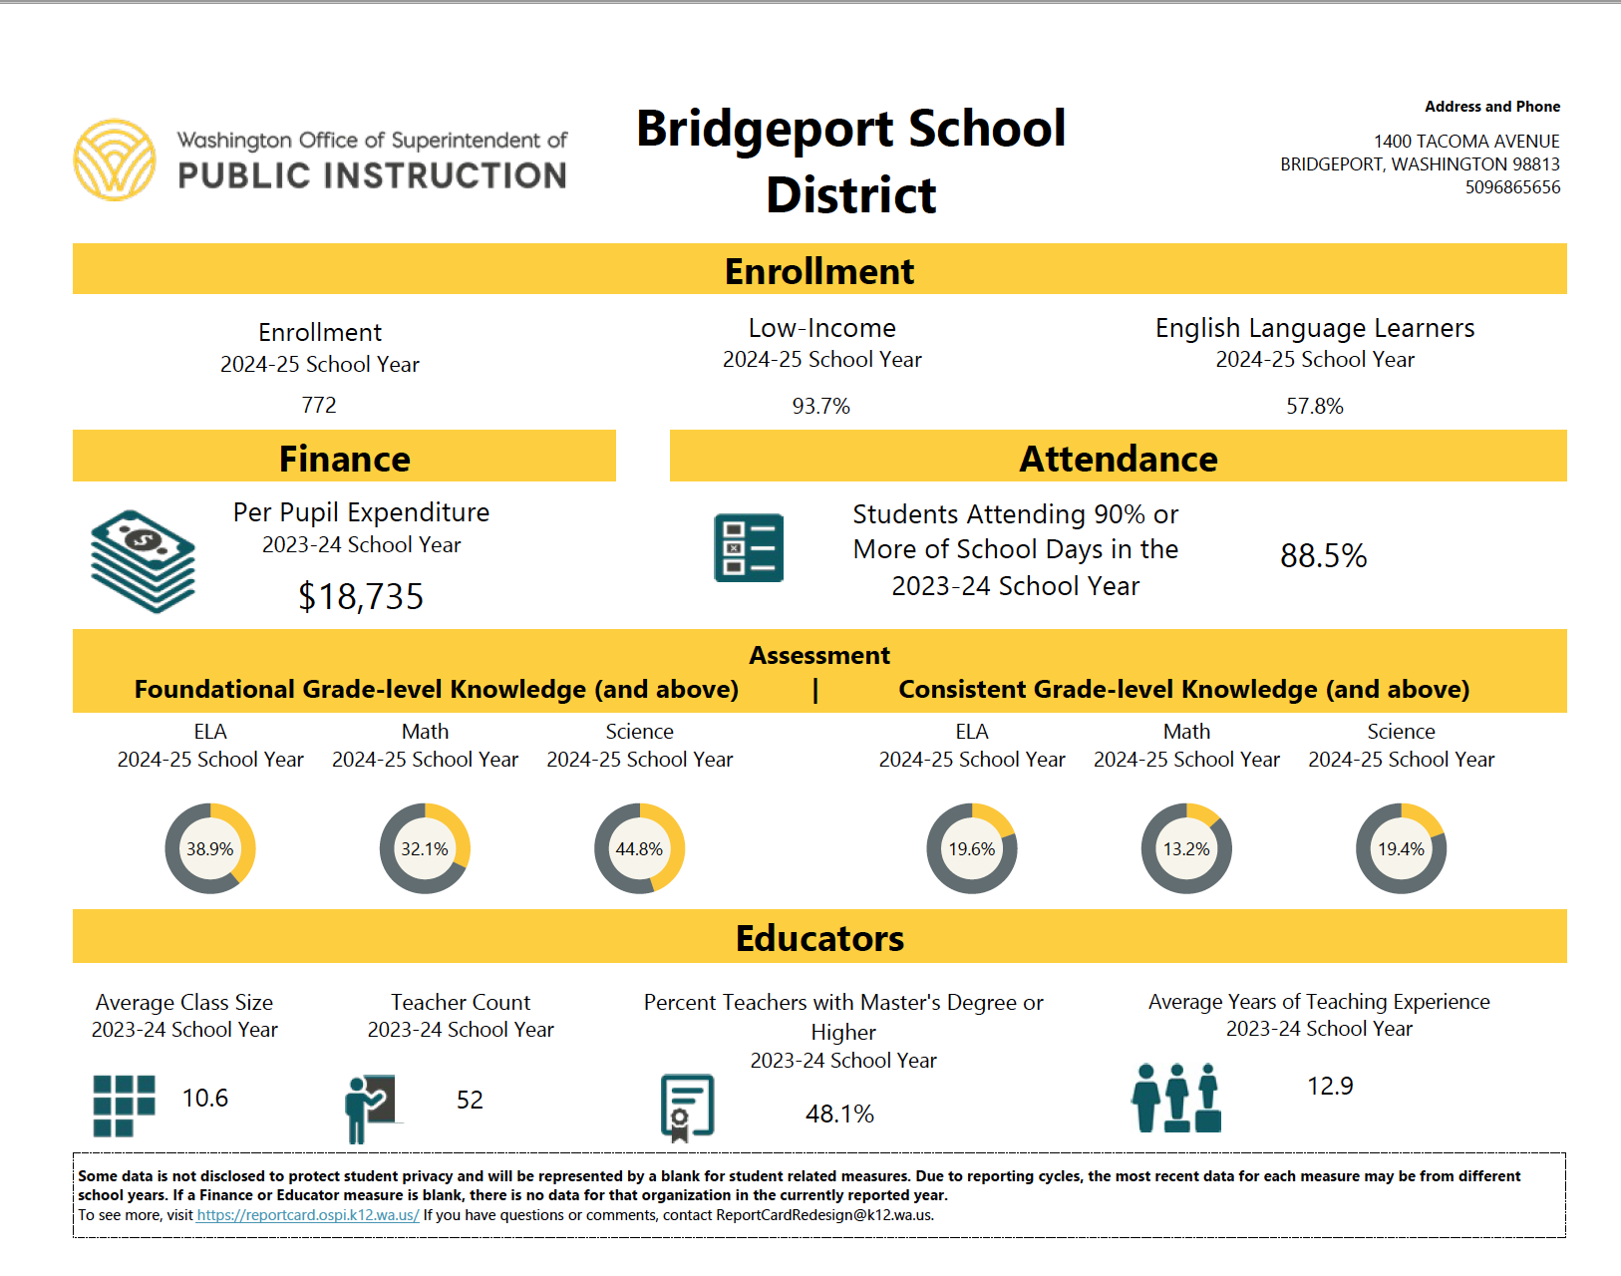
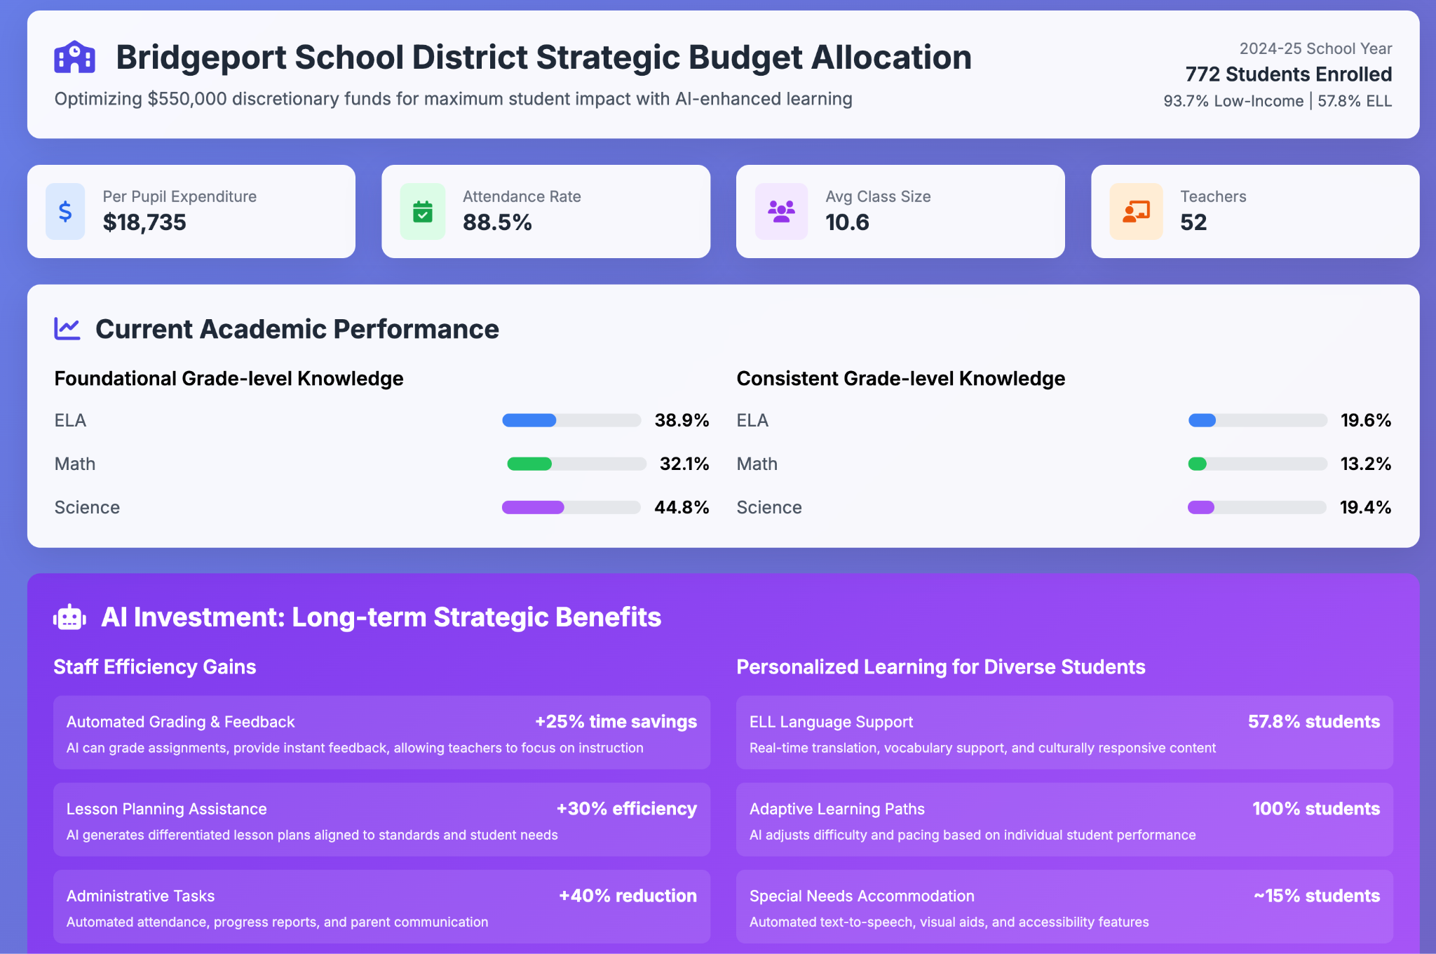
Resources Allocation (2)
Colleague AI’ Generated Resources Allocation
District data are attached to the prompt

Slide 20
Homework
Share whatever you created to Slack channel
Continue improve your coding skills
Review Prompting skills:
How to write effective prompts. The video recording.

Slide 21
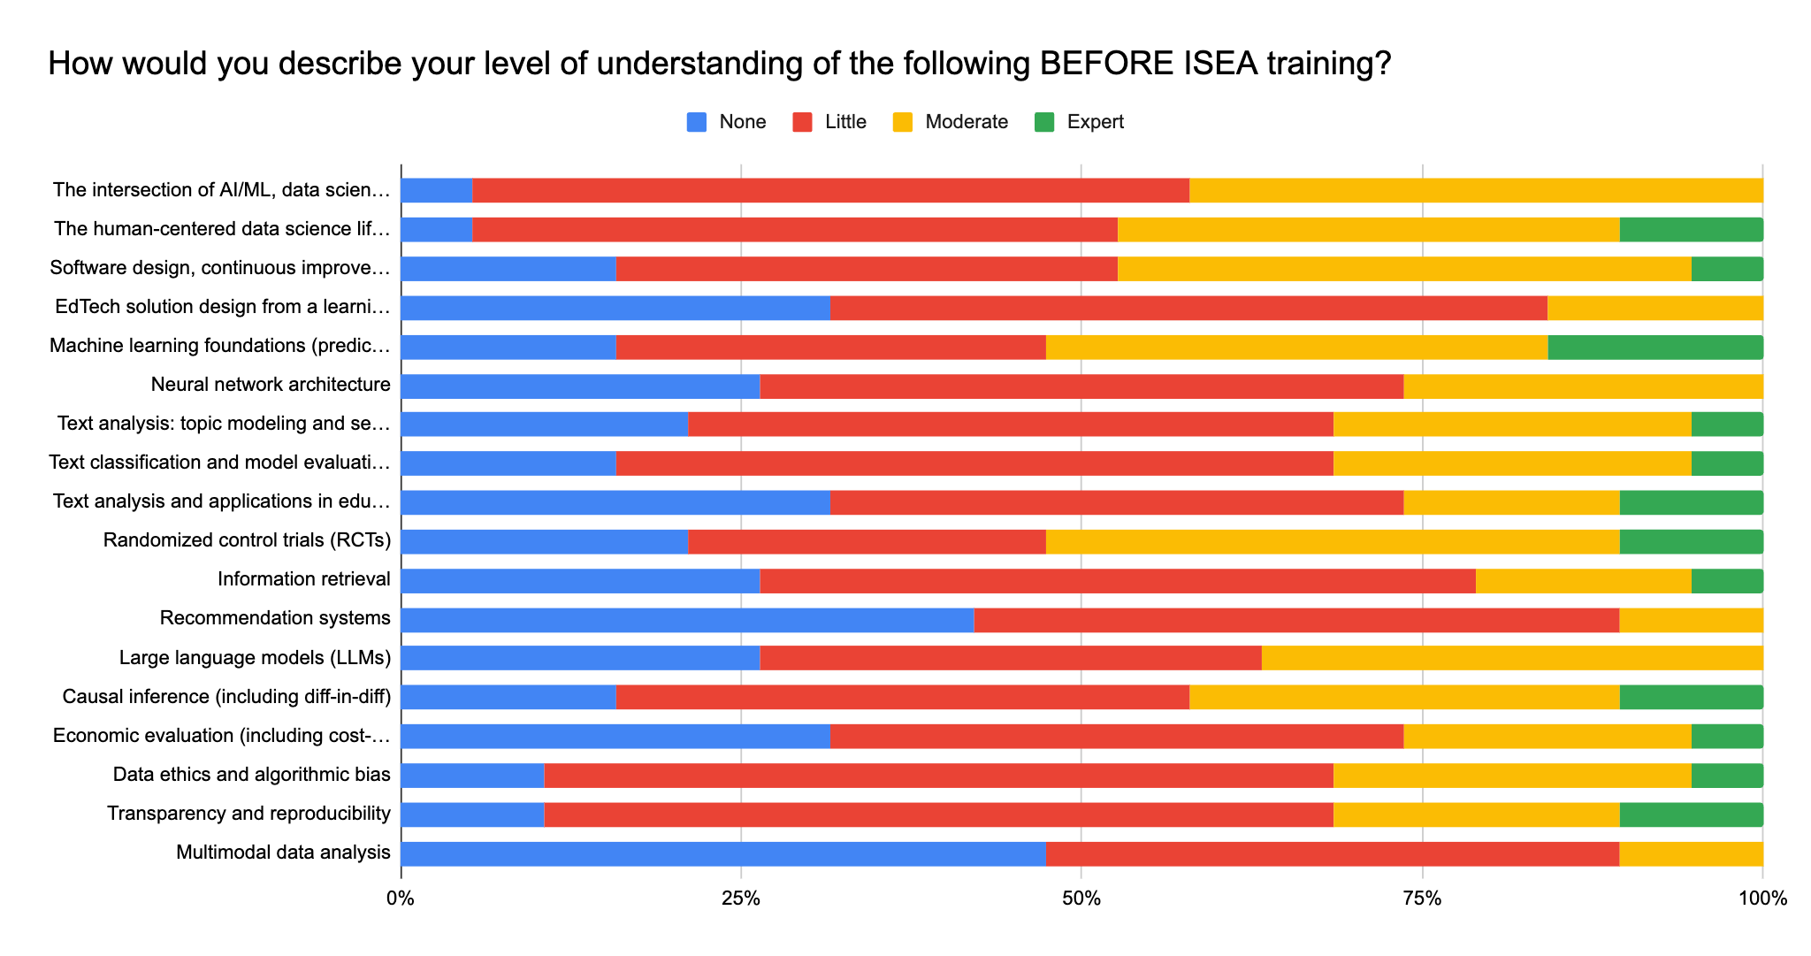
Data from the Pre-Survey

Slide 22
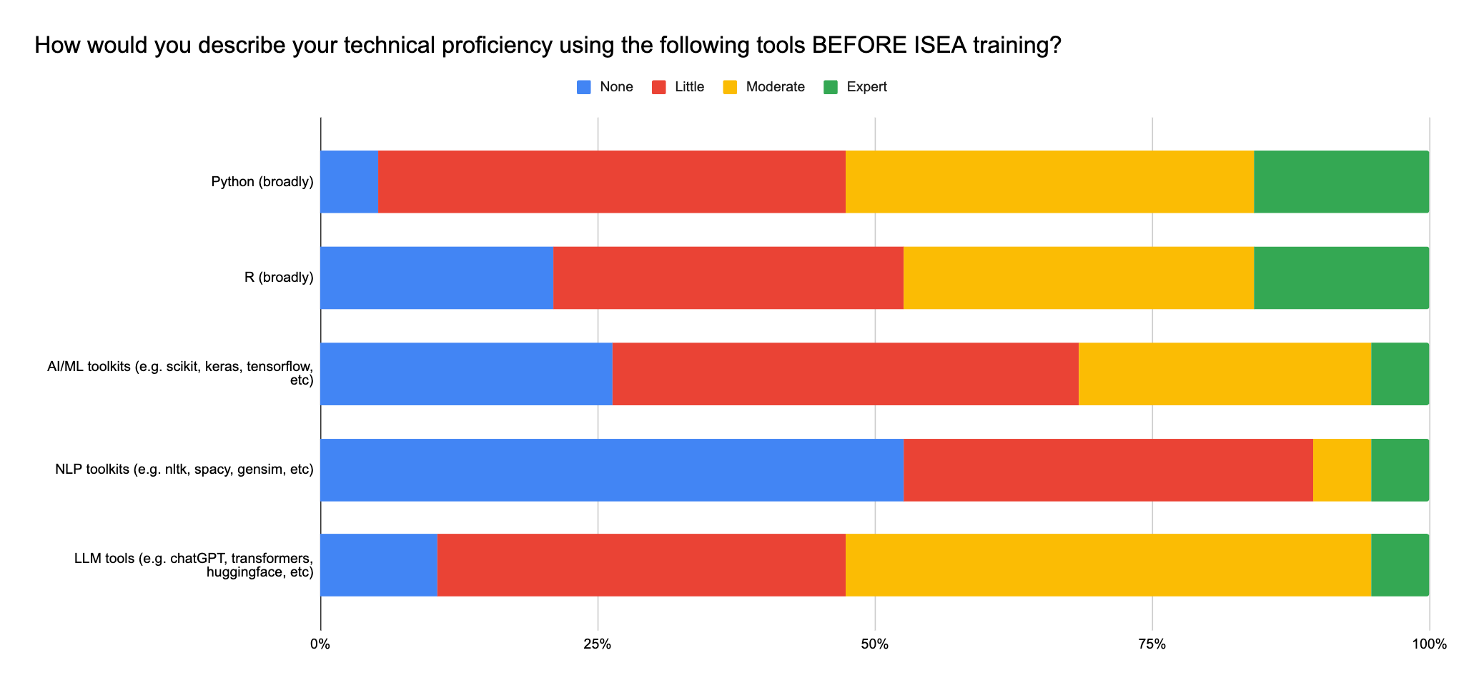
Data from the Pre-Survey

Slide 23
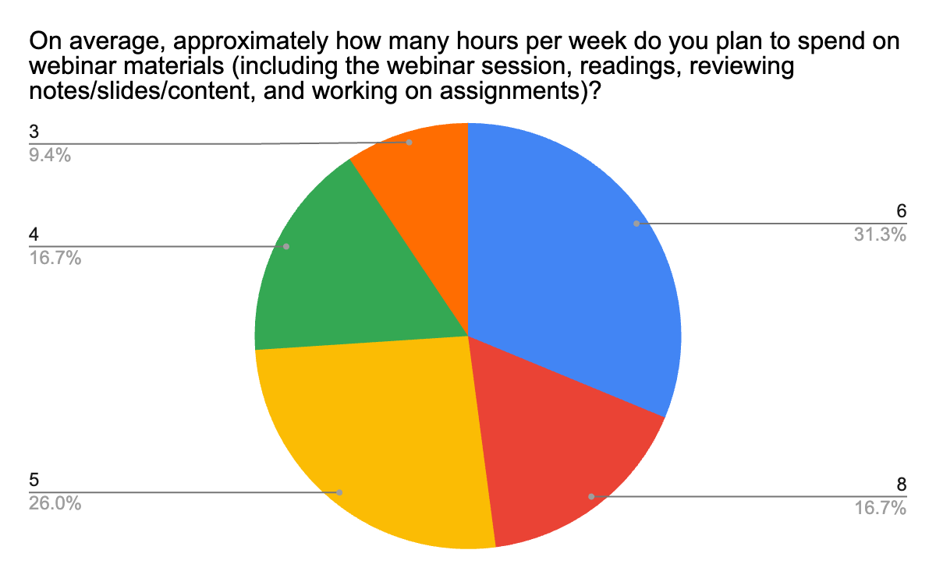
Data from the Pre-Survey

