Slide 1
Multimodal Analysis in Education—A Case Study Using the EDSI Dataset
April 3, 2026
Jing Liu
University of Maryland College Park
ISEA, 2026
University of Maryland

Slide 2

Mission
Objective 1: Accelerate data science and AI-driven research for equity and effectiveness.
Objective 2: Bridge diverse stakeholders for evidence-based data and AI use.
Objective 3: Transform education systems via technology advancement & policy.
Ed Policy in the AI Era
Expansion of CS/AI coursework in K-12 education
Industrial certifications and labor market performance
Tool Development, Implementation, & Evaluation
Automated feedback and coaching for professional learning
Usability and impact of AI-powered tools
Infrastructure Building
High-quality multimodal datasets for R&D
Speech technologies such as ASR and speaker identification for education contexts
edsi.umd.edu

Slide 3
Agenda
The EDSI dataset
Input from the field: user study
Pilot year (2024-25) data collection
Multimodal analysis case #1: Speaker identification & anonymization
Multimodal analysis case #2: Descriptive findings on classroom dynamics
A research agenda for using multimodal classroom data

Slide 4


What Multimodal Classroom Datasets Already Exist?
What’s missing?
Existing datasets are fairly outdated
Limited multimodal data available for use
Data not processed/optimized for AI purposes
Designed for very specific research topics
Measures of Effective Teaching Project (MET)
Gates Foundation
2009-2012
35 publications
National Center for Teacher Effectiveness (NCTE)
IES-funded
2010-2013
39 publications
Notes:
MET Project
3,000 teacher volunteers in six urban districts, 20,000 videotaped lessons, student surveys, and student performance on state and supplemental higher-order thinking skills tests
Pros: includes classroom video and audio, large sample
The single most important contribution of the MET study is its use of random assignment (of teachers to classrooms) to validate their overall effectiveness measure and its constituent parts.
Cons: only outcome measure is student growth measures, can’t assess other dimensions of teacher impact that may matter more
–VERY cumbersome remote access environment, turned off a lot of researchers
–lots of noncompliance may qualify causal findings

Slide 5

Purpose
The EDSI dataset aims to bridge education research and AI development, providing multimodal classroom data to advance both our understanding of teaching and learning and the development of AI models and tools specifically designed for educational contexts.

Slide 6
Guiding Research Qs
Equitable Classroom Discourse: What does equitable classroom talk look like across teachers? Which teacher characteristics and instructional practices promote equity in student participation?
Assessment: Can we measure and track student engagement and cognitive activity over time to supplement traditional achievement tests?
Teacher Effectiveness: Which classroom features from audio/video signals predict teacher effectiveness?
Professional Learning: What insights can video analysis add to NLP transcript analysis for automated teacher feedback?

Slide 7
User Study

Slide 8


User Study
During school year 2024-25, we surveyed the field to guide our data collection by interviewing 20 professionals from four stakeholder types:
5
AI Researchers
5
Data Scientists
5
Edtech Solution Providers
5
Social Scientists/Education Researchers

Slide 9
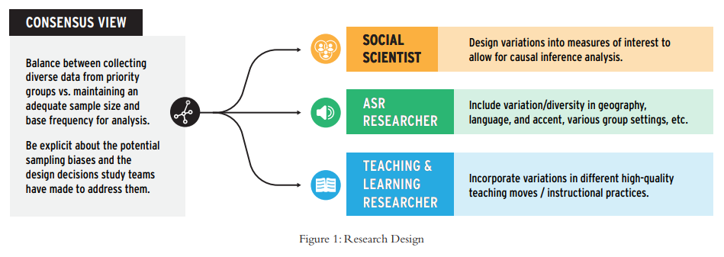
Design and Sampling
Almost all of our experts emphasized the importance of having a clearly defined target phenomenon of interest and optimizing variation to capture it, but those target phenomena varied widely by field and intended research questions.
Notes:
In addition to guiding the data collection process, experts across disciplines stressed the importance of clearly defining research interests to help weigh the risks and costs of managing PII in a dataset.
Having clearly defined phenomena of interest also helps identify potential limitations and sources of sampling bias, or which teachers, students, schools, and districts are represented in the dataset.

Slide 10
Data Collection
Regardless of the strength of a dataset’s design, the quality of the data gathered will determine its usefulness. We heard three themes repeatedly from our experts about investing in data quality:
Gathering rich contextual data enables deeper understanding of phenomena captured in classrooms;

Slide 11
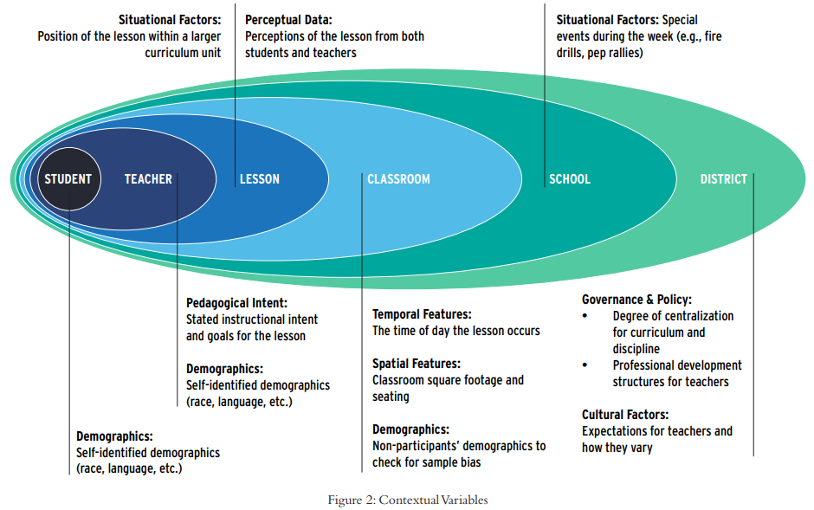
Data Collection (cont.)
Collecting and documenting contextual factors is integral to data quality. Experts made clear that a secondary user’s ability to accurately make meaning of data is a function of the context available to them.
Notes:
Varied contexts produce varied data, and so understanding sources of variation requires information about students, teachers, curriculum, and school and district contexts. Offering clarity about context extends not only to collecting data, but also explaining the measures used to collect those data. If in doubt, overcommunicate

Slide 12
Data Collection (cont.)
Regardless of the strength of a dataset’s design, the quality of the data gathered will determine its usefulness. We heard three themes repeatedly from our experts about investing in data quality:
Gathering rich contextual data enables deeper understanding of phenomena captured in classrooms;
Investing in technical quality in audio and video data collection is worth the expense, and crisp audio is more valuable than video if a tradeoff is necessary;
When combining so many data streams into one coherent dataset, it is important to consider synchronization, downstream diarization, and transcription.

Slide 13
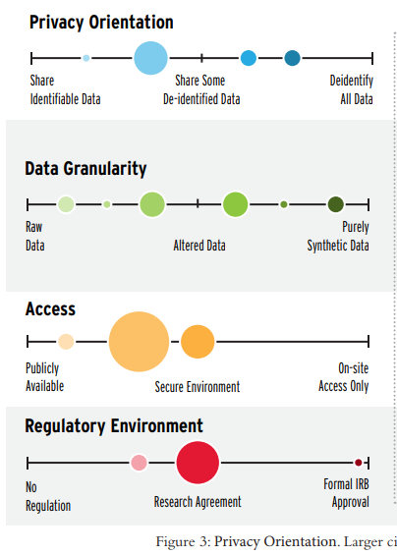
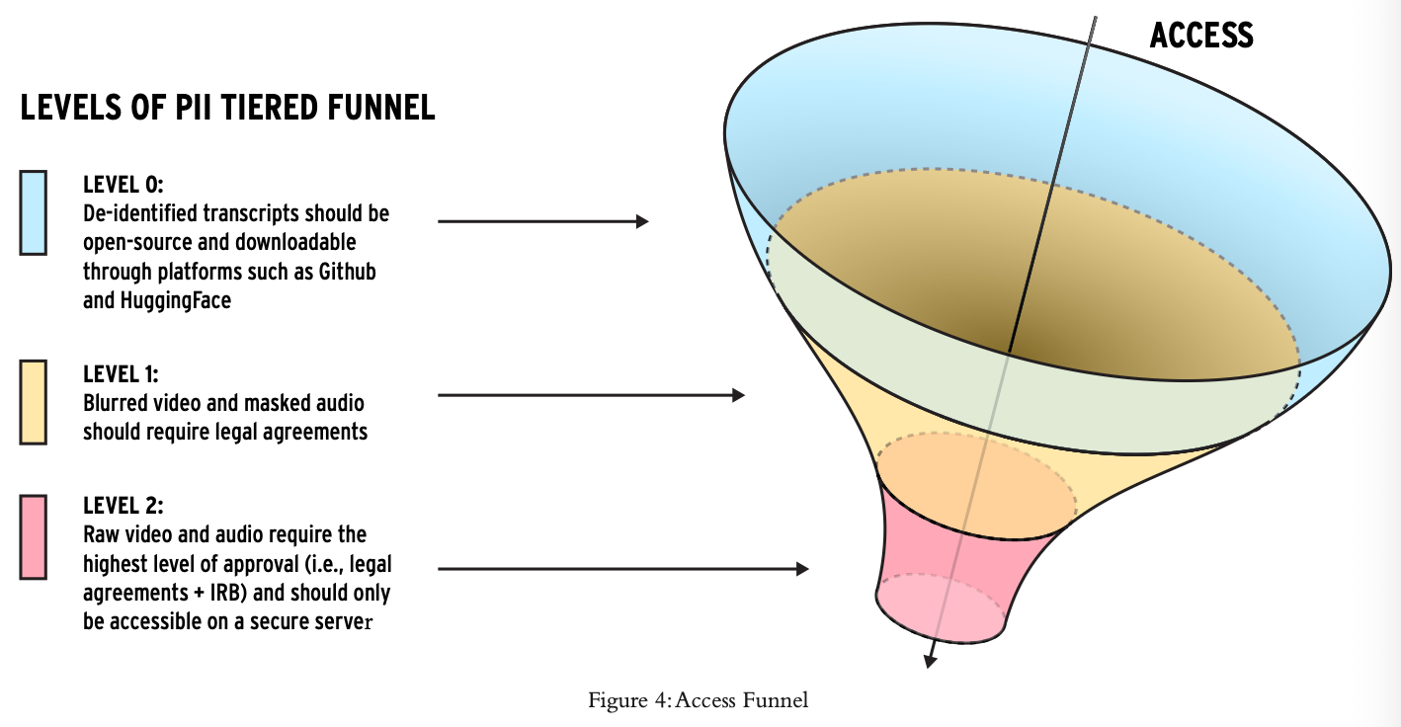
Student Privacy
Collecting classroom data inherently carries privacy risks, but the rapidly evolving capabilities of AI-based tools are creating new challenges to contemporary norms for managing personally identifiable information (PII) and consent.
Notes:
Experts we interviewed shared a common concern for privacy and confidentiality, and in particular agreed on the wisdom of offering differing levels of access based on the sensitivity of data, the expanding definition of PII over time, and the importance of clearly communicated parameters in obtaining consent.
However, they differed widely in their degree of preferred privacy protections for both data processing and data access for potential users, and they chose to emphasize differing aspects of security as important.

Slide 14
EDSI Dataset Preview
Video, audio, survey, and administrative data from 300 4th-8th grade mathematics classrooms
Multimodal data optimized for children's speech: High-quality audio with student speaker identification enabling longitudinal tracking and ASR model training
Pedagogically annotated naturalistic instruction: 300 teachers using HQIM with expert annotations of teaching moves and student reasoning processes
Designed to reduce bias: Sufficient geographic, linguistic, and accent diversity to ensure equitable model performance across student populations
Contextual richness: Linked student/teacher surveys, demographics, assessment data, coaching sessions, and teachers’ pedagogical intent to enable causal inference and validation
Accessible for AI development: Tiered access to support model training, benchmarking, and tool development

Slide 15


Timeline
First batch data from pilot year
fully de-identified and processed
Develop scoring rubrics & first proof-of-concept study
Data science competition
Year 2 data collection and processing
District Recruitment &
Pilot year data collection
Release second part of the data
Jan 2025
August
May 2026
August
March 2027
August
User study to guide data collection
Mini-grants to release first batch of data to select researchers
Second proof-of-concept study
Year 1 data collection and processing
We are here!

Slide 16
Pilot Year Data Collection

Slide 17
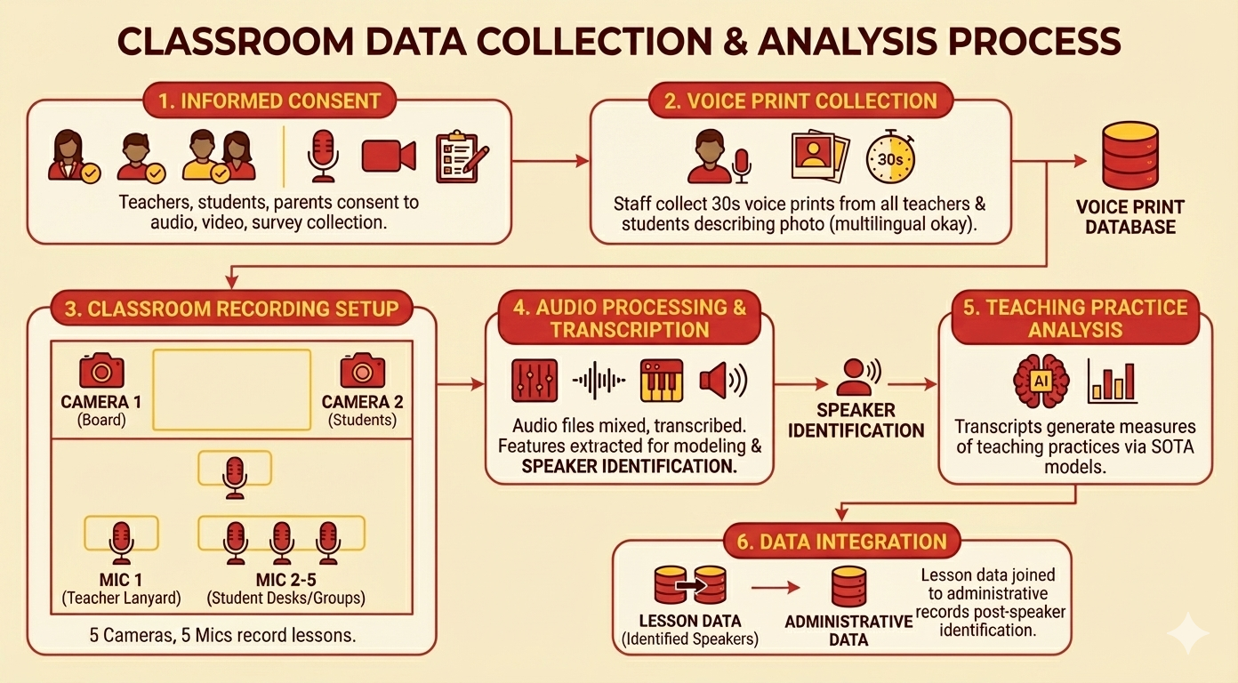

Slide 18

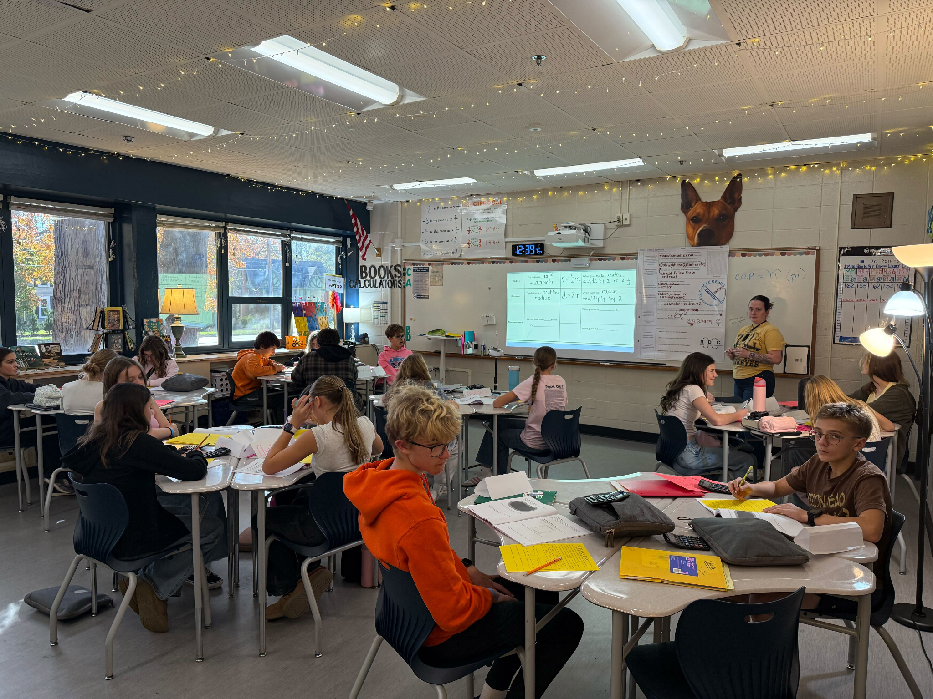
Pilot Year (2024-25) Data Collection
19 middle school teachers from 12 different schools in a North Carolina school district
13 teachers were recorded 6 times and 6 teachers were recorded 40 times (=313 lessons)
6 waves of lesson-level surveys to both teachers and students
Embed an RCT in the data collection to test one theory about teacher professional learning
Currently working with 60 teachers in 2 districts and expect to reach a sample size of 300 by 2027

Slide 19
 | All Students in District | Students in Study | Consenting Students | Consent vs. Non-Consent
 | mean | mean | mean | p
Female | 0.49 | 0.48 | 0.49 | 0.381
Asian | 0.07 | 0.08 | 0.08 | 0.842
Black | 0.42 | 0.31 | 0.28 | 0.000
Hispanic | 0.19 | 0.16 | 0.15 | 0.222
White | 0.27 | 0.39 | 0.44 | 0.000
Mutliracial | 0.06 | 0.05 | 0.05 | 0.632
English Language Learner | 0.12 | 0.11 | 0.09 | 0.030
Gifted | 0.47 | 0.47 | 0.54 | 0.000
Special Education | 0.13 | 0.13 | 0.11 | 0.001
Math Z-Score (2024) | -0.00 | -0.00 | 0.12 | 0.000
Math Z-Score (2025) | -0.00 | -0.00 | 0.12 | 0.000
Observations | ~70K | 509 | 406

Slide 20
Teacher Survey
The teacher survey included 16 questions about that day’s math lesson (response rate = 100%).
10 survey questions measured General Satisfaction(Factor 1).
3 questions measured Equity (Factor 2).
2 questions measured Student Behavior (Factor 3).
Factor 2: Equity of Student Work
• All students participated in the lesson.
• Opportunities to participate in the lesson were distributed equitably among students.
• Students with disabilities and/or who are English language learners were able to access and engage with the lesson in similar ways as their peers.
Factor 3: Student Behavior
• Instructional time was lost because of student misbehavior.
• I had to reprimand students to control the class.
Factor 1: General Satisfaction
• Students paid attention during the lesson.
• Students learned the intended material.
• Students demonstrated mastery of the lesson material.
• I am satisfied with the way I taught today’s lesson.
• This was one of my stronger math lessons.
• I conveyed the lesson material clearly and accurately.
• Students communicated their mathematical ideas during this lesson.
• Students engaged in mathematical reasoning during this lesson.
• Students worked on problems that required them to think critically during
this lesson.

Slide 21
Student Survey
Factor 2: Rigor and Equity
• I thought hard about math problems.
• My teacher encouraged our class to use math vocabulary.
• I felt like my teacher(s) and/or other students would help me master the lesson’s material.
• Many different students shared their ideas or solutions.
• The teacher talked about what students did right when solving problems.
• When someone couldn’t solve a problem the first time they tried, the teacher asked them to try
again rather than giving them the correct answer.
• Even students who weren’t sure of their answers had a chance to share their ideas.
• I felt like working hard counted more than getting the right answer.
The survey included 13 questions about that day’s math lesson. (response rate = 80% among consenting)
5 survey questions measured Engagement & Belonging (Factor 1).
8 questions measured Rigor & Equity (Factor 2).
Factor 1: Engagement and Belonging
• I explained my answers - why I think what I think.
• I spoke up to share my math ideas and solutions.
• I felt comfortable sharing my math ideas and solutions.
• I felt like I contributed important math ideas and solutions to the class.
• I felt confident that I could do good math.

Slide 22
Speaker Identification & Anonymization

Slide 23




Why Speaker Identification?
Removing Non-Consenting Students & Annonyimization
Difficult to isolate individual speakers
Speaker identification challenge
Linking individual utterances to student identity

Slide 24
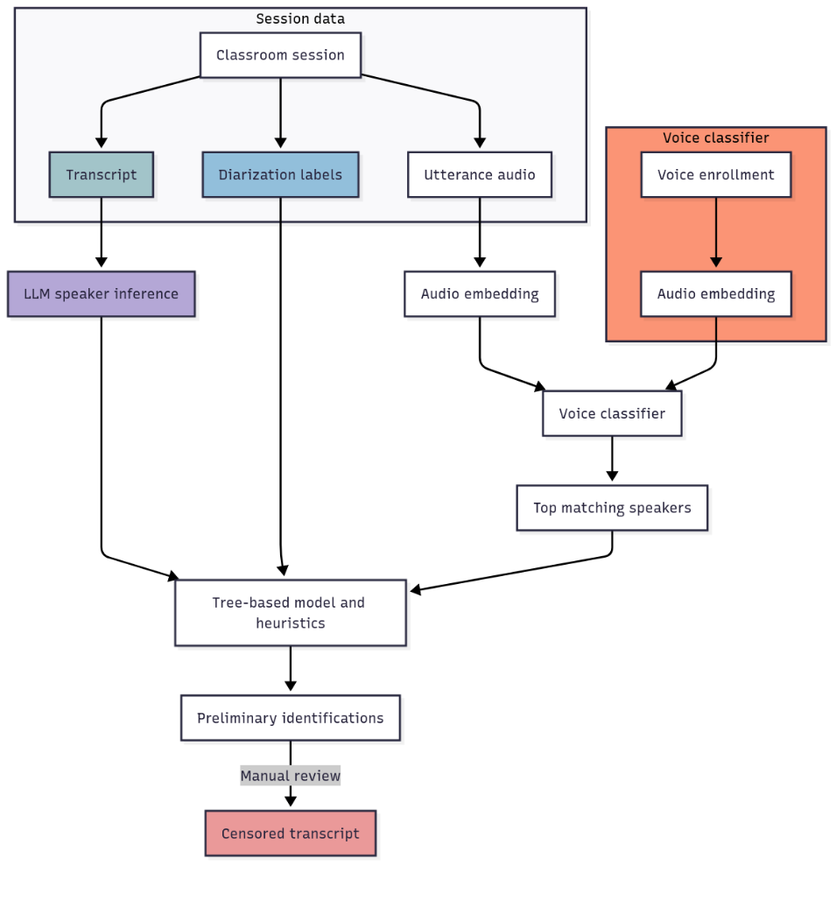
The challenge
The approach
Classrooms have many students, hence they are noisy and the conversation structure is complex (e.g., overlapping talk, <5 word utterances)
LLM‑based speaker inference from content
Use transcript context (e.g., teacher calls a student by name) to infer likely speaker. LLMs handle local discourse cues and conversation structure.
Original diarization labels
Use diarization labels to group utterances by same unknown speaker (e.g., S1, S2, etc.). Concatenate grouped audio and match to speakers via the voice classifier.
Voice classification
Collect ~30 seconds of isolated enrollment audio per known speaker*
Embed snippets with speaker identification model (e.g., ECAPA‑TDNN) and train a KNN classifier to label each utterance by closest voice embeddings.
Notes:
The model compares each utterance to each possible candidate speaker, and is run on each utterance candidate pair.
It is trained to learn whether one utterance is the candidate speaker and is not the other speakers.
Allows the model to generalize to speakers with no labeled data.
→ The model produces a prediction and probability that each candidate speaker issued the utterance.

Slide 25
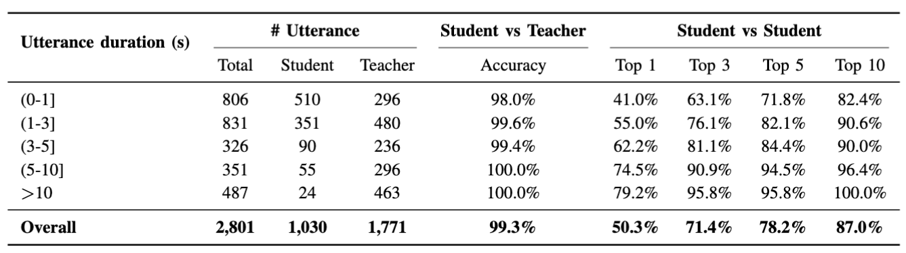
Overall Performance
Ground truth
3,999 utterances from 7 lessons have human‑verified speakers
Using a combination of audio, video recordings, seating charts, and class rosters
66.7% identified
Ongoing work: Promising improvement by fine-tuning the WavLM-MHFA model using our own dataset.
Notes:
In a nutshell, we combine three sources of information to identify who spoke: 1. conversational cues or whether a teacher nominated a student in her utterance; 2. manual labels from TranscribeMe, a transcription company (a transcriber listens to the audio and identifies speakers based on their judgment); 3. matching voice enrollment data to audio recording (i.e., comparing the similarity between voice enrollment to each utterance).
We did a near perfect job separating teachers and students. At the individual student level, we match each spoken utterance to all consenting students' voice enrollment. Our confidence in the top 1 speaker is 50% and when we look at the top 3 speakers (the chance that this utterance is from one of the top three speakers we identify) is 70%, which is pretty good!
One dilemma to highlight is some districts do not allow us to voice enroll nonconsenting students, which is key to identifying a speaker before we can remove their contributions...

Slide 26
Preliminary Analysis

Slide 27
Discourse as A Driver of Cognitive Development and Equity
Talk as a Cognitive Tool
Language is not merely a product of learning but a tool for cognitive development (Vygotsky, 1978; Resnick et al., 2018).
Language socializes students into disciplinary argumentation and academic habits of mind (Sfard, 2008).
Academic Language Acquisition
Discourse builds proficiency in formal structures distinct from everyday speech.
In math, this fluency allows students to justify solutions, interpret word problems, and engage in proof (Schleppegrell, 2007).
Student talk and Their Achievement
Classroom-level talk links to test scores, but intra-class variability is much less studied (e.g., Applebee et al., 2003; Muhonen et al., 2018; for a meta-analysis, see Tao & Chen, 2024).
At the individual level, low classroom participation associates with poorer end-of-year grades/test scores (Schnitzler et al., 2020; Sedova et al., 2019).
Silent students miss the cognitive benefits of “talking through” complex ideas (Schnitzler et al., 2020).
Equity Implications
Girls, multilingual learners, and students from racially and linguistically minoritized communities engage less in classroom discourse (Byun, 2024; Moser et al., 2022; Sedova et al., 2019)
Analyzing student discourse is essential to understanding how different student groups such as Multilingual Learners access (or are denied) the tools for mathematical expression (Moschkovich, 2004; Alexander, 2018).

Slide 28
Research Questions
How does classroom participation varies across teachers, and how do these patterns evolve over time?
What classroom features associate with classroom participation rates?
How does classroom participation varies by student characteristics, such as their gender, race/ethnicity, English learner status, and special education status?
How does student in-class participation associate with their achievement?

Slide 29
Research Questions
How does classroom participation vary across teachers, and how do these patterns evolve over time?
Define classroom participation as percent of students who spoke at least once in a given lesson
What classroom features associate with classroom participation rates?
How does classroom participation vary by student characteristics, such as their gender, race/ethnicity, and special education status?
How does student in-class participation associate with their achievement?

Slide 30
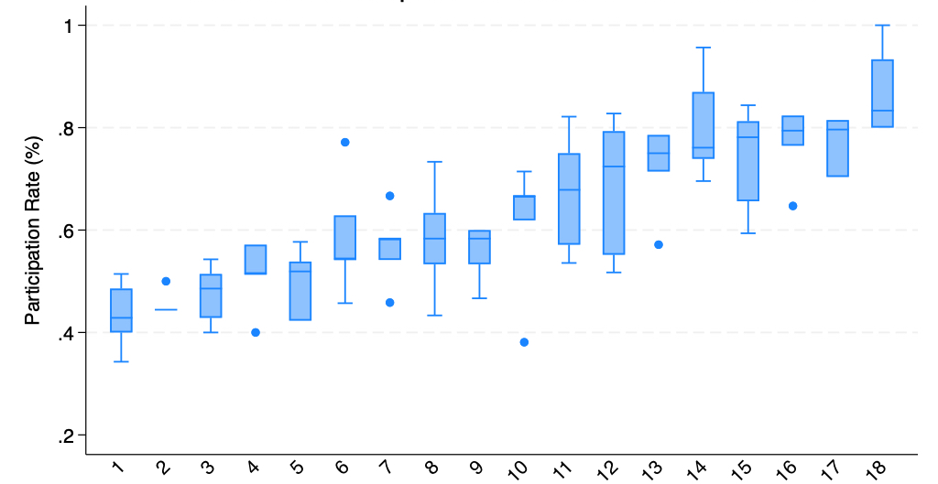
Classroom participation varies widely across classrooms
Notes:
Only show 18 teachers here because one teacher (newcomers classroom) doesn’t have voice enrollment

Slide 31
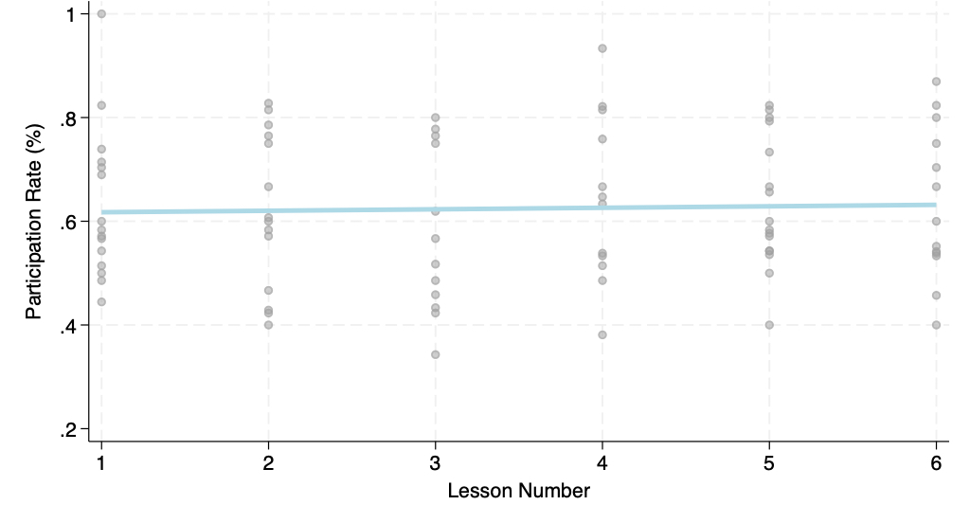
Participation rates are quite stable over the school year

Slide 32
Research Questions
How does classroom participation vary across teachers, and how do these patterns evolve over time?
What classroom features associate with classroom participation rates?
  Emotional state of teacher speech
  Teaching practice
  Student perceptions
How does classroom participation vary by student characteristics, such as their gender, race/ethnicity, and special education status?
  Volume: # of words & duration
  Quality: questions & math reasoning
How does student in-class participation associate with their achievement?

Slide 33
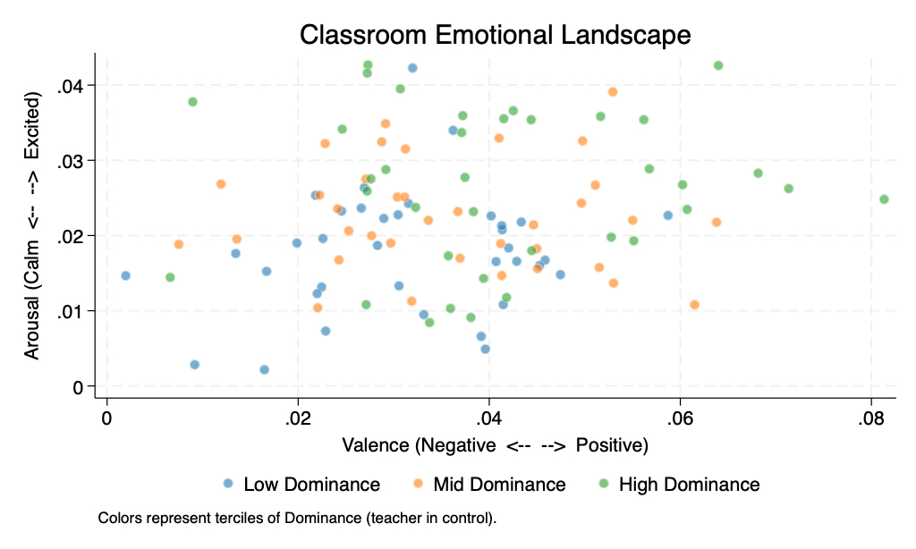
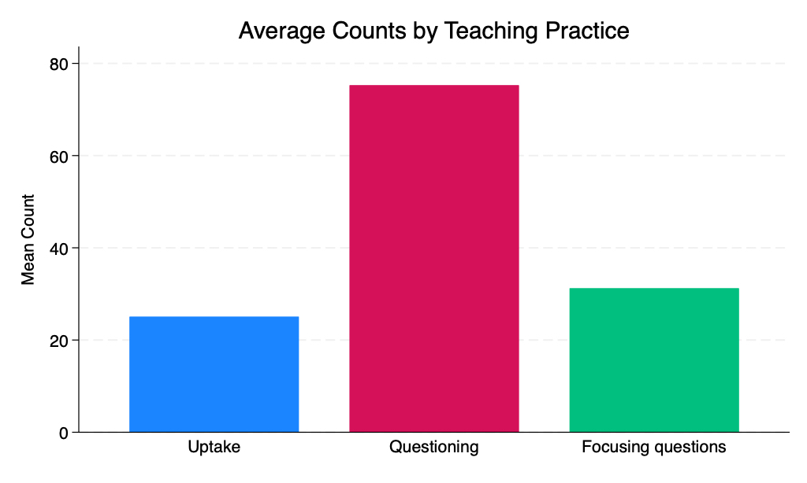
Classroom Features
Emotional state of teacher speech
Valence
Arousal
Dominance
High-leverage teaching practice
Uptake (Demszky et al., 2021)
Questioning
Focusing questions (Alic et al., 2022)
Notes:
Valence measures how positive or negative an emotion is, Arousal reflects the interlocutor’s intensity or energy level, and Dominance indicates the degree of control or power the interlocutor feels they have.
High valence: “Okay. All right. Excellent. Great. I love it. Did anybody use a different strategy? All right, Zain, come tell us a little bit about what you did. I like it. Great job. Those are correct answers. You can chat and join.”

Slide 34
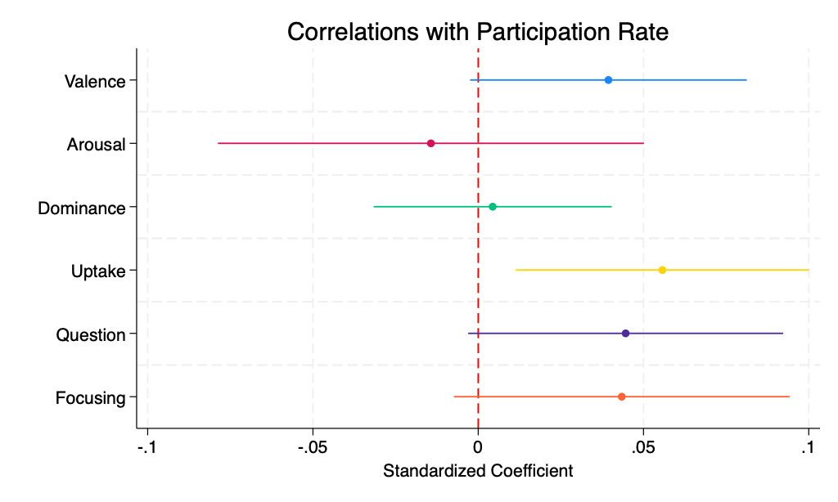
Several teacher speech features and practices associate positively with participation rates
Notes: Coefficients are from simple regressions on lesson participation rates on a standardized teacher measure. SE is clustered at the teacher level.

Slide 35
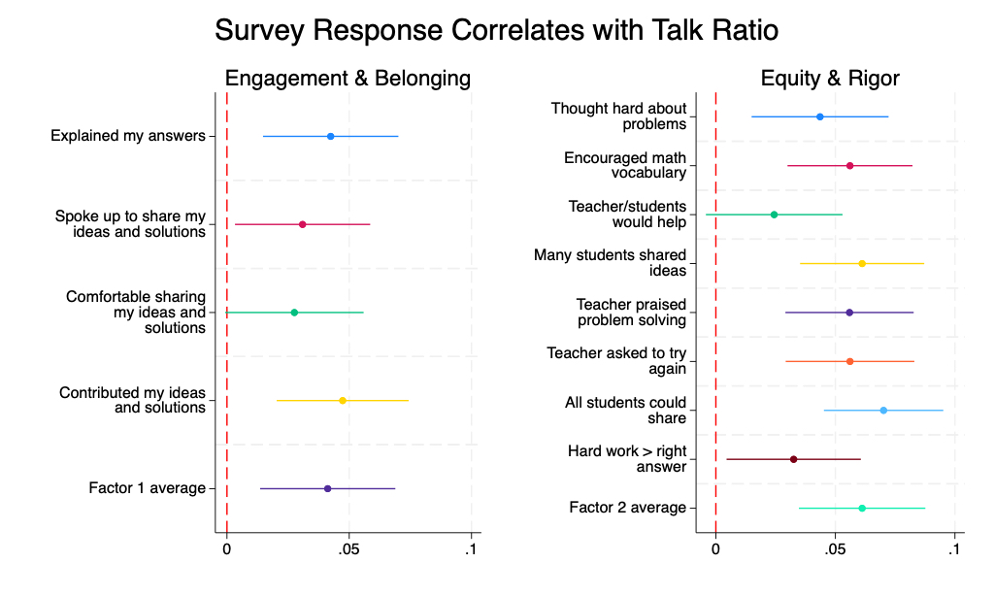
Student show more positive perceptions of their math lessons in classrooms with higher participation rates

Slide 36
Student show more positive perceptions of their math lessons in classrooms with higher participation rates

Slide 37
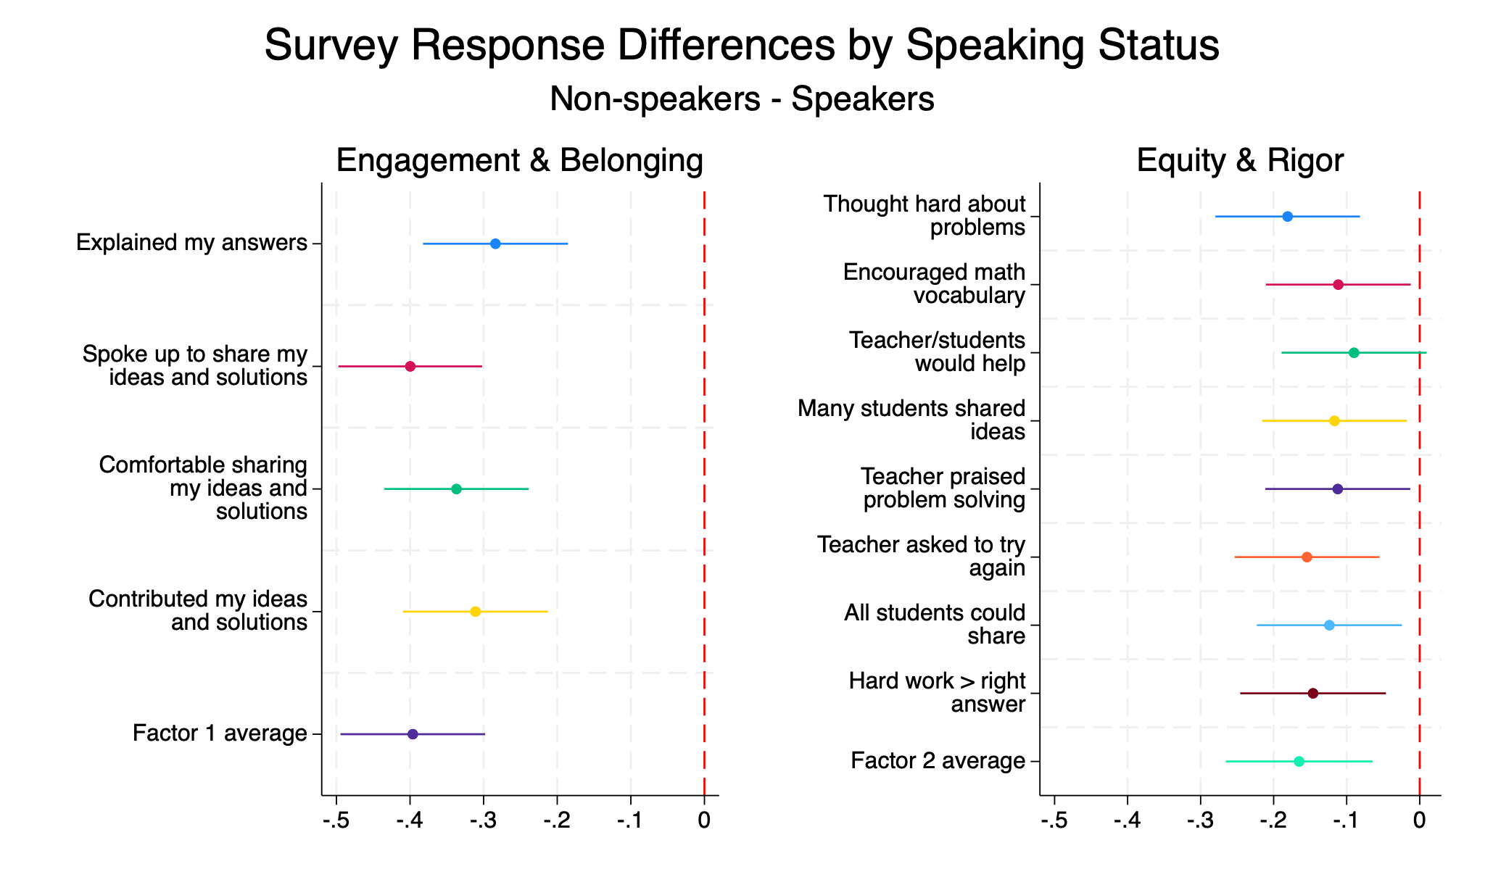
Students who didn’t speak have lower self-reported engagement and belonging compared to their peers.

Slide 38
Research Questions
How does classroom participation vary across teachers, and how do these patterns evolve over time?
What classroom features associate with classroom participation rates?
How does classroom participation vary by student characteristics, such as their gender, race/ethnicity, English learner status, and special education status?
  Volume: # of words & duration
  Quality: questions & math reasoning
How does student in-class participation associate with their achievement?

Slide 39
Volume vs. Quality of Student Talk
 |  | Mean | SD
Volume Metrics | Total words | 51.95 | 71.64
 | Total time (seconds) | 20.05 | 26.68
Quality Metrics | Mathematical reasoning | .54 | .80
 | Questions | .58 | .97
About 10% of student never spoke in the six lessons we observe, which might be due to
  they didn’t speak;
  they didn’t consent for voice recording and thus their speech is removed from our data;
  or our speaker identification model fails to correctly identify their identity.

Slide 40
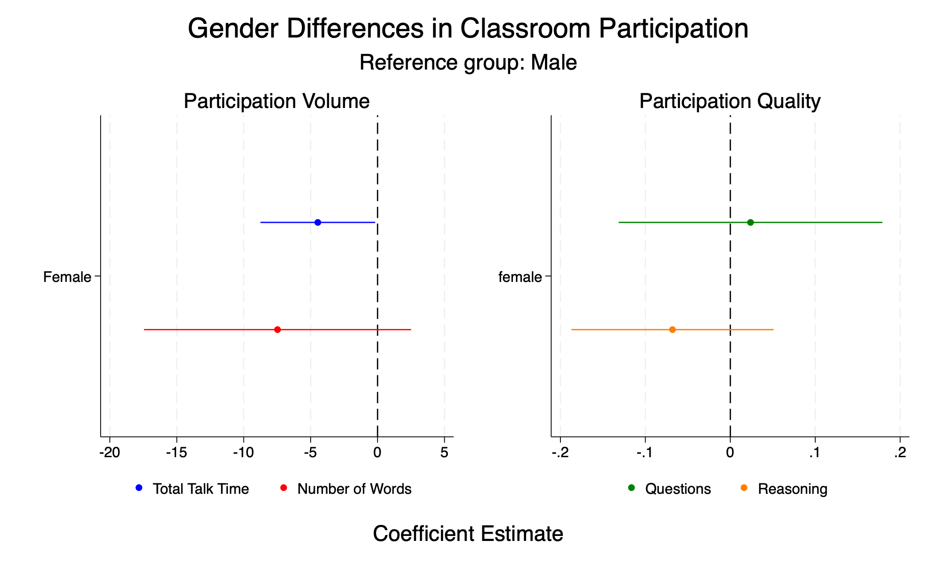
Note: Models control for teacher fixed effects.

Slide 41
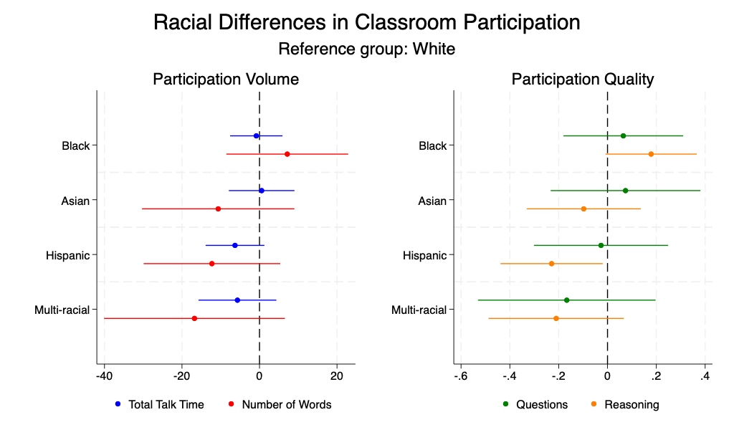

Slide 42
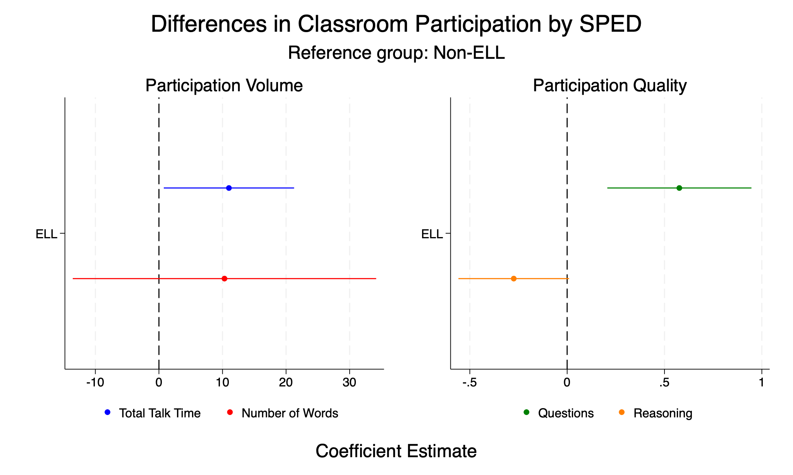

Slide 43
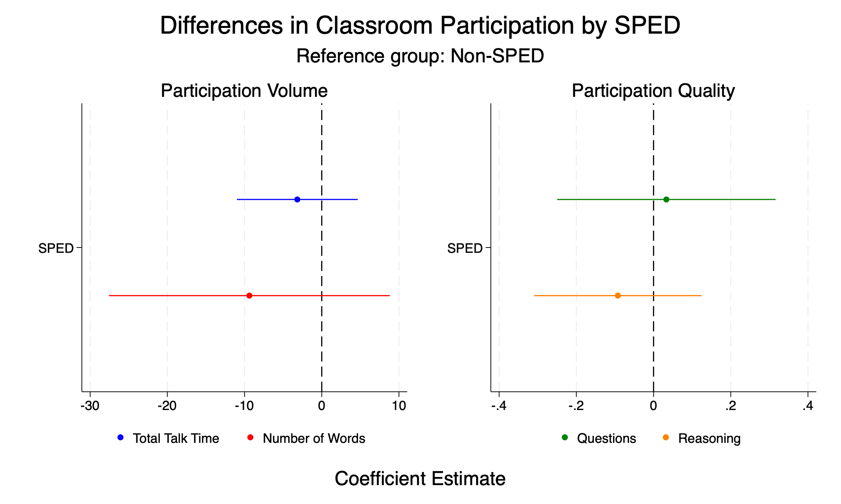

Slide 44
Research Questions
How does classroom participation varies across teachers, and how do these patterns evolve over time?
What classroom features associate with classroom participation rates?
How does classroom participation varies by student characteristics, such as their gender, race/ethnicity, and special education status?
How does student in-class participation associate with their achievement?

Slide 45
Methods
Typical value-added type of modeling
where a student i’s achievement in year t is a function of the prior year achievement, a speech feature in the current year, a vector of student demographics and characteristics, a classroom fixed effect, and an error term.
Speech measures are aggregated across lessons.
  Volume vs. quality
Potential omitted variables
  Student-specific unobservables that affect their opportunities/likelihood of participation
  Bias induced by our speaker identification model

Slide 46
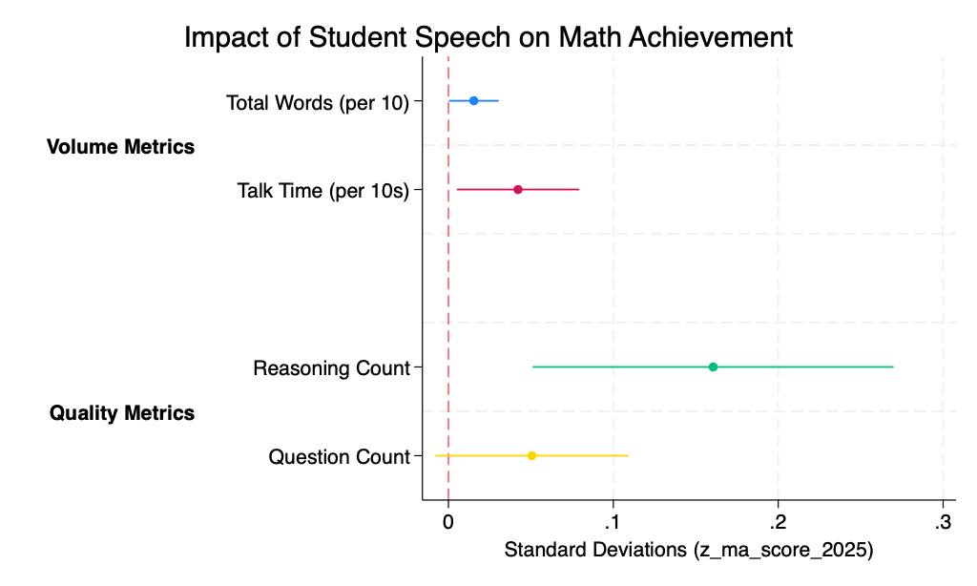

Slide 47
Summary
The EDSI dataset affords a novel opportunity to examine classroom dynamics and student discourse that are not previously feasible
Preliminary analyses of pilot data reveal large variabilities of classroom participation by teachers and student subgroups across a variety of dimensions
Student in-class contributions might play an important role in their cognitive development and achievement

Slide 48
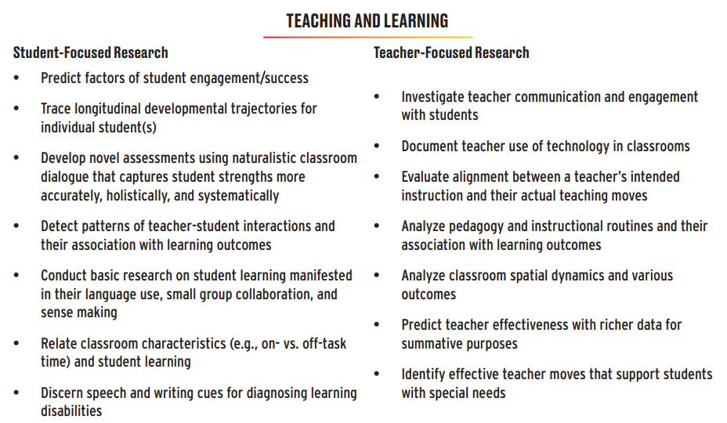
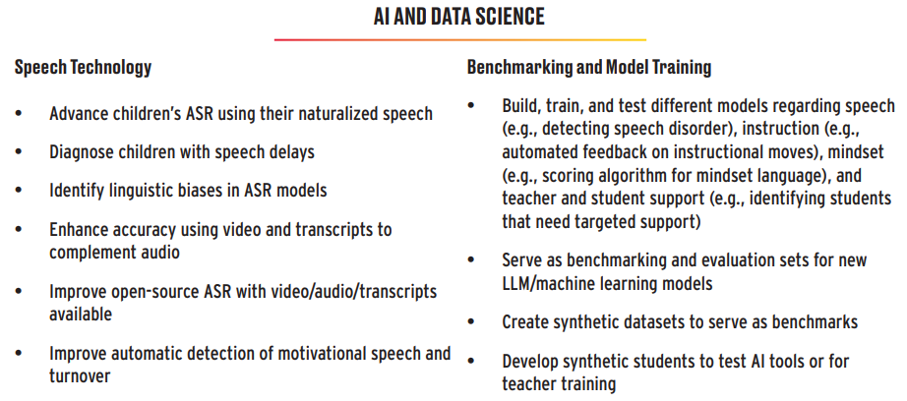
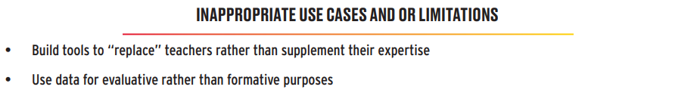
Potential Use Cases for
Multimodal Classroom Data
Notes:
We distill them into two broad categories–Teaching and Learning and AI and Data Science, with the first one more concerning the fundamental research questions in the substantive field of education and the latter category that is more technical in nature. These two buckets are not mutually exclusive, as many use cases share substantive and technical aspects.
Experts felt strongly that our dataset should reinforce the complex nature of teaching and learning; the knowledge and tools derived from this dataset should only aim to augment, not replace, teachers’ work. Experts also emphasized the importance of using the data only for informative rather than evaluative purposes, especially when conducting research about teacher effectiveness

Slide 49



Acknowledgement
UMD
Hannah Rosenstein
Michael Chrzan
Anika Alam
Ariel Chung
Carol Espy-Wilson
Sarah Montana
Eesha Iyer
Harvard
Heather Hill
Samantha Booth
Claire Gogolen
Stanford
Dora Demszky
Helen Higgins

Slide 50
Thank You!
Questions & Comments
edsi.umd.edu
jliu28@umd.edu

Slide 51



