Slide 1

Using Natural Language Processing to Measure and Improve Teaching Effectiveness: Evidence from Randomized Controlled Trials
Jing Liu
University of Maryland College Park
ISEA, 2026

Slide 2
Agenda
Motivation
M-Powering Teachers (MPT) —A Machine Learning Tool for Instructional Measurement and Feedback
Demonstrate the process of building automated measures on teaching practices
Three randomized controlled trials (RCTs) to test the effectiveness of MPT
Implications & next steps

Slide 3
Motivation
Providing teachers with formative feedback can improve both their instruction and their students’ outcomes (Taylor & Tyler, 2012; Steinberg & Sartain, 2015; Kraft et al., 2018 ).
Formative feedback is nonevaluative, supportive, timely, and specific, with the intention to modify teachers’ thinking or behavior to improve their teaching (Shute, 2008).
Few educators experience such feedback on a regular basis.
  An average public school teacher only receives formative feedback once or twice per year (Kraft & Gilmour, 2016)
  Teachers report the feedback they get as low utility (Hellrung & Hartig, 2013)
  Only 40% of schools provide teachers access to a math or reading coach AND limited coach time on instruction (Taie & Goldring, 2017, Bean et al., 2010; Gibbons & Cobb, 2016; Scott et al., 2012)

Slide 4


Human-Based Classroom Observation and Feedback
Widely used in the US and the world to evaluate teaching practices across early childhood, K-12, and higher education (Kane & Staiger, 2012; Pianta & Hamre, 2009; Cohen & Goldhaber, 2016; Hill & Grossman, 2013)
Resource and labor intensive
The quality of feedback varies: low rater consistency & prone to bias (Ho & Kane, 2013; Donaldson & Woulfin, 2018; Kraft & Gilmour, 2016)
Notes:
Traditional methods for improving instruction involve human scoring of classroom recordings.

Slide 5
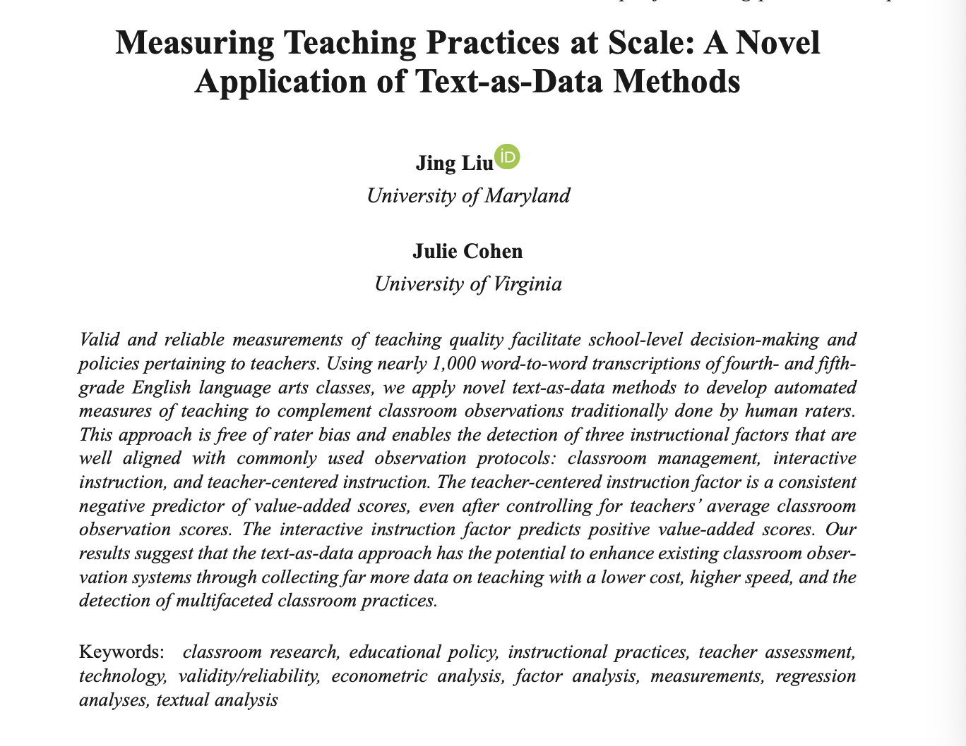
Natural Language Processing (NLP) Techniques Provide A Powerful Complement to Human-Based Classroom Observation
NLP is a branch of artificial intelligence (AI) used to process and understand human language.
Has the potential to measure nuanced teaching practices by analyzing transcripts of classroom recordings at scale.
NLP-based measures on teaching practices can facilitate frequent and timely feedback to teachers.

Slide 6







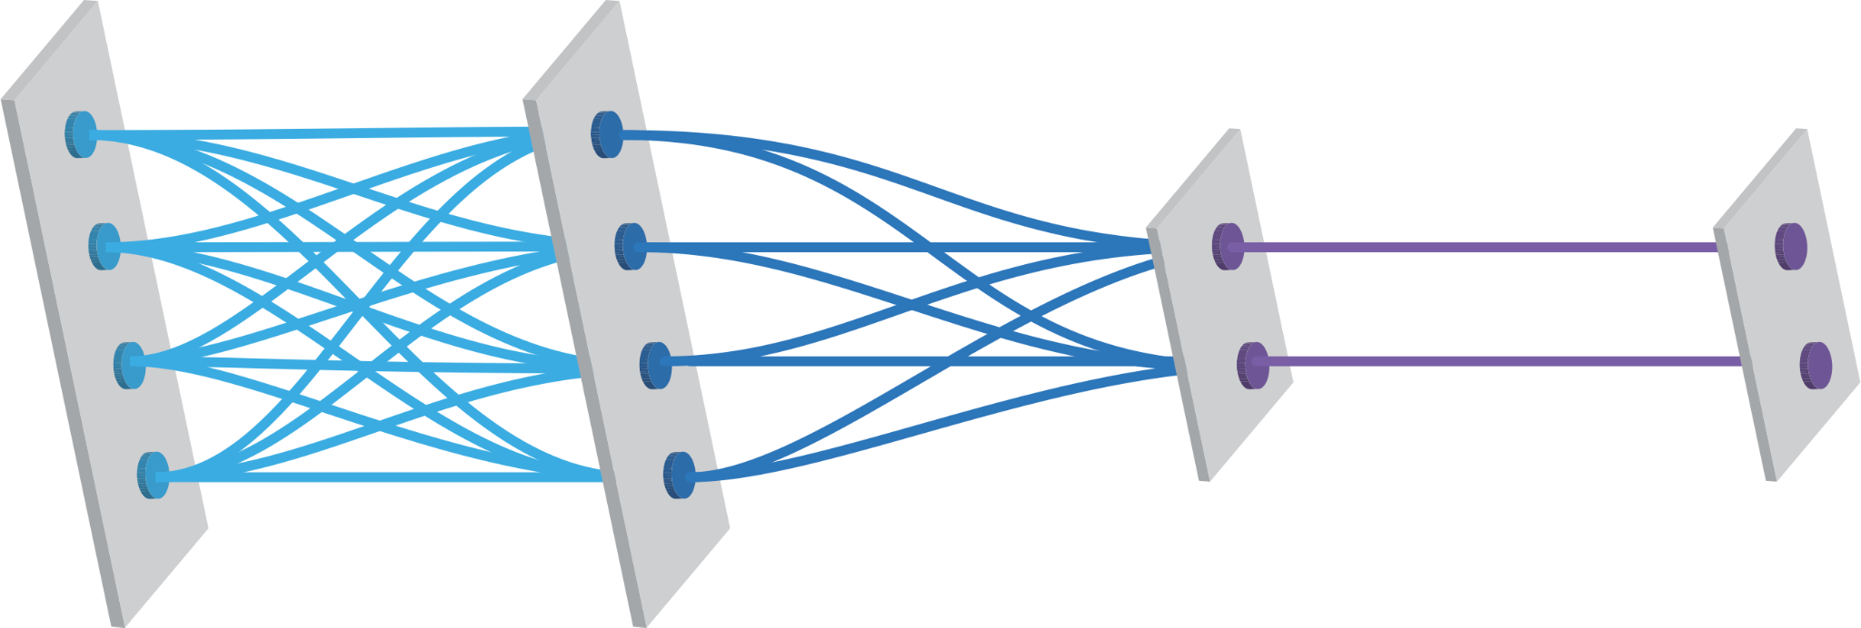
Mission
Natural Language Processing
Machine Learning
Education
Theory
Scalable & Theory-driven Classroom Measures
+
Effective
Feedback Mechanism
Descriptive research
Feedback to Teachers
Descriptive Research
Intervention Evaluation
Notes:
We use state-of-the-art natural language processing to build measures that are low-cost, and hence are scalable to implement. We also build on insights from educational theory to make sure what we measure is indeed matters for teachers and students.

Slide 7
The Development of M-Powering Teachers (MPT)—A Machine Learning Tool for Instructional Measurement and Feedback
Measurement
Speech Technology
Field Experiments

Slide 8
The Development of M-Powering Teachers (MPT)—A Machine Learning Tool for Instructional Measurement and Feedback
Measurement
Speech Technology
Field Experiments

Slide 9
What is Uptake?
(Collins, 1982; Nystrand et al., 1997; Wells, 1999).
s
I added 30 to 70...
acknowledgment
Okay.
t₁
Positive association with student learning and achievement across learning contexts (Brophy, 1984; O’Connor & Michaels, 1993; Nystrand et al., 2000; Wells & Arauz, 2006; Herbel-Eisenmann et al., 2009; Demszky et al., 2021).
Among the most difficult teaching practices to change, possibly due to the cognitive complexity (Cohen, 2011; Kraft & Hill, 2020, Lampert, 2001).
collaborative completion
And you got what?
t₂
repetition
Okay, you added 30 to 70.
t₃
reformulation
Good, you did the first step.
t₄
elaboration
Where did the 70 come from?
t₅
Notes:
One can take up, or in other words, build on the interlocutors’ contribution in several ways. For example, going back to a classroom example, if a student says “I added 30 to 70”, the teacher could acknowledge, collaboratively complete, repeat, reformulate or elaborate on what they said. This is not an exhaustive list, as there are several potential ways one could do uptake.

Slide 10
Measuring Uptake
Unsupervised machine learning model
  Do not rely on human annotation
  Learns to estimate the extent to which a teacher’s response is specific to a students’ contribution.
Trained on a combination of three large corpora of interactions
  NCTE transcript dataset of elementary math classrooms
  Switchboard dataset of phone conversations, widely used in NLP research on dialog
  A one-on-one math and science text-based tutoring dataset from a company
Outperforms other popular models
  Demonstrates high precision (0.62) on par with human annotation
  Correlates with related teaching practices across a range of learning settings
  Better at capturing a wide range of uptake phenomena, including reformulation and collaborative completion
(Demszky, Liu, et al., 2021)

Slide 11
Going Beyond Teachers’ Uptake of Student Ideas
Density of mathematical language
Teacher focusing vs. funneling questions
Student mathematical explanation and reasoning
Classroom management and time on task
Meta-cognitive modeling
Attributing competence to students
Explicit teacher mathematical sense-making and reasoning
……

Slide 12
The Promises and Pitfalls of Using Language Models to Measure Instruction Quality in Education
“Our results suggest that pretrained Language Models demonstrate performances comparable to the agreement level of human raters for variables that are more discrete and require lower inference, but their efficacy diminishes with more complex teaching practices that require further inferences.”
(Xu, Liu, Jones, Cohen, & Ai, 2024)
Notes:
Remediation of student errors and difficulties; imprecision in language

Slide 13
The Development of M-Powering Teachers (MPT)—A Machine Learning Tool for Instructional Measurement and Feedback
Measurement
Speech Technology
Field Experiments

Slide 14



Providing Instructors with Automated Feedback: Three RCTs
Online Computer Science Courses
Online Tutoring
Brick-and-Mortar Classrooms

Slide 15
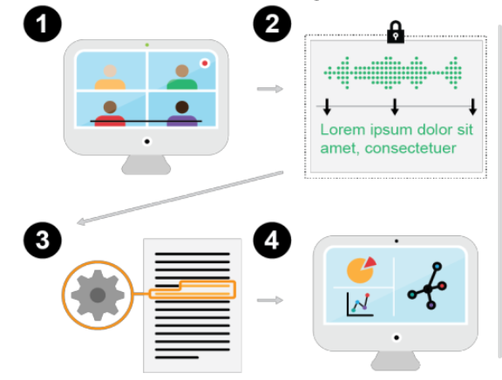
Pipeline of Giving Feedback
Recording
Transcription & Anonymization
Transcript Analysis
Feedback

Slide 16
Pipeline of Giving Feedback
Recording
Transcription & Anonymization
Transcript Analysis
Feedback

Slide 17
Pipeline of Giving Feedback
Recording
Transcription & Anonymization
Transcript Analysis
Feedback

Slide 18
Pipeline of Giving Feedback
Recording
Transcription & Anonymization
Transcript Analysis
Feedback

Slide 19
Design principles for reflective feedback
Non-judgmental & private
Concise, specific & actionable
Timely & regular
Notes:
Finally, we delivered the feedback in a timely and regular manner. To ensure that teachers still have a fresh memory of what they did and to make the feedback more relevant and exciting 9 (Shute, 2008), we shared feedback with teachers within 2-4 days after their class sessions, and always before their next class. We delivered feedback to teachers after each recorded class, with hopes that sustained work in this area would lead to improved practice over time.

Slide 20
RCT with Code in Place
Code in Place is a five-week free online computer science course organized by Stanford University.
12k students + 1.2k section leaders
Provide automated feedback to instructors on a key teaching practice—uptake of student contributions, and evaluate how such feedback affects instruction and student outcomes
Among the first to evaluate the impact of automated feedback on teacher instruction through a large-scale RCT.

Slide 21
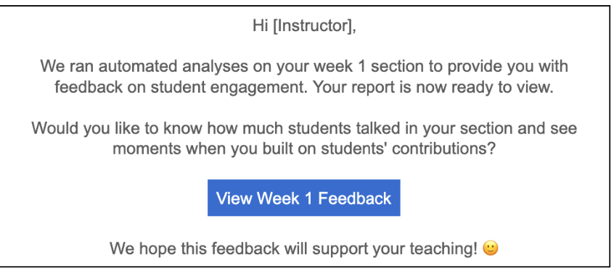
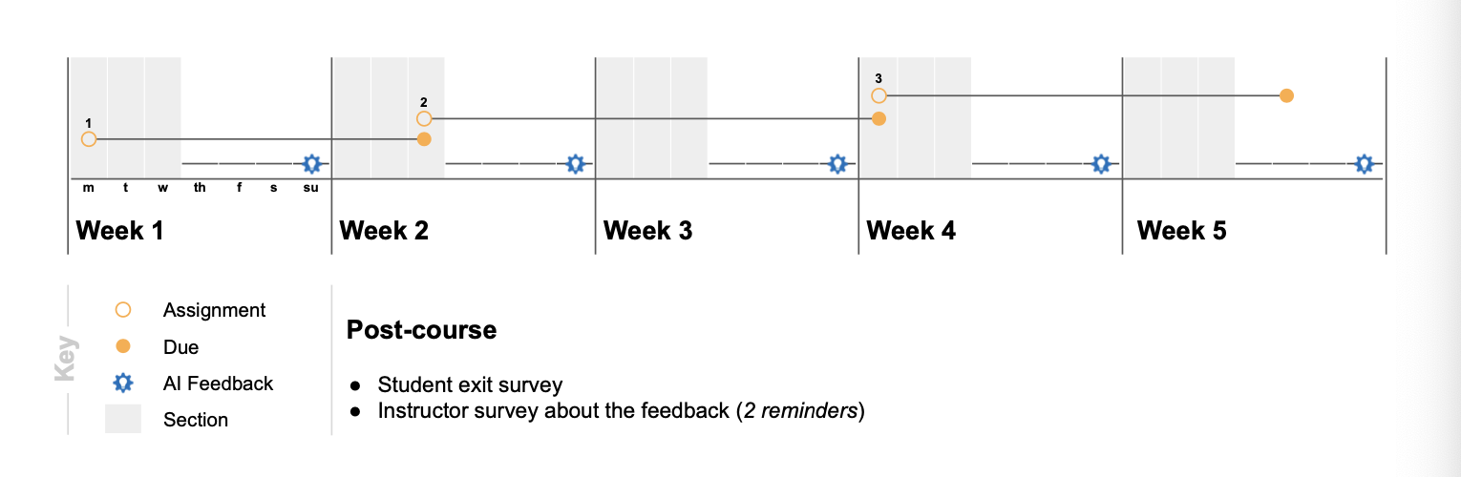
RCT with Code in Place
RCT Design
Randomized encouragement study
all instructors have access to feedback
A random 50% of instructors receive email
reminders
Feedback after each section (5x total)
Notes:
Here I’ll discuss results for Code in Place. The goal of this course is to democratize access to teaching and learning how to code. It’s a 5 week free online course organized by Stanford, and taught by volunteer section leaders. This spring it was organized for the second time, and they had 12k students and 12 hundred section leaders (I will refer to them as instructors).

Slide 22
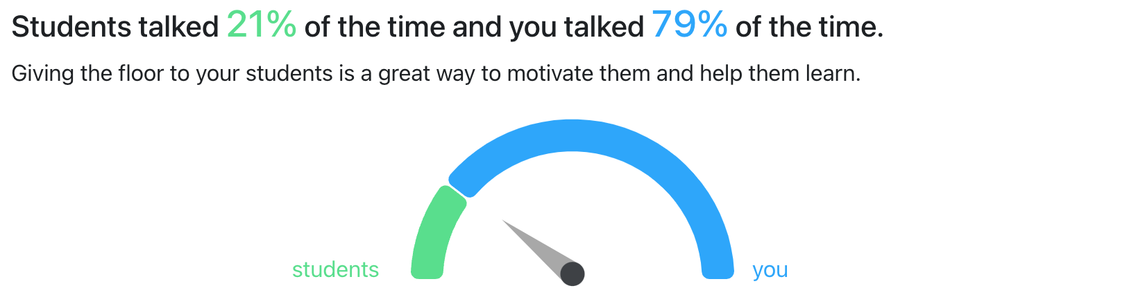
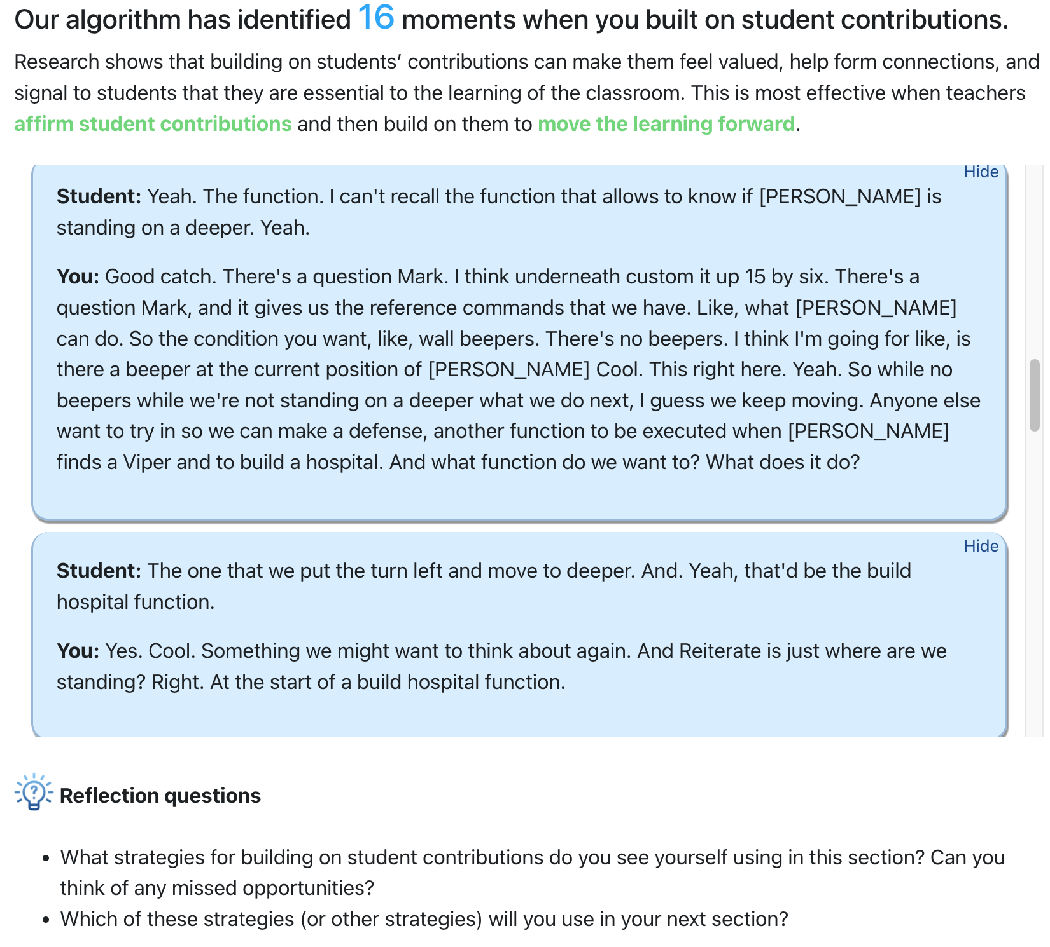
AI Powered Feedback on Your Teaching

Slide 23
Research questions
1. Does the feedback improve instructors’ practice?
  Uptake, questions, repetition, and instructors’ talk time
2. Does the feedback impact student engagement and satisfaction?
  Assignment completion
  Class attendance
  End-line survey about their perceptions
Notes:
We ask the following research questions.

Slide 24
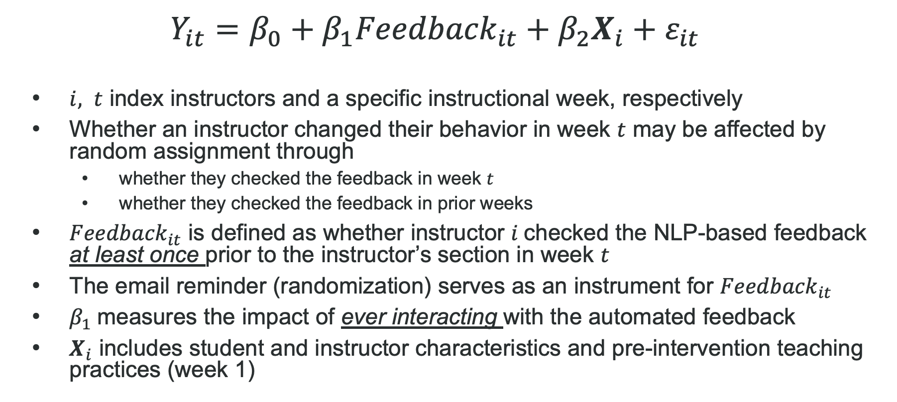
Identification Strategy: 2SLS Estimator

Slide 25
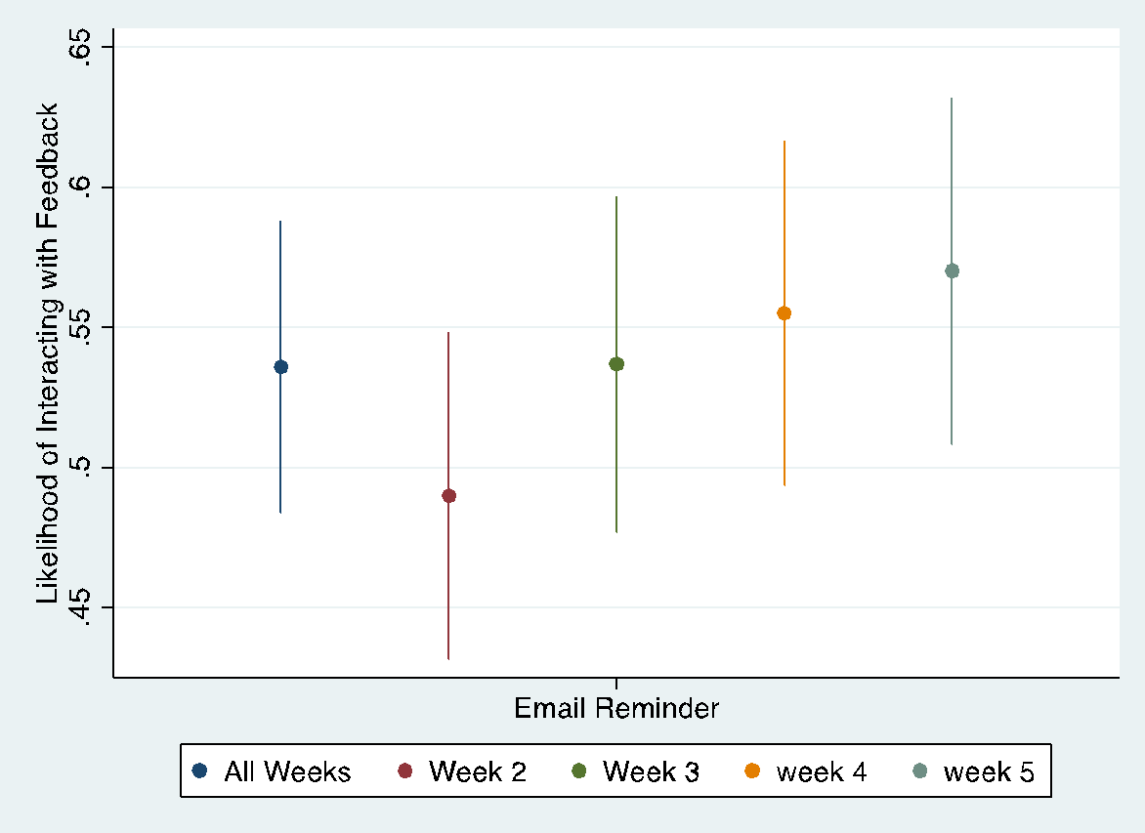
First Stages: By Week
Outcome: Whether an instructor ever checked the feedback
Across all instruction weeks, the email reminder increases treated instructors’ likelihood of checking the feedback at least once to 71.2%, four times the rate in the control group (17.6%).
The take-up appears to be the strongest in week 2, which is after the first email reminder.
First-stage F statistics = 34.151

Slide 26
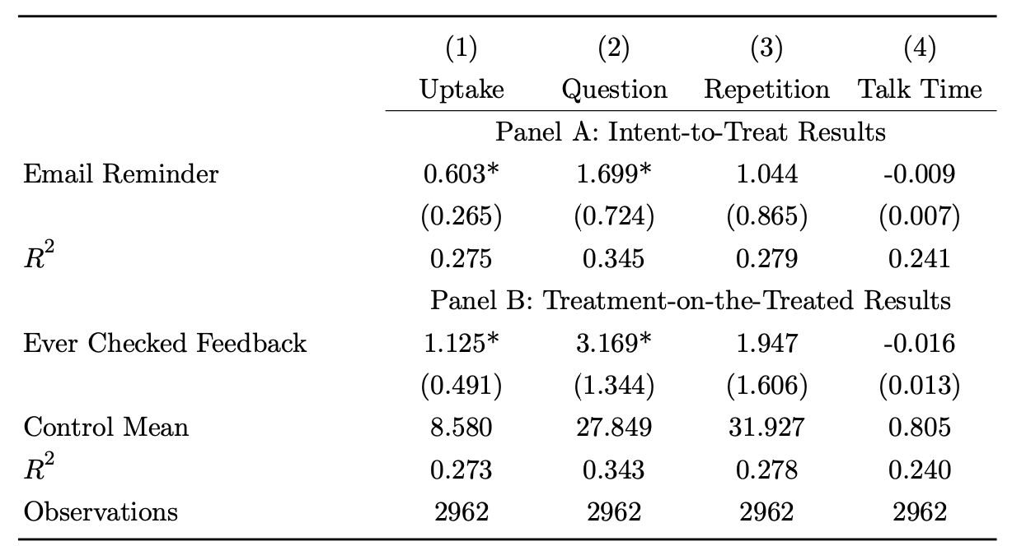
Effects of Automated Feedback on Teaching Practices
Instructors’ interaction with the feedback induced by the randomized email reminder improved their use of uptake by 1.13 times per hour (13.2%)
The improvement in uptake is driven primarily by more sophisticated strategies such as increased questioning rather than repetition or talk time.

Slide 27
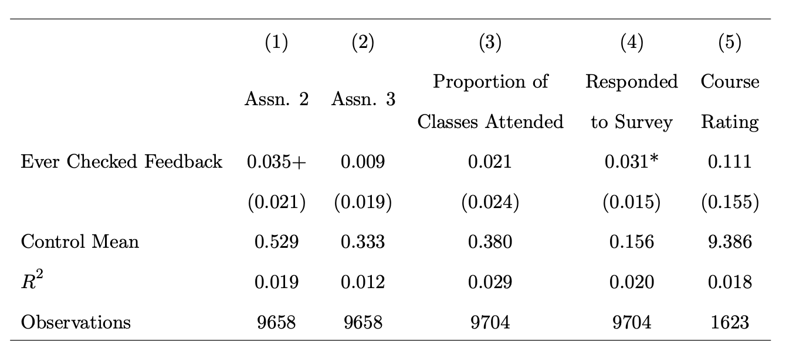
TOT Effects on Student Outcomes

Slide 28

RCT with Polygence
Tutoring is a quickly expanding form of instruction, especially by serving as a learning recovery tool post-pandemic
Polygence: A research mentorship platform for high schoolers
1:1 online tutoring mainly offered by Ph.D. students
N=414 mentors
Randomly assigned half to receive automated feedback on uptake; the other half has no access to such feedback

Slide 29
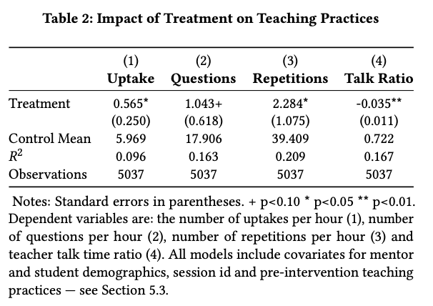
Results
Treated tutors improved their use of uptake by 0.57 times/hour.
The improvement in uptake is driven by both increased questioning and repetitions.
We also observe a reduced teacher-student talk ratio.
Results are broadly aligned with the Code in Place study.

Slide 30
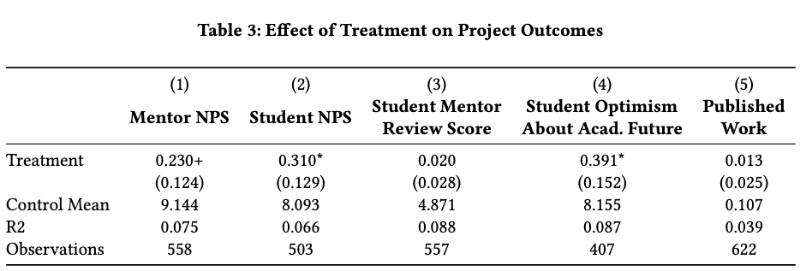
Note: NPS=Net promoter score (On a scale from 0 to 10, how likely are you to recommend this product/company to a friend or colleague?)
Notes:
NPS= net promoter score

Slide 31
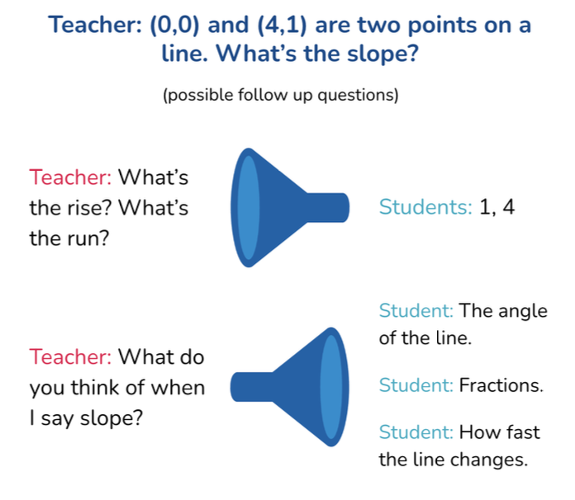
RCT w/ 500 Math/Science Teachers in Utah
First large-scale RCT that tests the efficacy of automated feedback in in-person, K-12 classrooms.
In partnership with TeachFX, a company that delivers automated feedback to teachers based on classroom recordings via a phone application.
N=523 math or science teachers teaching in Utah public schools.
All teachers have access to TeachFX’s feedback, but half of them are randomly assigned to additional weekly feedback on focusing questions through email.
Collected both quantitative data and rich interview data to understand teachers’ perceptions of the tool.
Notes:
Focusing is often contrasted to the less effective yet more common question pattern of funneling, where teachers pose “a set of questions to lead students to a desired procedure or conclusion, while giving limited attention to student responses that veer from the desired path”

Slide 32
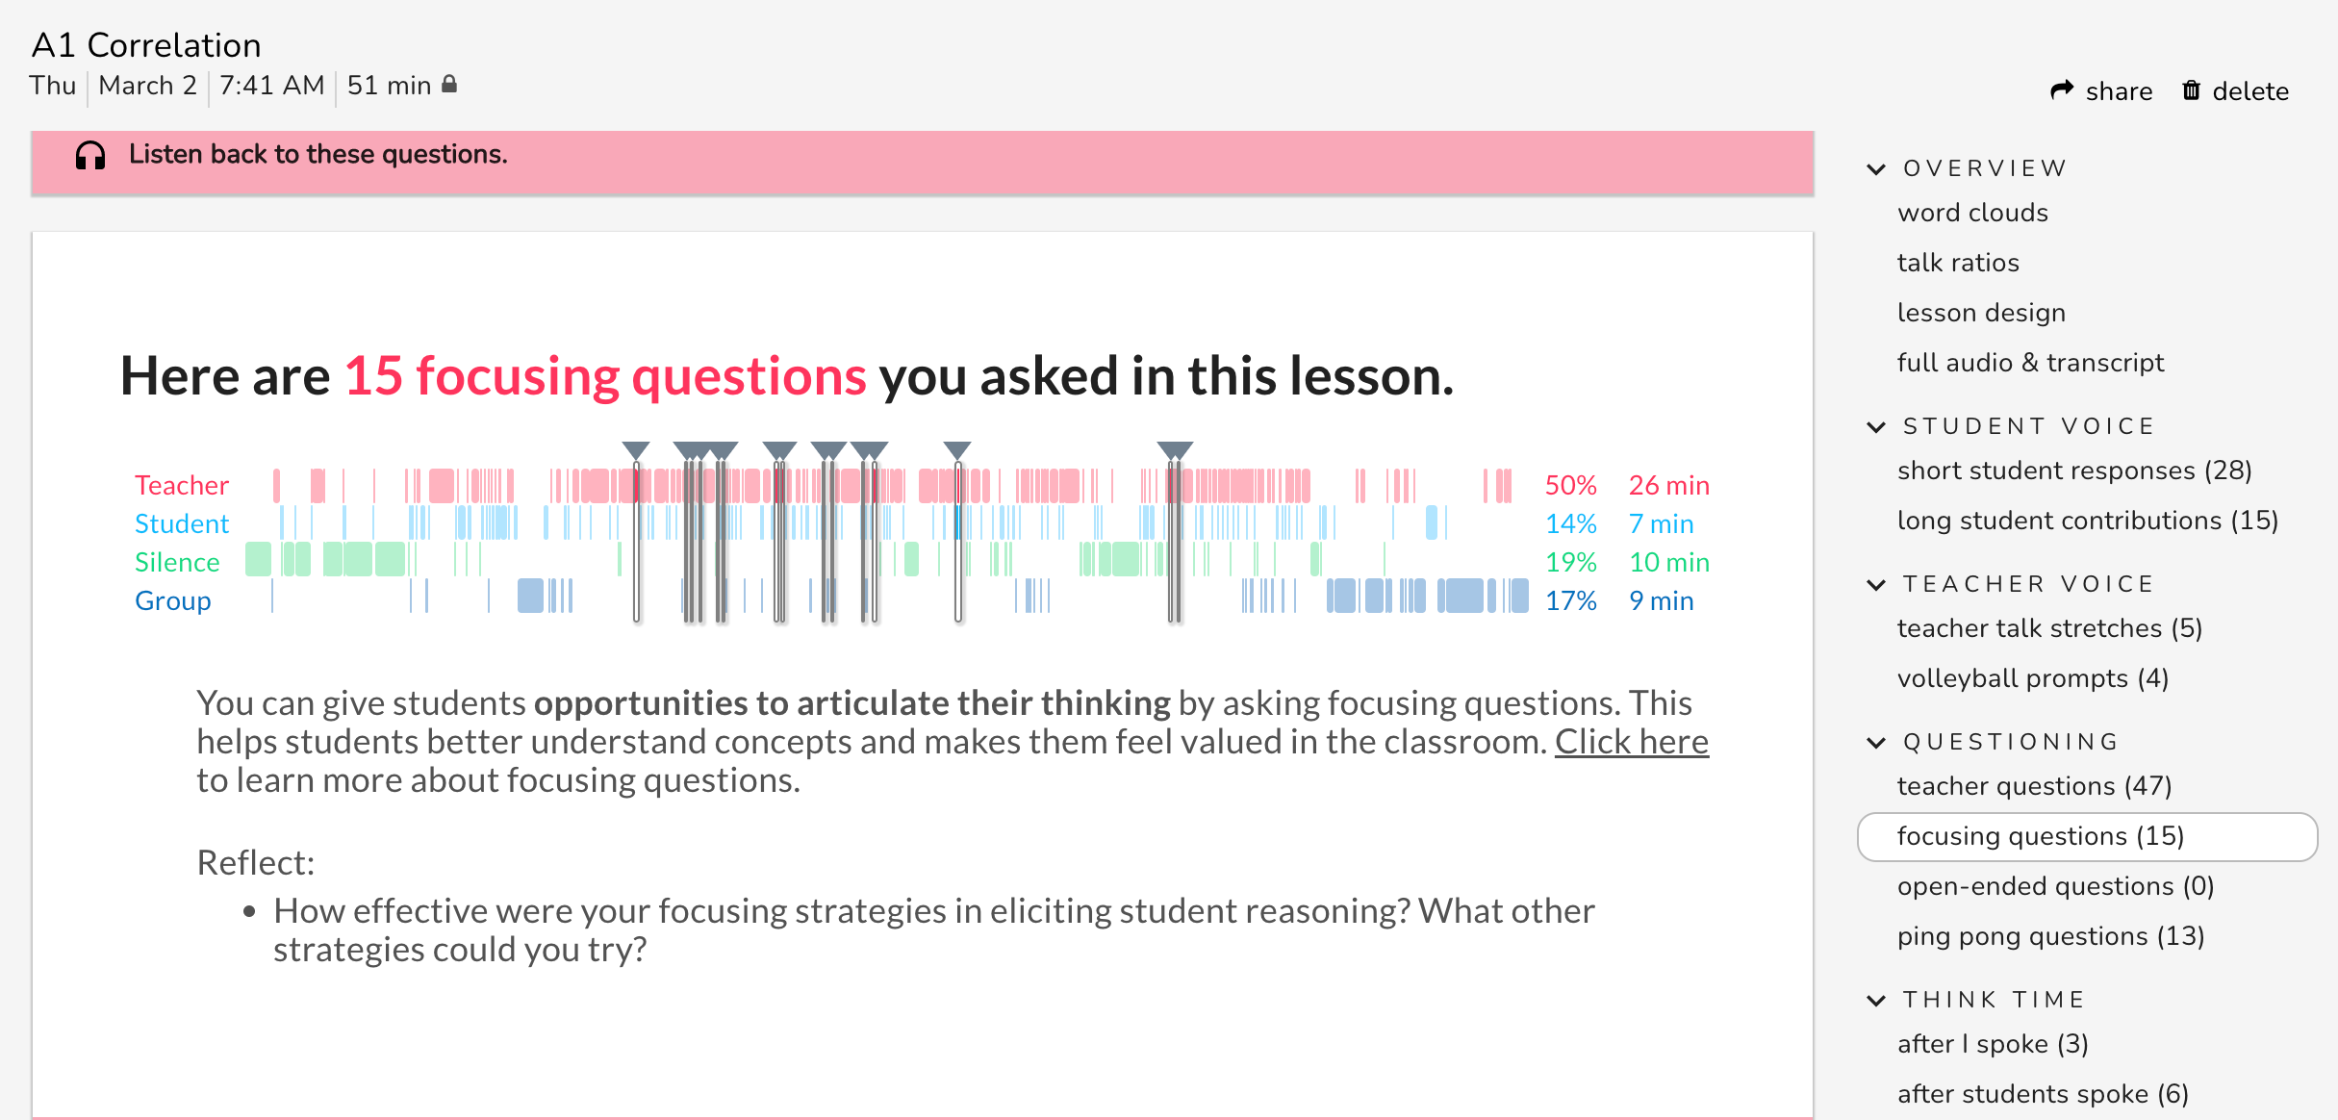

Slide 33
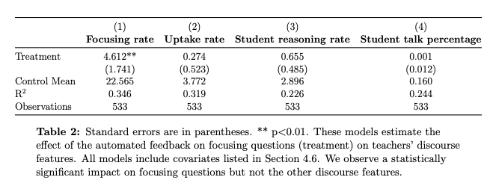
Results
The treatment improved teachers’ use of focusing questions, but not other related teaching practices or student engagement.

Slide 34
Many barriers prevent teachers from fully engaging with the feedback
1. Low recording and transcription quality
“It has some really obvious flaws in the recording. And so a lot of us are like, ‘Oh, I did not say that.’ . . . I know that that’s a hang-up for a lot of teachers.”
2. Time constraint
“I think for me the hard [thing] is like didn’t have time to sit and read it when it would come in, and then I would forget about it.”
3. Concerns about data privacy issues involved in automated feedback
“Nobody likes listening to themselves and being observed and things like that, so like finding ways to be able to share things that we’re happy about without feeling like... I don’t know, like you’re going to be criticized.”

Slide 35
Implications
It is feasible to measure many aspects of teaching practices with performance on par with human raters using NLP methods.
  Measurement development will be easier as large language models continue to evolve.
Automated feedback to teachers using NLP-based measures shows promising effects in improving teaching practices, and in some cases student outcomes, in both online and in-person teaching contexts.
Many barriers prevent teachers from fully engaging with the feedback, especially in in-person settings.

Slide 36
Ongoing Work
Infrastructure:
  Automated speech recognition systems
  Speech diarization
  MPT App development
Building a benchmark dataset of classroom recordings:
  High-quality audio and video data from 300 teachers
  Link student voices to their identity and outcomes that can enable the development of measures on equity-focused teaching practices
  Embed A/B tests in the data collection process to identify the most effective approaches of providing teachers automated feedback
Incorporating automated feedback into school routines
  Integrating AI-powered feedback and human coaching

Slide 37

Thank you!
jliu28@umd.edu
www.mpoweringteachers.com

Slide 38
Appendix

Slide 39
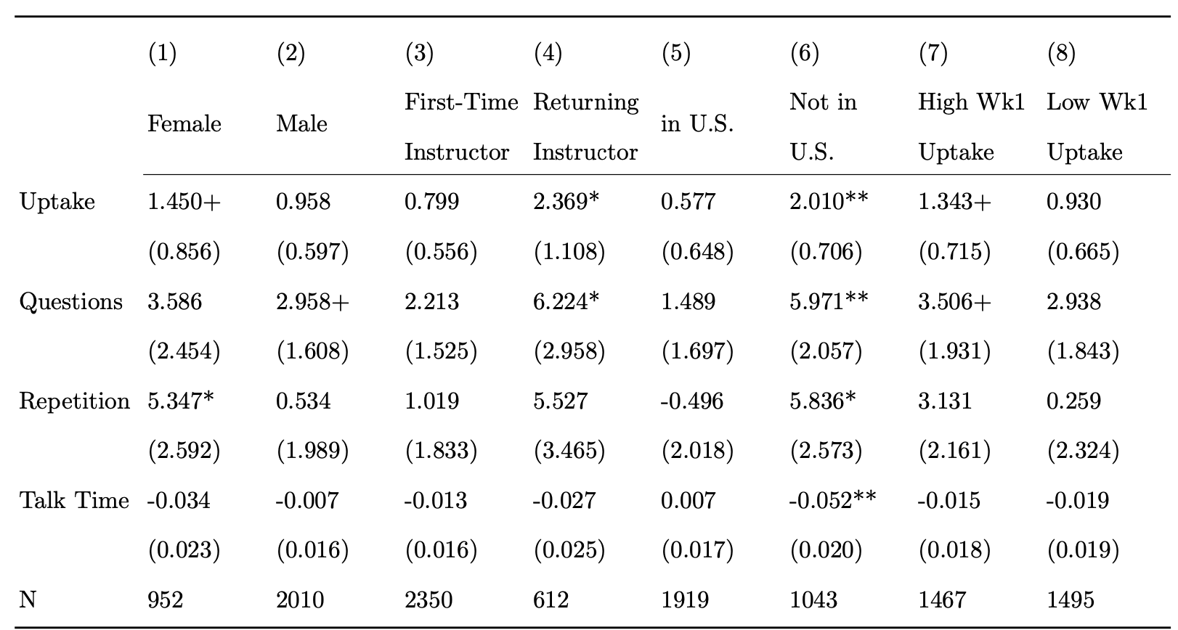
Heterogeneity

Slide 40
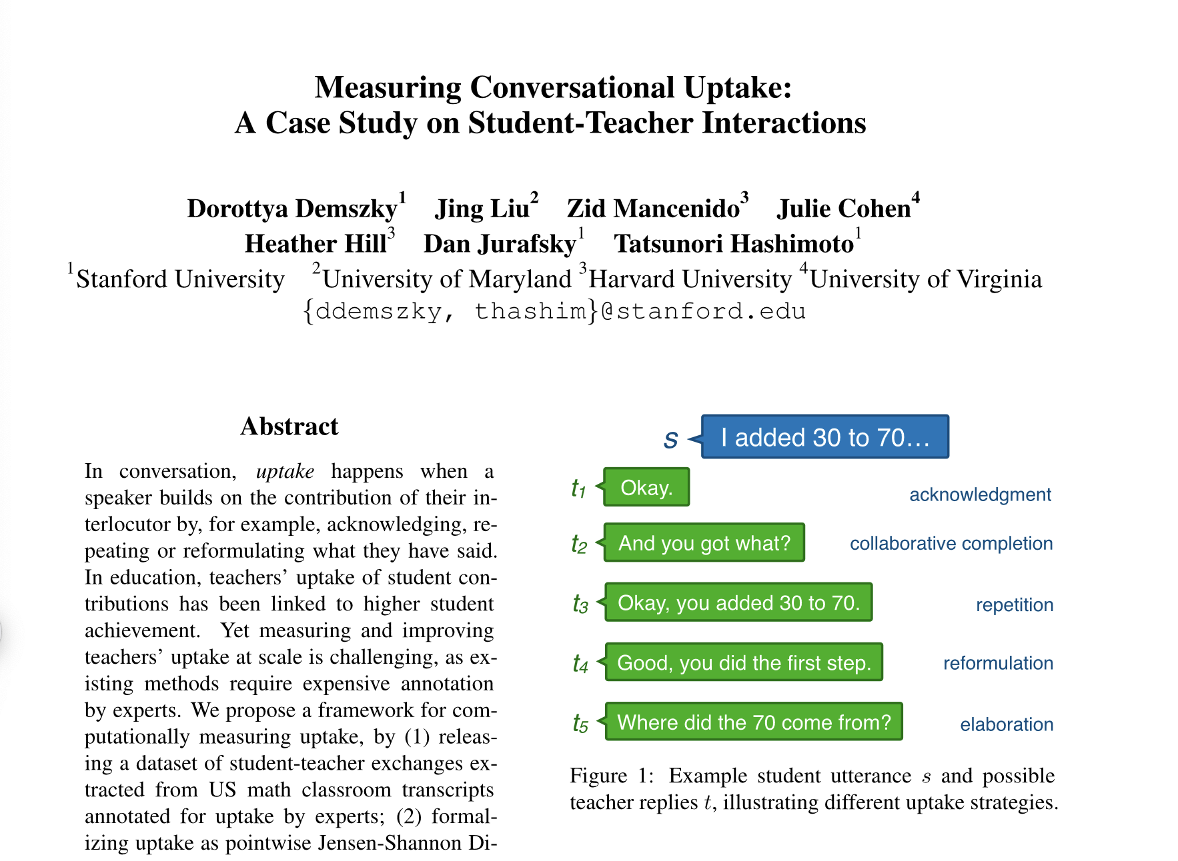

Slide 41
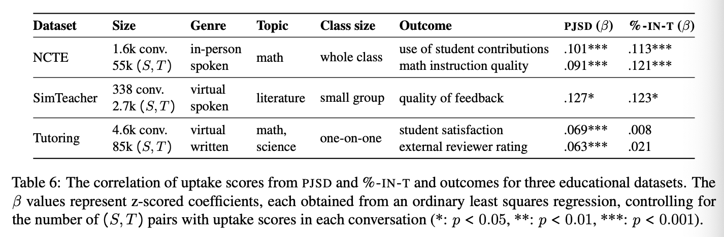

Slide 42
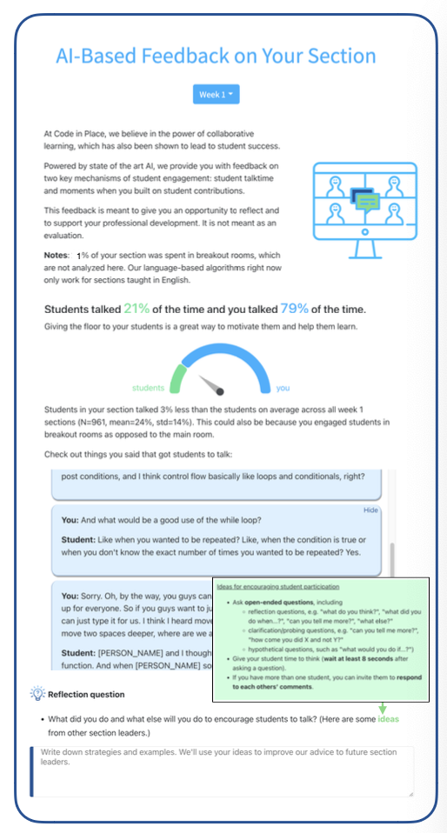
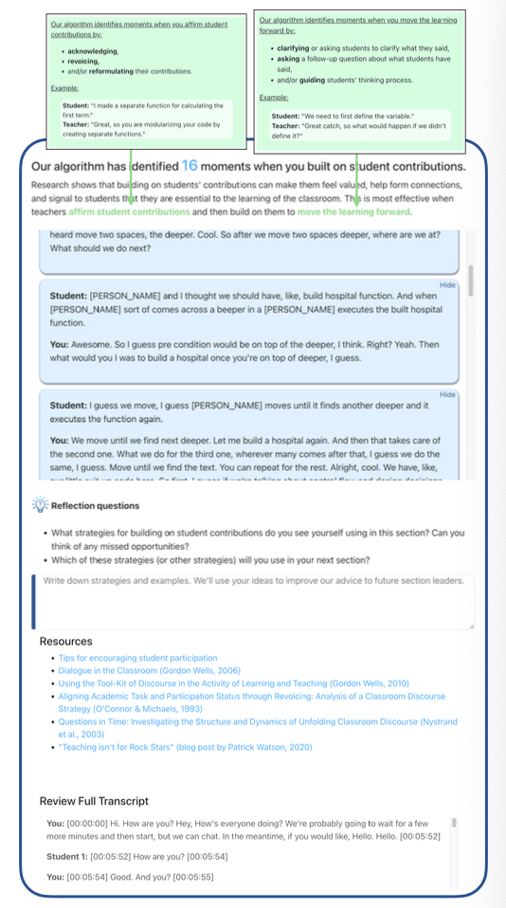

Slide 43
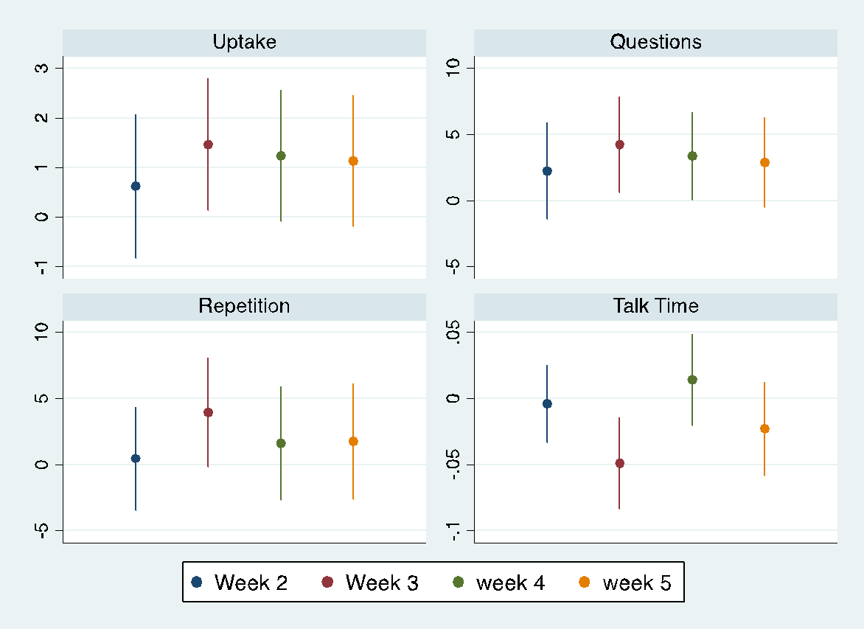
TOT Effects by Week & Outcome

Slide 44
Intervention data statistics
Transcripts | pre-intervention N (week 1) | 945
 | N (weeks 2-5) | 3,002
Instructors | N (weeks 2-5) | 880
 | country | 89 unique countries; 64% USA, 8% India, 3% Canada, 2% Germany, 2% Turkey, 2% UK, 1% each in other countries
 | gender | 65% male, 33% female, 1% non-binary, 1% missing
 | age | M=29, STD=11
Notes:
This table shows some high level statistics about the data. We have about 3000 transcripts from the intervention, from 880 teachers. Teachers are located in 89 countries (mostly in the USA and India), and 65% of them are male. Their average age is 29.

Slide 45
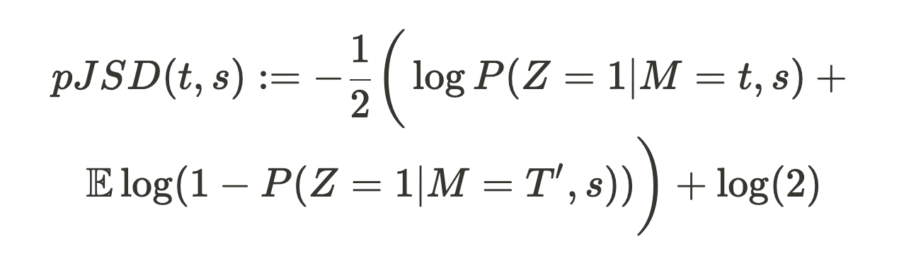
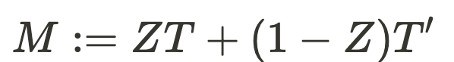
Use NLP to measure uptake
Next utterance classification
~ Pointwise Jensen Shannon Divergence (PJSD)
where (S, T) is a teacher-student utterance pair, T’ is a randomly sampled teacher utterance and is a mixture of the two with a binary indicator variable Z ~ Bern(p=0.5).
Notes:
In our paper, we show that next utterance classification is equivalent to estimating pointwise Jensen Shannon Divergence, which in turn is the same as our formal goal of estimating the divergence between T|S and T’|S. (click) PJSD is captured by this equation. (s, t) is a teacher-student utterance pair, t’ is a randomly sampled teacher utterance and M is a mixture of the two with the binary indicator variable Z.
[conditional mutual information between Z and T|S]

